Slide 1
Juggle-Press – Review
Georg Regal

Slide 2
Heuristics and Concepts
The following UI Heuristics and Concepts have been applied during the review.
http://code.w3.org/privacy-dashboard/wiki/UIHeuristicsAndConcepts
Consistency
Feedback
Efficiency
Flexibility
Clearly marked exits
Wording in users‘ language
Control
Recovery and forgiveness
Minimize memory load
Transparency
Aesthetics and emotional effect
Task orientation
Notes:
Consistency: Consistency describes a common design of elements and processes. All user interface concepts should thus be consistently designed
Feedback: Feedback means that users expect a sufficient system reaction to all of their actions
Efficiency: The user interface must enable the users to carry out their tasks efficiently
Flexibility: the system must allow different users to work differently, or a single user to work differently if she wishes or needs to, in order to accomplish goals
Clearly marked exits: the user must always know how she can leave a specific context, window or display when working with a user interface, and how she can return to her starting position
Wording in users‘ language: Wording in the user interface must be known and easily understandable to the user
Task orientation: a user interface shall always be designed to best possibly suit the users‘ tasks; Never shall a user need to adapt to a system
Control: the user must always be in control of the system; the user must never have the feeling of the system controlling her
Recovery and forgiveness: the system must prevent the user from (unknowingly) taking severe actions; The user shall be able to undo changes or actions easily
Minimize memory load: the user shall be enabled to focus totally on her task, not being troubled with the user interface as such; Therefore the user interface must require as little cognitive effort as possible
Transparency: the user must always know what will happen when she takes an action- the user interface must be transparent
Aesthetics and emotional effect: everything has an emotional effect; If a user interface has an un appropriate emotional effect, it will interfere with the user tasks

Slide 3



Legend
Good Solution!
Good Solutions will be marked!
Nice to Have / Suggestion
This is a suggestion. It would be nice to have but this is not a critical usability error.
Usability Problem
This is a problem and thus should be fixed!

Slide 4
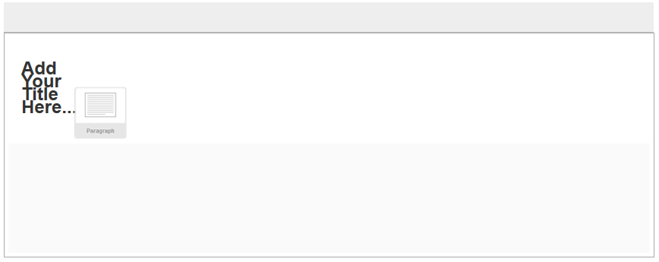
Juggle Press Review
Feedback
Providing Feedback about the actual size of the element is good.
Feedback
Contrast is way too little! It is barely seeable on my screen!
Control / Aesthetics
Bug! The first added element is displayed like this (strangely condensed) on the very left side.

Slide 5
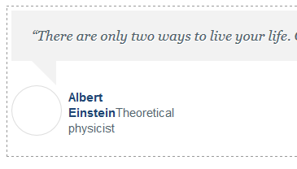


Juggle Press Review
Consistency
„Click to Add Image! is missing at the testimonial image.
Aesthetics
Law of proximity!
Text is too far away from the input field. Should be placed right of the field (or even better: an option to do so should be provided)
Feedback
Clear explanation how to add an image.

Slide 6
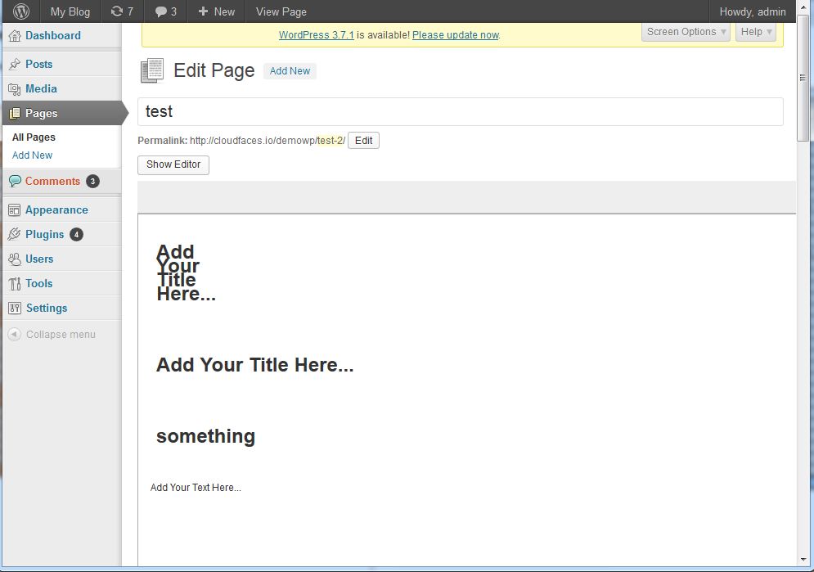
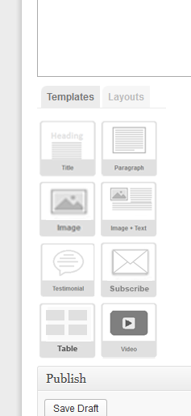
Juggle Press Review
Control
No Scrollbar, but the X to eliminate elements is on the right in the not visible and not accessible area.
Consistency
When resized to a small screen the elements move below the area. For consistency the should stay on the right.

Slide 7
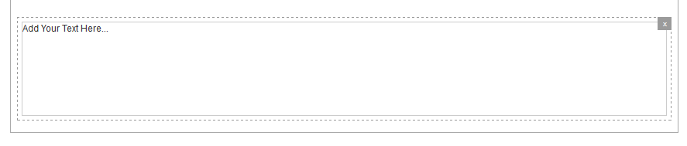
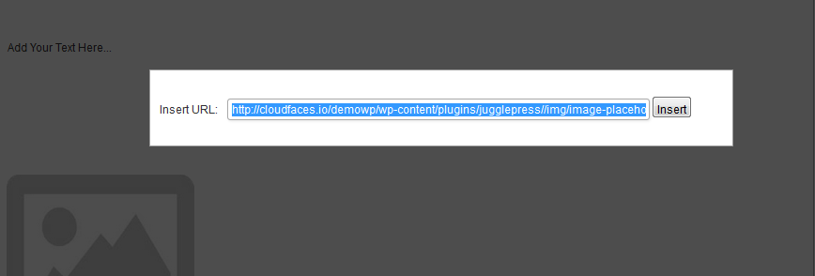
Juggle Press Review
Efficiency / Task orientation
Displaying the line would help to get overview about the layout.
Suggestion: use a toggle switch to change between mouse over only line display and permanent displayed lines.
Efficiency / Flexibility
Provide a possibility to upload an image.

Slide 8
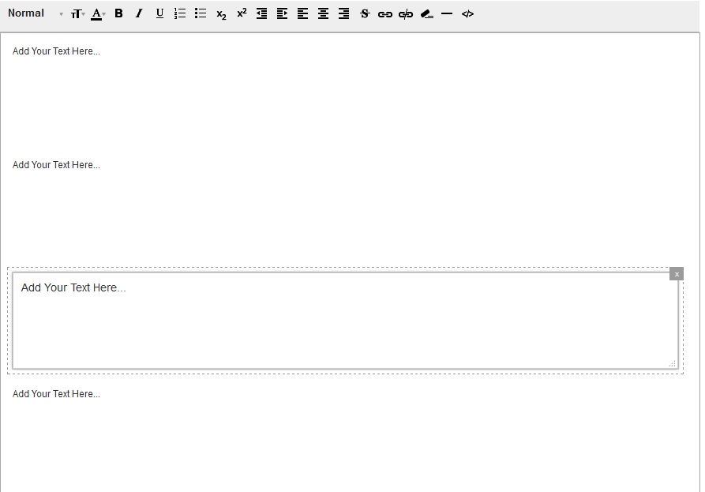
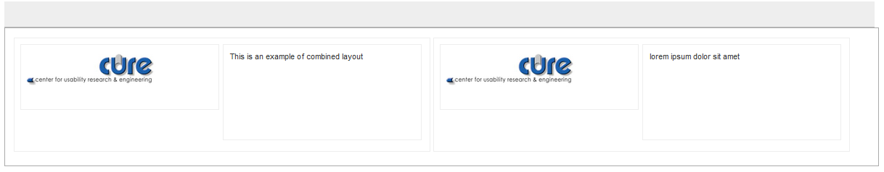
Juggle Press Review
Control / Efficiency
Rule of Proximity.
Edit controls are not close to the filed. May be not seen as belonging together by the user.
Suggestion: move the controls close to the actual element.
Task orientation / Flexibility
It is possible to combine two layouts!
e.g. 2 column layout combined with 2 column layout!

Slide 9
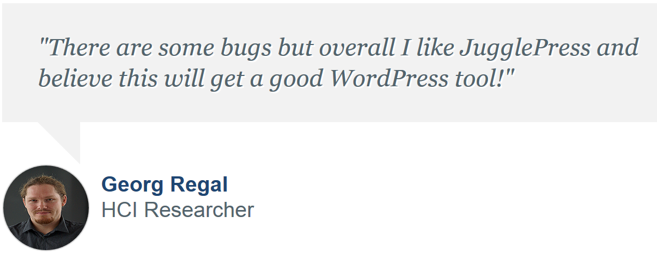
regal@cure.at
CURE - Center for Usability Research and Engineering
Businesspark Marximum
Modecenterstraße 17 / Objekt 2 A-1110 Wien Tel: +43/1/743 54 51 Fax: +43/1/743 54 51-30 www.cure.at

