Slide 1

DSE 730 Mobile application development
Pavel Sobolev

Slide 2
Executive summary
The aim of the project is to create mobile software which:
must function under Google Android operating system ;
must implement 2D and 3D animated scenes using appropriate graphical API;
can adjust itself to different versions of Android operating system and different sizes and resolutions of a device’s screen
is capable to use
touch screen,
accelerometer
voice commands
in order to deliver live interactivity to the graphical scenes.

Slide 3




Technologies

Slide 4
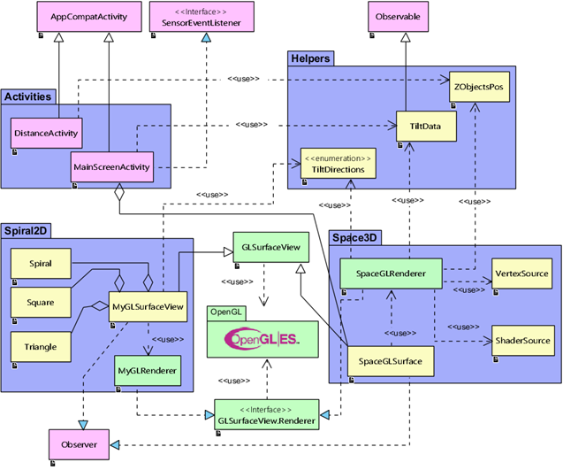
The project structure

Slide 5
Open GL ES
is highly efficient low-level technology for creation of 2D and 3D computer graphics
directly interacts with graphical processor units and memory
uses shaders and shader programs to control each pixel of the graphical scene
has its own 3-dimensional coordinate system which doesn’t coincide with window coordinate system
controls the scene with the set of geometrical transformations of coordinate system (rotation, transition, and scaling)
uses matrices to implement geometrical transformations
implements a metaphor of “virtual camera” (“viewer”)
implements texturing of the objects
and many other …

Slide 6
Shader • is a program inside your program • controls each pixel on the scene • has its own language
Main program
Creates text of shader program
OpenGL
Complies the program
GPU
Executes shader program
Links the program
Sets variables of shader program

Slide 7
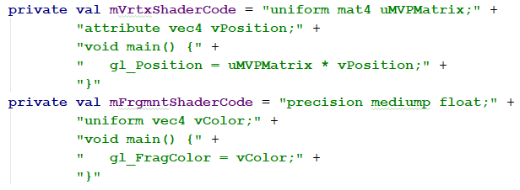
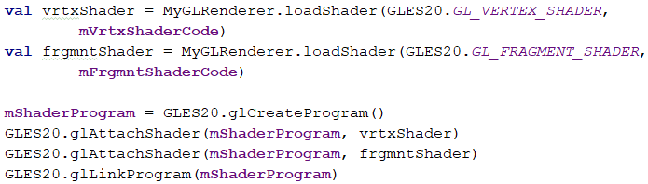
Example of shader’s usage

Slide 8
Common description
Graphical scenes:
Provide continuous 2D and 3D animations
Controlled by:
Main menu
Finger touch events
Accelerometer events
Voice commands

Slide 9
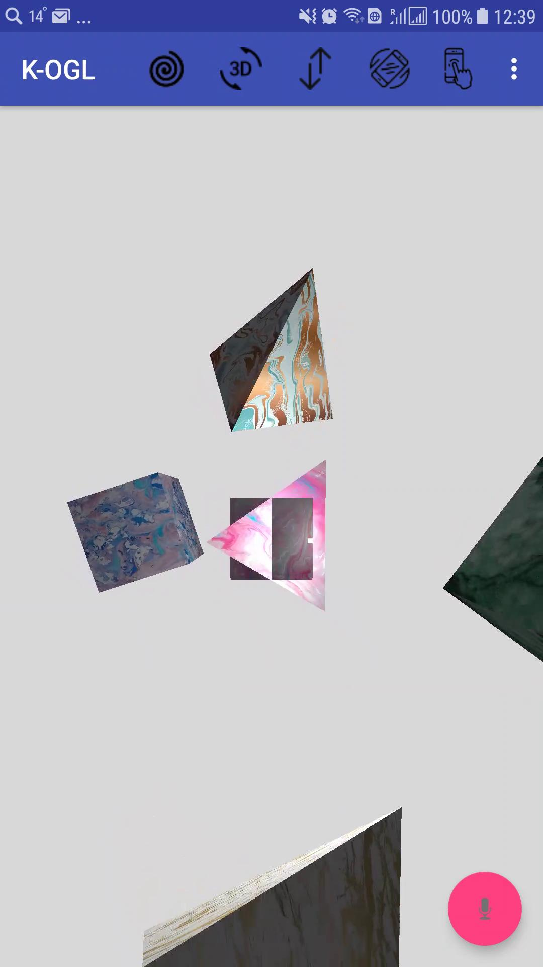
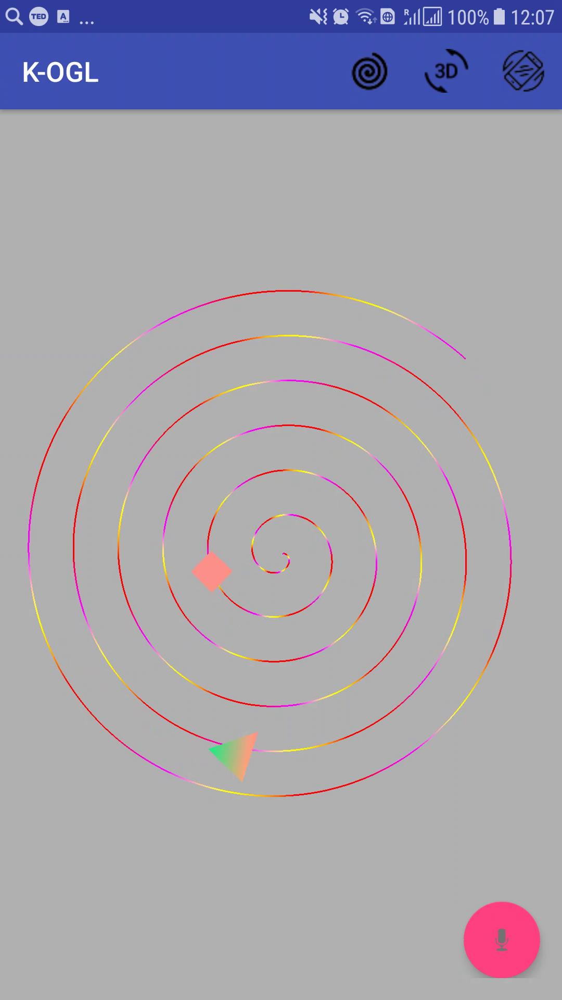
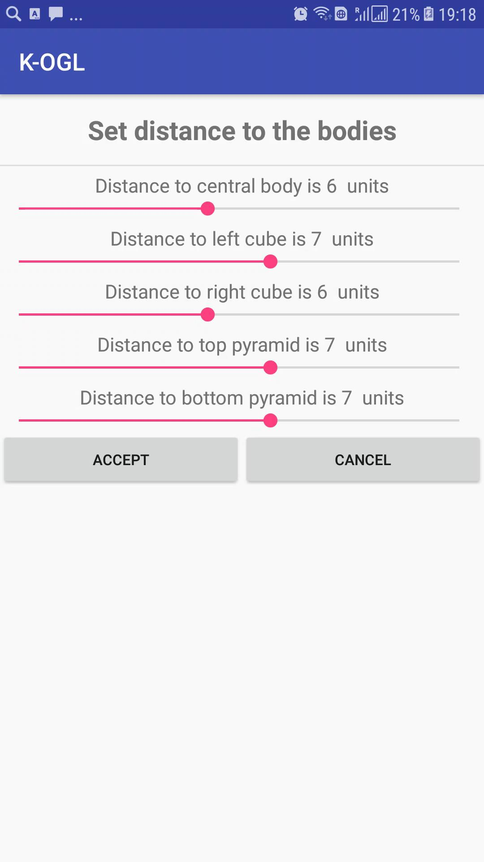
Screen shots

Slide 10
Reflection
Usage of software architectural patterns
Usage of software design patterns
Understanding of software project risks
Understanding of SDLC for mobile applications
New technologies
Kotlin programming language
Android mobile development + Android SDK
OpenGL ES API
Touch events handling
Accelerometers events handling
Voice commands handling
Testing of mobile applications

Slide 11
Thank you!

