Slide 1

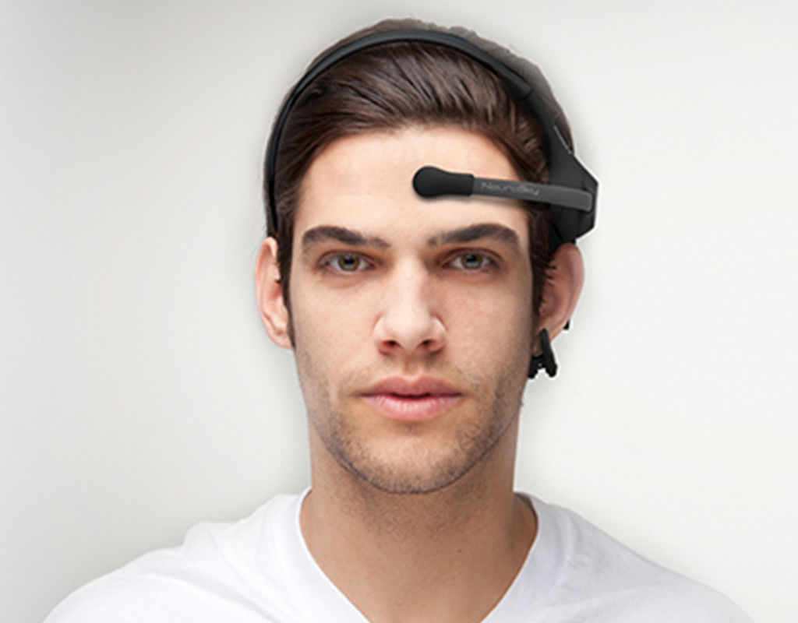
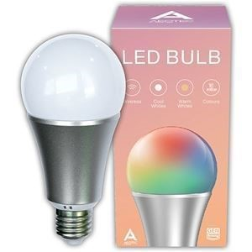
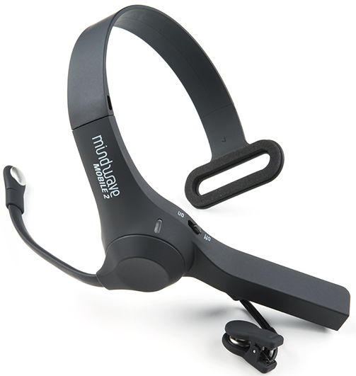

770RIoT
Brain-Computer
Interface
Internet of Things
Home
Automation
Pavel Sobolev

Slide 2
Goals of the project
to study technologies of brain-computer interfaces
to study technologies of Internet of things
to study technologies of home automation (smart home)
to develop and implement hardware and software architecture which can provide a user possibility to wirelessly interact with computing devices by direct receiving and interpretation of the user’s brain activity data

Slide 3
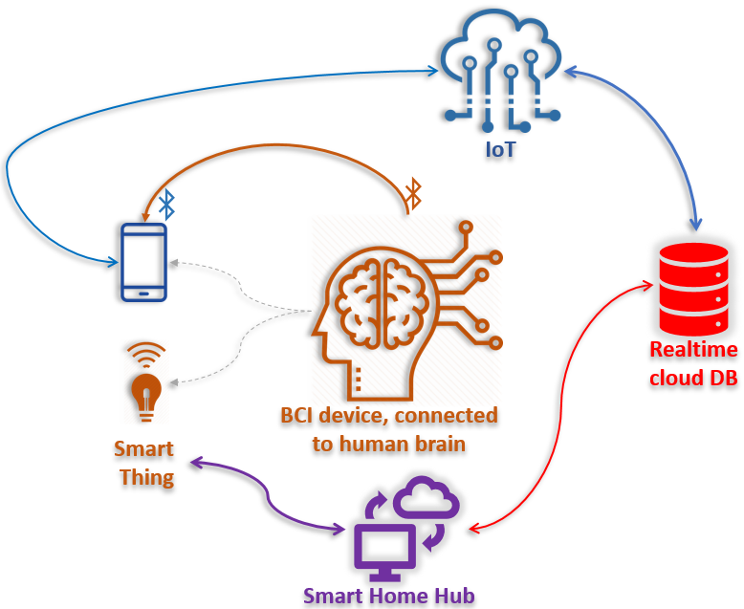
Developed architecture

Slide 4
Data flow
BCI
Data of brain activity
Cloud IoT service
Reactive DB for data retranslation
Smart home device
executing of a command
Raspberry PI
data and commands to control smart home device

Slide 5
Brain-computer interfaces (BCI)
BCI is a technology which is used to get and send data of human brain activity to process by some computing device (microcontroller or computer) for further interpretation and usage in practical goals.

Slide 6
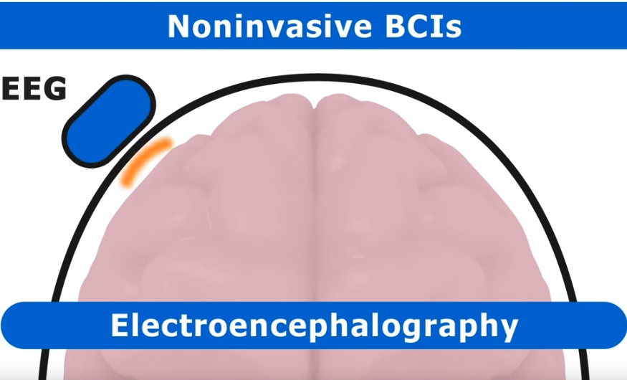
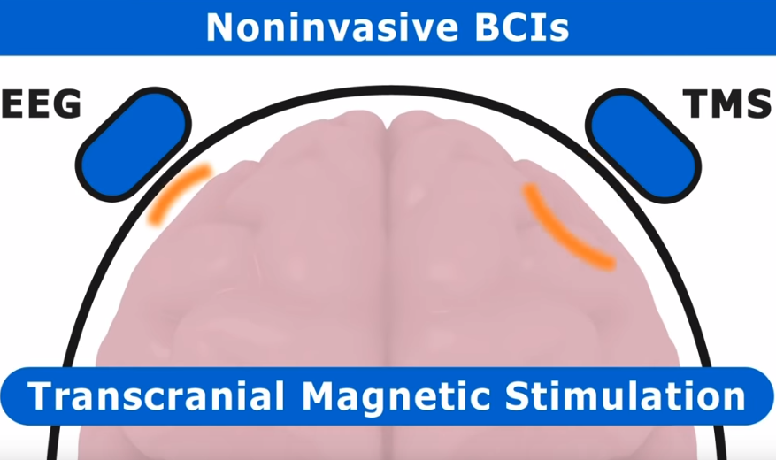
Non-invasive BCIs

Slide 7
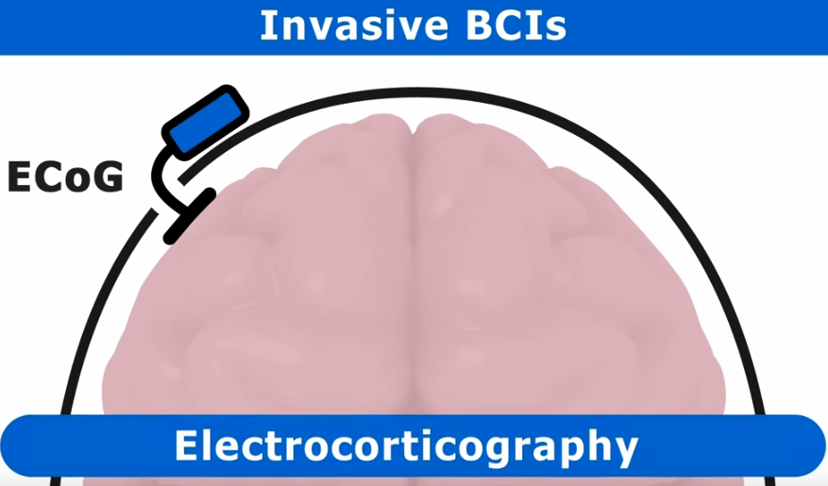
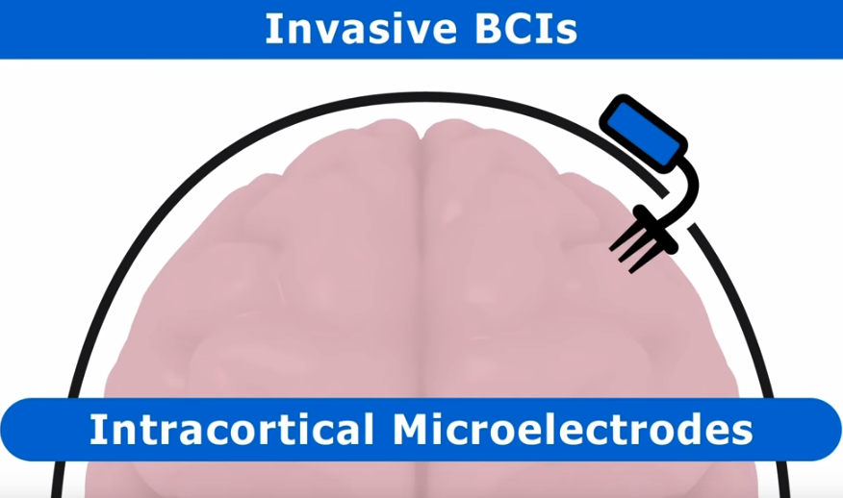
Invasive BCIs

Slide 8
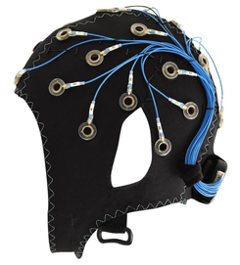
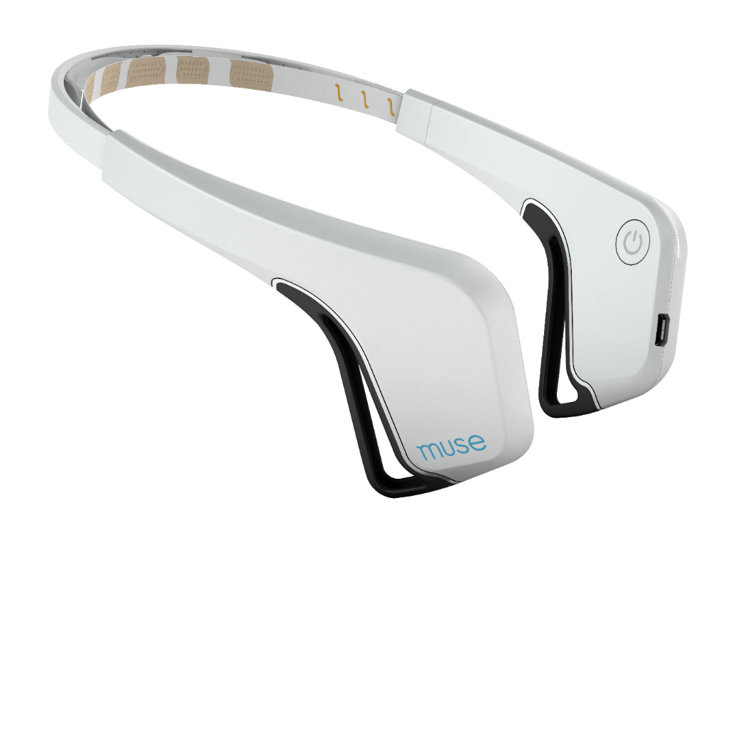
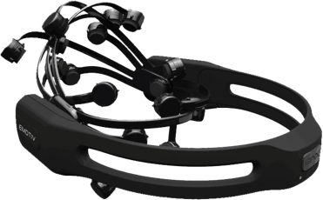
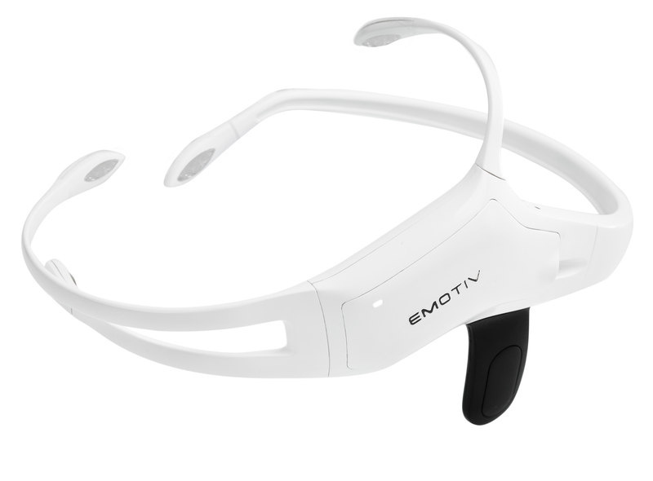
BCI EEG devices on market

Slide 9
NeuroSky MindWave Mobile
EEG BCI device
Detects brain waves: Alpha (2 ranges), Beta (2 ranges), Theta, Gamma (2 ranges)
Detects eyeblinks and their power
Returns additional derived brain data:
Level of user’s mind attention
Level of user’s mind relaxation
Additionally (calculated by patented algorithms): levels of familiarity, mental effort.
Sends data over Bluetooth Low Energy

Slide 10


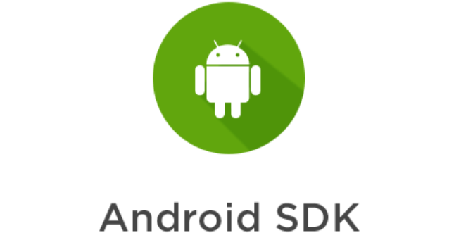



Technologies for programming of BCI
SDK
Android
SDK

Slide 11

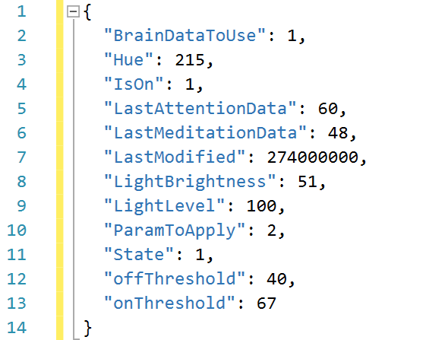
Technologies for IoT
IoT architecture demands service for immediate receiving of BCI EEG data and resending of the data to the smart home hub
Cloud data storage
NoSQL Database (JSON)
Provides push notifications of clients when data in DB is changed
Home automation server receives data from BCI through Firebase service during about 400 msec (in average)

Slide 12






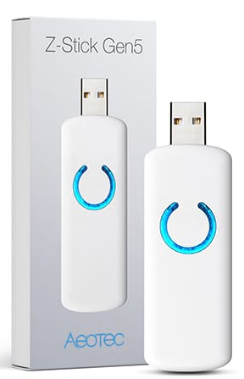
Technologies for home automation

Slide 13
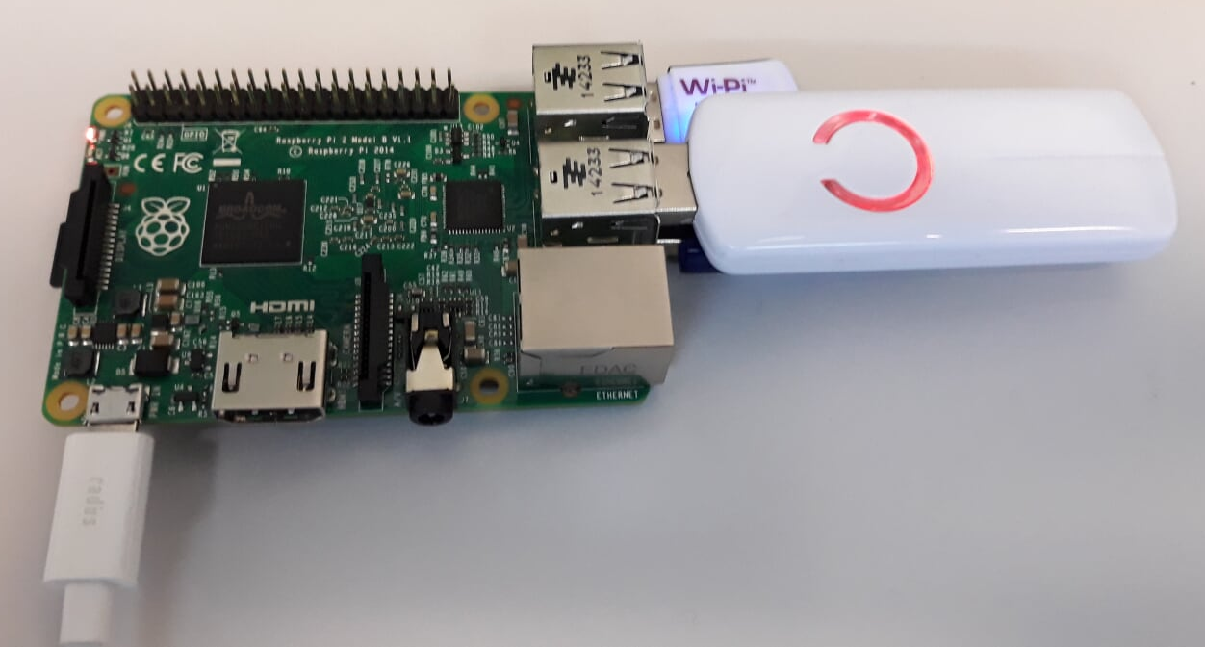
Raspberry PI and Z-Wave Controller

Slide 14
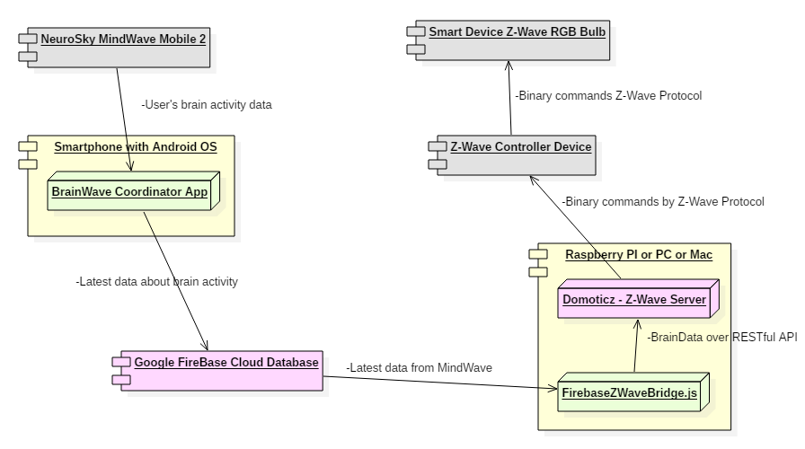
Final system design

Slide 15
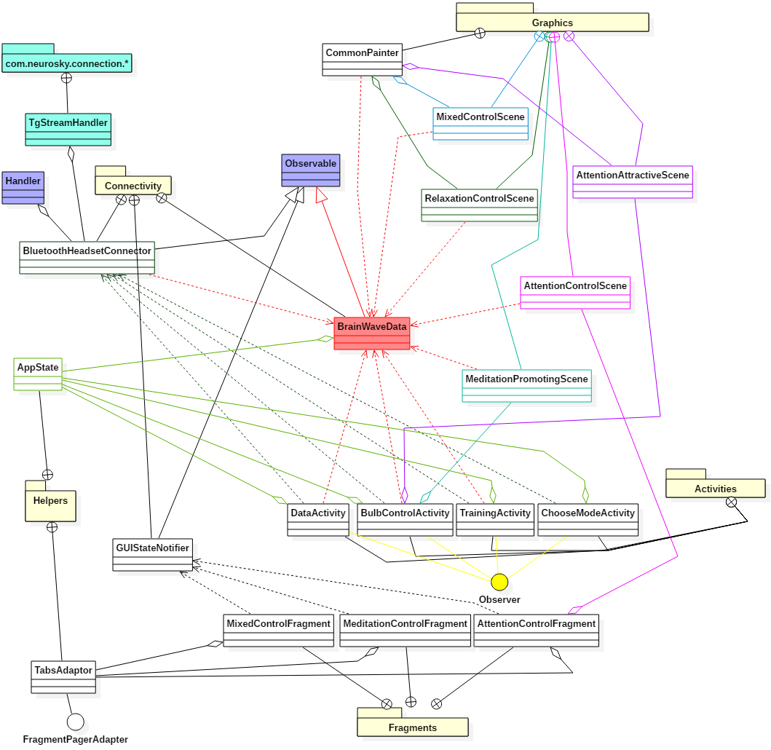
Mobile software architecture

Slide 16
Reflection
New knowledge in:
Practical usage of brain-computer interface
Design of hardware and software system
Implementation of real-time IoT system
Technology of real-time NoSQL DB
Home automation technologies
Working with Linux and Raspberry PI computer
Technological skills:
Programming of raw empirical data streams (brain’s activity data)
Bluetooth programming
Programming with Kotlin programming language
Node.js and modern JavaScript programming techniques
Programming of interaction with home automation systems with REST API
Testing of IoT real time system behaviour

Slide 17
Thank you

