Slide 1
Application of Machine Learning for Early Crop Classification
Using Satellite Imagery
Thesis&Presentation by Pavel O. Syomin
Supervised by Anastasia M. Maksimovskaya
HSE, Faculty of Computer Science, MDS program, 2023

Slide 2
Background
A company uses satellite shots to detect crops on fields.
Input data for the classification is an interpolated time series of median values of 10 bands for a given field.
Length of time series equals the duration of the season in days.
Season is from April 1 to September 30 (183 days).

Slide 3
Disadvantages of Full-Season Classification
Large amount of data being processed.
Classification is posterior, i.e. company have to wait till the end of September to produce a result.

Slide 4
Objective: Early Classification
Looks like we can use just a part of the season for the classification.
Last months of the season probably have no effect on quality, thus they can be dropped.
Early crop classification: use data from the beginning of the season to find out the crops which are being cultivated on a field.

Slide 5
Early Classification: Pros
Reduction in the amount of data → decreased storage and computational costs.
No need to wait till the end of September →possibility to build “real-time” applications.

Slide 6
Early Classification: Cons
It’s likely less accurate.

Slide 7
Crop Classification: General Approaches
Shots: Multispectral vs Hyperspectral.
Imagery: Airborne vs Satellite.
Sensor type: Optical vs Radiometric.
Number of shots: Single-shot vs Multi-shot.
Aggregation: Parcel-based vs Pixel-based.
Model: Classical vs Deep learning.

Slide 8
Crop Classification: Selected Approach
Shots: Multispectral vs Hyperspectral.
Imagery: Airborne vs Satellite.
Sensor type: Optical vs Radiometric.
Number of shots: Single-shot vs Multi-shot.
Aggregation: Parcel-based vs Pixel-based.
Models: Classical and Deep learning.

Slide 9
Two Ways to Earliness
Data subsets and ensembles of generic models
or
Use a special model

Slide 10
Way #1: Ensemble of Generic Models
Make subsets with different length of time series.
Train a “generic” model on each subset.
Compare the performance.

Slide 11
Way #2: Special Model
Use a model which optimizes simultaneously for accuracy and earliness.
Direclty assess the performance.

Slide 12
Implementation
Way #1: subsets by number of months from April (1 — April, 2 — April + May, 6 — full season from April to September), 3 classical models (Random Forest, Catboost, LightGBM), 2 neural models (Transformer, TempCNN).
Way #2: full-length time series, 2 special neural models — EarlyRNN (LSTM backbone + classification head + decision head + loss function which accounts for both accuracy and earliness) and EarlyTempCNN (EarlyRNN with TempCNN backbone).
Data: year 2018 shots and ground-truth (≈8000 fields in train,≈2000 in test).

Slide 13
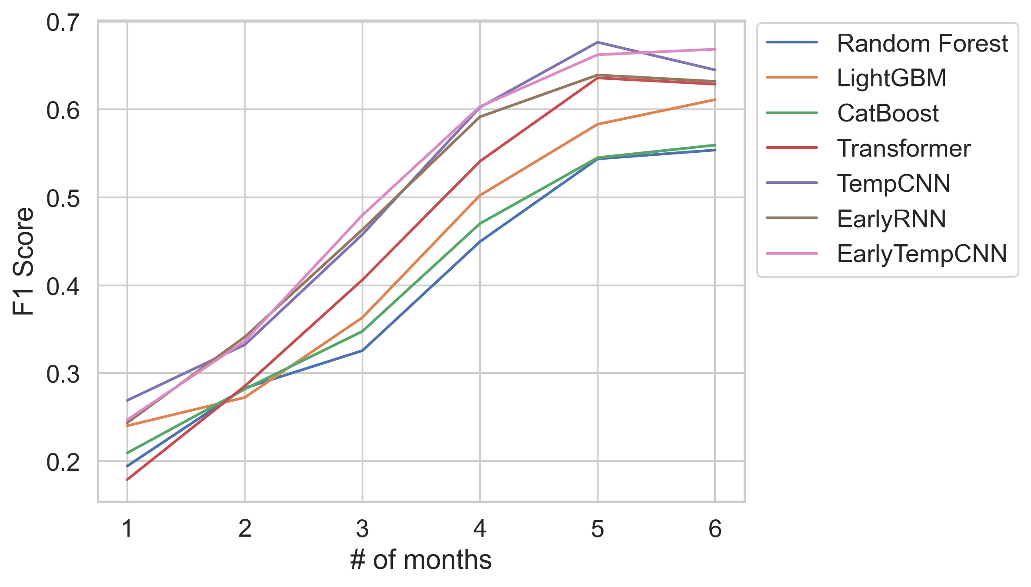
F1 Score ~ Number of Months

Slide 14
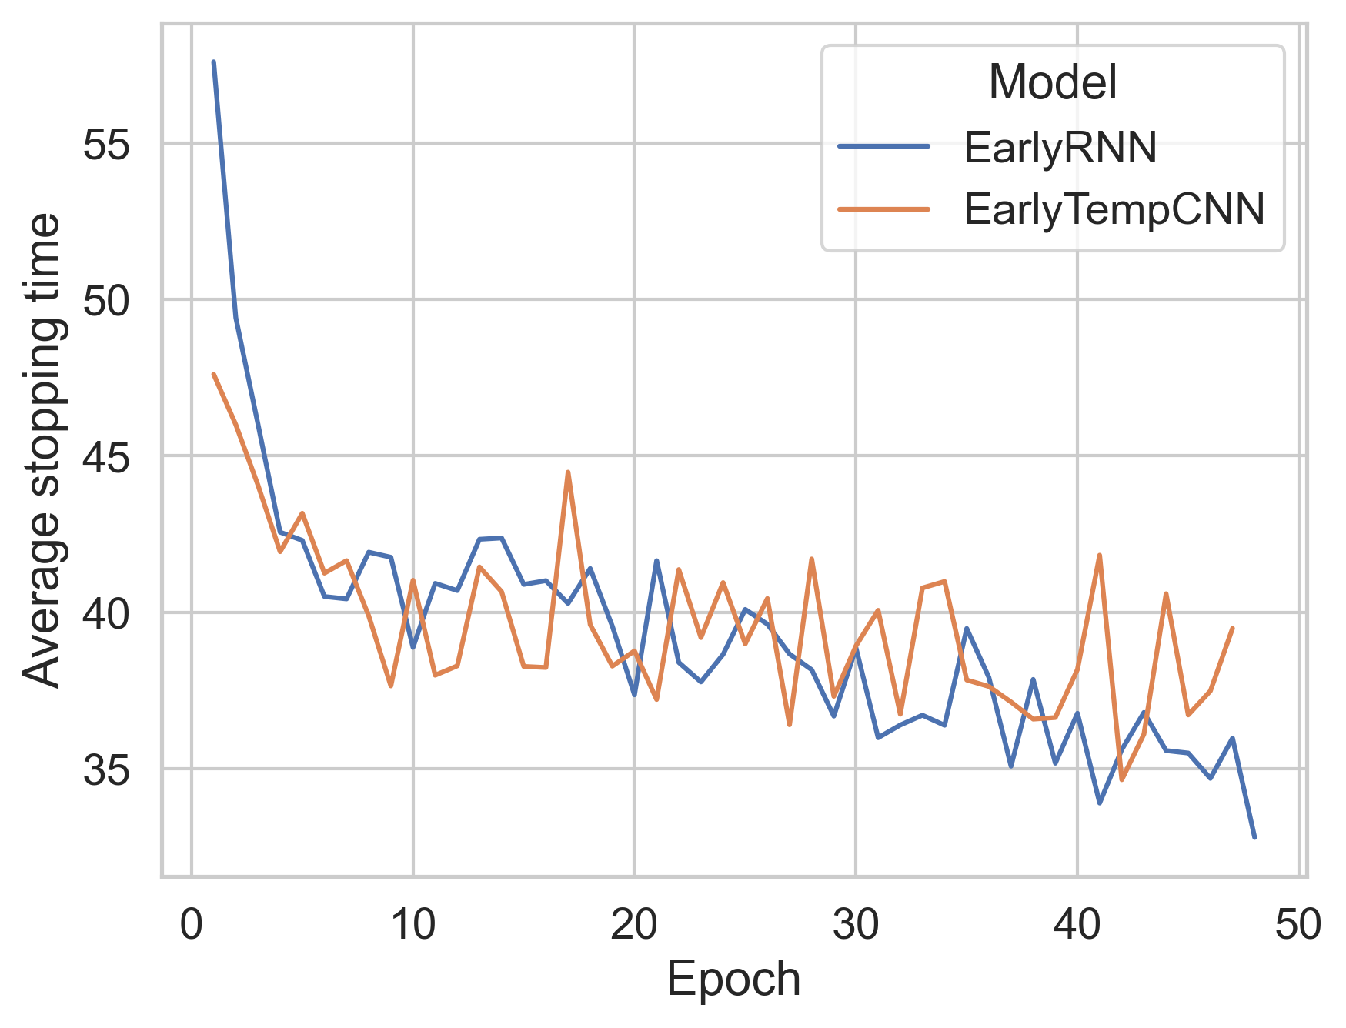
Early Models Stopping Time

Slide 15
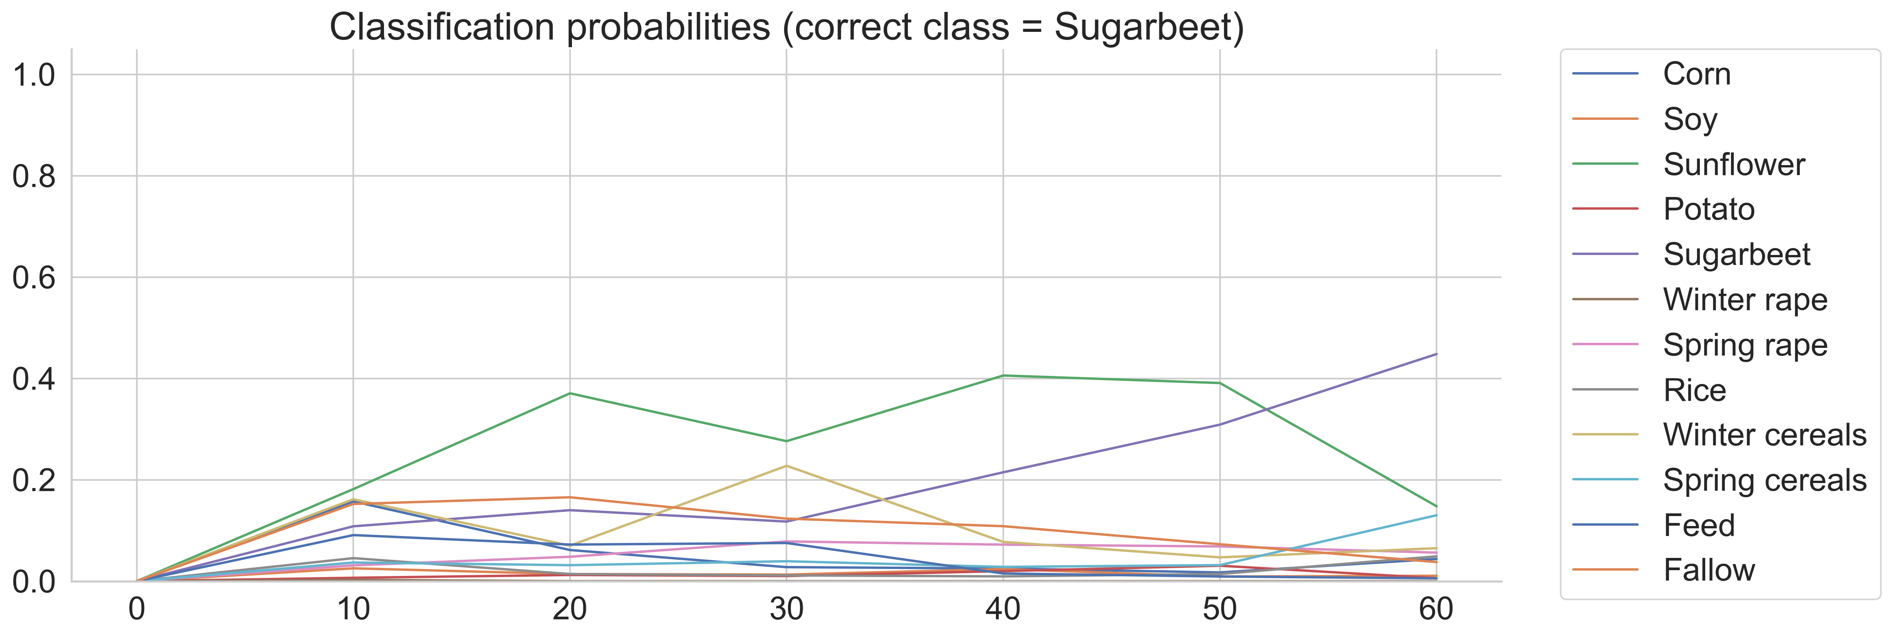
Single-Field Inference: Random Forest Ensemble

Slide 16
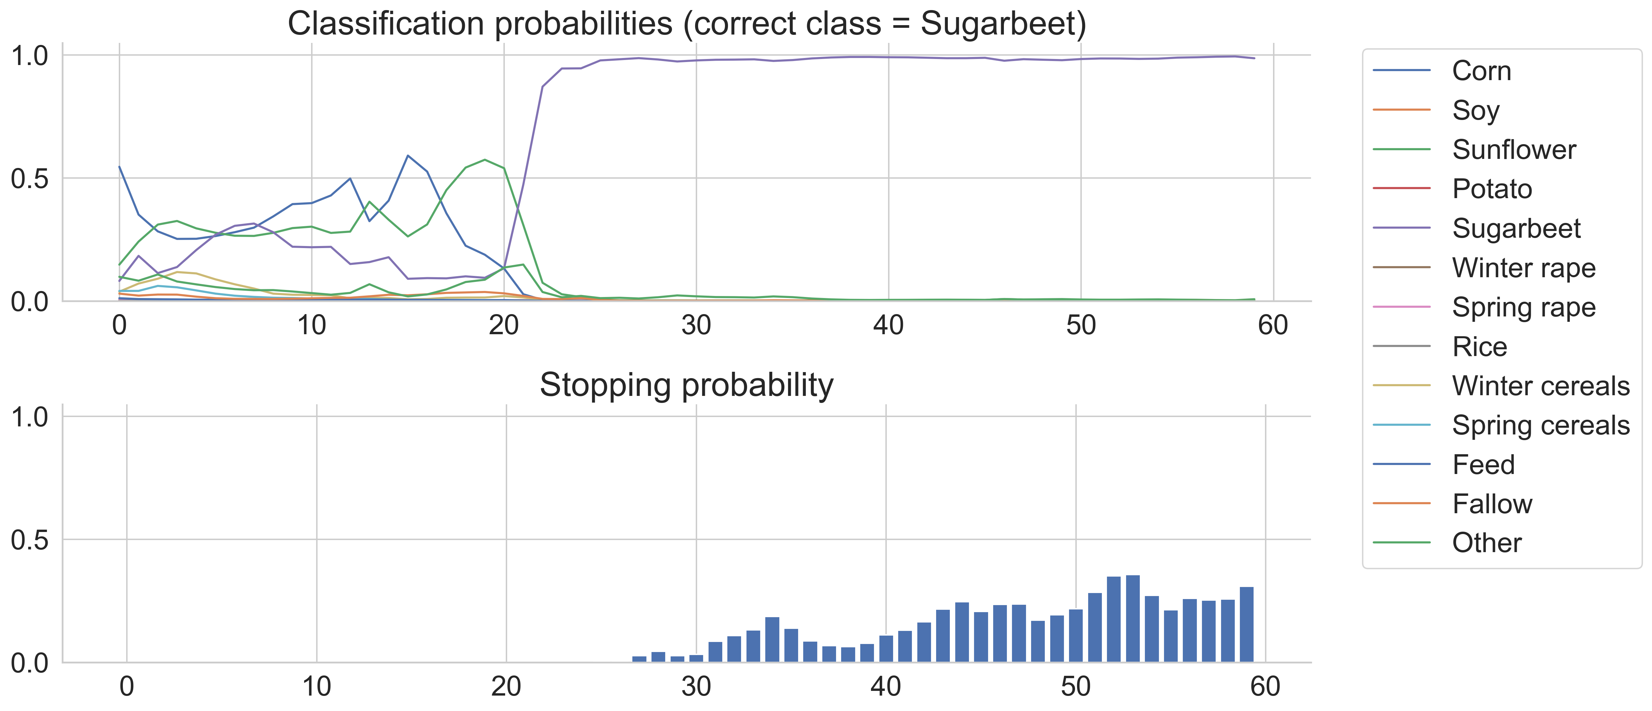
Single-Field Inference: EarlyRNN

Slide 17
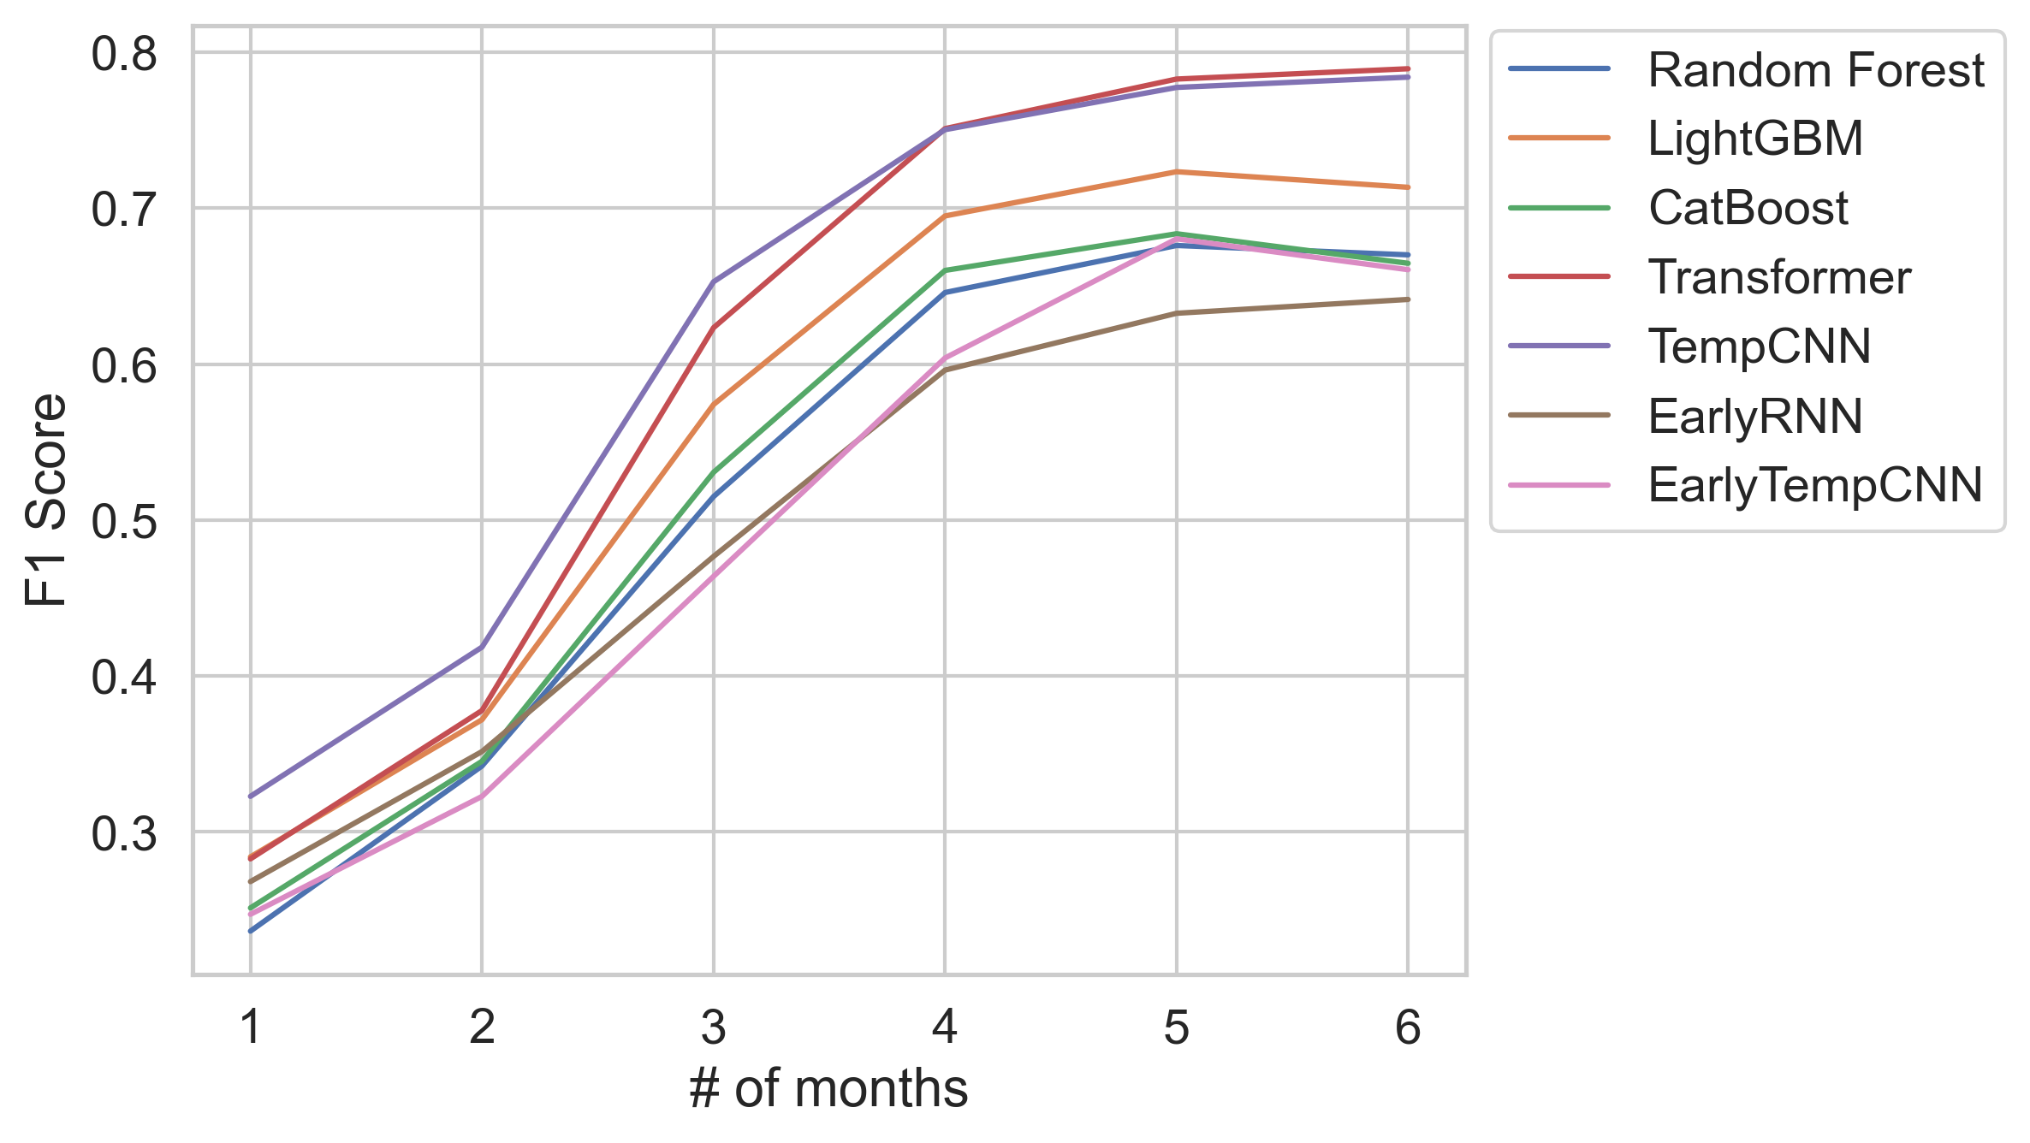
Robustness Check

Slide 18
Outcomes
4 months are enough → extract and store less data, train and predict faster.
Single-field prediction by special models gives probabilities and confidence estimates → make real-time decisions and products.
Neural models are better than classical (though it have been almost obvious).
On a large dataset, ensembles of generic models are better, and on a small dataset, specific models outperform.
My EarlyTempCNN is a bit better than original EarlyRNN.

