Slide 1
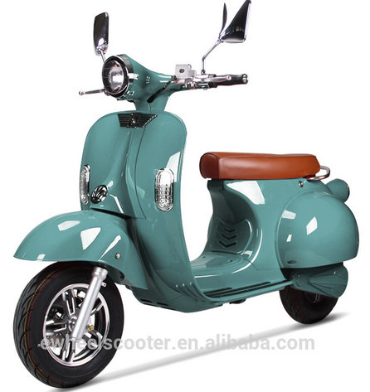



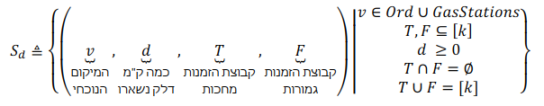
V=a
D=full
T={1}
F={}
V=b
D=full
T={1}
F={}
1
2
a
1
b
Dist = 2*d_refill
Dist = 2*d_refill

Slide 2

V=e
D=0
T={1}
F={2}
V=b
D=full
T={1,2}
F={}
b
V=s
D=0
T={2}
F={1}
Dist = d_refill
Dist = d_refill
e
s

