Slide 1
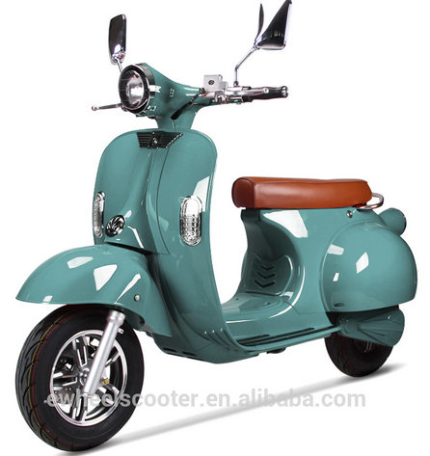


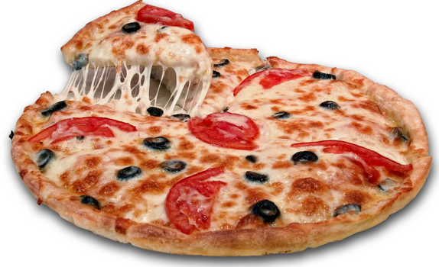
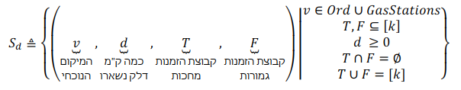
V=a
D=full
T={1}
F={}
V=b
D=full
T={1}
F={}
1
2
a
1
b
Dist = 2*d_refill
Dist = 2*d_refill

