Slide 1
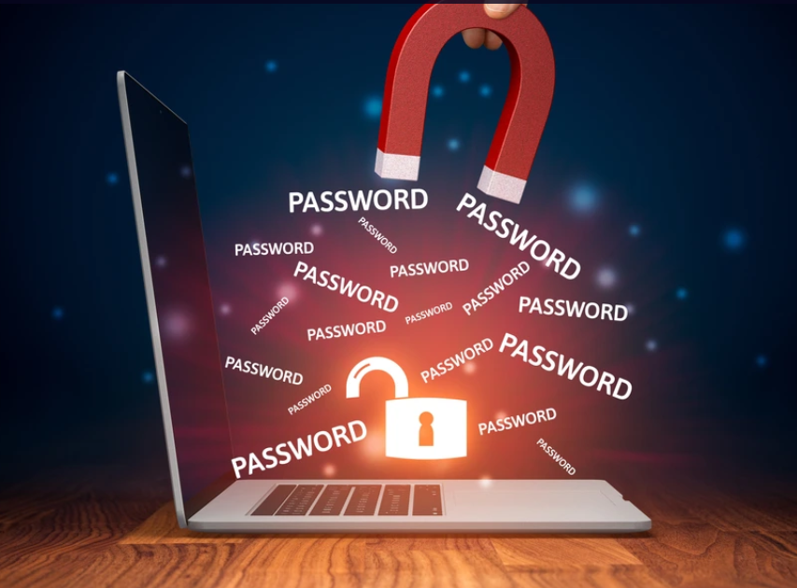
Pavithra Pirangi
Final Project

Slide 2

KEY LOGGER
A Kind Of virus or software known as a Keylogger Discreetly logs each Keystroke that is Typed on a computer. They are serious risk to one’s Security,privacy,and financial Stability.

Slide 3


AGENDA
Problem Statement
Project Overview
End Users
Solution and Value Proposition
The Wow Factor
Modelling
Results
3/21/2024 Annual Review

Slide 4

PROBLEM STATEMENT
Focuses on the Malicious use of Keyloggers by unauthorized Individuals or Entities.
It Addresses the impact on Individuals,Businesses,and organizations
Challenges:
Lack of awareness many users are unaware of the threat posed by keyloggers and how to protect themselves.
Attackers may use social engineering tactics to trick users into installing keyloggers on their own devices

Slide 5
Impact
Loss of Sensitive Information:
Keyloggers can capture login credentials,credit card details, personal messages,and other sensitive information typed by the users.it is used for identification of thefts,financial fraud,and other malicious activities.
Data Breaches:
Incorporate environments,keyloggers can compromise the security of entire systems by capturing employee credentials and accessing confidential data
Privacy violations:
Keyloggers can monitor all users activity,including personal communications,browsing history,and even Passwords.

Slide 6

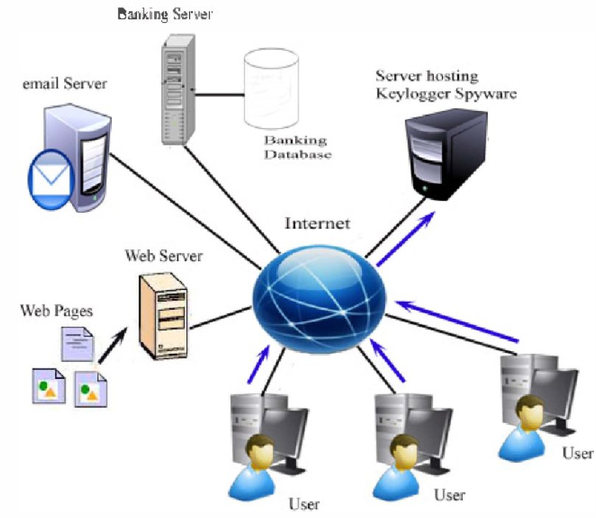
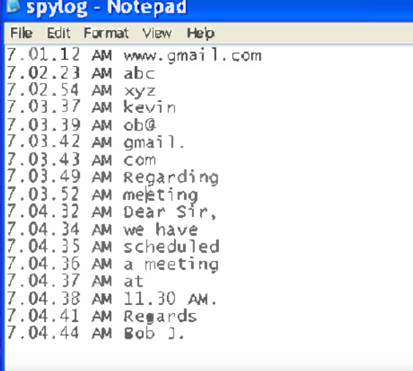
Connection

Slide 7

PROJECT OVERVIEW
The goal of the project is to create a Keylogger Application With Tkinter and Python.Keystrokes are captured by the Keylogger,which also records them in text and JSON forms and provide and Easy-to-use interface for initiating and terminating the logging process.

Slide 8

WHO ARE THE END USERS?
CyberCriminals:
They use keyloggers to intercept sensitive data that victims input, login credentials, including credit card details,personal messages
Identity Theft:
Criminals can get bank account,social media profiles,and other internet services for their own benefit and utilize credentials that they have stolen.
Hackers:
By obtaining login Credentials, hackers can utilize keyloggers to obtain unauthorized access to computer Systems.It may serve as a Springboard for more Serious network attacks.

Slide 9

YOUR SOLUTION AND ITS VALUE PROPOSITION
Anti_Keylogging Software:
This set of apps has the ability to identify and eliminate keyloggers from your System.
Multi_Factor Authentication(MFA):
MFA and strong Passwords make it more difficult for hackers to use stolen credentials
Encryption:
Even in the event that a keylogger obtains the information, using encryption for sensitive data provides an additional degree of security.
Stealing Sensitive information for criminal purposes in unethical and illegal.

Slide 10

THE WOW IN YOUR SOLUTION
Significant Reduction in the use of harmful Keyloggers.
A day when fraudsters no longer need Keyloggers because of strong security procedures and increased user awareness.
3/21/2024 Annual Review
10

Slide 11
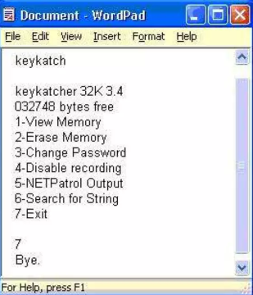
Interacting With Key Loggers
Interacting with the Keylogger is simple it can be done from compatible computer,to examine the data on another computer or perform the audit from that computer.

Slide 12
MODELLING
Technical Implementation:
Libraries&Languages:
Python
Tkinter
Pynput
Json
Functions:
Generate_text_log(key)
Generate_json_file
On_press_release(key)
12

Slide 13
RESULTS
Understanding the Threat and its Counterparts
Keylogger
Keylogger are a serious risk to user security and privacy. Within regulated settings with explicit permission and constraints.Modeling can be a useful for cybersecurity research education and defense
Remember:
The Focus should be on protecting yourself from keyloggers
Use strong passwords,MFA,and keep software updated
Be cautions of suspicious downloads and attachments.
13

Slide 14
Github Link
https://github.com/Pavi-pavithra/Keylogger.git

