Slide 1
Section B. Class and Objects
TECHMONTH 2017
JAVA WORKSHOP

Slide 2
Function/Methods
Example1. Swap
Example2. Input

Slide 3
Function? Methods?
“Divide and Conquer” Approach
Break Big one problem into smaller sub problems
Why Need Methods?
The bigger problem is, The longer execution time and the more difficult reading code is
Make The problem easy to solve
Notes:
Method and function is different
Method is defined and contained within a java class

Slide 4
Function/Methods
Pre-defined
Method
User-defined
Notes:
Pre-defined: JAVA API e.g. System.out.println(); nextLine();

Slide 5
Function/Methods Syntax
(1)modifier (2)static (3)void (4)methodName ((5)parameter list) { // method body }
(1)modifier: private OR public (2)static: static OR NO USE as Non-static (3)void: return type. In the case of void, there is no return type It can be any primitive data type or User-defined data type. (4)methodName . (5)parameter list: 1 or More types of arguments which are passed into the method. Syntax: param_datatype1 param_name1, param_datatype2 param_name2, ……..

Slide 6

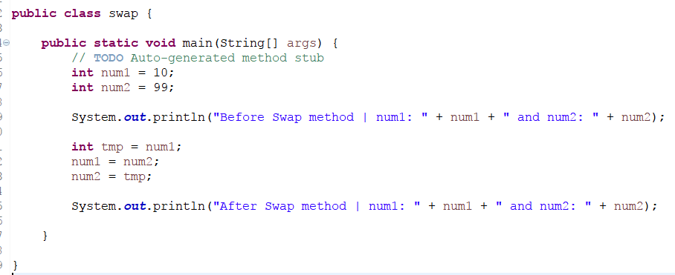
Function/Methods swap.java
Swap the two Integer

Slide 7

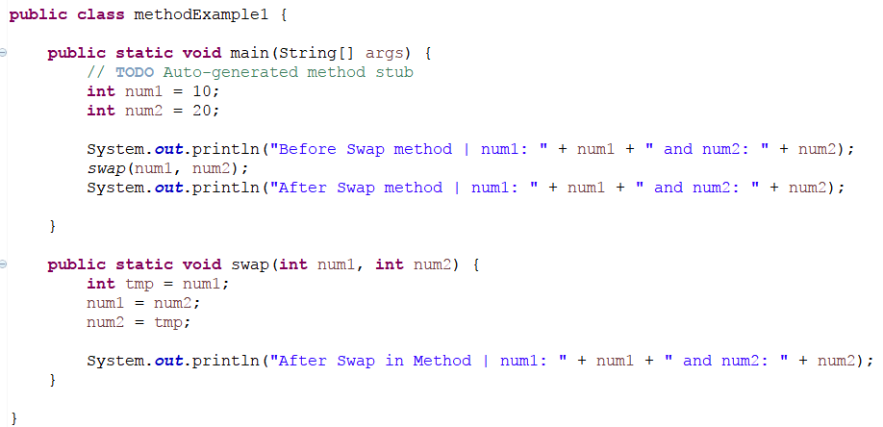
Function/Methods methodExample1.java

Slide 8
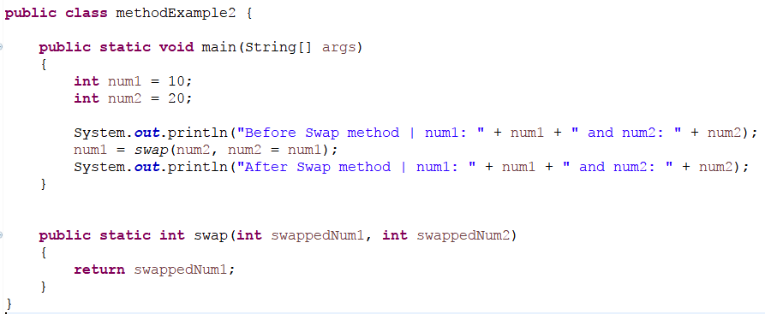

Function/Methods methodExample2.java

Slide 9
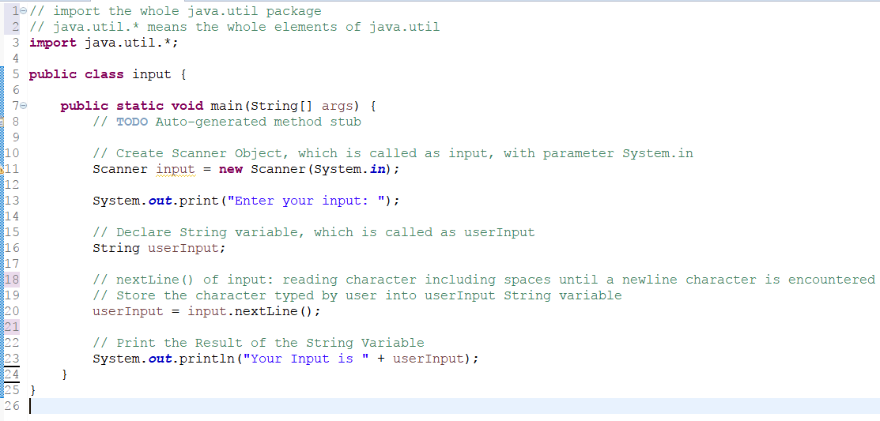
Function/Methods input.java
Remember This?

Slide 10
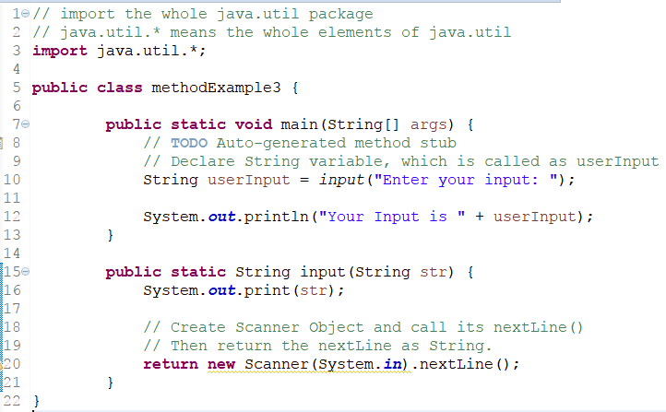
Function/Methods methodExample3.java
Notes:
int num = input(“Enter an integer”);
Public int input(String str) {
System.out.print(str);
return new Scanner(System.in).nextInt();
}
IF return type is void, THEN it is okay to right down return; at the last of code. But can omit the return;

Slide 11
String

Slide 12
String
Commonly used in JAVA
Not primitive Type. But class of Java.lang package

Slide 13
String
String str = “This is a test String”
String str = new String(“This is a test String”)
T
h
i
s
i
s
a
t
e
s
t
S
t
r
i
n
g
0
1
2
3
4
5
6
7
8
9
10
11
12
13
14
15
16
17
18
19
20

Slide 14
Comparing String == operator
String str1 = “This is a String”
String str2 = “This is a String”
String str3 = new String(“This is a String”)
Boolean same1 = (str1 == str2);
Boolean same2 = (str1 == str3);
Notes:
== operator only returns true if both string variables (str1 and str2) refer to the same location in memory
Thurs checks if references of both the objects are the same
True
True

Slide 15
Comparing String - equal
String str1 = “This is a String”
String str2 = “This is a String”
String str3 = new String(“This is a String”)
Boolean same1 = str1.equal(str2);
Boolean same2 = str1.equal(str3);
Notes:
Equal() compare whether two string contents store same value
equalsIgnoreCase
True
True

Slide 16
String Methods StringMethod.java
1. Concatenation Concept in String
2. Addition Concept in String
3. Concatenation and Addition difference
4. Length()
5. isEmpty()
6. SubString(beginIdx, endIdx), subString(beginIdx)
7. equals(string)
8. IndexOf(string)
9. Split(regular expression)
10. charAt(index)
11. Trim();
12. toUpperCase(), toLowerCase()
Notes:
6. Extracting Part of String
8. Return the first occurrence of the specified substring
9. Split a string around matches of the given regular expression
10. Return the character of string
11. Remove the spaces in string
12. Change the string as Uppercase or Lowercase

Slide 17
Class/Object

Slide 18
Class? Object?
Object = state + Behavior
Object is also called as instance of class
Ex1. Student
Ex2. Book
Ex3. …
Notes:
Ex1.
State: Name = “Albert”, StudentID=“1234567”, Course = “Information System”
Behavior: Register subject, Change subject, register exam, withdrawal from course
Ex2.
State: title, author, publisher
Behavior: Borrowed, returned, reserved

Slide 19
Class? Object?
Class: properties(type of state) + behavior
Something like blueprint/template to create object
Multiple objects can be created, Since a class is created.
Ex1. Student
Ex2. Book
Ex3. Staff
Notes:
Ex1.
properties: Name, StudentID, Course
Behavior: Register subject, Change subject, register exam, withdrawal from course
Ex2.
Properties: title, author, publisher
Behavior: Borrowed, returned, reserved
Ex3.
Properties: StaffID, name, address, salary, department
Behaviour: get Paid, Apply Leave, Update Profile

Slide 20
Class Declaration
public class class_Name { // Declaration of Data Members … // Declaration of Methods … }
public: Access Modifier either public or private Declaration of Data Members: class properties Declaration of Methods: class behaviors

Slide 21
Class
Data or variables as properties of class
Constructor
Initializes a new instance of class by using “new”
Accessors
Methods providing read-only access to variable
Mutators
Methods allowing to change variable
Methods
main features or behavior of class
Notes:
C++ need destructor for class but Java No need.

Slide 22
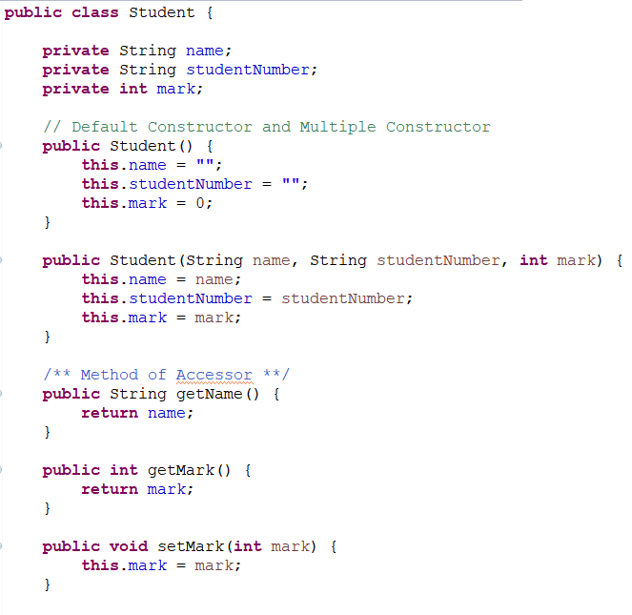
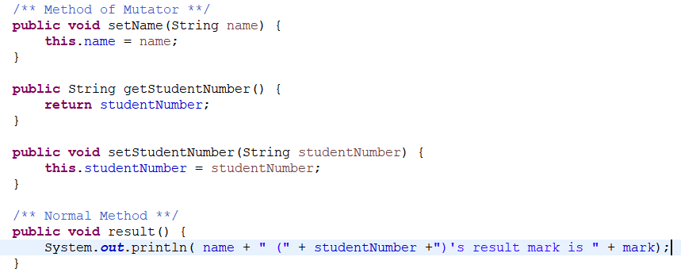
Class Example student.java
Name : String
studentNumber: String
Mark : int

Slide 23
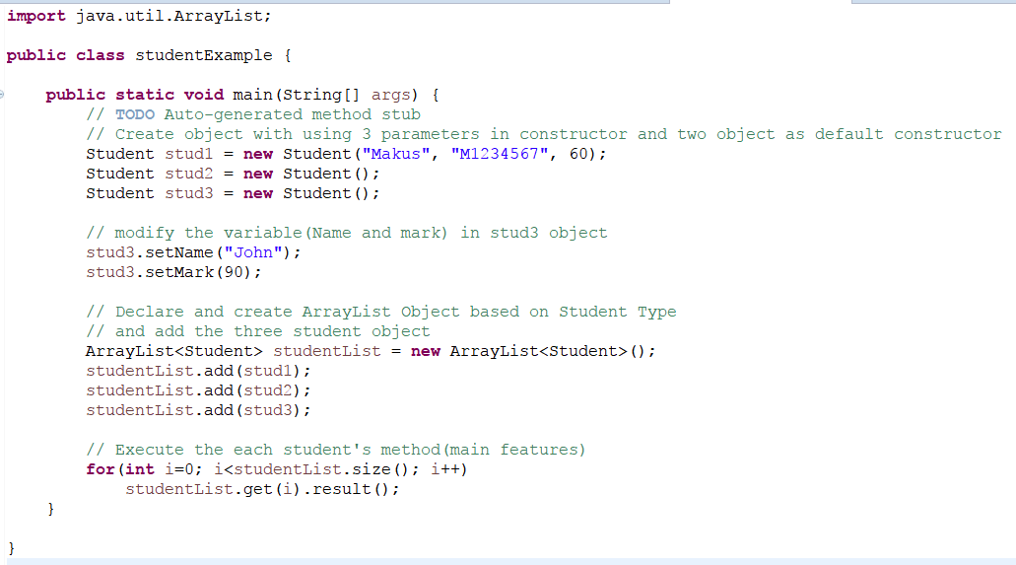
Class Example studentExample.java
studentList =
stud1
stud2
stud3

Slide 24
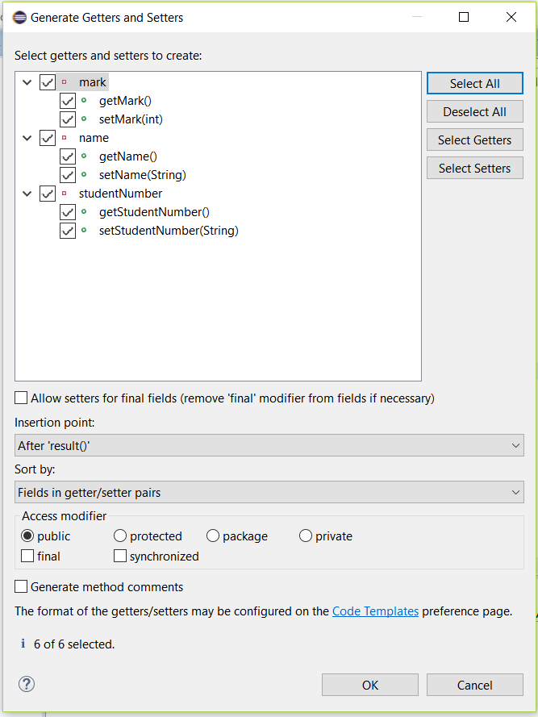
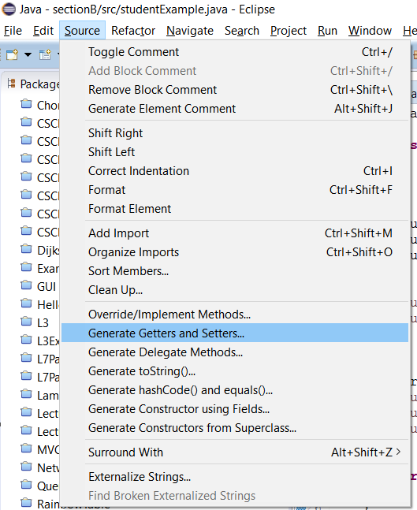
Tips for creating Accessor and Mutator

Slide 25
Playground Session
Choose and answer about the one question among Beginner, Intermediate and High level of questions.

