Slide 1
Section A. HelloWorld?
TECHMONTH 2017
JAVA WORKSHOP

Slide 2
Console Input & Output
- Output
- Input based on Scanner

Slide 3

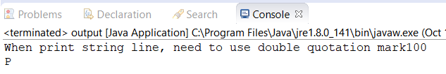
Output output.java
System.out.println( input );
System.out.print( input );

Slide 4
Scanner
Read of console input
Part of java.util package
How to input?
1. import the java.util package
2. declare the scanner
3. Gain the user input by using scanner’s features
For example, nextLine(), nextInt()…
4. print the input

Slide 5
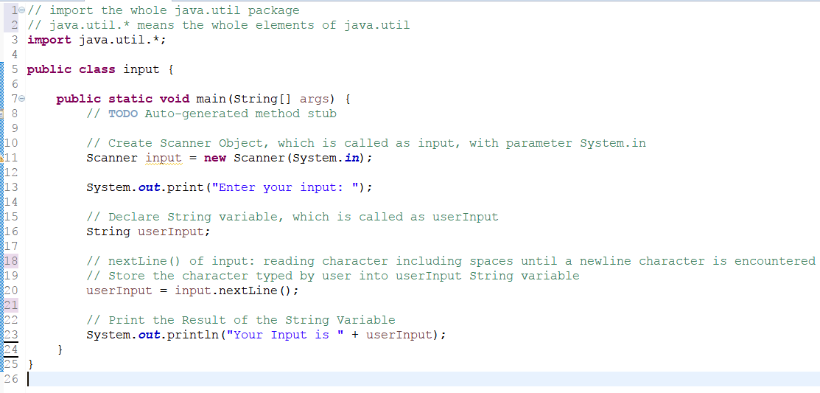
Input with Scanner output.java

Slide 6
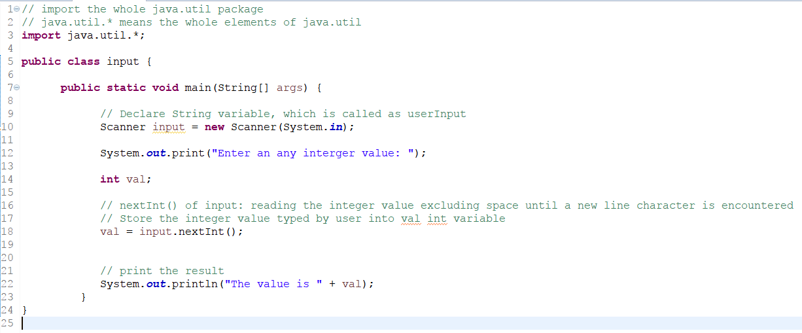
(Optional) Input with Scanner output.java

Slide 7
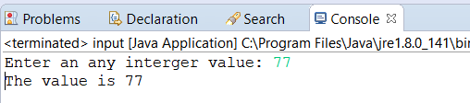
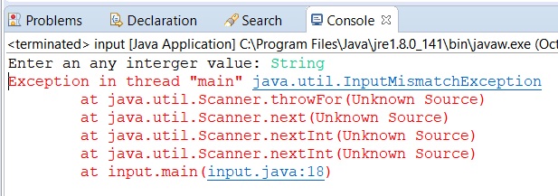
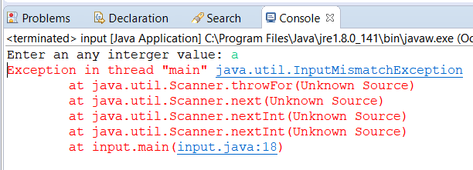
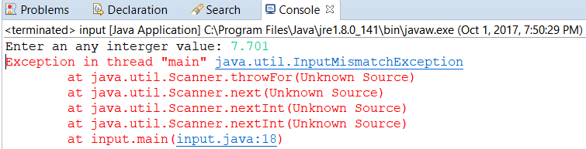
(Optional) Input with Scanner output.java

Slide 8
Data Type
- Primitive Data Type

Slide 9
Data Type
User-Defined
Data Type
Primitive

Slide 10
Primitive Data Type
Data Type | Size of Bits | Range of Values
boolean | 8 | True or False
char | 16 | 0 to 65535
byte | 8 | -128 to 127
short | 16 | -32,768 to 32,767
int | 32 | -2,147,483,648 to 2,147,483,647
float | 32 | -9,223,372,036,854,775,808 to 9,223,372,036,854,775,807
long | 64 | -3.4e8 to 3.4e38
double | 64 | -1.7e308 to 1.7e308

Slide 11
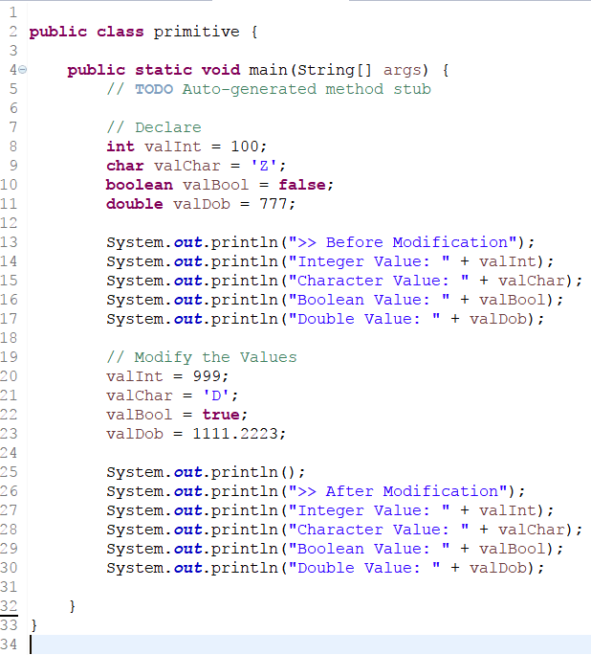
Example primitive.java

Slide 12
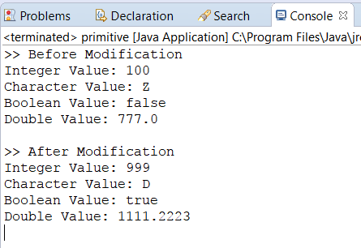
Example of result primitive.java

Slide 13
Operators
Arithmetic Operators
Assignment Operators
Increment / Decrement Operators
Logical Operators

Slide 14
Arithmetic Operators
Operator | Meaning | Example | Value of a
+ | Addition | int a = 20 + 2; | 22
- | Subtraction | int a = 30 – 5; | 25
* | Multiplication | int a = 17 * 3 | 51
/ | Division | int a = 17 / 3 | 5
% | Modulus | int a = 55 % 7 | 6

Slide 15
Assignment Operators
Addition | total+=5;; | Total = total+5;
Subtraction | Total -= (sum-2)/ count; | Total = total – (sum-2)/count
Multiplication | Result *= num1+num2; | Result = result*(num1+num2);
Division | Sum/=number; | Sum=sum/number’
Modulus | Result%=num1*num2 | Result=result%(num1*num2);

Slide 16
Increment / Decrement Operators
Let’s assume that
int val = 10;
Post-Increment ++val; // val:11 System.out.println(val); // val:11 | Pre-Increment val++; // val:10 System.out.println(val); // val:11
Post-Decrement --val; // val:9 System.out.println(val); // val:9 | Pre-Decrement val--; // val:10 System.out.println(val); // val: 9

Slide 17
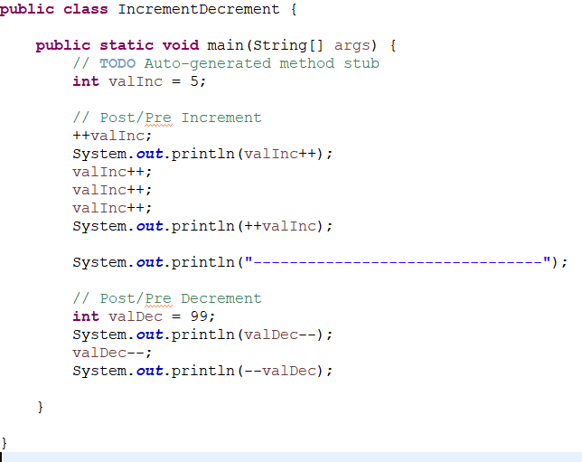
Increment/Decrement IncrementDecrement.java
Output?

Slide 18
Logical Operators
Logical Operator | Symbol | Example | Value
NOT | ! | !false !true | true false
AND | && | true&&true true&&false false&&true false&&false | true false false false
OR | || | true||true true||false false||true false||false | true true true false

Slide 19
Condition/Selection

Slide 20
Condition/Selection Statement
Depends on 1 or more conditions
If
If ~ Else
Nested If
Switch … case

Slide 21
Condition/Selection Syntax
IF If( condition ) { code matching with condition } | IF ~ ELSE If( condition ) { code matching with condition } else { code not matching with condition }
NESTED IF If( condition 1 ) { code matching with condition 1 } else if ( condition 2 ) { code matching with condition 2 } … else { code not matching with condition } | SWITCH Switch(value) { case i: code matching with i; break; case j: code matching with case j; break; case l: code matching with case l ; break; default: code as default condition; }

Slide 22
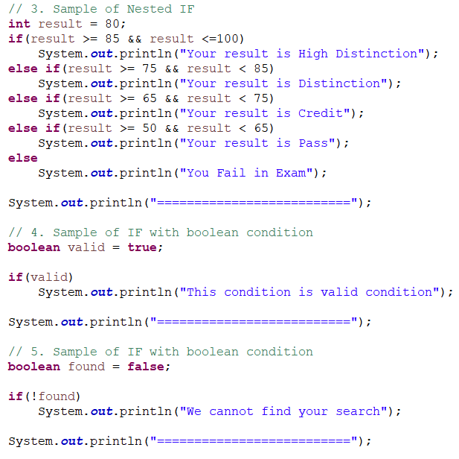
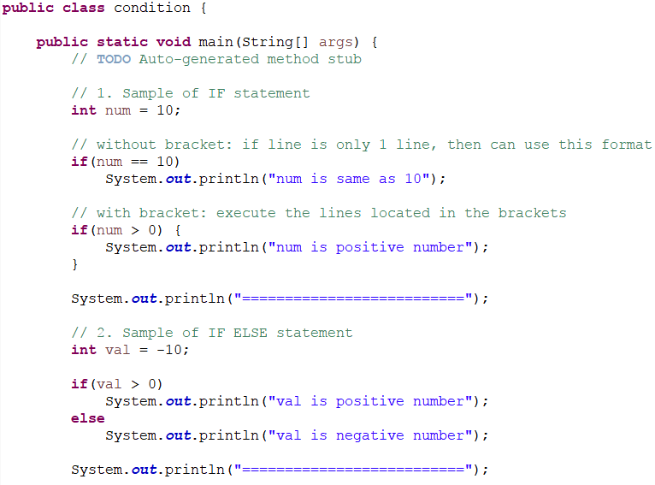
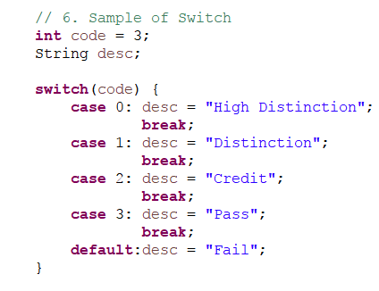
Example condition.java

Slide 23
Repetition

Slide 24
Loop/Repetition Statement
A Line or multiple lines of code is executed repeatedly
for
while
do~while

Slide 25
Loop/Repetition Syntax
while | do~while | for
while(condition) { code … } | do { code … } while(condition); | for(initialization; condition; increment/decrement) e.g. for(int i=0; i<10; i++) for(int j=10; j > -10; j--)

Slide 26
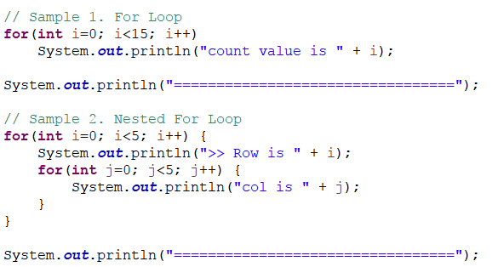
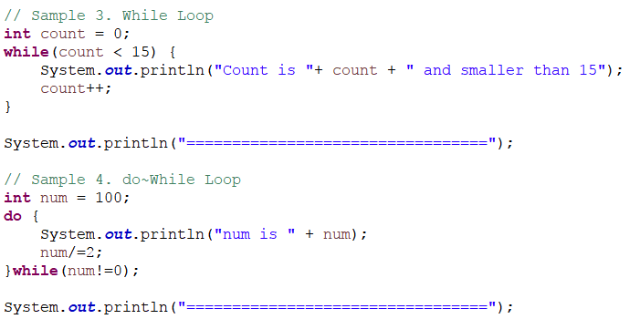
Example loop.java

Slide 27
Array
Concept of Array
1D and 2D Array
ArrayList / Vector

Slide 28
Array
Fixed length sequence of values of Same Data Type
Each item is referred as ELEMENT
Each Element accessed by INDEX which is unique position: Zero(0) to length of Array - 1

Slide 29
Array Syntax
Declare Array
Data_Type[] array_Name;
Create Array
Array_Name = new Data_Type[array_Size];
Declaring and Creating Array
Data_Type[] array_Name = new Data_Type[array_Size];
Declaring,Creating and Initializing Array
Data_Type[] array_Name = {1st element, 2nd element, …, last element};

Slide 30
Array
int[] result = new int[5];
result[0]
result[1]
result[2]
result[3]
result[4]
55
77
40
39
89
Array Name: result
Index of the Array: 0, 1, 2, 3, 4
Size of Array: 5
Array Elements: 55, 77, 40, 39, 89

Slide 31
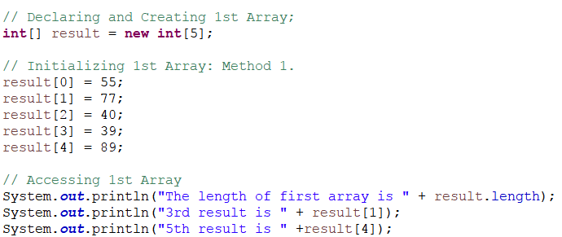
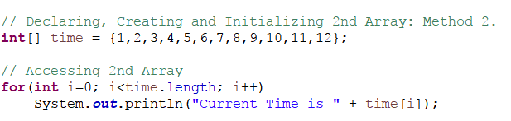
1D Array array1D.java

Slide 32
2D Array and Syntax
Consist of rows and columns values
Declare Array
Data_Type[][] array_Name;
Create Array
Array_Name = new Data_Type[rows_size][cols_size];
Declaring and Creating Array
Data_Type[] array_Name = new Data_Type[rows_size][cols_size];
Declaring,Creating and Initializing Array
Data_Type[] array_Name = {[0][0]element, [0][1]element, …, [rows_size-1][cols_size-2] element ,[rows_size-1][cols_size-1] element};

Slide 33
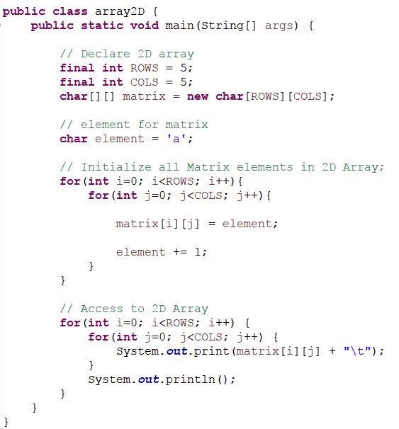
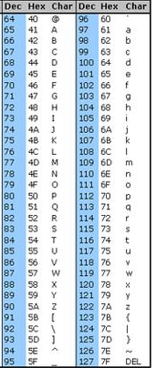
2D Array array2D.java
ASCII Code Table
Notes:
Reference of ASCII Code Table Image
https://www.commfront.com/pages/ascii-chart

Slide 34
ArrayList / Vector
Dynamic version of array: More Flexible
Need to Import from Java.util package
Java.util.ArrayList, Java.util.Vector;
At This Workshop, we will study the ArrayList

Slide 35
ArrayList’s functions DynamicArray.java
1.ArrayList_Name.size();
2.ArrayList_Name.isEmpty();
3.ArrayList_Name.contains(elements);
4.ArrayList_Name.get(index);
5.1.ArrayList_Name.add(element);
5.2.ArrayList_Name.add(index, element);
6.ArrayList_Name.remove(index);
7.ArrayList_Name.clear();
Notes:
https://www.tutorialspoint.com/java/util/java_util_arraylist.htm

Slide 36
Playground Session
Choose and answer about the one question among Beginner, Intermediate and High level of questions.

