Slide 1
Section A. PlayGround

Slide 2
Beginner’s Level
1. Simple Calculator
2. Even Number? Odd Number?

Slide 3
Simple Calculator
Build a Simple Calculator
1st, program need to ask user to input first integer number
2nd, program should ask user to input operator
3rd, program ask user to input second integer number.
4th, program should print the result of the operation and the result become first integer number
1~4 step is repeated for 5 times.
The first input integer Name: num1
The second input integer Name: num2
The input operator Name: operator

Slide 4
Even Number? Odd Number?
There is an integer array which length is n, where n is the user-defined integer input. User need to input any integer number into the n array. After input integer numbers into the array, Then the program should print two array. One array should only show the odd number of n array with the number of odd number. And the another should show only the even number of n array with the number of even number.

Slide 5
Intermediate Level
1. Advanced version of Even Number? Odd Number?
2. Multiplication table

Slide 6
Advanced version of Even Number? Odd Number?
There is an integer 2D array which length is n, where n is the user-defined integer input. User need to input any integer number into the n array.
When input number is Even, then add to the in front of the array
When input number is Odd, then add to the back of the array.
The Program should show the result of input in array.

Slide 7
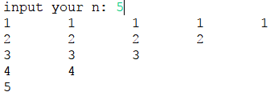
Multiplication Table
Create a Multiplication Table with n, where n is the user-defined integer input. The range of n is 0 < n <= 20.
if n is smaller and equal with 10, it should show like this.

Slide 8
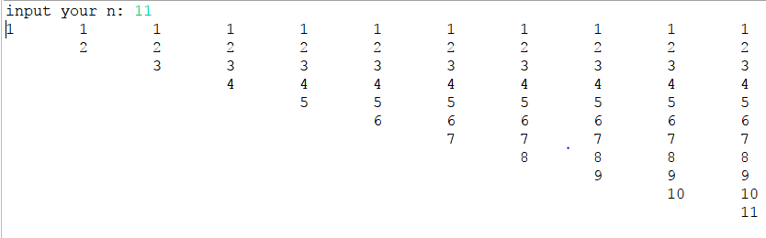
Multiplication Table
if n range is 10 <= n <= 20, The program should show like this

Slide 9

Multiplication Table
if n is out of the range, then the program should print “Invalid range of n”

Slide 10
High Level
1. Sorting
2. Snail Array

Slide 11
Sorting Array
There is an integer array which length is n, where n is the user-defined integer input. User need to input any integer number into the n array.

Slide 12
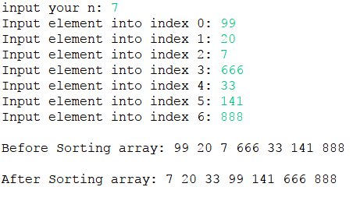
Sorting Array
If n is 7 and user input 99, 20, 7, 666, 33, 141, 888, Then the program should show pre-swap statement and post-swap statement

Slide 13
Snail Array
There is an integer 2D array which length is n, where n is the user-defined integer input. User need to input any integer number into the n array. Then the program should show like this format. Let’s Assume that n is 4.
1 | 2 | 3 | 4
12 | 13 | 14 | 5
11 | 16 | 15 | 6
10 | 9 | 8 | 7

