Slide 1
LimbRevive: VR-Based Therapy for Motor Recovery
InnovAct 2025
AR/VR
HEAL
IR2025-995954
https://github.com/PavihaaChander/InnovAct2025_HEAL.git
Pavihaa Lakshmi B, Marimuthu R, Saqhibuddeen Ahmed F, Keerthana B, Abitha V

Slide 2
Problem Statement
Background: Motor impairments caused by neurological disorders, trauma, or degenerative diseases severely affect individuals' ability to perform daily tasks, leading to reduced autonomy and quality of life.
Limitations of Traditional Therapy:
Conventional rehabilitation methods often face challenges such as:
Low patient engagement and motivation
Limited personalization of therapy
Restricted access in remote or underserved regions

Slide 3
What does it solve?
VR-Based Game Therapy:
Virtual Reality (VR) offers immersive, interactive environments that simulate real-world motor tasks.
Game-based therapy within VR platforms can:
Enhance patient motivation and adherence
Stimulate neuroplasticity through repetitive, goal-oriented tasks
Allow real-time feedback and adaptive difficulty levels

Slide 4
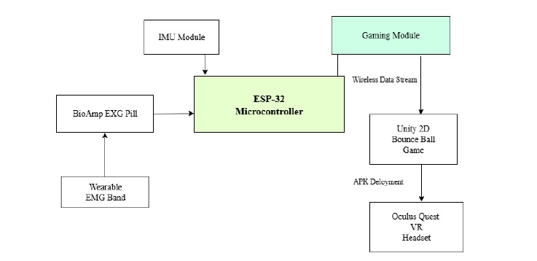
METHODOLOGY

