Slide 1






KONGU ENGINEERING COLLEGE
PERUNDURAI ERODE-638060
DEPARTMENT OF COMPUTER TECHONOLOGY-UG
TITLE : Promotional Website for
Software Training Center
Team Members:
Angappan N(22BIR003) Gokula shankar T.K(22BIR011)
Pavish K(22BIR036)
Guided By:
Dr.A.Muthusamy
In association with:

Slide 2
ABSTRACT
The promotional project for the Software Training Centre involves the creation of a dedicated website aimed at enhancing the company's visibility and market reach. This project includes comprehensive domain registration, web hosting, and digital marketing services to ensure a strong online presence.
Our promotional website showcases a range of high-performance hosting plans designed for businesses and individuals aiming to enhance their online presence. The platform provides seamless domain registration and robust SSL certificates, ensuring security and reliability for all users.
Built using MongoDB, Express, React, and Node (MERN stack), the website offers exceptional speed, security, and scalability. These features are designed to meet the needs of modern businesses and individuals who require robust and efficient online solutions.
With dedicated customer support, all crafted to empower the digital journey. Experience unparalleled service and reliability with company.

Slide 3


PROBLEM STATEMENT
Complex User Registration Process: Users may find the registration process cumbersome or confusing, leading to abandoned sign-ups and frustration.
Difficulty in Finding Available Domains: Users might struggle to search for and find available domain names, resulting in a poor user experience and potential loss of customers.
Confusing Hosting Plan Options: Users may find it difficult to compare different hosting plans due to unclear presentation or lack of detailed information, leading to indecision and loss of sales.
Complicated Course Booking System: Users may experience difficulties navigating the course booking system, such as unclear course descriptions, complex booking steps, or payment issues, which could deter them from enrolling in courses.
Lack of Accessible Customer Support: Users might face challenges in accessing customer support for resolving issues or getting answers to their questions, leading to dissatisfaction and a negative perception of the company.

Slide 4
SYSTEM REQUIREMENTS
HARDWARE:
Processor: 12th Gen Intel(R) Core(TM) i5
RAM: 8 GB
Storage: 256 GB SSD
Network: Stable internet connection
SOFTWARE :
Operating System: Windows 11
Web Server: Local development server
Database: MongoDB atlas
Text Editor/IDE: Visual Studio Code
Version Control: Git
Package Managers: npm (Node Package Manager)
Browsers: Latest versions of Google Chrome
Additional Tools: Postman

Slide 5
MODULES
Login and Register Module
Domain Management Module
Hosting Plans Module
Course Booking Module
Customer Service Module
Analytics and Reporting Module
Security Module

Slide 6
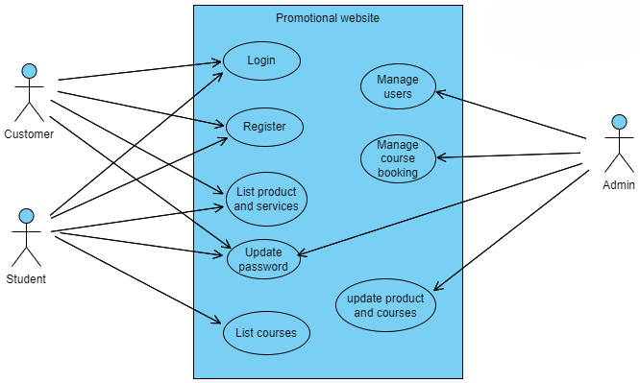
USE CASE DIAGRAM

Slide 7
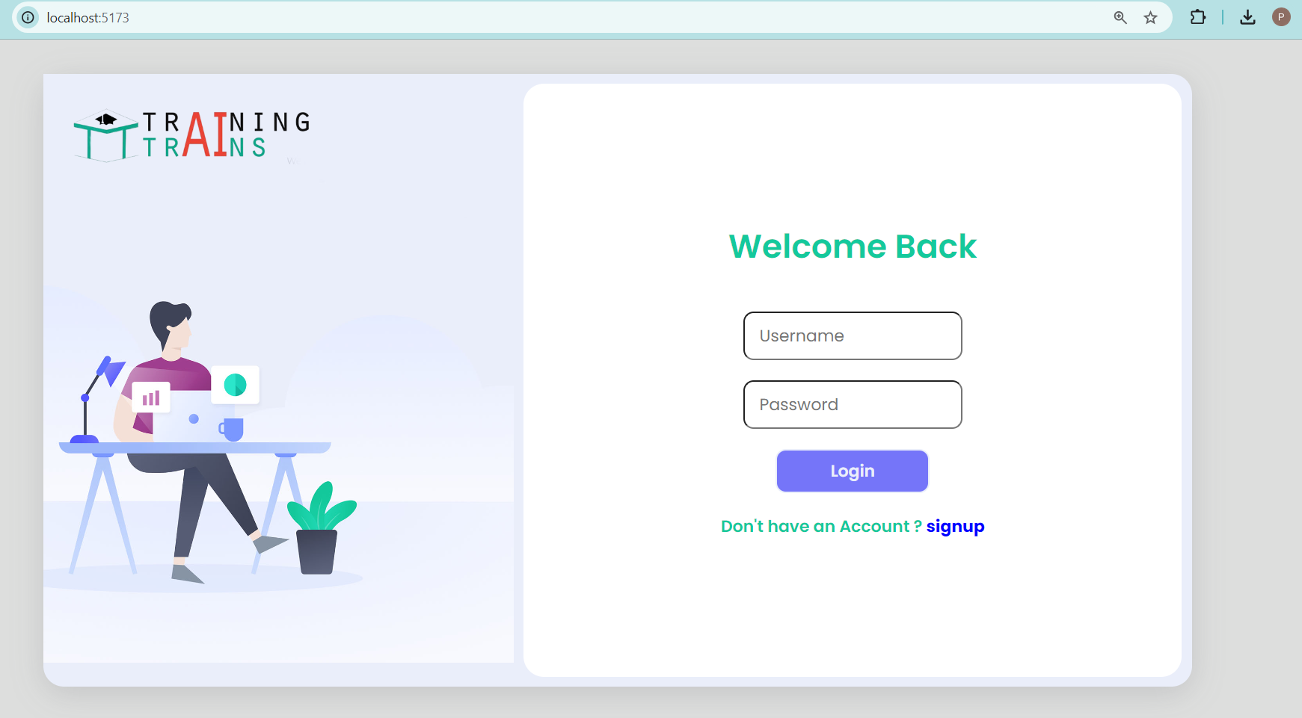
USER INTERFACE
Login page

Slide 8
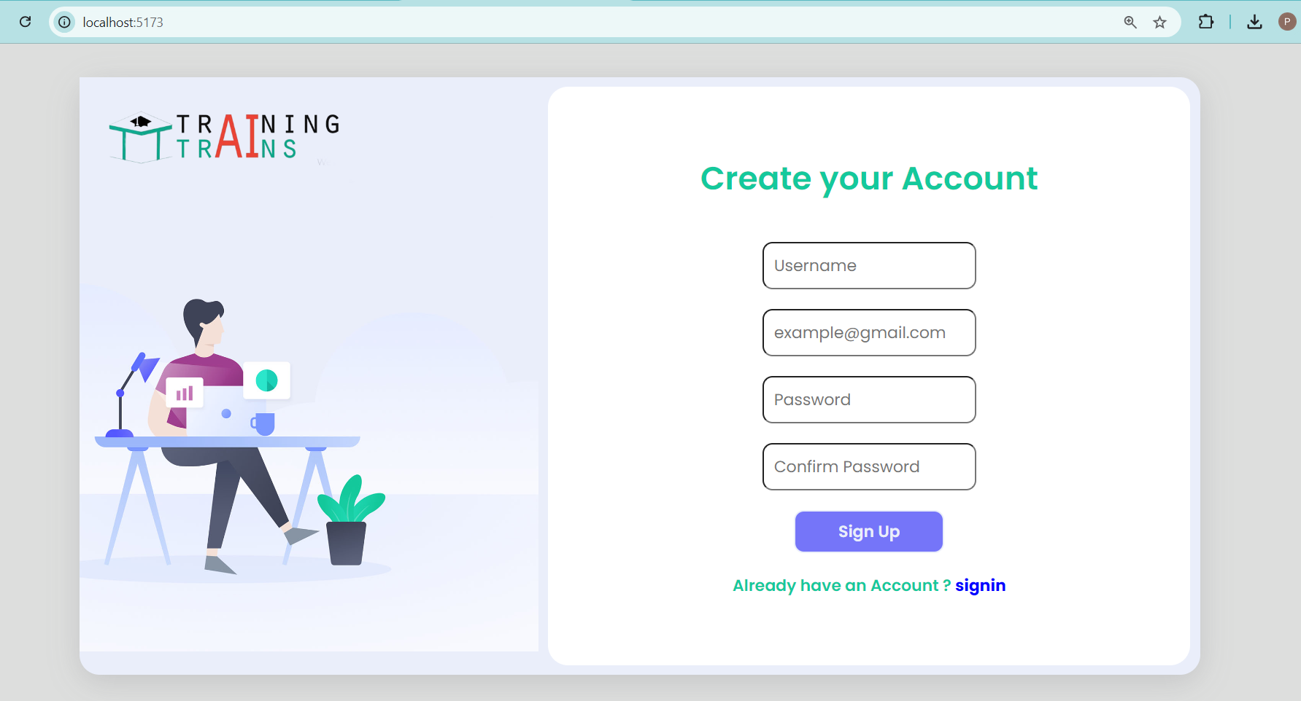
USER INTERFACE
Register page

Slide 9
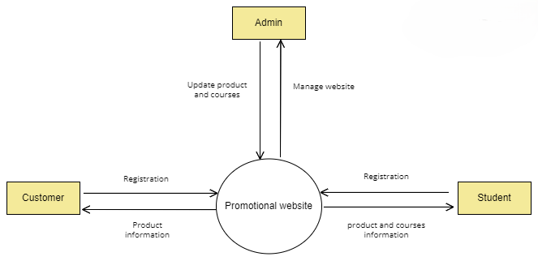
DATAFLOW DIAGRAM

Slide 10
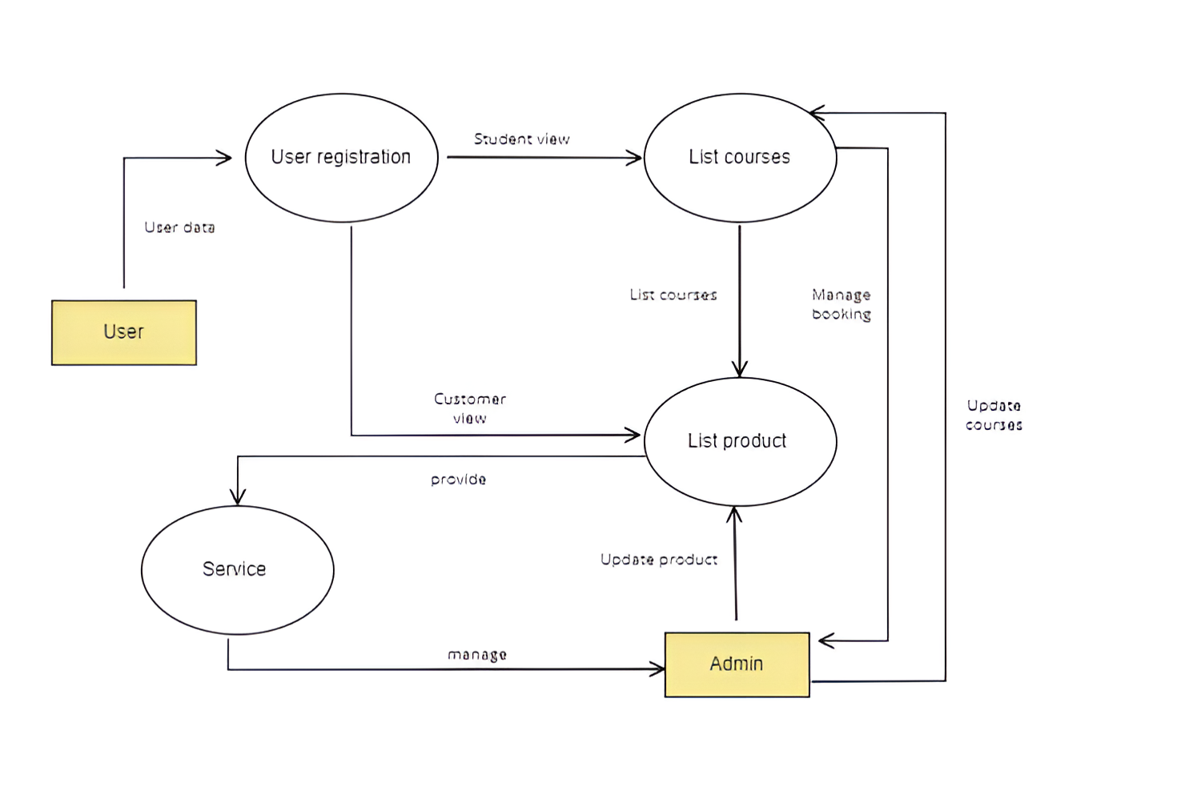
DATAFLOW DIAGRAM

Slide 11
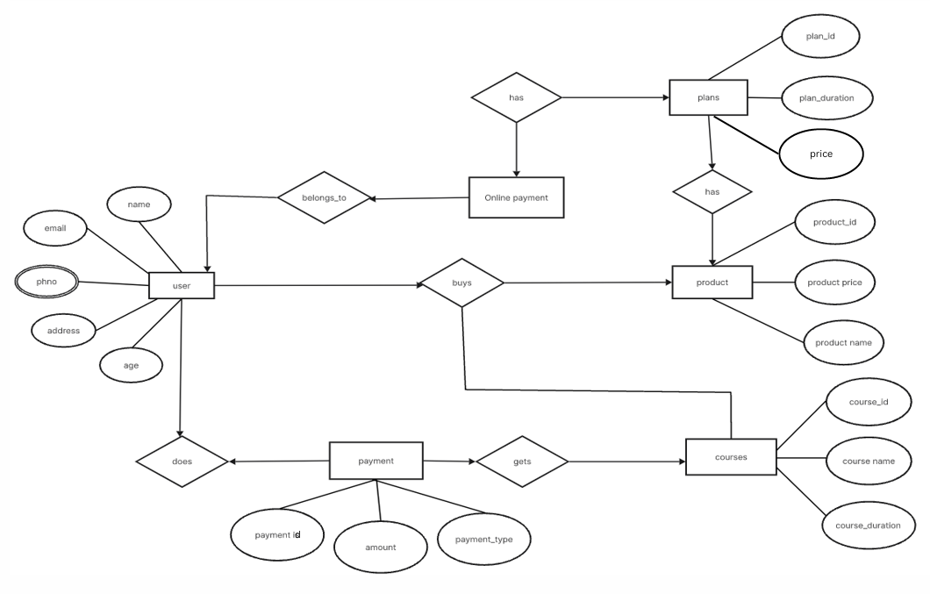
ER DIAGRAM

Slide 12
THANKYOU!

