Slide 1






KONGU ENGINEERING COLLEGE
PERUNDURAI ERODE-638060
DEPARTMENT NAME
KEC IDEATHON
Promotional Website for
Software Training Center
Team Members:
Angappan N(22BIR003) Gokula shankar T.K(22BIR011)
Pavish K(22BIR036)
Technology Readiness Level : FIRST REVIEW
Team Mentor with Designation and Department:
Dr A.Muthusamy M.C.A.,Ph.D.,
In association with:

Slide 2


Introduction
Our project aims to design and develop a promotional website for our software training center to attract potential clients and showcase our comprehensive offerings. Unlike existing solutions that often lack user-friendly interfaces and detailed product information, our website will provide an intuitive and engaging user experience.
It will feature detailed descriptions of all available product and services, including the advantages of each product and services, and suggest appropriate courses for students.
This approach makes it easier for prospective students to find and enroll in the right programs for their career advancement. Our solution addresses the gaps in current promotional websites by focusing on usability, accessibility, and comprehensive content.

Slide 3
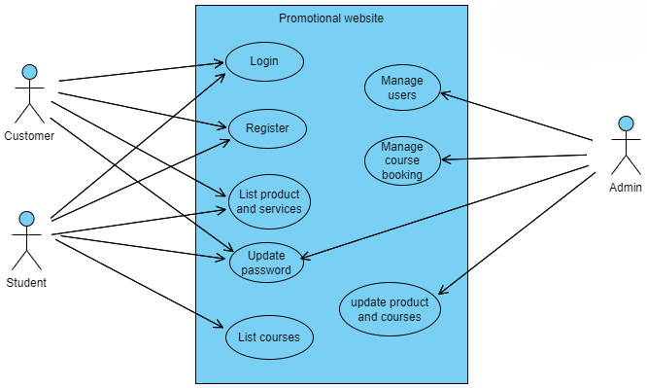
Use Case Diagram

Slide 4
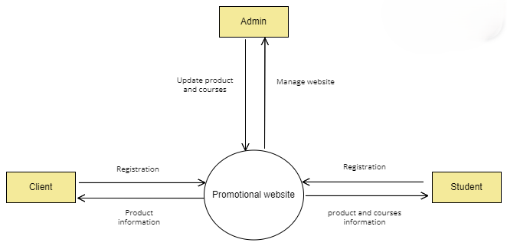
Data Flow Diagram : Leve 0

Slide 5
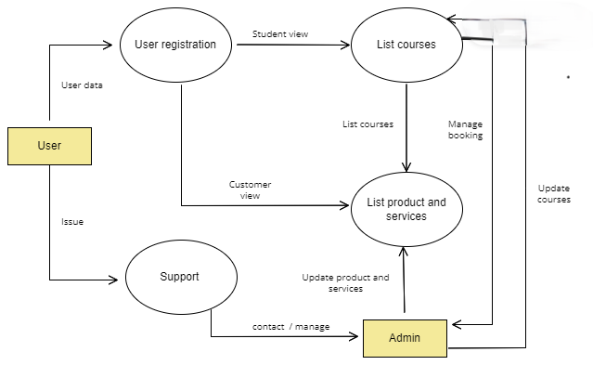
Data Flow Diagram : Leve 01

Slide 6
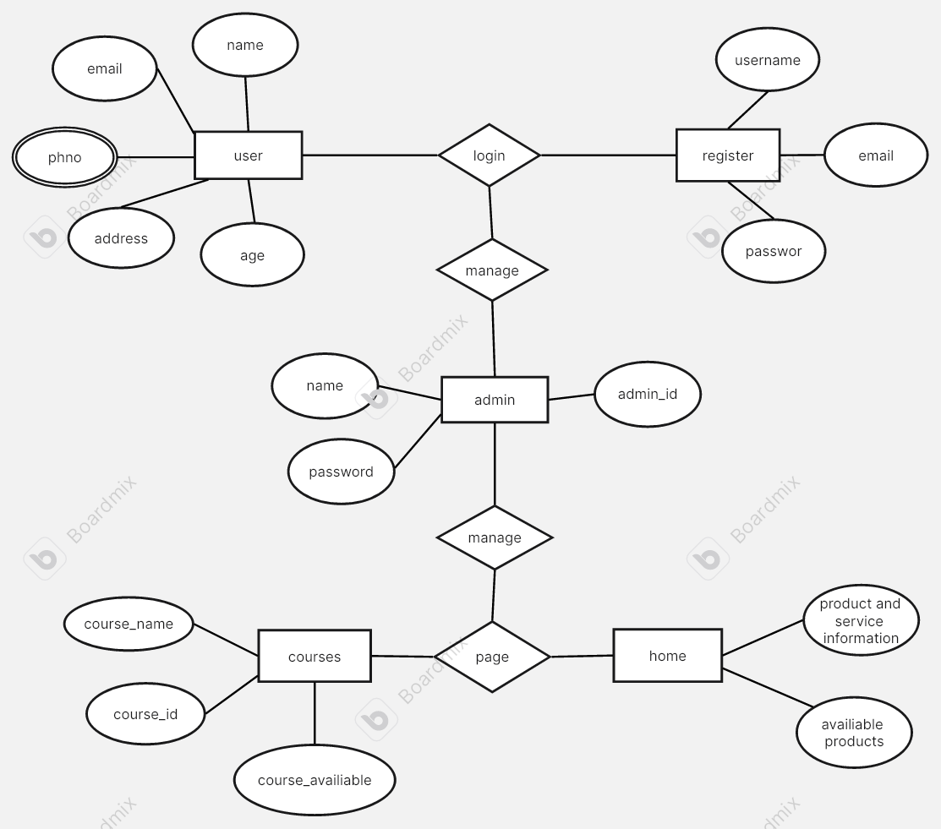
ER Diagram

Slide 7
Thank You !!

