Slide 1






KONGU ENGINEERING COLLEGE
PERUNDURAI ERODE-638060
DEPARTMENT OF COMPUTER TECHONOLOGY-UG
TITLE : Online Platform For Dessert
Products
Team Members:
Angappan N(22BIR003) Gokula Shankar T.K(22BIR011)
Pavish K(22BIR036)
Guided By:
Dr.A.Muthusamy
`
In association with:

Slide 2
ABSTRACT
The Online Platform for Dessert Products simplifies ordering by allowing bulk orders for customers. It features an easy interface to browse, check availability, and place orders.
Customers can view detailed product information, explore special offers, and enjoy secure online payments. Real-time order tracking, inventory management, and customer support ensure a smooth experience.
Built with Angular, MongoDB, Express, and Node, the platform offers fast, secure, and scalable performance. It helps the bakery expand its business and reach more customers in the digital world.

Slide 3


PROBLEM STATEMENT
The bakery struggles to reach a larger customer base and expand its sales channels.
Customers face difficulty in browsing and ordering bakery items conveniently.
The bakery lacks a system for managing bulk orders and tracking real-time order statuses.
The absence of a digital platform limits customer engagement and business growth.
13-Feb-25

Slide 4
SYSTEM REQUIREMENTS
HARDWARE:
Processor: 12th Gen Intel(R) Core(TM) i5
RAM: 8 GB
Storage: 256 GB SSD
Network: Stable internet connection
SOFTWARE :
Operating System: Windows 11
Web Server: Local development server
Database: MongoDB atlas
Text Editor/IDE: Visual Studio Code
Version Control: Git
Package Managers: npm (Node Package Manager)
Browsers: Latest versions of Google Chrome
Additional Tools: Postman
13-Feb-25

Slide 5
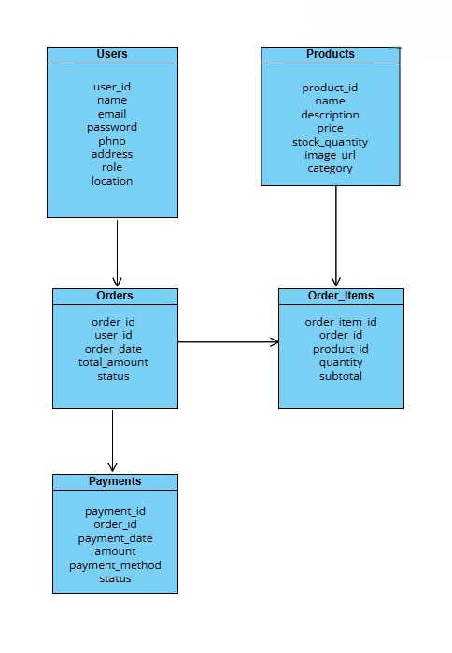
DATABASE DESIGN
Primary key: user_id, product_id, order_id, order_item_id, payment_id Foreign key: user_id, product_id, order_id

Slide 6
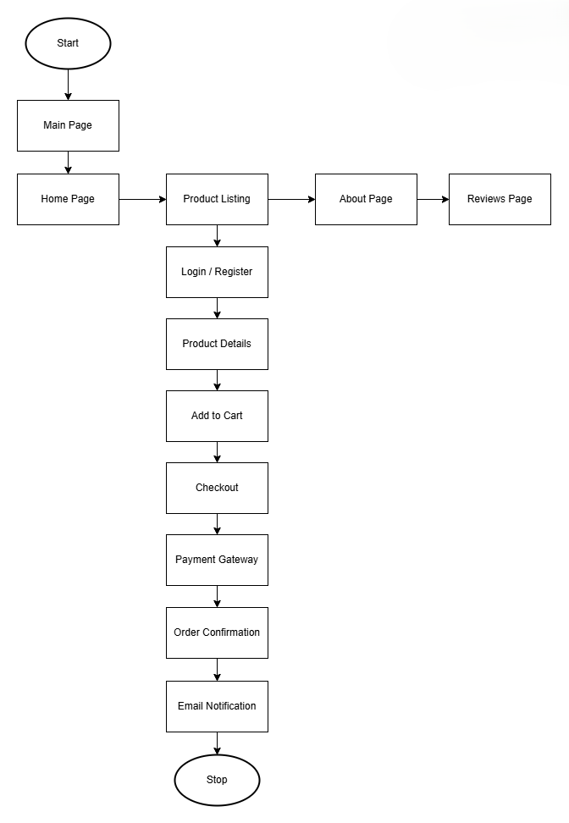
SYSTEM FLOW DIAGRAM

Slide 7
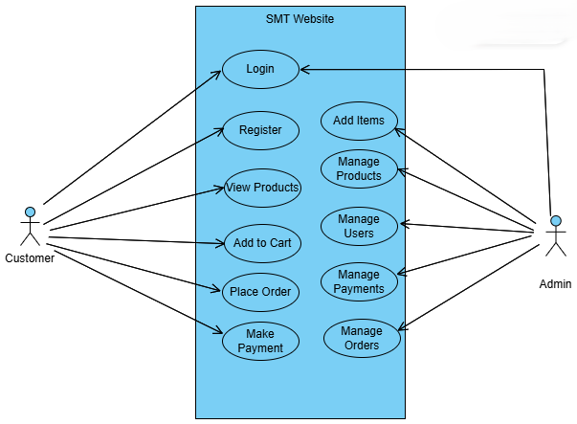
USE CASE DIAGRAM
13-Feb-25

Slide 8
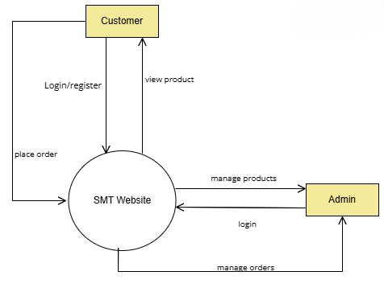
DATAFLOW DIAGRAM

Slide 9
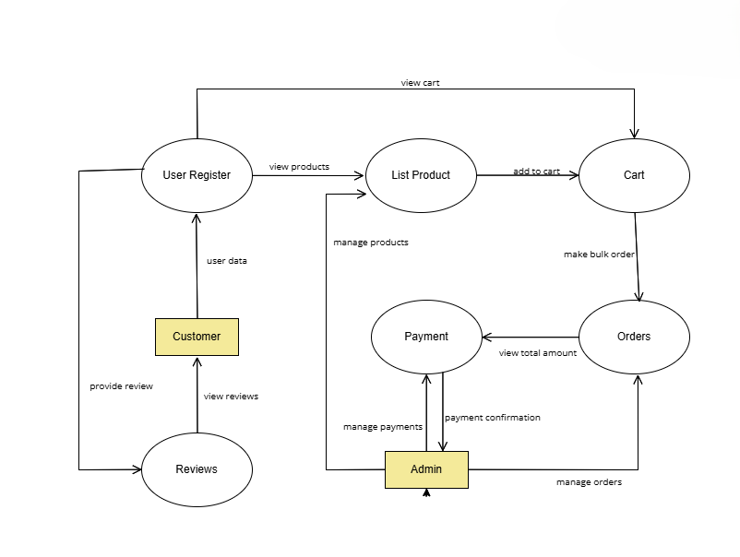
DATAFLOW DIAGRAM

Slide 10
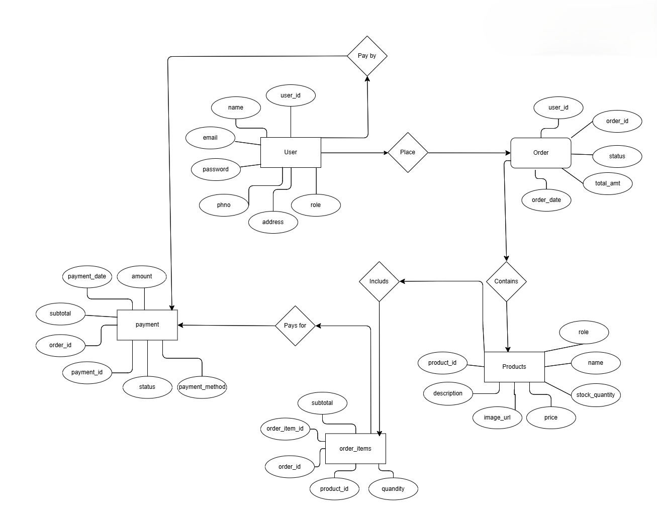
ER DIAGRAM

Slide 11
MODULES
Login and Register Module
Home Module
Product Module
About Module
Reviews Module
Admin Module
Payment Module
13-Feb-25

Slide 12
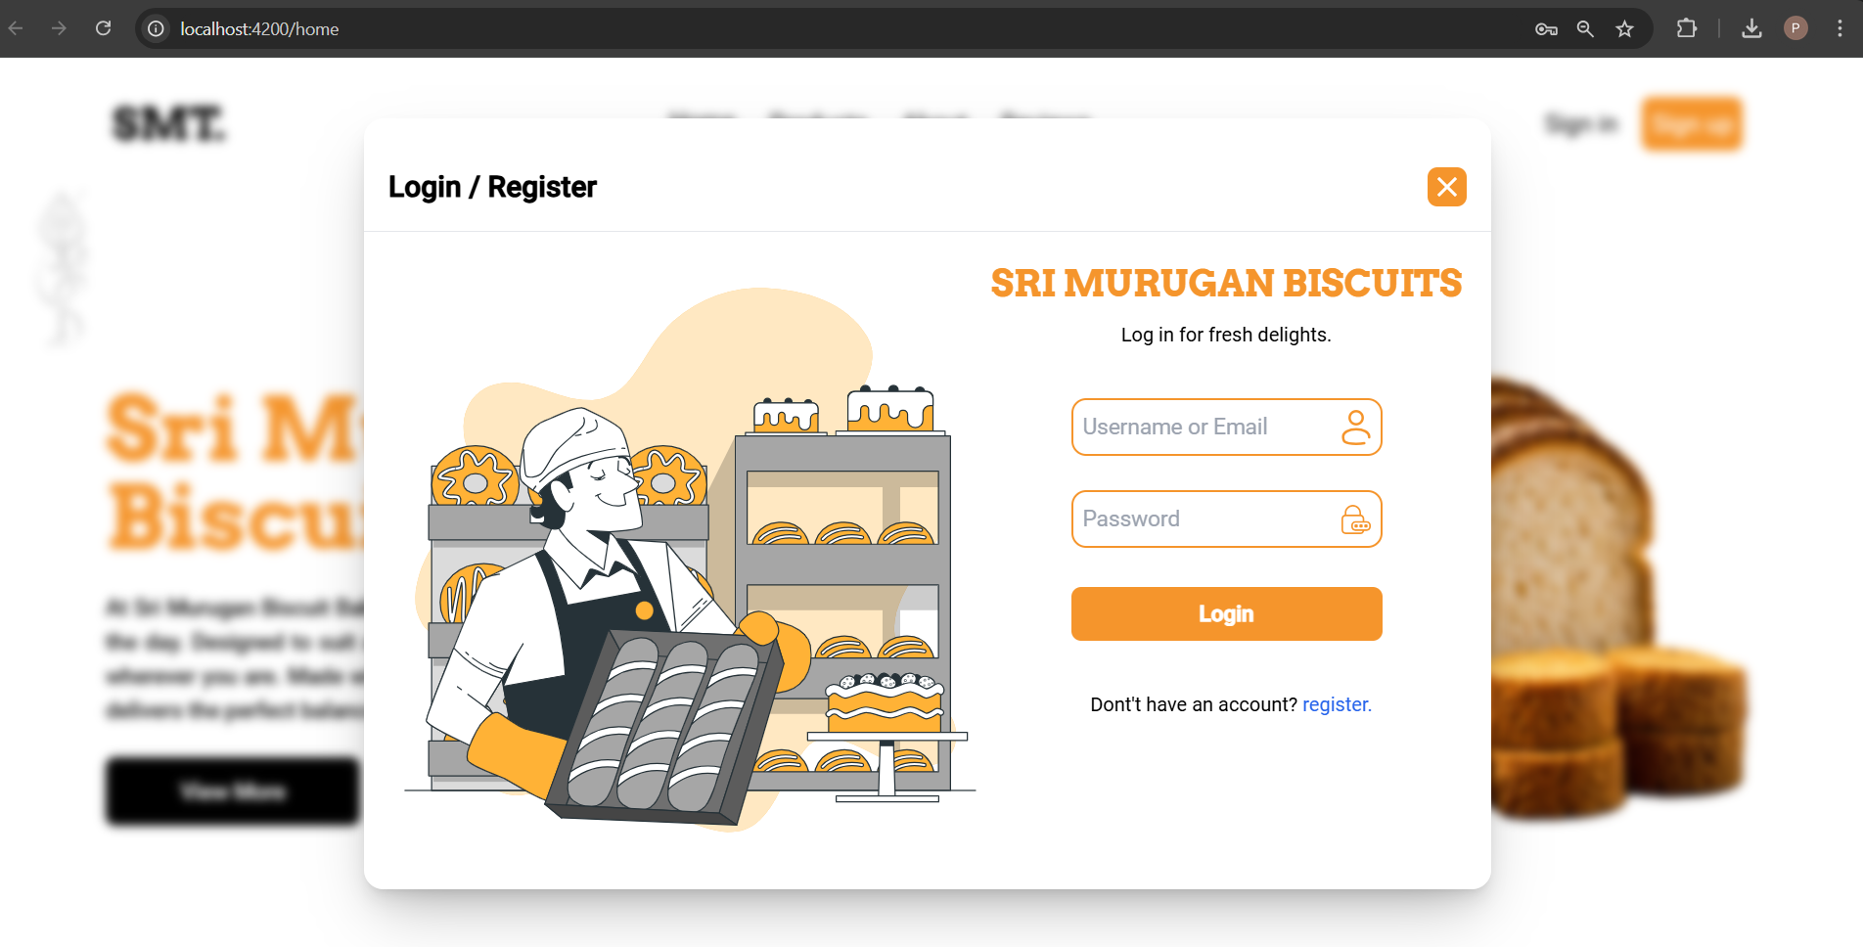
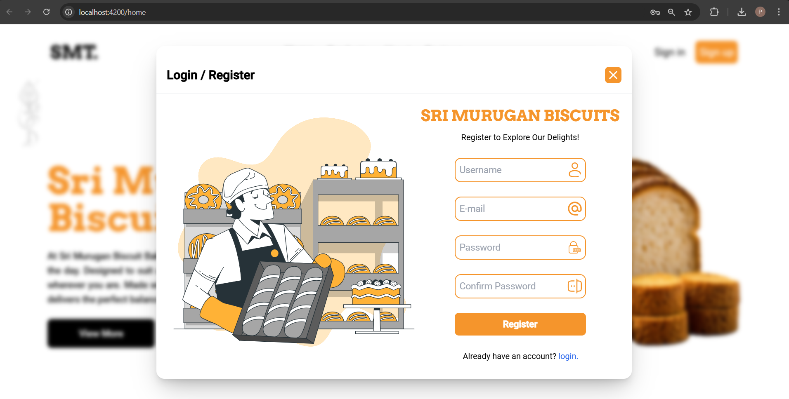
USER INTERFACE DESIGN
Login Page
Register Page

Slide 13
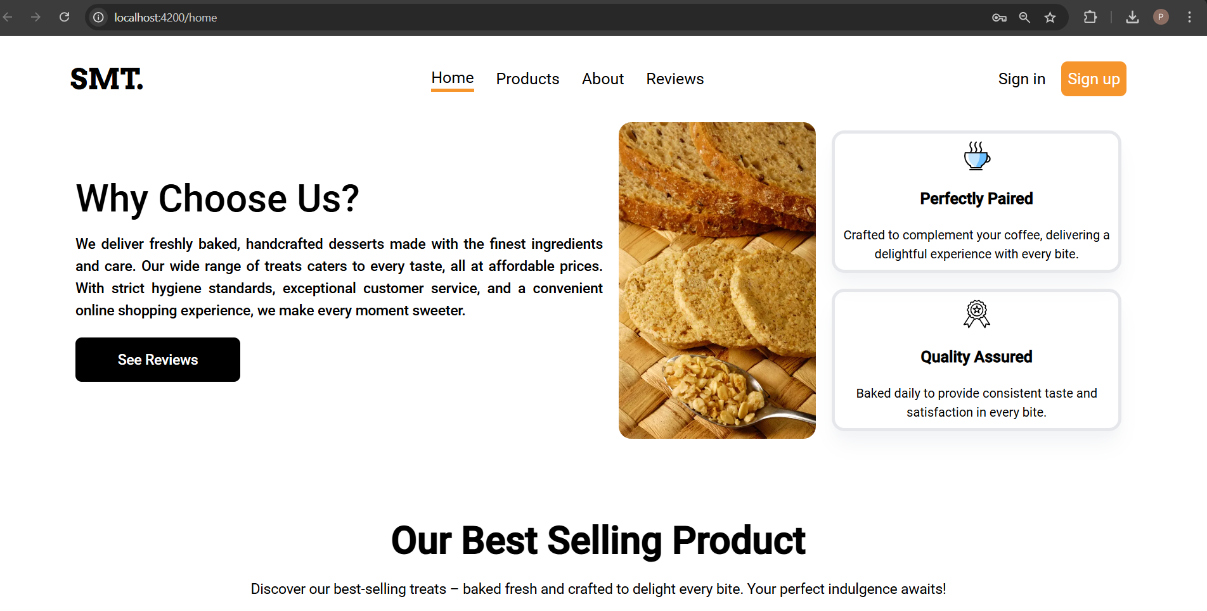
USER INTERFACE DESIGN
Home Page

Slide 14
THANKYOU!

