Slide 1






KONGU ENGINEERING COLLEGE
PERUNDURAI ERODE-638060
DEPARTMENT OF COMPUTER TECHONOLOGY-UG
TITLE : Online Platform For Dessert
Products
Team Members:
Angappan N(22BIR003) Gokula Shankar T.K(22BIR011)
Pavish K(22BIR036)
Guided By:
Dr.A.Muthusamy
`
In association with:

Slide 2
ABSTRACT
The Online Platform for Dessert Products simplifies ordering by allowing bulk orders for customers. It features an easy interface to browse, check availability, and place orders.
Customers can view detailed product information, explore special offers, and enjoy secure online payments. Real-time order tracking, inventory management, and customer support ensure a smooth experience.
Built with Angular, MongoDB, Express, and Node, the platform offers fast, secure, and scalable performance. It helps the bakery expand its business and reach more customers in the digital world.

Slide 3


EXISTING SYSTEM
Local bakeries rely on manual order management, with orders taken in person, via phone, or WhatsApp. Bulk orders are tracked manually, leading to inefficiencies and mismanagement.
Inventory tracking is done manually or in spreadsheets, making stock management difficult. There are no real-time updates, leading to wastage or shortages.
Customer engagement is minimal, with no online platform for browsing or ordering. Marketing depends on word-of-mouth and social media, with no order tracking for customers.
13-Feb-25

Slide 4
PROBLEM DEFINITION
Inefficient Order Management: Orders are manually taken in person, via phone, leading to errors, inefficiencies, and challenges in tracking bulk orders.
Manual Inventory Tracking: Inventory is tracked manually or with spreadsheets, causing stock mismanagement, shortages, and wastage due to the lack of real-time updates.
Limited Customer Engagement & Marketing: There is no online platform for browsing or ordering, and marketing is dependent on word-of-mouth and social media, limiting customer reach and interaction.
13-Feb-25

Slide 5
FEASIBILITY STUDY
The project is technically feasible using the MEAN stack, ensuring scalability and smooth integration of payment gateways and order tracking.
The system’s initial development cost is offset by the long-term benefits of improved efficiency, reduced wastage, and increased customer reach. The operational savings make it financially viable.
The platform will be easy to use for bakery staff and customers, improving order management and inventory control. The online system also allows for better customer engagement and business growth.
13-Feb-25

Slide 6
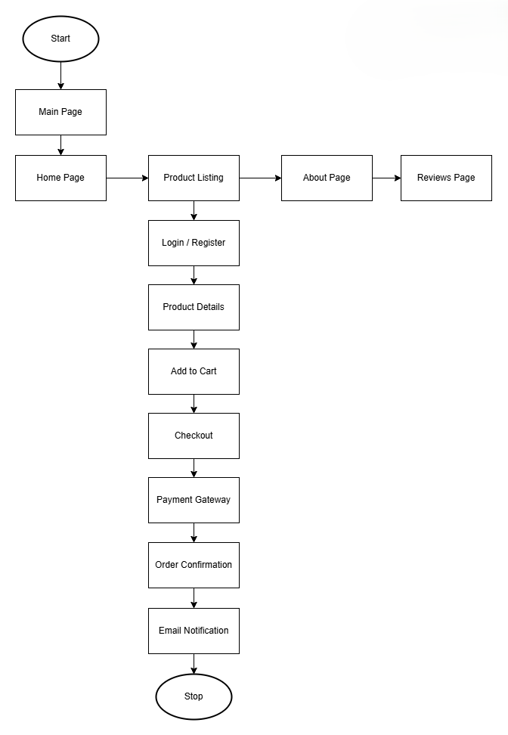
SYSTEM FLOW DIAGRAM
13-Feb-25

Slide 7
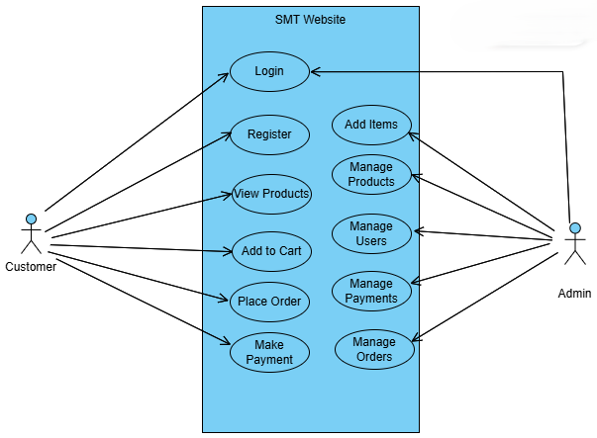
USECASE DIAGRAM
13-Feb-25

Slide 8
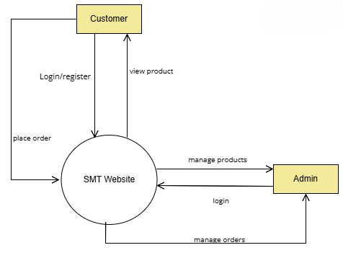
DATA FLOW DIAGRAM LV0
13-Feb-25

Slide 9
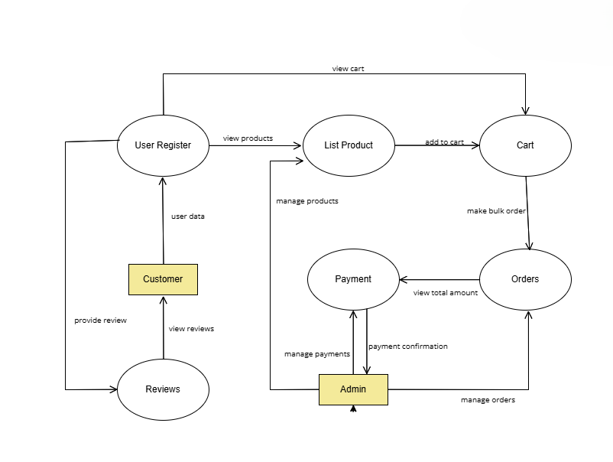
DATA FLOW DIAGRAM LV1
13-Feb-25

Slide 10
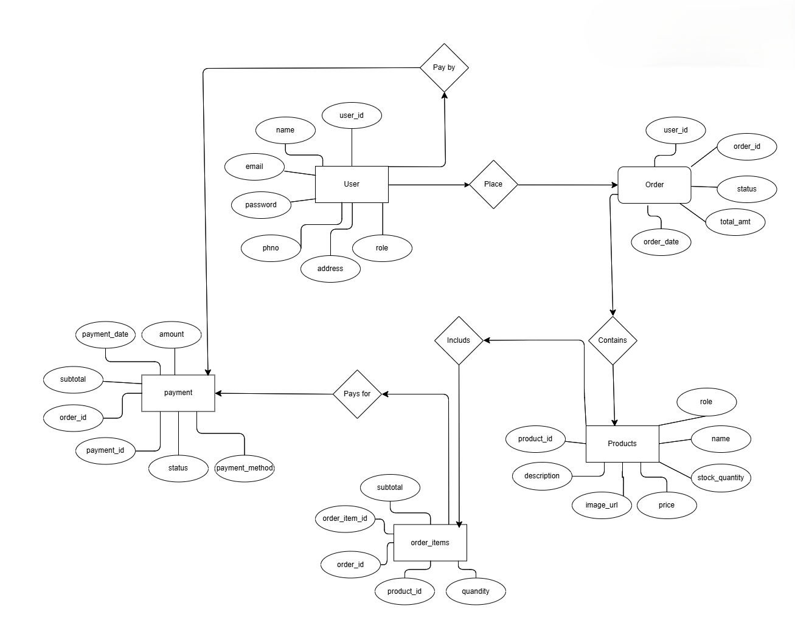
ER DIAGRAM
13-Feb-25

Slide 11
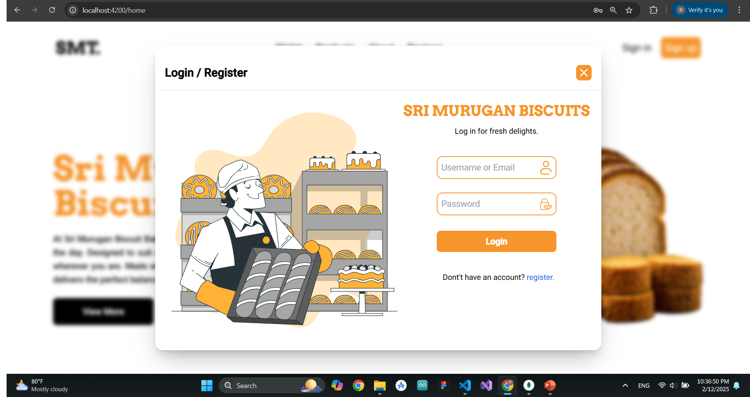
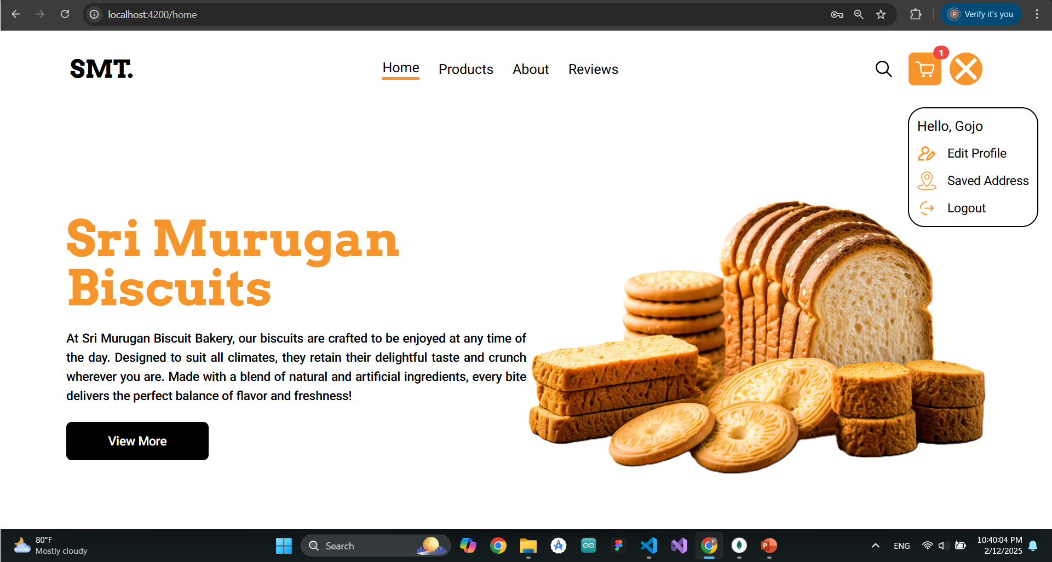
USER INTERFACE DESIGN
User management module
13-Feb-25

Slide 12
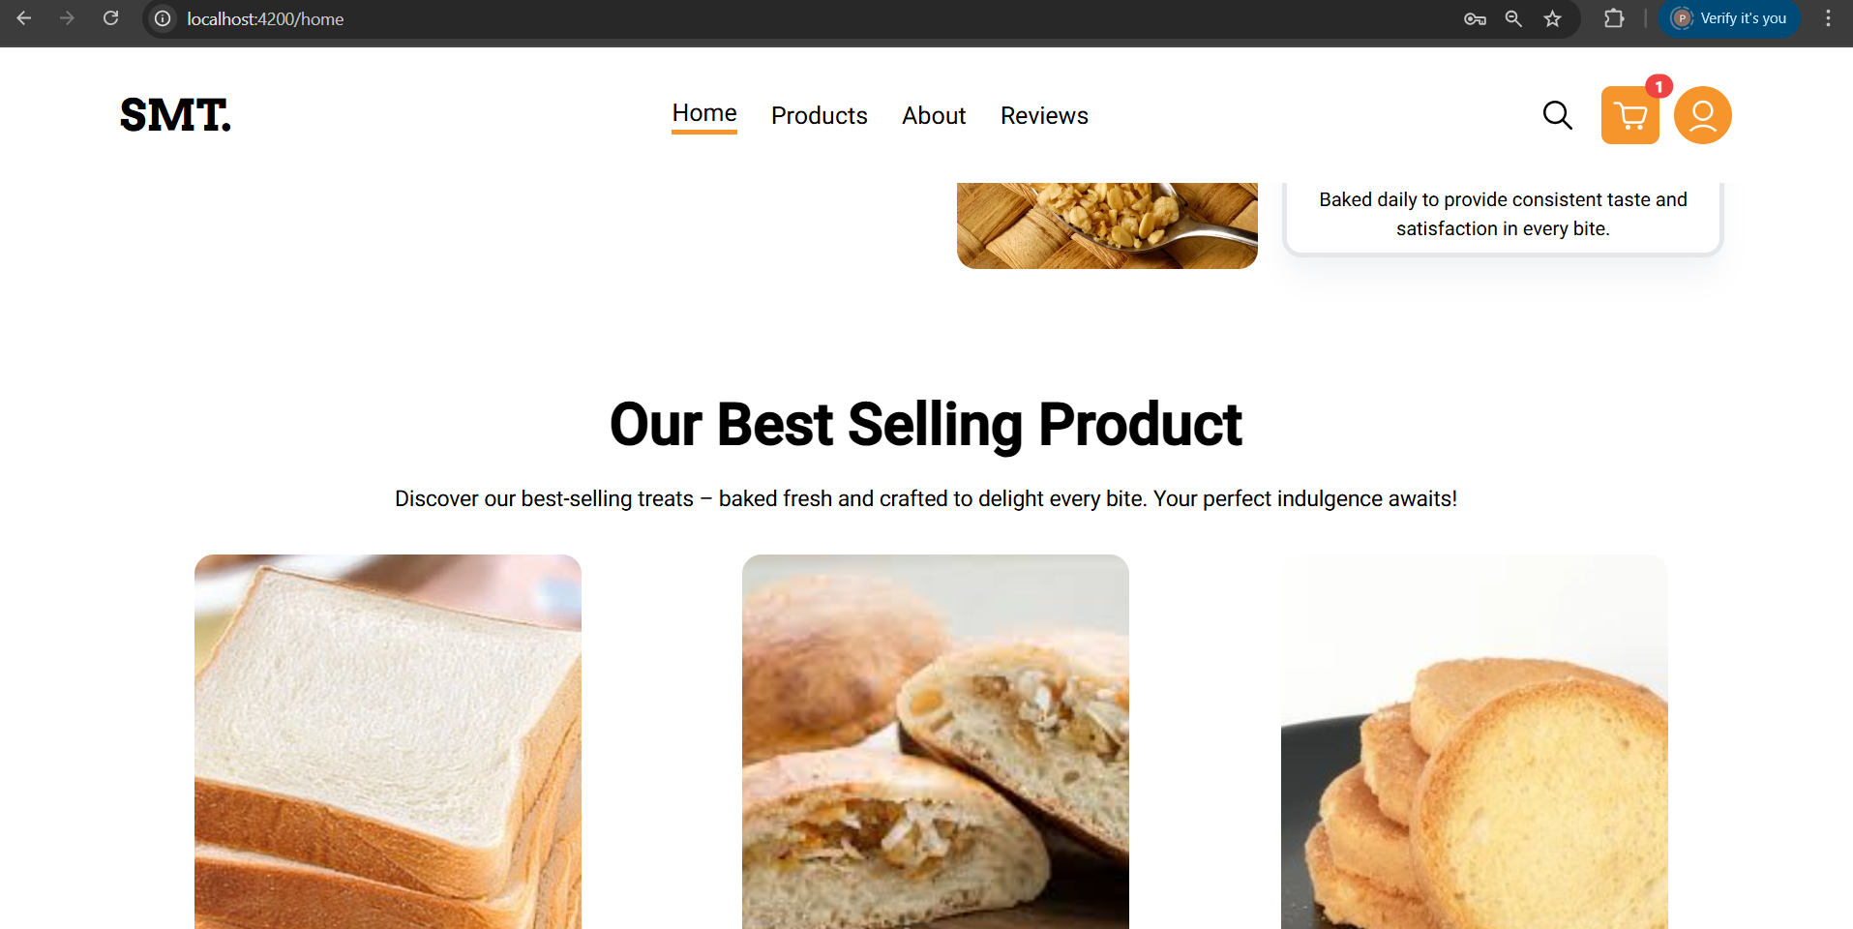
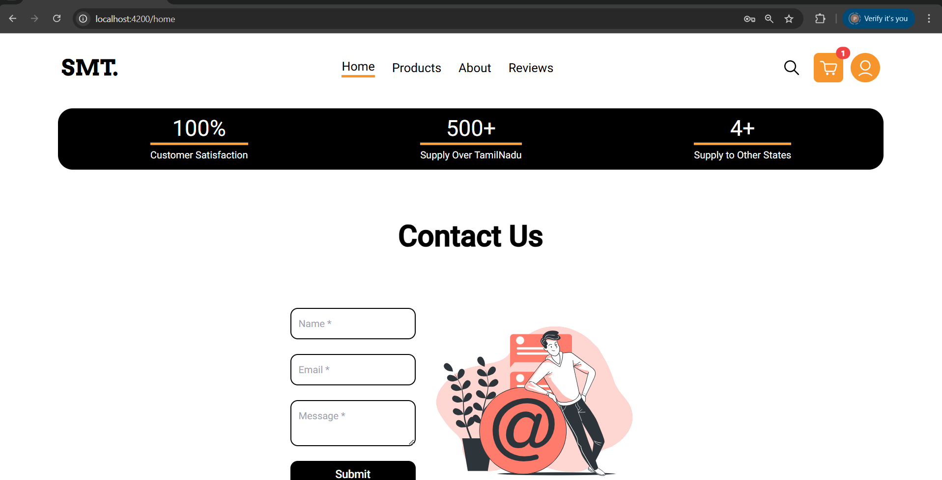
USER INTERFACE DESIGN
Home module
13-Feb-25

Slide 13
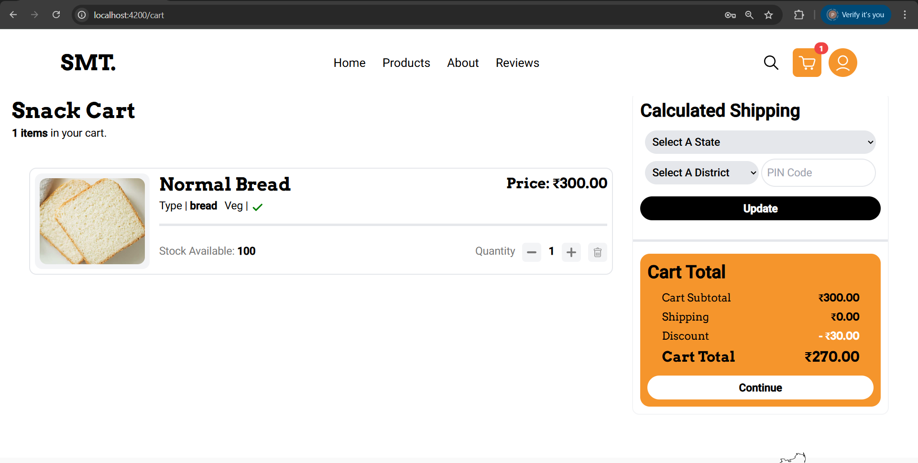
USER INTERFACE DESIGN
Cart module
13-Feb-25

Slide 14
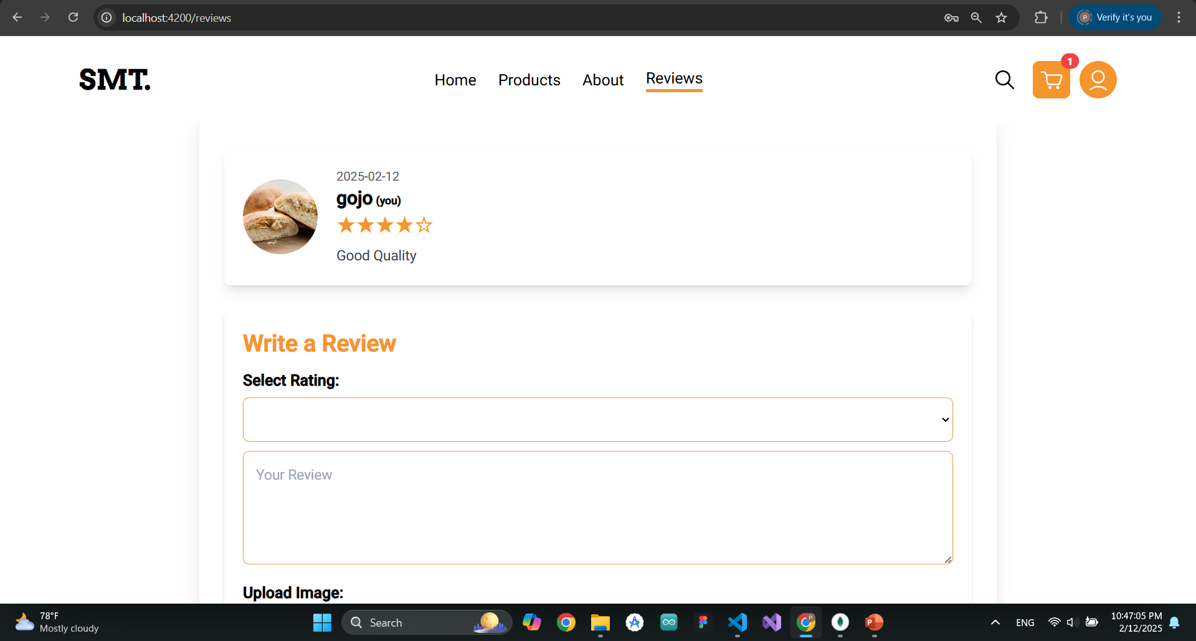
USER INTERFACE DESIGN
Review module
13-Feb-25

Slide 15
USER INTERFACE DESIGN
Product module
13-Feb-25

Slide 16
CONCLUSION
In conclusion, developing a digital platform for the bakery is both technically and economically feasible, offering significant improvements in order management, inventory tracking, and customer engagement. By automating processes and providing an online ordering system, the bakery can reduce operational costs, minimize wastage, and expand its customer base. The user-friendly system will enhance customer experience and streamline operations, positioning the bakery for long-term growth and success in the competitive market.
13-Feb-25

Slide 17
FUTURE WORK
Notification System will send push notifications and SMS alerts to update customers on their order status, including confirmations and delivery details. Customers can also choose their preferred notification method for a personalized experience.
Real-Time Order Tracking will allow customers to track their orders live from placement to delivery. It will provide real-time updates, including an estimated delivery time and a map interface to track the order's progress.
13-Feb-25

Slide 18
THANKYOU!

