Slide 1
Understanding ROC AUC
ROC AUC (Receiver Operating Characteristic - Area Under the Curve) evaluates the performance of classification models not regression models.
It measures how well a model can distinguish between classes and is suitable for both binary and multi-class classification using the One-vs-All (OvA) approach.

Slide 2
Key Concepts
True Positive Rate (TPR): How many actual positives were correctly predicted. Correctly predicted positives.
False Positive Rate (FPR): The proportion of actual negatives incorrectly classified as positives. Incorrectly predicted positives .
Area Under Curve (AUC): The total area under the ROC curve, representing the overall model performance.

Slide 3
When to Use ROC AUC
Suitable for binary classification problems.
Can be used for multi-class classification using One-vs-All (OvA).
Helpful for imbalanced data.
Evaluates model performance beyond accuracy.

Slide 4
One-vs-All (OvA) in Multi-Class Classification
Understanding One-vs-All (OvA) In a multi-class classification problem, ROC AUC can be calculated using a One-vs-All strategy.
Each class is treated as positive, and all others as negative.
The average ROC AUC across all classes gives the final evaluation score.
Example:
Class A -> Positive Class: A, Negative Classes: B, C
Class B -> Positive Class: B, Negative Classes: A, C
Class C -> Positive Class: C, Negative Classes: A, B

Slide 5
Interpretation of ROC AUC Values
ROC AUC Interpretation
0.5 - No discrimination capability (random guess).
0.6-0.7 - Poor model performance.
0.7-0.8 - Fair performance.
0.8-0.9 - Good performance.
0.9-1.0 - Excellent performance.

Slide 6
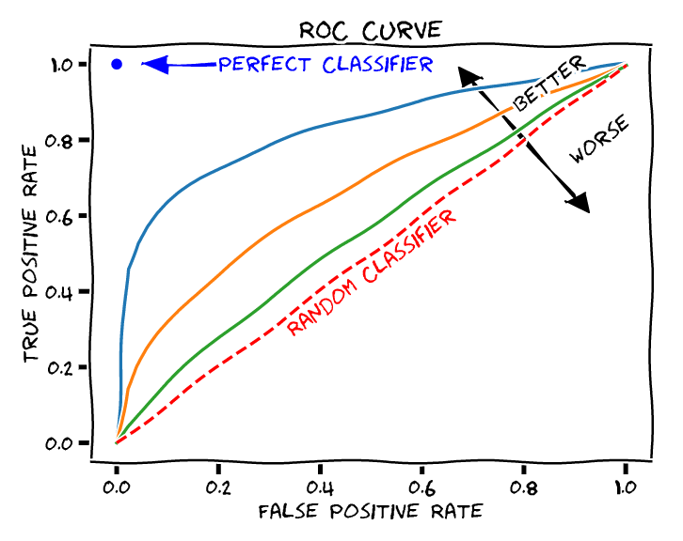
Visual Representation
Perfect Model: ROC AUC = 1.0
Random Model: ROC AUC = 0.5
Good Model: ROC AUC = 0.85

Slide 7
Example Code for ROC AUC
from sklearn.metrics import roc_auc_score, roc_curve
import matplotlib.pyplot as plt
# Assuming y_test (actual labels) and y_pred_proba (predicted probabilities)
y_pred_proba = model.predict_proba(X_test)[:, 1]
fpr, tpr, thresholds = roc_curve(y_test, y_pred_proba)
auc_score = roc_auc_score(y_test, y_pred_proba)
# Plot ROC Curve
plt.figure() plt.plot(fpr, tpr, color='blue', label=f'ROC Curve (AUC = {auc_score:.2f})’)
plt.plot([0, 1], [0, 1], color='gray', linestyle='--’)
plt.xlabel('False Positive Rate’) s
plt.ylabel('True Positive Rate’)
plt.title('Receiver Operating Characteristic (ROC) Curve’)
plt.legend()
plt.show()

