Slide 1

Fire Detection Using Cascade Classifier
by
R. Gnaneswar
Roll No. 184G1A0518
T. Jyothirmai
Roll No. 184G1A0528
C. Pavithra
Roll No. 184G1A0556
D. Ajith
Roll No. 184G1A0501
Under the guidance of
Dr. C. Sasikala M.Tech.,Ph.D
Associate Professor
Github link : https://github.com/Pavithra-Chittari/Fire_Detection_Using_Cascade_Classifier/tree/main
Department of Computer Science and Engineering
Srinivasa Ramanujan Institute of Technology
(Affiliated to JNTUA & Approved by AICTE) (Accredited by NAAC with ‘A’ Grade & Accredited by NBA (EEE, ECE & CSE)
Rotarypuram Village, B K Samudram Mandal, Ananthapuramu – 515701.
2021 - 2022

Slide 2
Abstract
During fire accidents, the fire must be detected quickly to avoid any kind of losses.The existing solution is using fire or smoke sensors for fire detection. The sensor works on basis of temperature. But the major disadvantage is that sensors are very sensitive and can easily lead to false alarms. Also, they are not quick and quite expensive.
To overcome these drawbacks we use Cascade classifier instead of those fire or smoke sensors. When a fire is detected, it rings the alarm and sends an alert notification to the fire department.

Slide 3
Contents
Introduction
Literature Survey
Existing System
Proposed System
Problem Definition
Requirements
Architecture
UML Activity Diagram
Data Flow Diagram
Implementation
Sample Code
Screenshots
Conclusion
References

Slide 4
Introduction
Fire accident is one of the major disasters. It leads to damage of infrastructure and loss of lives. To overcome these losses, detection of fire must be quick and early.
Generally, fire detection systems are based on sensors to make decision. Most of the sensors that are used are smoke detector, flame detector, heat detector.
Usage of above sensors leads to some drawbacks like false alarms, take time to respond and they are too sensitive to maintain.
So we are going to detect the fire with the help of Cascade classifier without using fire and smoke sensors.

Slide 5
Literature Survey
[Majid Bahrepour, Nirvana Meratnia, Paul Havinga- Automatic Fire Detection: A Survey From Wireless Sensor Network Perspective Pervasive Systems Group, University of Twente -1]
From this paper, we came to know that although temperature sensors are probably the simplest and the most obvious sensors for fire detection, studying various sources in this field reveals that all researchers agree on the fact that it alone cannot accurately indicate fire and gas (e.g., CO, CO2) concentrations which are main features for fire detection.
[FengjuBu ,Mohammad Samadi Gharajeh Intelligent and vision-based fire detection systems: A survey Image and Vision Computing Volume 91, November 2019, 103803 -2]
This shows that cameras combined with image processing techniques detect fire occurrences more quickly than sensors. Moreover, they provide the size, growth, and direction of fires more easily than sensors.

Slide 6
Contd...
[Vishesh Goel, Sahil Singhal, Tarun Jain, Silica Kole. Specific Color Detection in Images using RGB Modelling in MATLAB International Journal of Computer Applications March 2017-3]
This paper shows that conversion of image from RGB to Grayscale reduces the complexity while processing the images.
[Faming Gong, Chuantao Li, Wenjuan Gong, Xin Li, Xiangbing Yuan, Yuhui Ma, and Tao Song - A Real-Time Fire Detection Method from Video with Multifeature Fusion 14 Jul 2019 -4]
From this article, we came to know that motion of the fire pixels can be used as a feature to detect the fire.

Slide 7
Existing System
Existing systems use electronic sensors to detect fire. The change in temperature indicates the presence of fire.
Installation and maintenance of sensors is difficult. So the sensors cannot be more effective.
Sensors are quite expensive and they can detect fire only up to some extent.
High false alarm rate.

Slide 8
Proposed System
In proposed system, without using any fire or smoke sensors, in order to detect the fire occurrence, we use computer vision library called Opencv and cascade classifier.
To process the data collected from CCTV we use Opencv.
Cascade classifier is a machine learning based approach where a cascade function is trained from a lot of positive and negative images. It is then used to detect objects in other images.
After processing, as soon as the fire is detected, it rings the alarm and sends an alert notification to the fire department.

Slide 9
Problem Definition
A fire detection system should detect fire in various environments like forests, rural areas, industries etc in the shortest time to save lives and protect infrastructure. Nowadays almost all the fire detection systems use sensors. The accuracy, reliability and positional distributions of the sensor determine the betterment of the system.
For high precision fire detection systems, large numbers of sensors are needed in the case of outdoor applications. The cost of these sensors is quite expensive. Sensors easily lead to false alarms. They also need a frequent battery charge which is impossible in a large open space. Sensors detect fire if and only if it is close to fire. This will lead to damaging of sensor.

Slide 10
Contd…
To overcome the existing problems, we are using image processing approach. This machine learning approach for visual object detection is capable of processing images extremely rapidly and achieving high detection rates.
In the proposed system, we are using Haar Cascade classifier which is an effective way for object detection. Opencv, an open-source library is used to create HAAR Cascade classifier.
It is a machine learning based approach where a cascade function is trained from a lot of positive and negative images. It is then used to detect objects in other images.

Slide 11
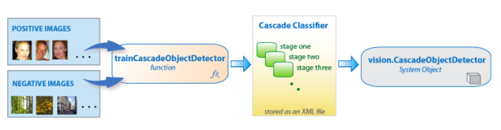
Contd...
To train the classifier, we use a dataset which consists of hundreds of fire and non-fire images imported in an xml file. This xml file is used in training the classifier making the classifier to recognize and detect fire.
With this vision based approach, fire can be detected even when the fire is not nearer. Unlike sensors, it does not require too much power to operate. This solution provides quicker results with high accuracy than sensors.
Dataset

Slide 12
Requirements
IDE – Spyder
Libraries & Modules – opencv, threading, playsound, smtplib, imghdr
Coding Language – Python
Dataset – Positive and negative images of fire imported in an xml file
Algorithm – Cascade classifier

Slide 13
Architecture
Reading video in the form of frames
Motion Analysis using Background Subtraction
Object Detection using Cascade Classifier
Reading consecutive frames
Detecting moving pixels
Image
Acquisition
Fire Detection
Fire Alert
Frame subtraction
Image
Conversion
Image
Analysis

Slide 14
UML Activity Diagram
yes no
Reading video frames
Frame subtraction
Converting frames to grayscale
and applying smoothing
Detecting movement of pixels
Searching for fire in frame
Fire Detected
Send email
Fire alert

Slide 15
Data Flow Diagram
no
yes
Converting to grayscale format
and applying smoothing
Reading video frames
Frame subtraction
Detecting moving pixels
Searching for fire
Fire detected?
Send Email notification and alert

Slide 16
Implementation
Providing Dataset:
By using CascadeClassifier from OpenCV we are going to access dataset.
fire_cascade = cv2.CascadeClassifier(‘dataset_file')
The method CascadeClassifier follows Ada Boost algorithm to learn from the dataset.
It determines false positives and true negatives in dataset.
AdaBoost:
AdaBoost is also called the Adaptive Boosting algorithm. It combines multiple classifiers to increase the accuracy of classifiers.
It is an iterative ensemble method.
AdaBoost classifier builds a strong classifier by combining multiple poorly performing classifiers so that you will get high accuracy strong classifier.
The basic concept behind Adaboost is to set the weights of classifiers and train the data sample in each iteration such that it ensures the accurate predictions of unusual observations.

Slide 17
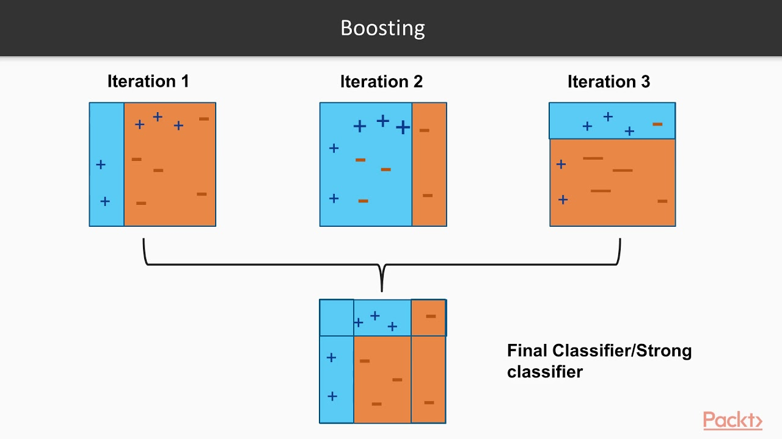
Contd...
Read the Live Video:
By importing cv2 library , we are going to create a video capture object, which would help stream the video.
Create a variable which stores the object
# live_Camera = cv2.VideoCapture(0)
The function takes argument 0 or 1 depending upon whether you are using primary camera or external camera.
i.e., 0 - primary camera
1 – external camera

Slide 18
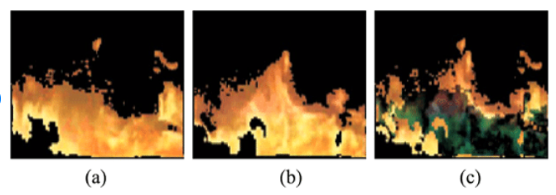
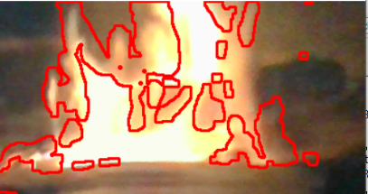
Contd...
Motion Detection:
Motion detection is done using “Background Subtraction”.
The function that OpenCV provides for this purpose is absdiff.
destination_image = cv2.absdiff(image1, image2)
It helps in finding the absolute difference between the pixels
of the two images. By using this we will be able to extract just the
pixels of the objects that are moving.
After obtaining the pixels that have movement, we need to binarize the image.
If the pixel value is smaller than the threshold, it is set to 0, otherwise it is set
to a maximum value(255).
Now, the region which has movement is identified by drawing the contours
over the region where there are maximum valued pixels.

Slide 19
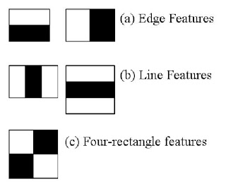
Contd..
Conversion to Grayscale:
In-order to make the image processing faster, we are going to read each and every frame and convert color frame into gray color.
We use OpenCV’s cvtColor() method to convert color frame into grayscale.
cv2.cvtColor(frame, color_code)
This method follows “Weighted Average” algorithm to convert frame into grayscale.
Formula : Y= 0.299*R+0.587*G+0.114*B
Object Detection:
The object we are detecting here is fire.
Here in fire detection, we are using the Haar Cascade classifier.
The algorithm outlines a box and searches for the fire in the image,
mainly, the box is searching for Haar-like features.

Slide 20
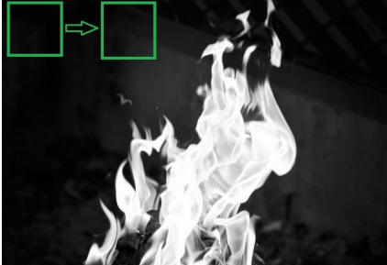
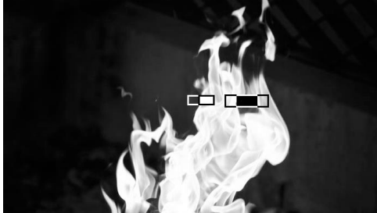
Contd...
To detect haar like features, we use an inbuilt function called detectMultiScale() and parameters like scale factor and min neighbor s are passed.
detectMultiScale(frame, scale _factor, min_ neighbors)
The scale_factor will allow rescaling the size of an input frame to detect the fire of any size.
The min_neighbors parameter directly affects the quality of detected fire.
If the fire is identified in the same region atleast min_neighbor number of times then that region is said to be contained fire.

Slide 21
Contd...
Sending Email:
To send an email to fire department, we here use smtplib python library .Simple Mail Transfer Protocol (SMTP) is a protocol, which handles sending e-mail and routing e-mail between mail servers.
It defines an SMTP client session object that can be used to send mail to any internet machine with an SMTP or ESMTP listener daemon.
We create a recipient mail variable . There we are going to add receiver email .
#recipient_mail=“firedept@gmail.com”
By using server , we will send a mail to receiver mail address
#sender_mail=“xyz@gmail.com”
Playing Fire Alarm:
To send a alert sound we here use playsound python library. These module contains only a single function named playsound().
It requires one argument - the path to the file with the sound you’d like to play. This may be a local file, or a URL.
#playsound.playsound('fire_alarm.mp3',True)

Slide 22
Contd...
Capturing Photo:
We take a snap of the scene and send it as a proof by attaching the photo to the mail.
For this we use imghdr module.
ret,frame = vid.read()
cv2.imwrite("NewPicture.jpg",frame)

Slide 23
Sample Code
import cv2
live_Camera =cv2.VideoCapture(0)
fire_cascade = cv2.CascadeClassifier(‘dataset_file')
def play_alarm_sound_function():
playsound.playsound('fire_alarm.mp3',True
print("Fire alarm end")
def send_mail_function():
with smtplib.SMTP_SSL('smtp.gmail.com', 465) as smtp:
smtp.login(Sender_Email, Password)
smtp.send_message(newMessage)
print('mail sent')

Slide 24
Contd...
while(True):
ret, frame = vid.read()
ret, frame1 = vid.read()
difference = cv2.absdiff(frame, frame1)
gray = cv2.cvtColor(difference, cv2.COLOR_BGR2GRAY)
blur = cv2.GaussianBlur(gray, (5,5), 0)
_, threshold = cv2.threshold(blur, 20, 255, cv2.THRESH_BINARY)
dilate = cv2.dilate(threshold, None, iterations=3)
contour, _ = cv2.findContours(dilate, cv2.RETR_TREE, cv2.CHAIN_APPROX_SIMPLE)
cv2.drawContours(frame, contour, -1, (0, 0, 255), 2)
gray = cv2.cvtColor(frame, cv2.COLOR_BGR2GRAY)
fire = fire_cascade.detectMultiScale(frame, 1.2, 5)

Slide 25

Screenshots
Starts capturing the live video.

Slide 26
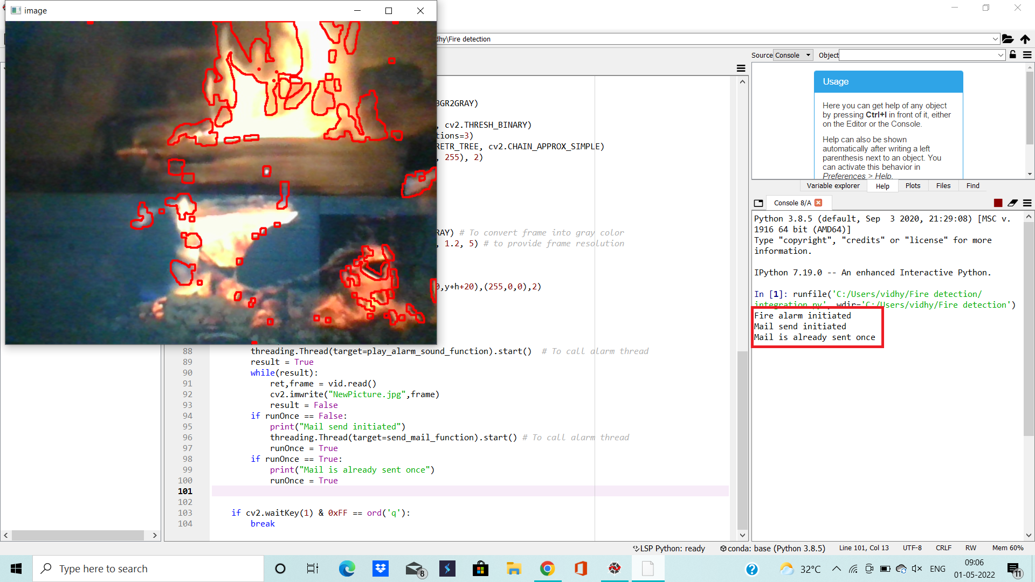
Contd...
When it identifies fire, it initiates the fire alarm, captures the photo of fire and initiates the mail sending process.

Slide 27

Contd...
Mail is sent by mentioning the address and snap of the location.

Slide 28
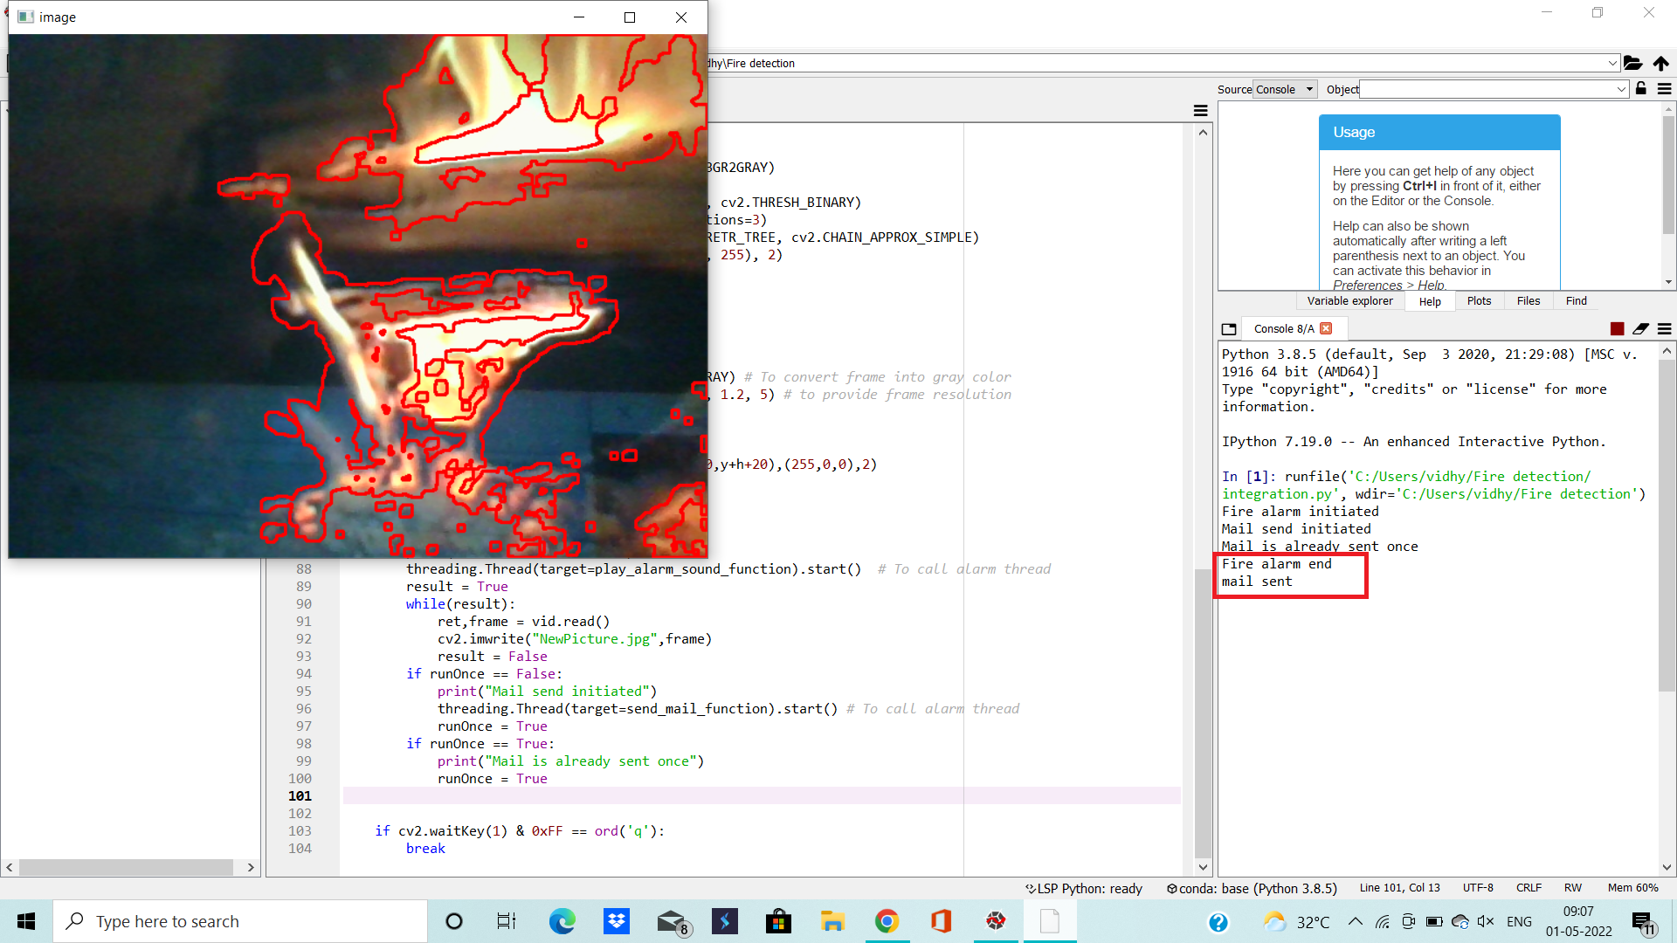
Contd...
Mail is sent successfully and fire alarm ends.

Slide 29
Conclusion
Image and video based systems can be an alternative to particle sensors for fire detection. Proposed fire detection system is based on computer vision based technique. The system was made to detect fires while they are still small and have not grown too large. The system also has reasonable response time which is another objective. The detection time needed is much faster than an average conventional fire detector. The system uses a low cost camera to capture images in order to determine whether fire exists in the video caught by the camera.
Another boon of the system is the range. As the fire detection algorithm works on the entire screen of the video, the range of fire detection depends on the range of which the camera can capture. It is especially useful in large open areas, such as a field, where sensor based detectors would have difficulty, because of the fire growing large before reaching the sensors.

Slide 30
References
[1]. R Raja John Naveen, R Santhosh, M Vallarasu, S Jayanthi- “Home Fire Detection using Image Processing” IJSDR | Volume 6, Issue 3 ISSN: 2455-2631 March 2021
[2]. Trinath Basu Mariyala, Ragipati Karthik, J Mahita, V Lokesh Reddy- “IOT based forest fire detection system” March 2018 International Journal of Engineering & Technology 7(2-7):124
[3]. F Anwar, R I Boby, M M Rashid, M M Alam and Z Shaikh- “Network-Based Real-time Integrated Fire Detection and Alarm (FDA) System with Building Automation” 2017 IOP Conf. Ser.: Mater. Sci. Eng. 260 012025
[4]. Bibek Shrestha- “Fire Detection Using Image Processing’’ Feb 2020 Metropolia University

Slide 31
Github link
https://github.com/Pavithra-Chittari/Fire_Detection_Using_Cascade_Classifier

Slide 32
Thank You!!!

