Slide 1
EMOTION-BASED MOVIE RECOMMENDATION SYSTEM BY TEAM 23

Slide 2
Problem Statement
Users spend a lot of time searching for movies matching their mood.
Existing recommendation systems mainly depend on search history and ratings.
They do not understand the real-time emotions of users.
This project detects facial emotions using a webcam.
Based on detected emotion and language preference, suitable movies are recommended.
The system also provides trailers, ratings, and OTT platform details for a better user experience.

Slide 3
Objectives
To develop a web application for emotion-based movie recommendation.
To detect user emotions using facial expressions.
To recommend movies according to mood and language selection.
To provide trailers, ratings, and OTT platform information.
To create an interactive Netflix-style user interface.
To combine AI, Computer Vision, and Web Technologies in one system.

Slide 4
Feasibility
Technical Feasibility
Uses OpenCV, Deep Face, Flask, HTML, CSS, and JavaScript.
Supports real-time emotion detection and movie recommendation.
Economic Feasibility
Uses open-source tools and free APIs.
Requires only a webcam and internet connection.
Operational Feasibility
Easy to use and user-friendly interface.
Fast and interactive recommendation process.

Slide 5
Tools and Technologies
Frontend
HTML — Structure of web pages
CSS — Netflix-style UI design
JavaScript — Webcam capture and dynamic content
Backend
Python — Core programming language
Flask — Backend server and routing
AI & Computer Vision
Deep Face — Facial emotion detection
OpenCV — Webcam and image processing
APIs Used
TMDB API — Movie details, trailers, ratings, OTT platforms
YouTube — Trailer playback
Development Tools
VS Code — Code editor
Libraries: Flask, OpenCV, DeepFace, NumPy, Requests
System Flow
Camera → Emotion Detection → Movie Recommendation → Trailer & OTT Display

Slide 6
Relevance of Project
Provides personalized movie recommendations based on emotions.
Improves user entertainment experience.
Combines AI, Computer Vision, and Web Development.
Useful in modern OTT and streaming applications.
Demonstrates real-world application of Artificial Intelligence.
Can be extended for music or content recommendation systems.

Slide 7
Design
Frontend designed using HTML, CSS, and JavaScript.
Backend developed using Flask in Python.
Webcam captures user facial expressions.
Deep Face detects emotions from captured frames.
TMDB APIs fetch movie details, trailers, and OTT platforms.
Results displayed in Netflix-style poster format.

Slide 8
Implementation and demo
User opens the web application.
Webcam captures facial expressions.
User selects preferred language.
DeepFace analyzes emotions using captured frames.
Emotion is mapped to movie genres.
TMDB APIs fetch recommended movies.
Posters, trailers, ratings, and OTT platforms are displayed.

Slide 9
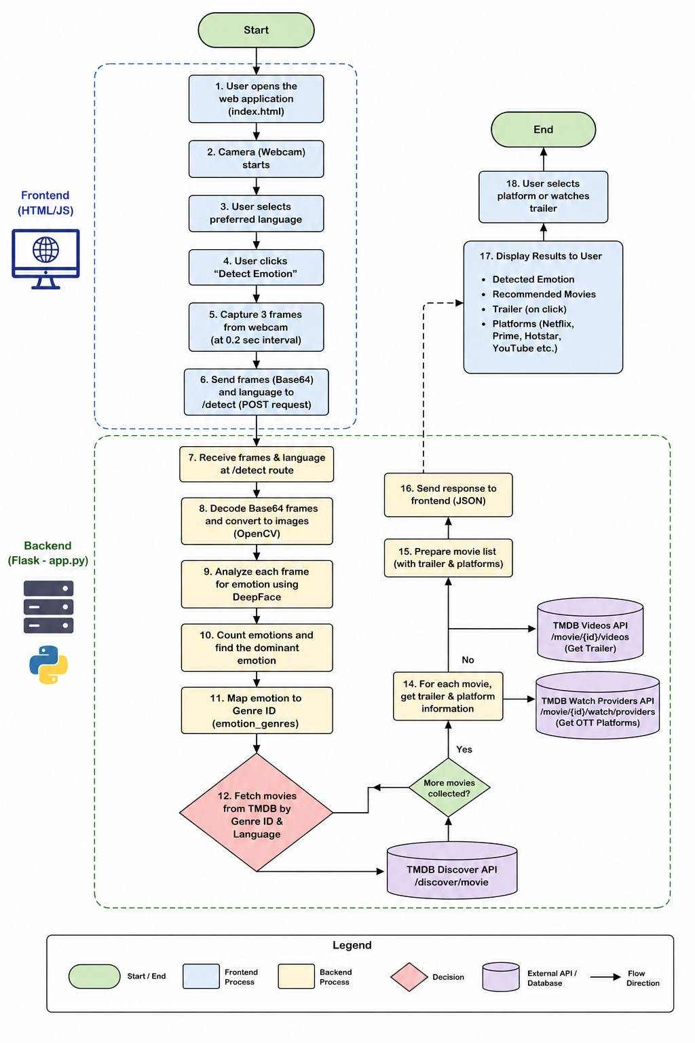

Slide 10
Contribution
Developed a real-time emotion-based recommendation system.
Integrated AI with web application development.
Provided personalized movie recommendations.
Added multi-language support.
Included trailer and OTT platform integration.
Improved user interaction with modern UI design

Slide 11
Learning and Challenges
Learning Outcomes
Learned Flask web development.
Understood API integration and JSON handling.
Worked with OpenCV and Deep Face.
Improved frontend and backend integration skills.
Gained knowledge in AI and recommendation systems.
Challenges Faced
Handling real-time webcam processing.
Improving emotion detection accuracy.
Managing frontend-backend communication.
Integrating multiple APIs together.
Designing a responsive user interface.

Slide 12
Involvement in Project Work & Teamwork
Involvement in Project Work
Contributed to project planning, design, and implementation.
Participated in frontend and backend development tasks.
Worked on emotion detection and movie recommendation features.
Assisted in API integration and UI design.
Teamwork
Collaborated effectively with team members during development.
Shared responsibilities for coding, testing, and debugging.
Coordinated ideas and improvements for better project performance.
Maintained good communication and teamwork throughout the project.

Slide 13
Thank you!!!!

