Slide 1

Customer Service Requests Analysis in New York City
It would be great, if someone is helping us with prioritizing the customer requests?
GitHub Link: https://github.com/Pavithra-Shankarbabu/PavithraShankarbabuDistributed-ScalableEngineeringProject

Slide 2




Our Team :
Dinesh Reddy
Data Analyst
Shaagun
Data Engineer
Ramya Krishna Chava
Data Visualization
Pavithra Shankar Babu
Team Leader
(Data Scientist)

Slide 3

The Business question :
How can NYC optimize its services to improve response times and efficiency in addressing various types of complaints across different locations?
What are the major trends in service requests over time? Are there any seasonal patterns or recurring spikes in specific types of complaints?

Slide 4
Project Plan :
Data
Collection
Model
Deployment
Data Understanding & preparation
Model
Evaluation
Data
Modeling

Slide 5
Key Objectives:
Analyze NYC 311 service request data to identify trends and patterns, enabling better service delivery.
Extract insights, visualize data, and perform the complaint type analysis.
Finally, propose operational improvements based on analysis findings to enhance customer satisfaction and service efficiency.

Slide 6
Data Understanding & Preparation :
About Dataset :
Public dataset of customer service request complaints (Around 300k complaints from 2010 - 2016) is taken from Kaggle.
The features include unique complaint ID, complaint type, resolution description, resolution action, latitudes & longitudes etc.
Data Preprocessing :
We are planning to perform preprocessing in the dataset by first of all feeding the dataset in an Amazon S3 bucket which is in unstructured manner in Json format,
Dropping out unnecessary features in the dataset, removing duplicates in all features.
Filling out null values with mean for numerical columns and dropping out wherever it’s required.
Converting the column types into apt format. For example, date to datetime.
Amazon Glue Data Brew is used to do all data preprocessing and after that, proper data format suitable for the model is again fed into Amazon S3 bucket.

Slide 7
Data Modeling & Deployment :
Data Modeling :
The models developed for analyzing customer service requests are deployed using Amazon Athena for executing SQL queries and statistical functions.
Results are made accessible through user-friendly interfaces, including web-based dashboards and custom applications developed using AWS services.
Deployment :
The visualization is done using Tableau for deploying dashboards. The below figure is a representation of final output in Tableau.

Slide 8
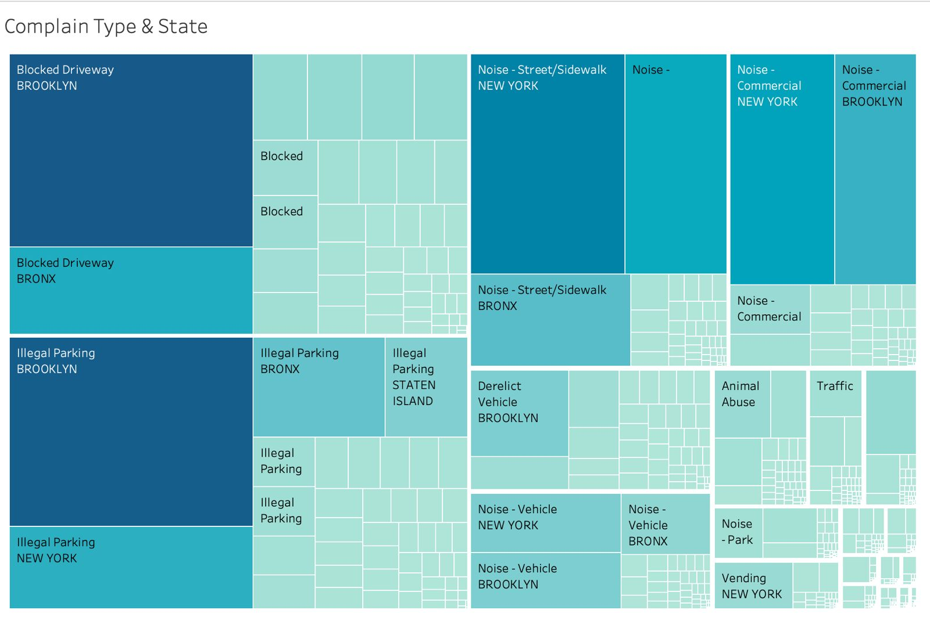

Slide 9
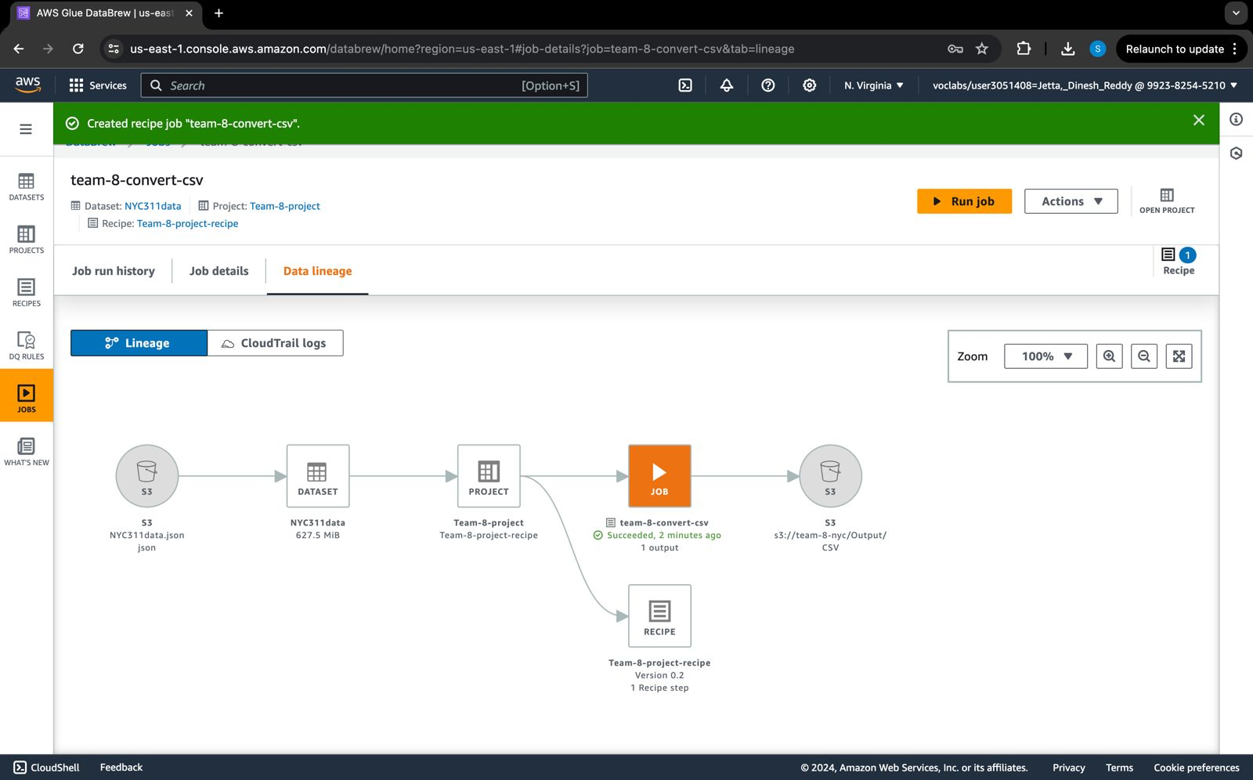
Results:

Slide 10
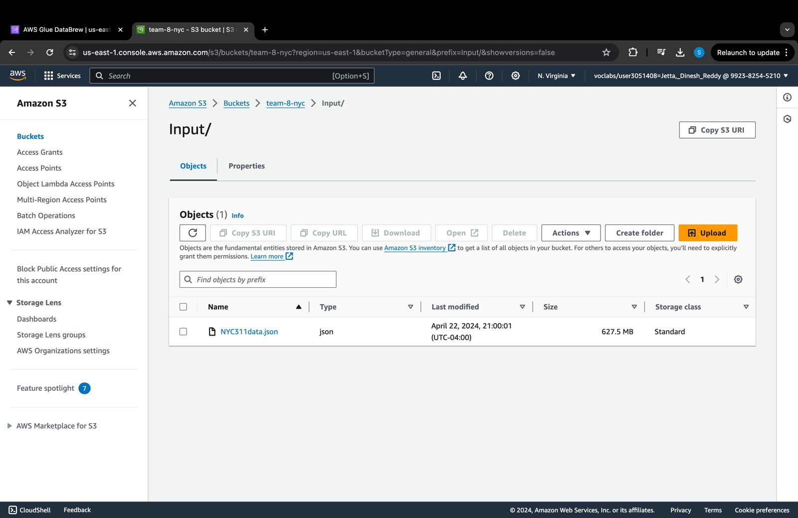

Slide 11
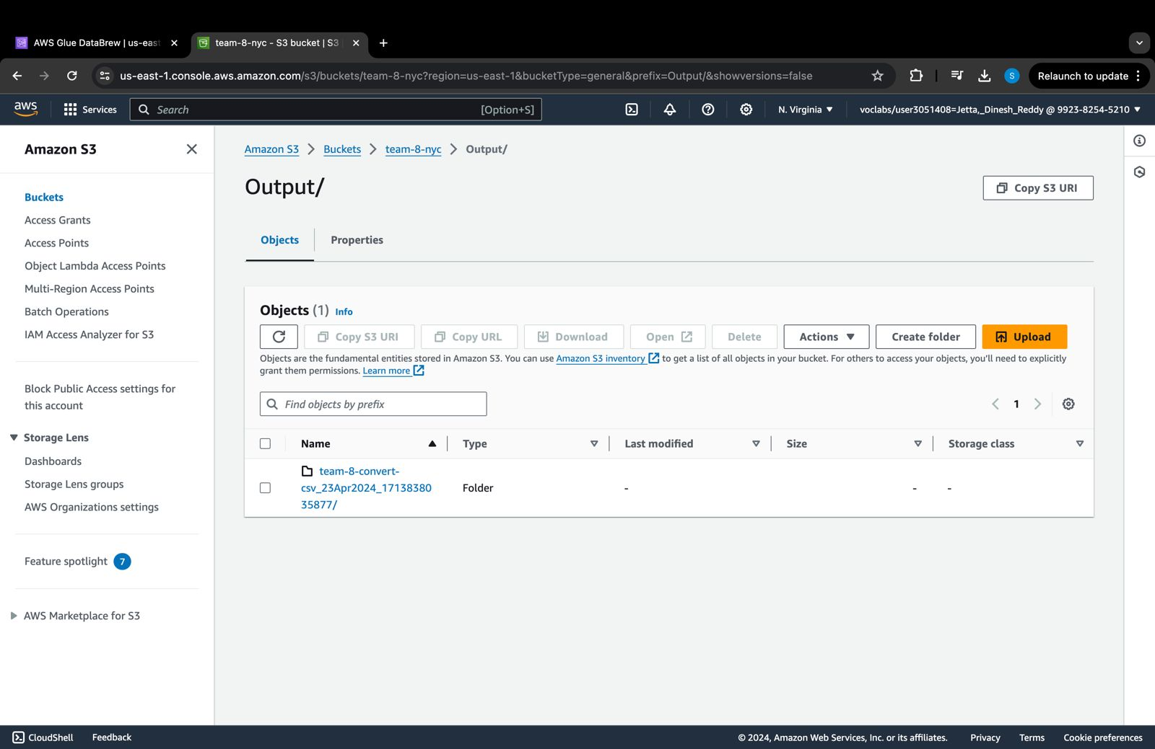

Slide 12
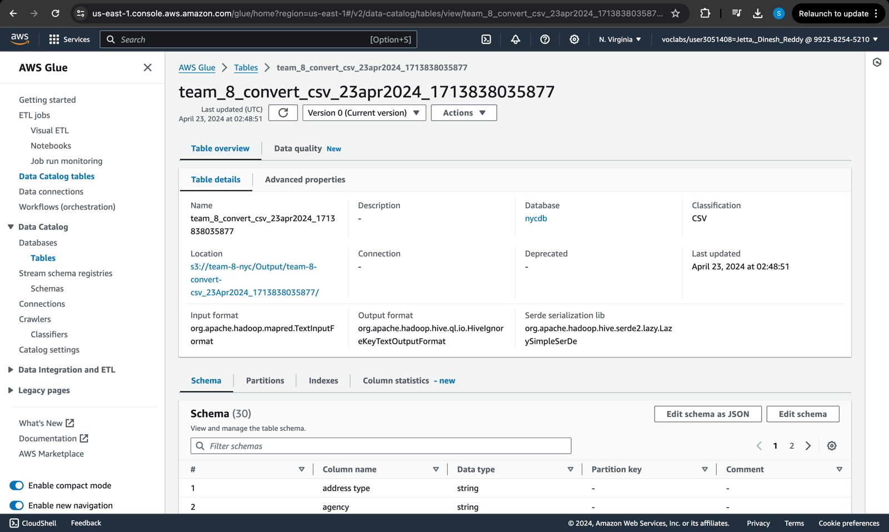

Slide 13
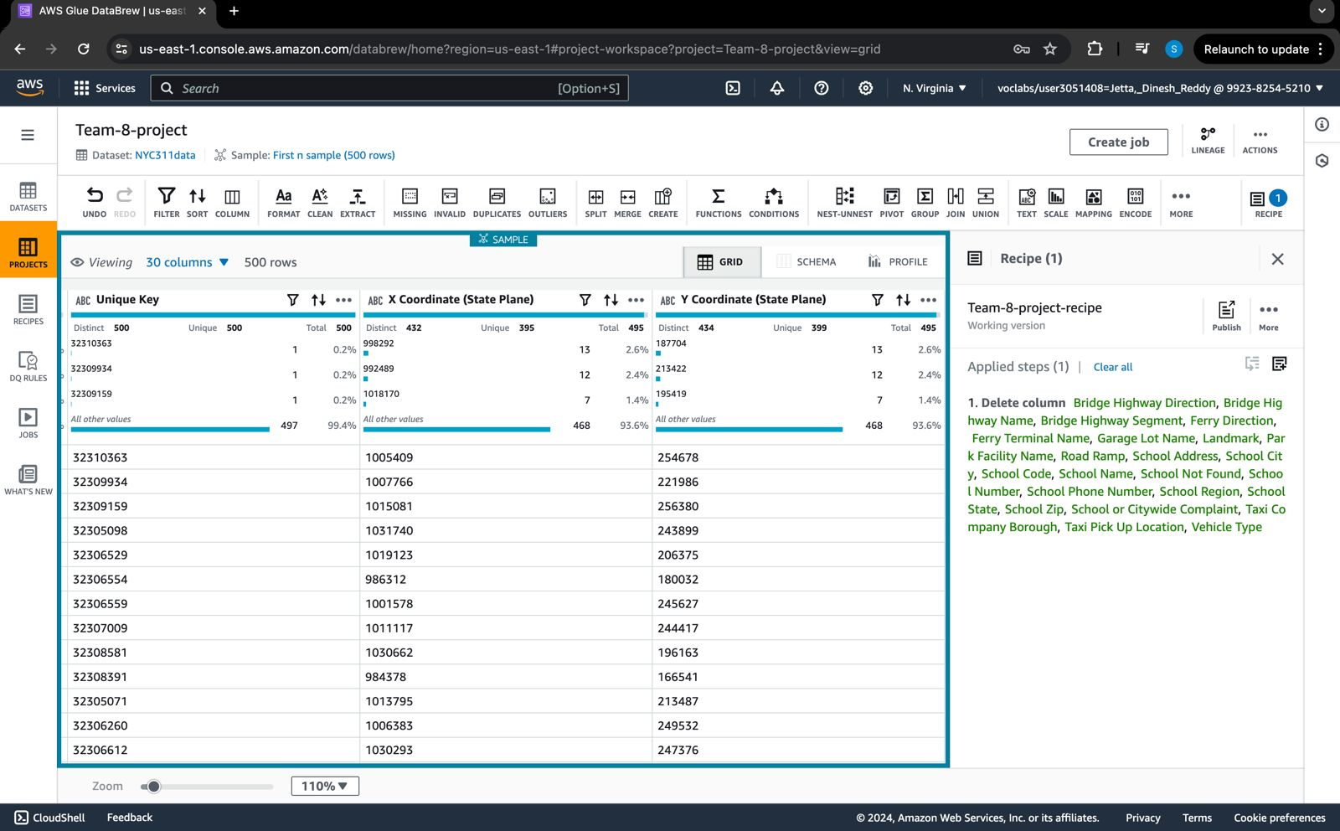

Slide 14
THANK YOU!

