Slide 1
PAVITHRA SHANKAR BABU
KEERTHI SAI KASARANENI

Slide 2

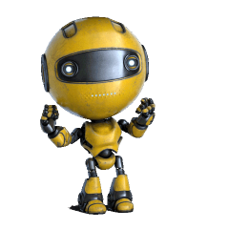
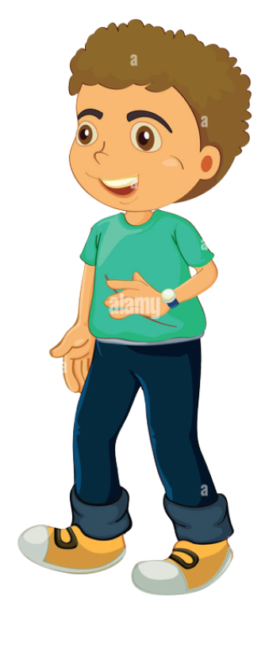

I’ll never let you win!!!
IMPLEMENTATION OF TIC-TAC-TOE BETWEEN A PLAYER
& AI

Slide 3
OBJECTIVE:
The objective of the tic-tac-toe game implemented between a player and an AI agent is to take turns marking X and O in a 3x3 grid without allowing the opponent to take three of their marks in a row (up, down, across & diagonally).
We will develop a heuristic through Minimax algorithm to determine the best move for AI player and make the game more interesting for the real time player.

Slide 4
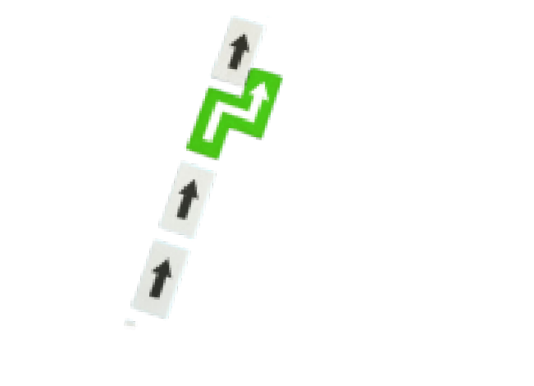
APPRO ACH:
The code which we will develop is a console-based Tic Tac Toe game in Python and Visual Studio will be the IDE. It defines Player and Game classes. Players can be human or AI, and the AI uses the Minimax algorithm to make optimal moves.
The Minimax algorithm is a recursive decision-making approach where the AI player evaluates and assigns scores to potential moves, maximizing its chance of winning and minimizing the opponent’s chance.
Command-line arguments determine player types and AI difficulty levels. The game alternates turns, updating the board and checking for a winner or tie after each move.

Slide 5
DELIVERABLES:
A Python script implementing the Tic Tac Toe game logic, including Player and Game classes, move validation, AI decision-making with Minimax algorithm and overall game flow.
A command-line interface for user interaction, allowing players to specify the opponent type and the AI difficulty level (easy, medium and hard).
Objective Verification:
Sample outputs or screenshots demonstrating the execution of the code, showcasing interactions between players, AI moves, and game outcomes.

Slide 6
EVALUATION METHODOLOGY:
We will be developing a python file (test_Game.py & test_player.py) and it is a set of unit tests designed to evaluate the correctness of the game class methods in the Tic Tac Toe implementation.
The unit tests cover various aspects of the game logic like Winning conditions, Moves Validation, Game Logic, Attribute Initialization ensuring that the methods behave as expected.
THANK YOU!

