Slide 1
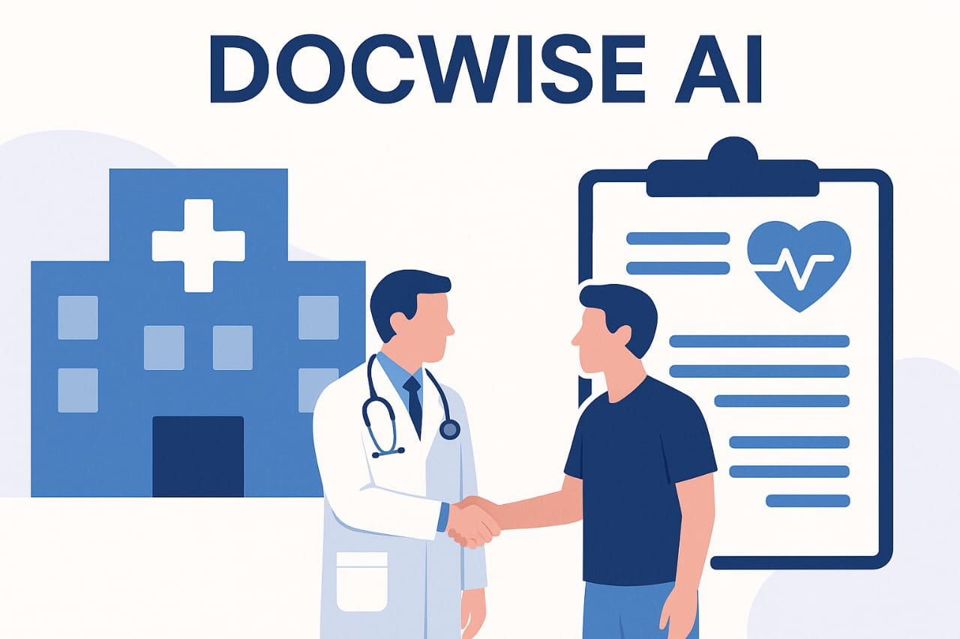
DOCWISE AI-A SMART MEDICAL HISTORY ANALYZER & DOCTOR RECOMMENDATION SYSTEM
Team Members:
K.Pavithra (2023PECCS306)
S.Pooja (2023PECCS315)
Department: Computer Science and Engineering
Coordinator Name: Mr.C.Elangovan,Mr.U.Ravindran
Domain:Machine Learning
Date:24-09-2025

Slide 2

CASE STUDY & BASE PAPER
Base Paper: AI-Driven Disease Prediction and Doctor Recommendation System. Published:2025 3rd International Conference on Advancement in Computation & Computer Technologies (InCACCT)
Key Learnings and Gaps Identified
We learned that AI can effectively match disease types with appropriate specialists to improve care access. However, the gap lies in automated analysis of real medical reports and integration of verified doctor reviews, which our project aims to address.

Slide 3
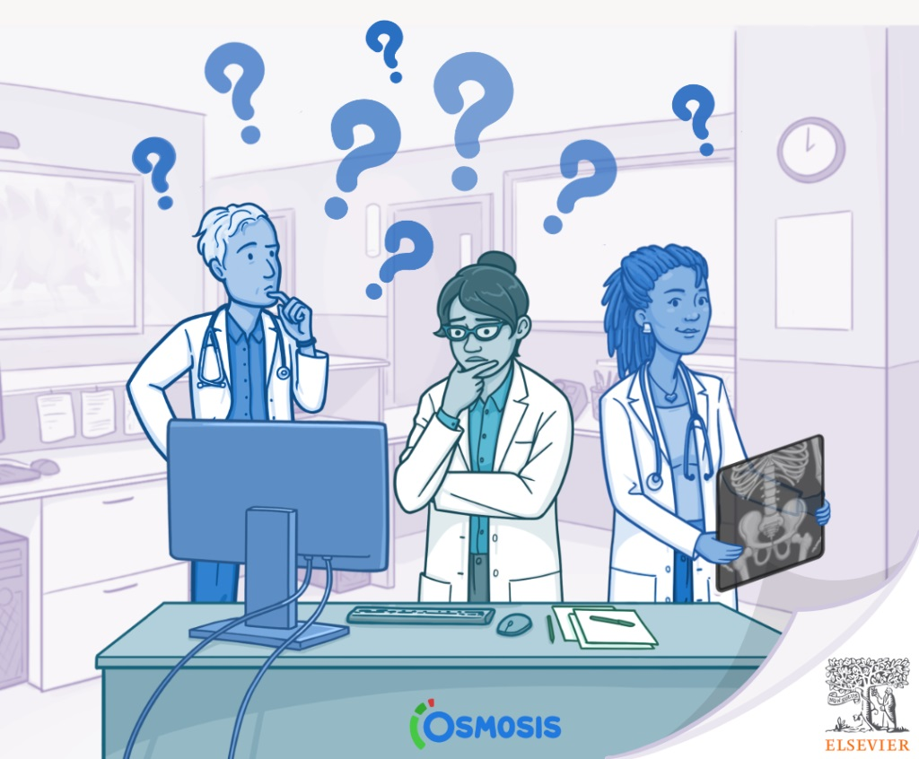
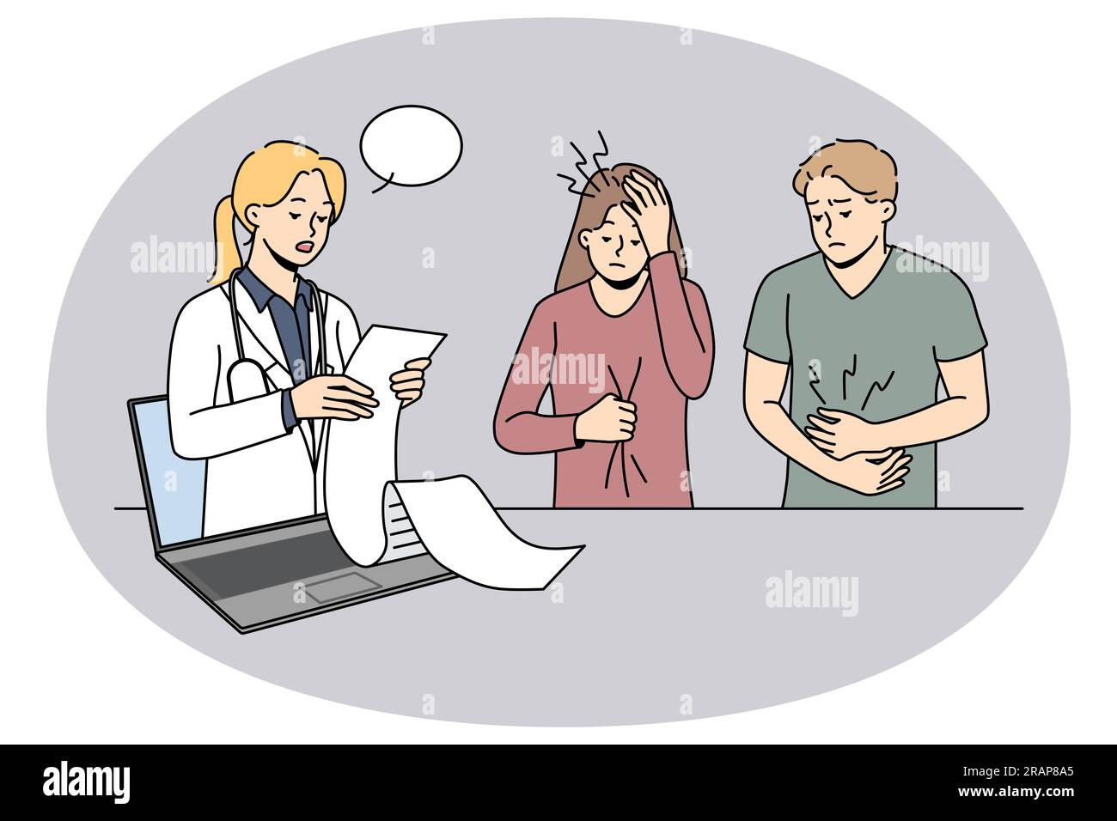
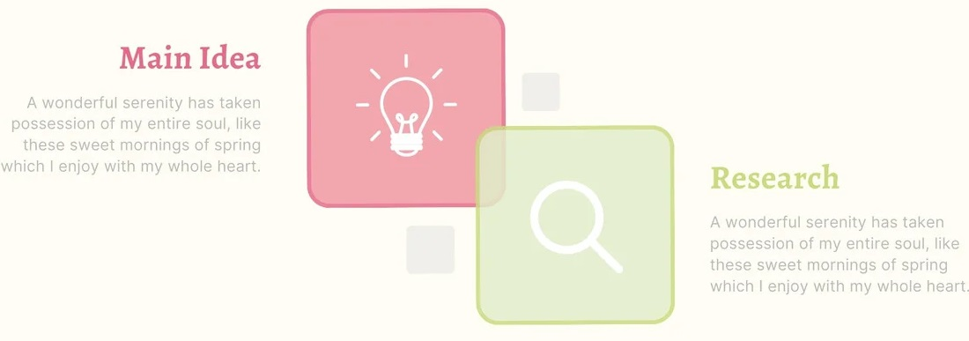
ABSTRACT
Problem Statement:
Many patients face misdiagnosis or delayed treatment due to lack of access to their complete medical history. Additionally, patients struggle to find trustworthy doctors due to unreliable or scattered recommendation sources.
Supporting Data:
Studies show that medical errors affect over 12 million outpatients annually, largely due to incomplete history. Over 70% of patients rely on online reviews, yet only 30% trust them fully, showing the need for verified doctor recommendation systems.
Affected Users:
Patients seeking accurate diagnosis and reliable medical consultation face the highest risk. Doctors and healthcare providers lack a streamlined tool to assess historical records efficiently during consultations.

Slide 4
SDG GOALS:
SDG 3 :Good Health and Well-being
SDG 9 : Industry, Innovation, and Infrastructure
SDG 16 : Peace, Justice and Strong Institutions

Slide 5
INTRODUCTION
In healthcare, incomplete patient history and difficulty in finding reliable doctors are major challenges.
Lack of consolidated medical data leads to delays, repeated tests, and misdiagnosis.
Patients often rely on scattered or unverified online reviews to choose doctors.
AI and ML have been applied to disease prediction and recommendation systems, but most focus on single diseases or structured data only.
DocWise AI addresses these gaps by:
Reading and analyzing both scanned and digital medical reports.
Summarizing patient history for doctors.
Predicting diseases with risk levels.
Recommending verified specialists based on expertise, location, and availability.

Slide 6
SOFTWARE SPECIFICATIONS
Operating System: Windows11
Programming Language: Python 3.9+
Libraries / Frameworks: Scikit-learn, TensorFlow, PyTorch, Pandas, NumPy, NLTK, SpaCy,
Hugging Face Transformers, Matplotlib, Seaborn, Flask, Django, Streamlit, PyPDF2, pdfplumber, pytesseract
IDE / Tools: VS Code, PyCharm, Jupyter Notebook, Git, GitHub

Slide 7
PROPOSED SYSETM
Description:
The proposed system is an AI-driven Doctor Recommendation platform that suggests the most suitable specialist for a patient based on symptoms, predicted disease, and personal medical history. Unlike generic search engines (like Google) that only give broad suggestions, this system uses intelligent algorithms and personalized mapping to connect the patient directly with the right doctor.
It integrates:
SMOTE – to balance the training dataset for better model performance.
Rule-Based Mapping – to match each disease with its correct specialist.
Content-Based Filtering – to recommend doctors based on expertise and patient needs.
Collaborative Filtering – to refine suggestions using feedback from similar patients.

Slide 8
MODULE
A module in a software project is a self-contained unit or component that performs a specific task in the application. Each module works like a building block and may interact with other modules to complete the overall functionality.
MODULES IN DOCWISE AI:
PDF Reporter Reader
Disease Symptom/Disease Matcher
Report Summarizer
Suggested Action Generator
Disease-to-Doctor Mapper
Doctor Profile Database
Matching & Filtering Engine
Recommendation Engine

Slide 9
1.PDF Report Reader:
Extracts text, tables, and medical entities from medical PDF files, including scanned and digital formats.
FUNCTIONS:
Reads both scanned and digital PDFs using OCR and text extraction.
Identifies and separates medical sections like vitals, tests, observations.
Converts structured/unstructured data into analyzable text.

Slide 10
2.Disease Symptom/Disease Matcher:
Matches extracted symptoms/test results to possible diseases using a knowledge base and NLP models.
FUNCTIONS:
Identifies symptoms, diagnosis terms, and test abnormalities.
Maps to possible diseases using ontology (SNOMED/ICD).
Uses semantic similarity and rule-based matching for accuracy.
Sends suspected diseases to the prediction engine.

Slide 11
3.Report Summarizer:
Converts extracted and analyzed content into a doctor-friendly summary of patient history and current findings.
FUNCTIONS:
Creates a natural language summary (with AI/NLP).
Highlights key concerns, trends, and abnormal findings.
Mentions previously diagnosed conditions and medications.
Structures it for easy readability in a PDF or web UI.

Slide 12
4.Suggested Action Generator:
Provides AI-based recommendations for further tests, procedures, or specialist visits.
FUNCTIONS:
Checks predicted diseases and suggests standard next steps (based on guidelines).
Cross-checks with patient history to avoid repetition.
Advises specialist type or diagnostic test to confirm.
Flags critical conditions for urgent intervention.

Slide 13
5.Disease-to-Doctor Mapper:
Maps predicted diseases to the appropriate type of medical specialist.
FUNCTIONS:
Converts the output of disease prediction into relevant doctor categories (e.g., Cardiologist, Dermatologist).
Stores predefined disease-specialist mappings in a dictionary or table.
Allows updating or adding new disease-specialist pairs.
Logs the disease-specialist mapping history for audit purposes.

Slide 14
6.Doctor Profile Database:
Stores details of doctors including their name, specialization, location, availability, and ratings.
FUNCTIONS:
Supplies doctor data for filtering and recommendation
Allows admin or hospital staff to update doctor profiles.
Supports search/filter based on location, consultation type (online/offline), etc.
Can integrate with APIs to fetch real-time doctor availability.

Slide 15
7.Matching & Filtering Engine:
Filters and selects doctors based on specialization, location, and other patient preferences
FUNCTIONS:
Matches patient needs with available doctor profiles.
Filters based on criteria like distance, consultation mode, language spoken, and patient gender preference.
Supports ranking based on doctor experience or patient ratings.

Slide 16
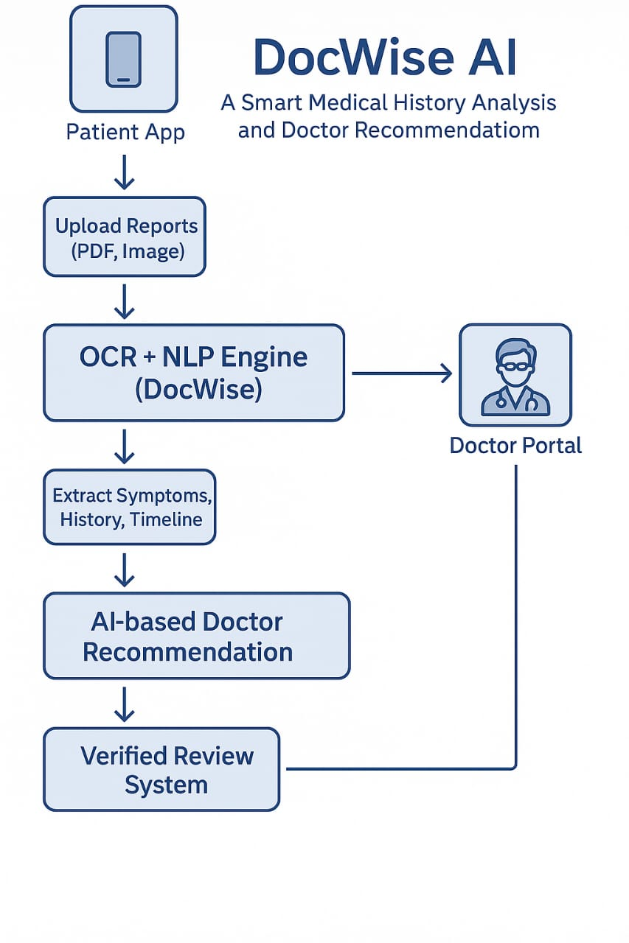
ARCHITECTURE
React Frontend → FastAPI/Flask Backend → NLP Model for Medical Report Analysis → Database + Email Service + Map APIThe architecture supports seamless user interaction, medical data processing, secure storage, doctor recommendation, and email notifications

Slide 17
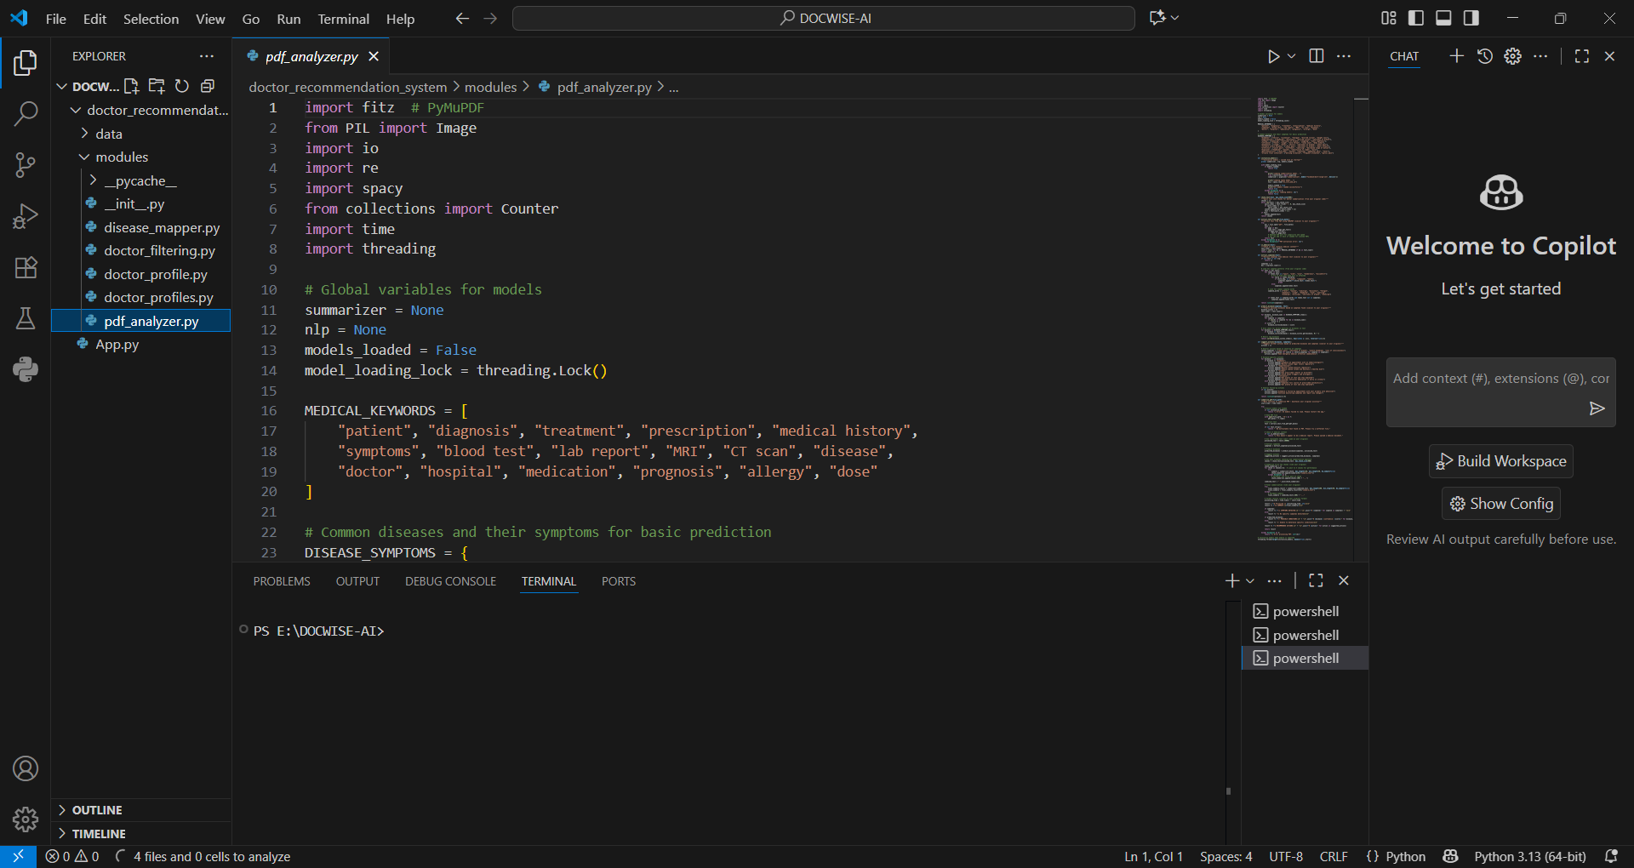
IMPLEMENTATION

Slide 18
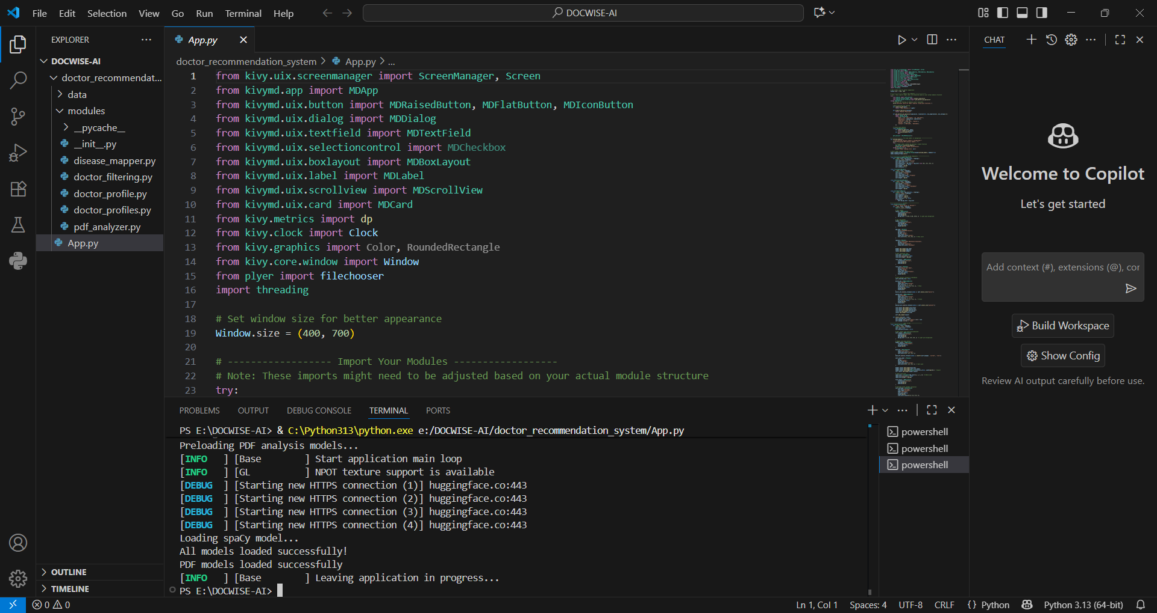

Slide 19
CONCLUSION
The proposed AI-Driven Doctor Recommendation System provides a personalized and accurate approach to connecting patients with the right medical specialists. By integrating techniques like Named Entity Recognition,Rule-Based Mapping, Content-Based Filtering, and Collaborative Filtering, the system ensures that recommendations are both medically relevant and accessible. Unlike generic search engines, it tailor results based on predicted disease, patient profile, location, and availability, making it more effective in improving healthcare accessibility and efficiency.

Slide 20
FUTURE SCOPE
*Integration with real-time hospital databases for live doctor availability.
*Addition of multilingual support to serve a diverse population.
*Incorporation of telemedicine appointment booking directly from the system.
*Expansion to global healthcare networks for cross-border consultations.
*Implementation of AI-based treatment and medicine recommendations alongside doctor suggestions.
*Use of deep learning models for enhanced disease–specialist matching accuracy.

Slide 21
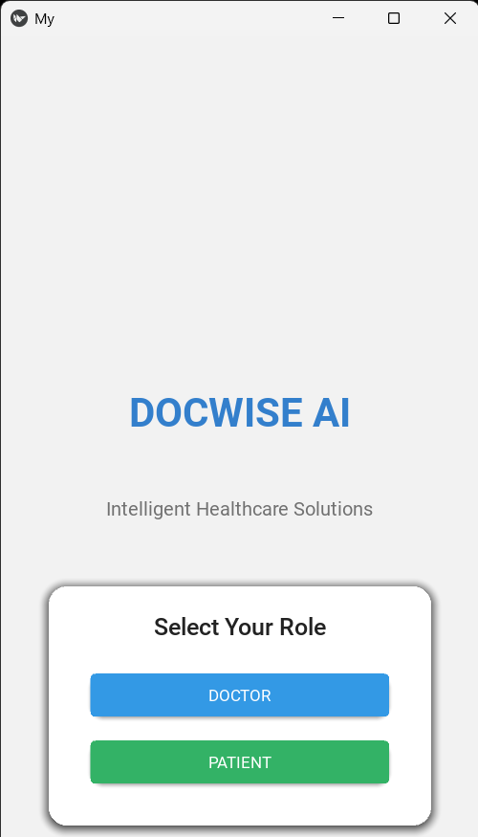
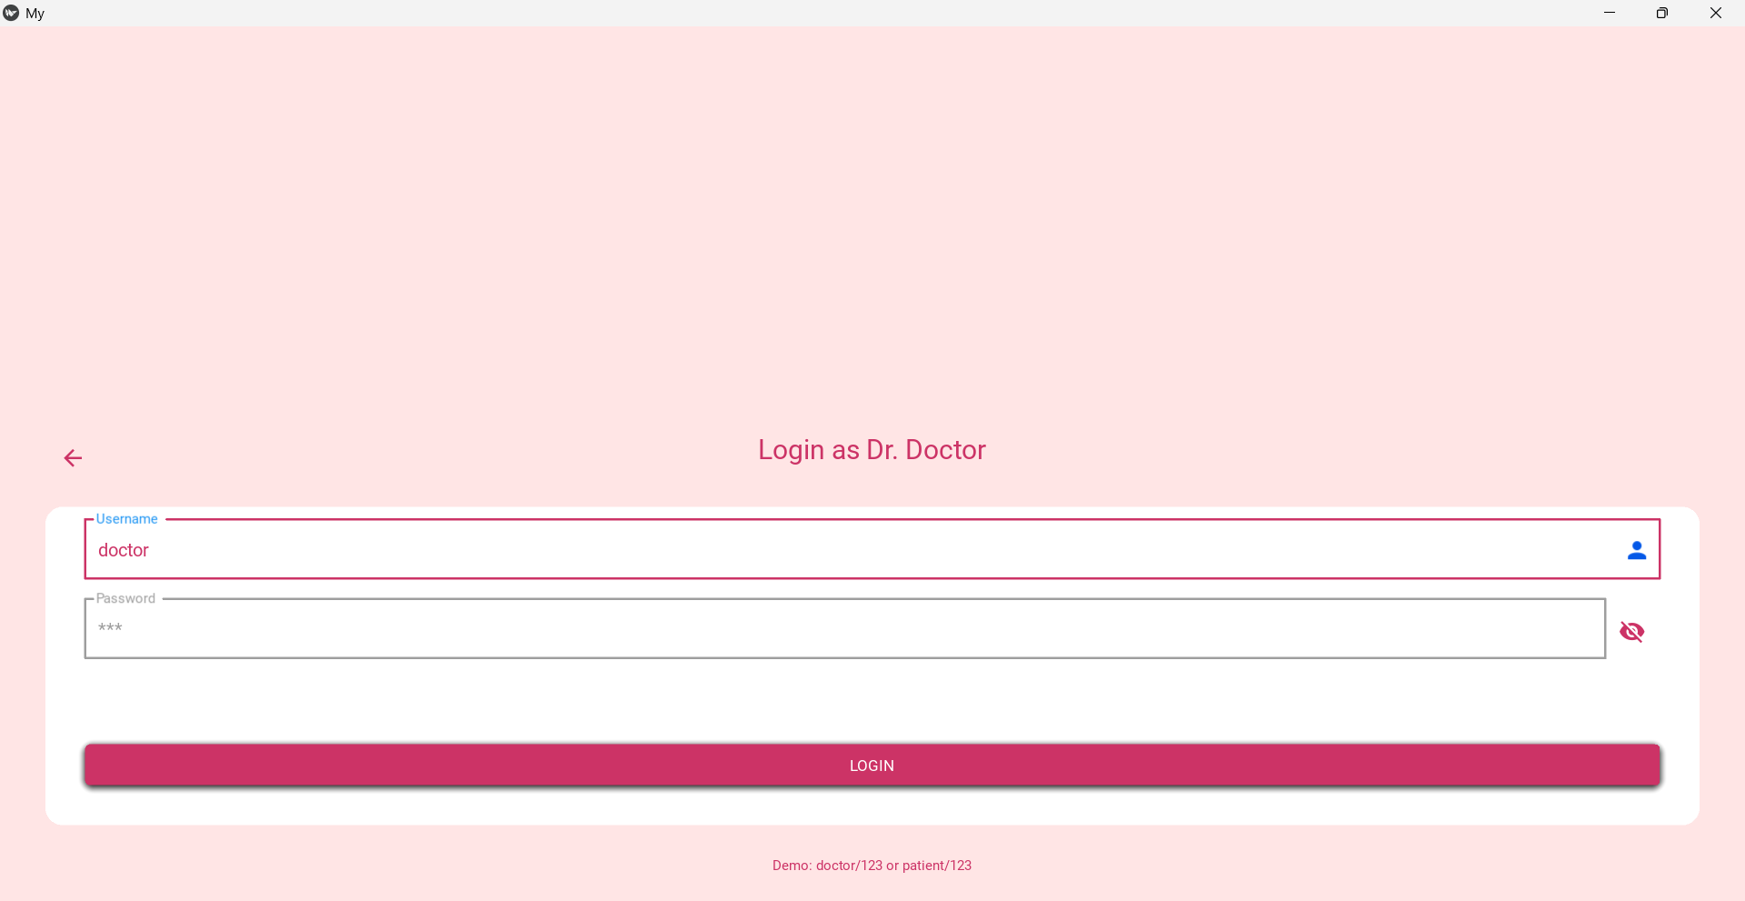
OUTPUT

Slide 22
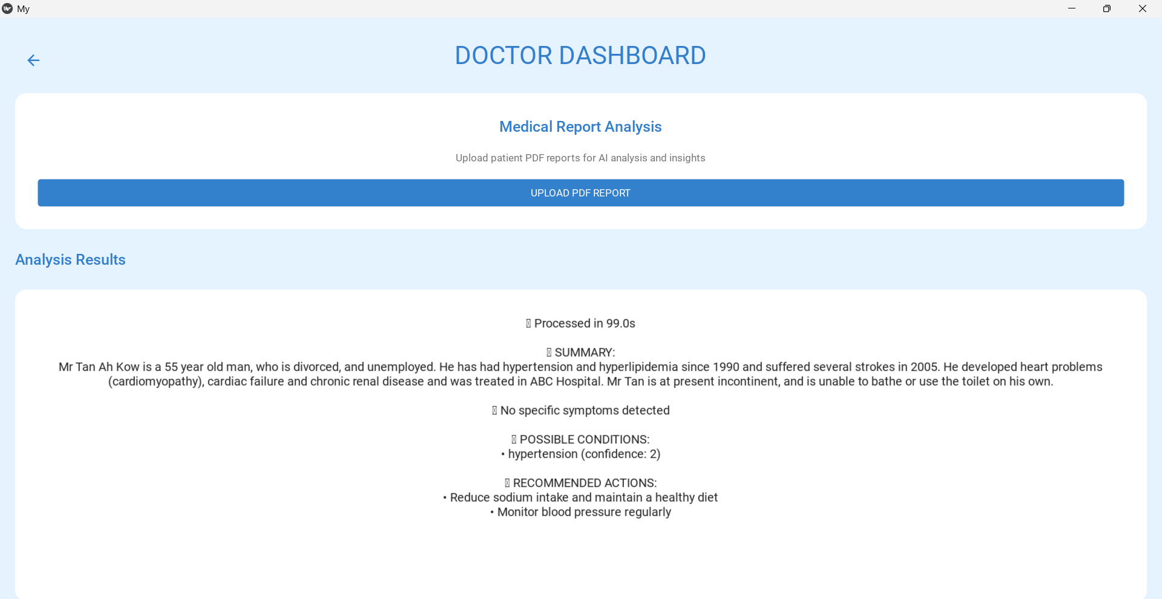

Slide 23
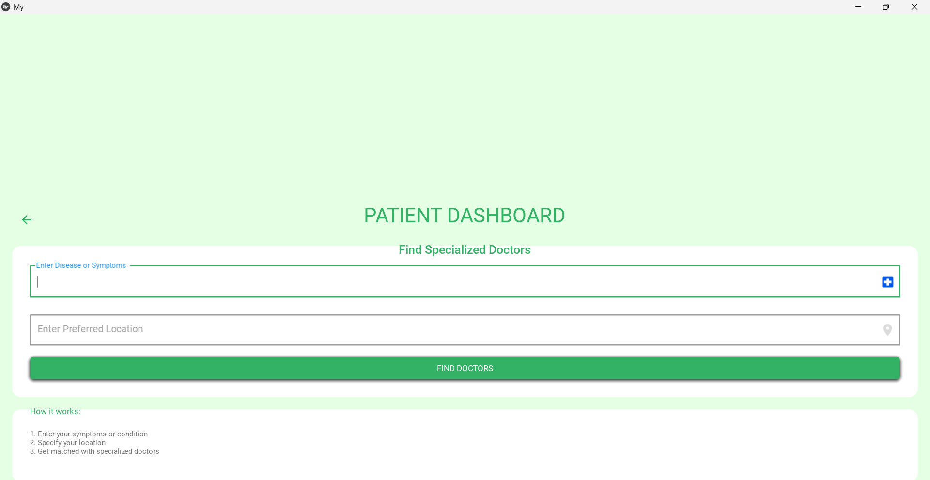
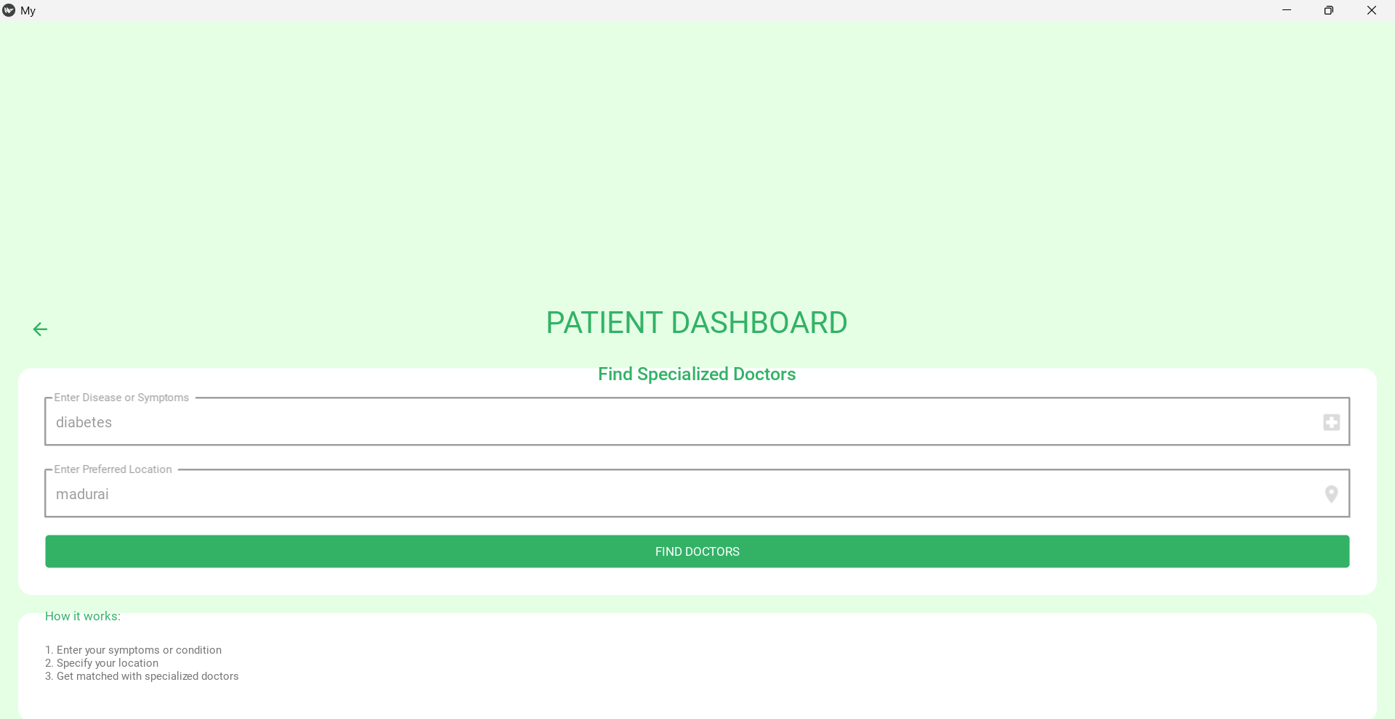

Slide 24
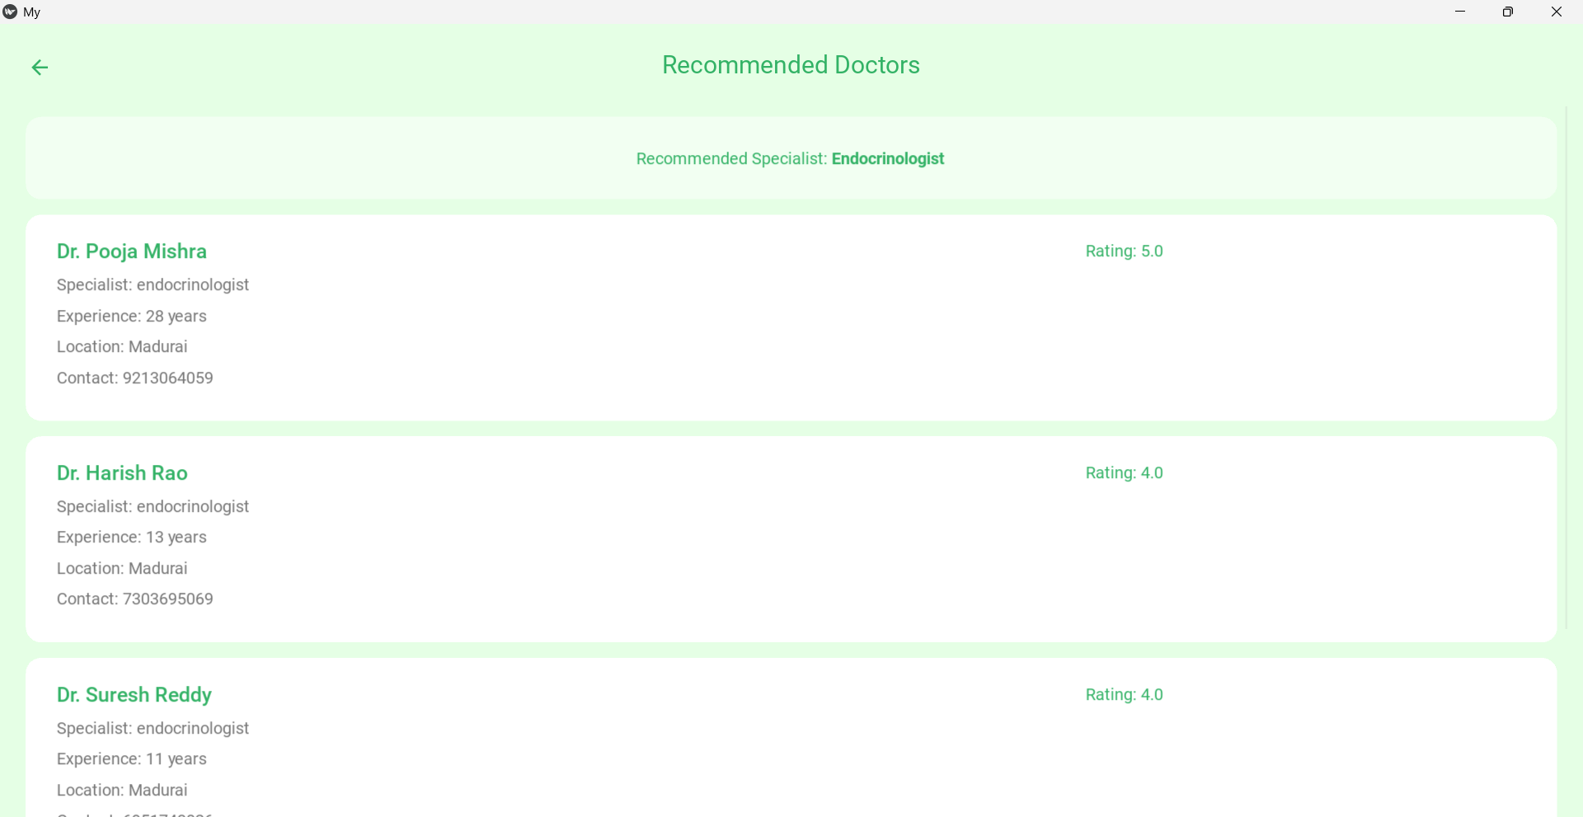

Slide 25
REFERENCES
1)M. Natarajan et al., "AI-Driven Disease Prediction and Doctor Recommendation System," 2025. 2)S. K. Nayak et al., "An Intelligent Disease Prediction and Drug Recommendation Prototype by Using Multiple Approaches of Machine Learning Algorithms," 2023. 3)K. Alnowaiser, "Improving Healthcare Prediction of Diabetic Patients Using KNN Imputed Features and Tri-Ensemble Model," 2024. 4)A. Kumar et al., "Disease Prediction and Doctor Recommendation System using Machine Learning Approaches," 2021. 5)A. Das et al., "A collaborative empirical analysis on machine learning based disease prediction in health care system," 2024.

Slide 26
6)K. Arumugam et al., "Multiple disease prediction using machine learning algorithms," 2023. 7)M. M. Yaqoob et al., "Hybrid Classifier-Based Federated Learning in Health Service Providers for Cardiovascular Disease Prediction," 2023. 8)F. Al-Turjman et al., "Intelligence in the Internet of Medical Things era: A systematic review of current and future trends," 2020. 9)S. Dash et al., "Big data in healthcare: management, analysis and future prospects," 2019. 10)D. A. Watkins et al., "Rheumatic Heart Disease Worldwide: JACC Scientific Expert Panel," 2018.

Slide 27
11)S. Mohan et al., "Effective Heart Disease Prediction Using Hybrid Machine Learning Techniques," 2019. 12)J. P. Li et al., "Heart Disease Identification Method Using Machine Learning Classification in E-Healthcare," 2020.
13)R. Kaur et al., "Lifestyle and Dietary Management Associated with Chronic Diseases in Women Using Deep Learning," 2023. 14)R. Kaur et al., "Food Image-based diet recommendation framework to overcome PCOS problem in women using deep convolutional neural network," 2022. 15)R. Kaur et al., "Review on Transfer Learning for Convolutional Neural Network," 2021.

Slide 28
THANK
YOU

