Slide 1
PowerPulse: Household Energy Usage Forecast

Slide 2
PowerPulse: Household Energy Usage Forecast
A smart system that predicts household energy consumption using historical data and machine learning.
It helps optimize energy usage, reduce costs, and support efficient energy planning.
Problem Statement
In today’s world, managing energy efficiently is crucial. Households often lack visibility into their energy consumption patterns, leading to higher costs and wastage.
Energy providers also face challenges in accurately predicting demand. A reliable prediction system is needed to optimize usage, reduce costs, and improve planning.
Project Objective
Build a machine learning model to predict household energy consumption using historical data
Identify key factors influencing energy usage
Provide actionable insights to reduce energy costs and improve efficiency
Enable better demand forecasting and support smart energy management systems

Slide 3
Technical Tags:
Data Preprocessing
Regression Modeling
Feature Engineering
Hyperparameter Tuning
Visualization - Matplotlib/Seaborn
Python, Pandas
Scikit-learn
Overview about Data:
The dataset contains household energy consumption records collected over time
Includes variables such as:
1. Global Active Power (target variable)
2. Voltage
3. Sub-metering values (Sub_metering_1, Sub_metering_2, Sub_metering_3)
Data is recorded at time intervals, capturing usage patterns across different appliances.
Used to analyze energy consumption trends, detect patterns, and build predictive models.
Helps in understanding how different factors influence electricity usage

Slide 4
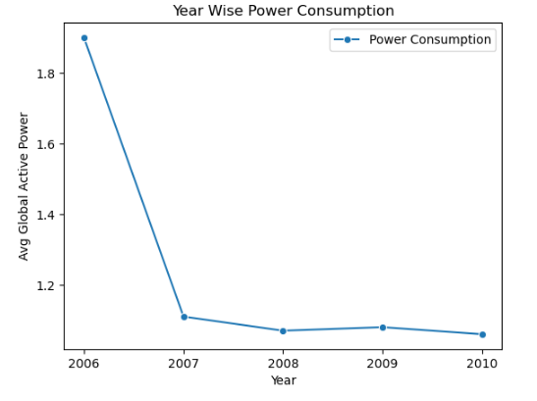
Year Wise Average Energy Consumption

Slide 5
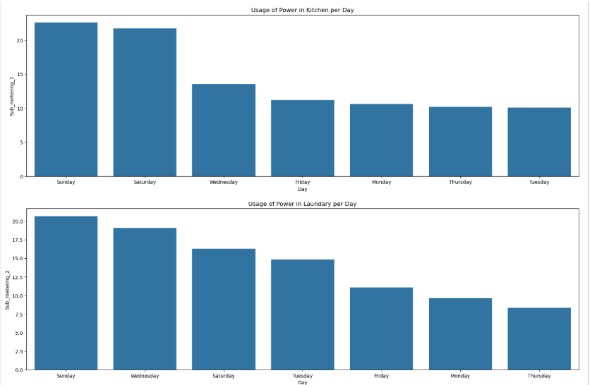
Average Usage of Energy Consumption Day Wise

Slide 6
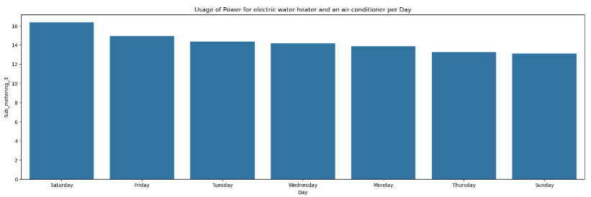
Average Usage of Energy Consumption Day Wise

Slide 7
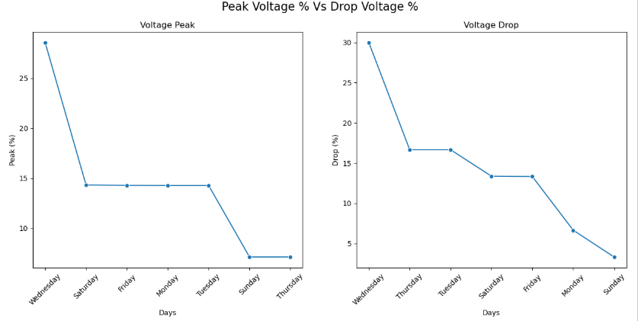
Day Wise Average % of Peak Vs Drop in Voltage

Slide 8
Outlier Treatment & Skewness Handling
Outliers were identified using statistical methods and visualizations
The data showed right skewness.
Applied Log Transformation to reduce moderate skewness.
Used Box-Cox Transformation for strongly skewed data.
These transformations helped normalize the distribution and improve model performance.

Slide 9
Correlation Analysis: Original vs Transformed Data
Correlation analysis was performed on both original and transformed datasets
In the original data, skewness and outliers affected the correlation strength
After applying Log / Box-Cox transformation, relationships became more consistent and reliable
Improved correlation helped in better feature selection and model accuracy

Slide 10
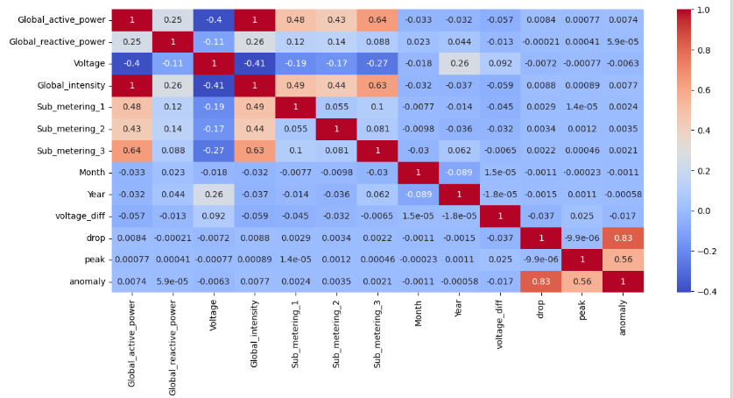
Correlation heatmap (original data)

Slide 11
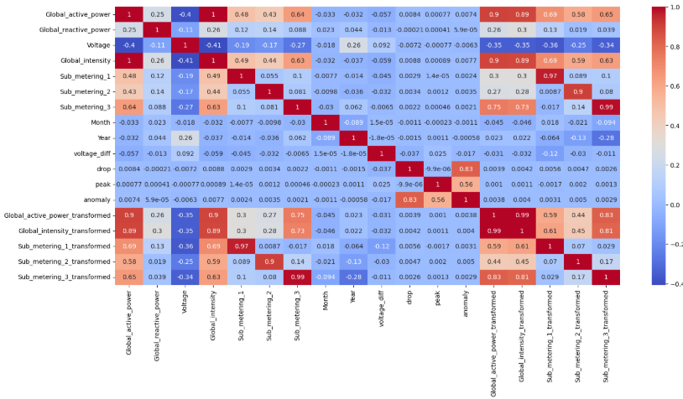
Correlation heatmap (transformed data)

Slide 12
Feature Selection and Model Building
Feature Selection
Selected important features based on Correlation analysis.
Focused on variables that strongly influence energy consumption.
Model Building
Split data into training and testing sets.
Trained multiple models:
Linear Regression,
Bagging Model: Random Forest, Decision Tree
Boosting Model: Gradient Boosting, XGBoost
Neural Network: MLP (Multi Layer Percerptron)
Performed hyperparameter tuning for better performance.
Evaluated models using metrics like MSE, RMSE, MAE, and R² Score.
Selected the best-performing model for final prediction

Slide 13
Linear Regression
Definition:
Linear Regression predicts a continuous value by finding the best-fit line between input features and the target variable.
Key Insights:
Model shows consistent performance (Train ≈ Test → no overfitting) .
Sub_metering_3 has the highest impact on energy consumption.
Voltage shows a negative relationship with the target.
Model explains ~66% variance (R² ≈ 0.66).

Slide 14
Random Forest
Definition:
Random Forest is an ensemble machine learning algorithm that builds multiple decision trees and combines their predictions to improve accuracy and reduce overfitting.
Key Insights:
Before tuning → Slight overfitting (Train > Test).
After tuning → Better generalization (Train ≈ Test)
Model performance improved (R² ~ 0.71)
Sub_metering_3 dominates (~73% importance)

Slide 15
Decision Tree
Definition
Decision Tree is a model that splits data into branches based on feature values to make predictions in a tree-like structure.
Key Insights:
Before tuning → Overfitting (Train > Test)
After tuning → Balanced performance (Train ≈ Test)
Significant improvement in test accuracy (R² ~ 0.71)
Sub_metering_3 is the dominant feature (~80%)

Slide 16
Gradient Boosting
Definition
Gradient Boosting is an ensemble technique that builds models sequentially, where each new model corrects the errors of the previous one.
Key Insights:
Model shows stable performance (Train ≈ Test → no overfitting)
Slight improvement after tuning (R² ~ 0.71)
Sub_metering_3 remains the most important feature
Voltage influence increased after tuning

Slide 17
XGBoost
Definition
XGBoost (Extreme Gradient Boosting) is an optimized boosting algorithm that builds models sequentially using gradient descent and regularization to improve accuracy and efficiency.
Key Insights:
Model shows very stable performance (Train ≈ Test)
Tuning provided slight improvement and better generalization
XGBoost performs slightly better than other models (~R² 0.709)
Sub_metering_3 dominates feature importance (~76%)
Voltage has minimal impact

Slide 18
MLP
Definition
MLP Regression (Multi-Layer Perceptron) is a type of neural network that uses multiple layers of neurons to learn complex non-linear relationships in data.
Key Insights:
Model shows consistent performance with no major overfitting
Slight decrease in performance after tuning
MLP performs slightly lower compared to boosting models
Sub_metering_3 is the dominant feature (~93%)
Neural network captures complex patterns.

Slide 19
Conclusion
XGBoost (XGB) is the best model for prediction.
Why XGBoost is the best?
Highest / among the highest R² score (~0.709) after tuning
Lowest error metrics compared to other models (RMSE, MAE are well balanced)
Very stable performance (Train ≈ Test → no overfitting)
Handles non-linear relationships effectively
Consistently performs better than:
Linear Regression
Decision Tree
Random Forest
Gradient Boosting
MLP (Neural Network)

Slide 20
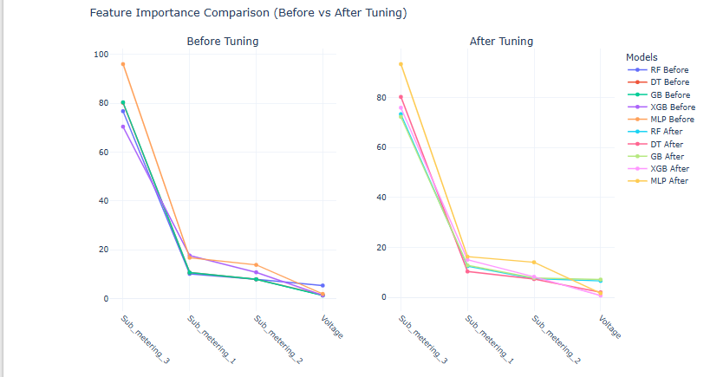
Visualization Of Feature Importance

Slide 21
Thank You

