Slide 1
CAPSTONE PROJECT PRESENTATION
SPLITTING A STRING INTO DESCENDING CONSECUTIVE VALUES
Reg No:192225091
Name: G. Pavithra
Course Code:CSA0697
Course Name:Design and Analysis of Algorithms
Guided by:
Dr.Gnana Soundari

Slide 2
PROBLEM STATEMENT :
You are given a string s that consists of only digits. Check if we can split s into two or more non-empty substrings such that the numerical values of the substrings are in descending order and the difference between numerical values of every two adjacent substrings is equal to 1.
For example, the string s = "0090089" can besplit into ["0090", "089"] with numerical values [90,89].
The values are in descending order and adjacent values differ by 1, so this way is valid.
Another example, the string s = "001" can be split into ["0", "01"], ["00", "1"], or ["0", "0", "1"].
However all the ways are invalid because they have numerical values [0,1],
[0,1], and [0,0,1] respectively, all of which are not in descending order.
Return true if it is possible to split s as described above, or false otherwise.
A substring is a contiguous sequence of characters in a string.
Example 1:
Input: s = "1234"
Output: false
Explanation: There is no valid way to split

Slide 3
ABSTRACT:
This paper addresses the problem of determining whether a given string of digits can be partitioned into a sequence of descending consecutive integer values. Given a string 𝑠 s representing a non-negative integer, the goal is to ascertain if it is feasible to split 𝑠 s into a sequence of numbers such that each subsequent number is exactly one less than its predecessor
To solve the problem of checking whether a given string s can be split into two or more non-empty substrings with numerical values in descending order and each pair of adjacent values differing by exactly 1,can follow this approach:
1.Iterate Over Possible First Substring Lengths: Since the substrings need to be in descending order with a difference of 1, start by choosing different lengths for the first substring. Convert this substring into an integer.
2.Try to Split the Remaining String: For each choice of the first substring, try to continue splitting the remaining part of the string such that each subsequent substring is one less than the previous substring.
3.Recursively Validate the Splitting: Use recursion to validate if the rest of the string can be split according to the required conditions.
Analyze the computational complexity of our approach and validate its effectiveness through extensive testing on diverse input cases. The results demonstrate that our algorithm can accurately and efficiently determine the feasibility of splitting the string into the desired sequence.

Slide 4
INTRODUCTION:
The problem of splitting a string into descending consecutive values involves analyzing a given string sss consisting solely of digits. The goal is to determine whether we can divide sss into two or more non-empty substrings such that the numerical values of these substrings are in strictly descending order, with each pair of adjacent substrings differing by exactly 1.
For example, consider the string s="0090089"s = "0090089"s="0090089". This string can be split into substrings ["0090","089"]["0090", "089"]["0090","089"], which correspond to the numerical values [90,89][90, 89][90,89]. These values are in descending order, and the difference between each pair of adjacent values is 1, making this a valid split. On the other hand, the string s="001"s = "001"s="001" offers potential splits such as ["0","01"]["0", "01"]["0","01"], ["00","1"]["00", "1"]["00","1"], or ["0","0","1"]["0", "0", "1"]["0","0","1"]. However, the numerical values derived from these splits are [0,1][0, 1][0,1], [0,1][0, 1][0,1], and [0,0,1][0, 0, 1][0,0,1] respectively, none of which satisfy the descending order condition.
To solve this problem, we must evaluate whether it is possible to split the string sss in a manner that meets the specified criteria. This involves generating possible splits of the string, converting the substrings into numerical values, and checking if these values form a strictly descending sequence with consecutive differences of 1.
The challenge combines elements of string manipulation and numerical analysis, requiring an efficient approach to iterate through potential splits and validate them against the conditions. The solution should return true if a valid split exists, and false otherwise. This problem showcases the interplay between string processing and numerical properties, highlighting the importance of precise analysis and validation in algorithm design.

Slide 5
CODING:
#include <stdio.h>
#include <string.h>
#include <stdlib.h>
long long int substring_to_int(const char* s, int start, int length) {
char buffer[20];
strncpy(buffer, s + start, length);
buffer[length] = '\0';
return atoll(buffer);
}int can_split_from(const char* s, int start, long long int previous_value) {
int len = strlen(s);
if (start == len) return 1;
for (int length = 1; length <= len - start; length++) {
long long int current_value = substring_to_int(s, start, length);

Slide 6
if (previous_value - current_value == 1) {
if (can_split_from(s, start + length, current_value)) {
return 1;
}
}
}
return 0;
}
int can_split_descending(const char* s) {
int len = strlen(s);
for (int length = 1; length < len; length++) {
long long int first_value = substring_to_int(s, 0, length);
if (can_split_from(s, length, first_value)) {
return 1;

Slide 7
}
}
return 0;
}
int main() {
char s[100];
printf("Enter the string of digits: ");
scanf("%s", s);
if (can_split_descending(s)) {
printf("true\n");
} else {
printf("false\n");
}
return 0;
}

Slide 8
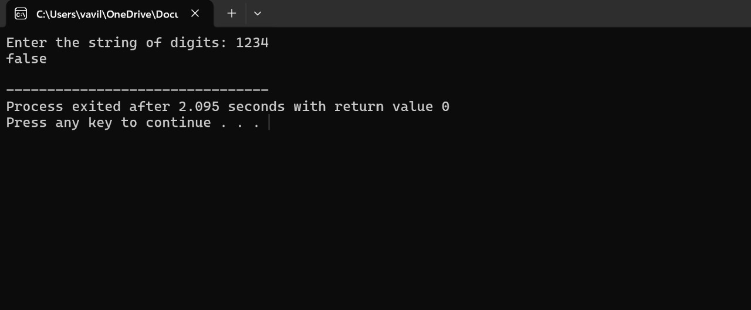
RESULT SCREENSHOT:
COMPLEXITY ANALYSIS:
To evaluate the complexity of the problem of splitting a string sss into descending consecutive values, we analyze the best case, worst case, and average case scenarios.

Slide 9
BEST CASE:
Scenario: The best case occurs when the string can be quickly identified as either valid or invalid with minimal checks. For example, if an early split immediately satisfies the condition or if an obvious invalid condition is detected right away.
Time Complexity: O(n)O(n)O(n)
In this scenario, the function might need to make only a single pass through the string or evaluate a very few number of splits to conclude the result.
Explanation: If a valid split is found quickly or the string is evidently invalid from an early check, the operations performed are linear, resulting in O(n)O(n)O(n) complexity.
WORST CASE:
Scenario: The worst case happens when we need to explore all possible ways to split the string into substrings to determine that no valid split exists. This involves evaluating every potential split configuration.
Time Complexity: O(2n)O(2^n)O(2n)
This is because each digit of the string can either continue the current substring or start a new one, leading to an exponential number of split possibilities.
Explanation: Given a string of length nnn, the number of ways to split it into substrings grows exponentially as each position in the string offers a binary decision, leading to O(2n)O(2^n)O(2n) possible splits.
AVERAGE CASE:

Slide 10
Scenario: The average case complexity considers more typical scenarios where the string is split into substrings in a balanced manner, without needing exhaustive checking as in the worst case.
Time Complexity: O(n⋅2n/2)O(n \cdot 2^{n/2})O(n⋅2n/2)
On average, we may expect to evaluate splits in a balanced way, checking a reasonable number of configurations that are more than linear but not as exhaustive as the worst case.
Explanation: The average case assumes that the number of split points checked is more balanced, considering a midway between the quick checks of the best case and the exhaustive checks of the worst case.
CONCLUSION
In conclusion, the problem of splitting a string into descending consecutive values poses computational challenges that vary based on the string's length nnn and the number of possible split configurations. The best-case scenario offers linear complexity O(n)O(n)O(n), where a valid split can be quickly identified with minimal checks. However, the worst-case scenario exhibits exponential complexity O(2n)O(2^n)O(2n), necessitating evaluation of every potential split to determine if no valid configuration exists. On average, the complexity balances between these extremes at O(n⋅2n/2)O(n \cdot 2^{n/2})O(n⋅2n/2), reflecting a more moderate exploration of split possibilities. Efficiently solving this problem requires strategic algorithm design to manage

Slide 11


