Slide 1



Air Veterans’ Hand book
Prepared By: DSW - Puducherry
Rev.2 Dt. 11 Apr. 2022

Slide 2



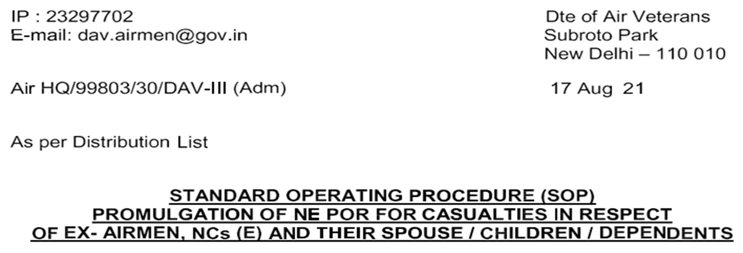
Information on NE POR for Name/ DOB/ Home Address Change/ Marriage/ Re- marriage/ Child Birth, etc.
Reference Document
Objective:
Objective of this document is to guide the Air veterans with step by step and easy to follow methodology. Due care is taken in a practicable approach to complete the process for each item. This document is wholly derived from the SOP issued by DAV dated 17 Aug 2021. However, the information on practical ways and means of getting the job done were obtained from Air Veteran brethren. In future this Hand Book may be added with upcoming relevant documents useful to the Air Veteran community, so that it will serve as a simple/ Handy document for easy reference.

Slide 3

Prologue:
Dear fellow Air Veterans,
In the past there were many instances of Widows/ dependents of Ex- service men were made to run to pillar to pole in getting the family pension due to some documental error or otherwise. As you are aware the pension disbursing agency is as of now the Bank, the bank employees may not have a clue of our problems and they may hold the pension. Though the PDA is being shifted to SPARSH, there may be the same problem in waiting.
Let us mention just two cases among thousands of such cases.
One Veteran Corporal from Pune attempted Suicide as he was running for 16 long years for getting correct pension.
A widow of an Air Officer was getting very meagre Family pension, had no clue of her correct pension at all. She was almost poverty stricken, finally got her arrears at the age of 89.
Let us be frank on this:
Though we hear many cases of stoppage of pension due to very minor mistakes in PPOs, Address, Spelling mistake in names etc. Are we taking any action while we are still active/ alive and kicking. Frankly many of us either postpone it OR do not do it at all. This is a wakeup call for all of us.
Though due care is taken to add all items as practical as possible, still there are chances of miss-outs. THERE IS ALWAYS “OPPORTUNITY FOR IMPROVEMENT”. So it is requested that anyone who has knowledge on these matters may contribute and add their valuable points in this document. For that purpose this document is purposely made in MS word also for easy editing.
Hence it is strongly advised to correct all short comings of your documents in time for the cases below by taking NE- POR:
Change of Self Name
Change of Spouse/ Child Name
Change of Name of Family Pensioners in Death Cases
Change of DOB of Spouse
Change of DOB of Adult Child
Birth of Child
Marriage/ Re-marriage
Death of Veteran/ Spouse/ Children
Adoption
Dependents of Air Veteran
Change of Permanent Home Address –PHA

Slide 4
General instructions
1. All copies of documents are to be self attested
2. For affidavits first party is Deponent, The second party is Directorate of Air Veterans, New Delhi.
3. Self DOB is not allowed.
Criteria for change of Name:
Inclusion/ Deletion of a letter.
Inclusion/ Deletion of First Name, Middle Name, and Surname.
Inclusion/ Deletion of any part of name for change in respect of location, father's name, caste etc.
Change in name/ Surname on change of Marital status.
Splitting or merger of any part/ parts of the name (First Name, Middle Name, and Surname).
Any change that is not as per service records held by IAF.
Publication of change of name in Gazette of India is mandatory for Honorary Commissioned Officers and Warrant Officers.
In case for complete change of name, documentary proof of old name and new name with a photograph to be attached.

Slide 5
Tips while submitting documents for 1st class Magistrate Affidavit (In our case DCRN):
For all affidavits it is advised to submit available photo identity proofs such as Aadhar, PAN card, Driving license.
Attach copy of your original PPO.
(It gets your work done smartly)

Slide 6
Change of Self Name
If you have changed your name already and it is published in the Gazette, then all you need to do is to submit an application to DAV with a) Self attested Gazette copy, b) DOB proof such as self attested Aadhar/ PAN/ School certificates to DAV.
OR
Get a Rs. 20 Non-Judicial Stamp paper, mention the first party as your name(Deponent), The second party as Directorate of Air Veterans, New Delhi.
Get it notarized for the purpose of News paper advertisement.
Place advertisement in English in any regional news paper. The content MUST be in ENGLISH.
The full page of the advertisement is to be self attested and attached. The name and date of publication shall be clearly written in English on top and to be signed by the individual.
Attach the supporting documents a) Newspaper Advertisement (original) b) DOB proof such as Aadhar/ PAN/ School certificates c) Discharge book copy d) PPO copy.
Obtain Affidavit from First class Magistrate.
Submit all the documents with DSW along with a letter of application to DAV.
Note:
Publication of change of name in Gazette of India is mandatory for Honorary Commissioned Officers and Warrant Officers.
In case for complete change of name, documentary proof of old name and new name with a photograph to be attached.

Slide 7
Change of Spouse/ Child Name
If your spouse/ child name is already changed through a gazette, all you need to do is to submit an application to DAV with a) self attested gazette copy, b) DOB proof such as Aadhar/ PAN/ school certificates to DAV.
OR
Get a Rs. 20 non-judicial stamp paper, mention the first party as your spouse/ child name(deponent), the second party as Directorate Of Air Veterans, New Delhi.
Get it notarized for the purpose of News paper advertisement.
Place advertisements in English in any regional news paper. The content must be in English.
The full page of the advertisement is to be self attested and attached. The name and date of publication shall be clearly written in English on top and to be signed by the individual.
The changed name should match your name in Aadhar/ PAN card.
Attach the supporting documents a) Newspaper advertisement (original) b) DOB proof such as Aadhar/ PAN/ school certificates. (If you attach school certificate for child, that shall contain names of Father and Mother).
Obtain Affidavit from Fist Class Magistrate.
Submit all the documents to DSW along with a letter of application to DAV.
Fist Class Magistrate Affidavit is mandatory

Slide 8
Change of Name of Family Pensioners in Death Cases
Submit a self declaration with authenticated finger prints and photographs duly attested by Adjutant of last unit or Zila Sainik Board.
Such cases will be approved by Gp. Capt. AV (A&N) based on the merits.
In case of change of full name “The name change” procedure is to be followed.
If required cases will be verified through P&S units.
The changed name should match your name in Aadhar/ PAN card.

Slide 9
Change of DOB of Spouse
Personal application by the Air veteran for correction/ amendment of DOB.
Self attested copy of INK signed copy of DOB certificate issued by registrar of Birth & Death. OR Any one self attested copy of Aadhar card/ PAN card/ Matriculation Certificate with photo/ Voter Id card/ Indian Passport.
Attach all DOB proof such as Aadhar/ PAN/ school certificates.
Submit all the documents with DSW along with a letter of application to DAV.
Note:
It is always better to attach the Birth Certificate.
In case where both change of name and DOB of dependents are involved affidavit from first class magistrate is mandatory.

Slide 10
Change of DOB of Child
Personal application by the Air veteran for correction/ amendment of DOB.
Self attested copy of INK signed copy of DOB certificate issued by registrar of Birth & Death. OR Any one self attested copy of PPO/ Corr. PPO/ Pension Certificate/ Aadhar card/ PAN card/ Matriculation Certificate with photo/ Voter Id card/ Indian Passport.
Attach all DOB proof such as Aadhar/ PAN/ school certificates.
Submit all the documents with DSW along with a letter of application to DAV.
The Birth certificate/ Matriculation certificate should include the name of father and mother.
Note:
It is always better to attach the Birth Certificate.
In case where both change of name and DOB of dependents are involved affidavit from first class magistrate is mandatory.

Slide 11
Birth of Child
Personal application by the Air veteran for registration of DOB of child.
Self attested copy of INK signed copy of DOB certificate issued by registrar of Birth & Death.
Note:
Prior to 1999 where registration of birth was not mandatory the case may be dealt based on the documents such as Matriculation certificate).
It is better attach a latest document of the child with annotation of father and mother on it.

Slide 12
Marriage/ Re-Marriage
Personal application by the Air veteran for Marriage/ Re-marriage.
Self attested INK signed copy of Marriage certificate issued by registrar of Marriages.
Affidavit in original duly sworn in before First class Magistrate as per the details mentioned in specimen affidavit.
In case the wife is a divorcee/ widow INK certified true copy of the Divorce Decree or death certificate of first husband should be attached.
If Air Veteran is also a divorcee/ widow INK certified true copy of the Divorce Decree or death certificate of first wife should be attached.
Two copies of joint photograph duly attested by Zila Sainik Board.
Self attested INK signed copy of DOB certificate issued by registrar of Birth & Death for wife.
Name of wife after marriage should match with name of wife in Aadhar/ PAN Cards etc.

Slide 13
Death of Veteran/ Spouse/ Children
Personal application by the Air veteran.
Original INK signed copy of Death certificate.
Latest details of Pension Disbursing Agency (PDA), i.e. DPDO/ Bank/ Treasury Etc. In case the PDA is bank, furnish full details of Account number/ IFSC/ full address of the bank.

Slide 14
Divorce
Personal Application by Air veteran.
Attested true copy of divorce decree (Absolute) issued by the Competent Court of Law.

Slide 15
Adoption
Personal application by the Air veteran.
Ink signed self attested copy of adoption deed issued by Competent Court of Law duly countersigned by Zila Sainik Board.
Ink signed self attested copy of birth certificate of the child issued by Registrar of Birth & death.

Slide 16
Dependents of Air Veteran
Personal application by Air Veteran giving details of Dependents.
Income certificate issued by concerned District/ Block development authority along with details of movable/ immovable properties.
A certificate from Tehsildar/ Magistrate stating the details of Air Veteran’s parents, their relationship and the fact that they are wholly dependent on the Air Veteran and residing with him.
Date of birth/ age proof of dependents in DD/MM/YYYY format.

Slide 17
Change of Permanent Home Address -PHA
Personal application by the Air veteran for Change of Permanent Home Address –PHA.
Declaration form in triplicate.
Declaration form to be verified and forwarded by Zila Sainik Board.
Note:
1. Discharge Book either in original or photo copy is not required to be forwarded along with declaration form.

Slide 18
Actions by DAV after receipt of applications
Any application which requires subsequent processing with Jt. CDA/ PCDA(P) by Service/ Family/ Disability Pension cell.
On receipt of application I will be scrutinized by concerned section, in case of discrepancy it may be rejected and Air Veteran may be advised to furnish required details/ documents.
In case of doubtful cases the Officer In charge may carry out a verification.
On successful scrutiny the applications will be forwarded to welfare section for promulgation of NE- POR.
The Air Veteran will be informed accordingly through Zila Sainik Board.
After promulgation of NE- POR the documents of the concerned Air Veteran will be amended accordingly.

Slide 19
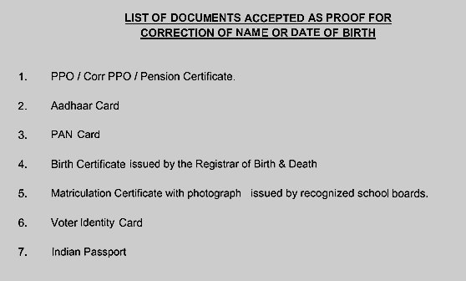

Slide 20
Important Links:
http://ex-airman.blogspot.com/?m=1
(Voice Of Pensioner Website, where you can download your e-PPO Easily)
https://iafpensioners.gov.in/ords/dav_portal/r/dte_av/login
(DIRECTORATE OF AIR VETERANS Veterans’ Login)
https://web.umang.gov.in/landing/
(Umang App Website – Here you have many facilitating sites in single App to manage Life Certificate/ Gas/ PAN/ Aadhar/EPFO/ EISC/ Digilocker etc.)
You can submit/ View your Life Certificate)
Click Services by States then Jeevan Pramaan

Slide 21
Acknowledgement
Special thanks to Mr. Sandirakumaran for his support and guidance.
Thanks to Mr. Mahadevan and Mr. Jeganathan Gilbert for some of the formats.
The below specimen formats are given in separate Editable MS Word formats for easy use.
Specimen formats for Name/ DOB Change, Marriage/ Re-Marriage etc.
All the specimen covering letters.
Specimen formats to be used in case of death of pensioner.

