Slide 1

SUMMER INTERNSHIP REVIEW | IT3711
CloudVault — Secure Cloud Storage and Data Access Management System
J. Pavithra – 810023205035
B.Tech Information Technology, VII Semester
University College of Engineering (BIT Campus), Anna University, Tiruchirappalli – 620 024
Department of Information Technology
Internship: DLK Software Solutions, Vadapalani, Chennai | 06 June – 06 July 2026 | Mentor: Mr. Ram

Slide 2
Contents
1
Introduction and Objectives
2
Company Profile
3
Problem and Proposed System
4
Technologies and Concepts
5
Workflow and Weekly Plan
6
Architecture and Database Design
7
Algorithms
8
Code Implementation
9
Application Screens
10
Analysis, Conclusion and Future Work

Slide 3
Internship at a Glance
Objectives
Company: DLK Software Solutions
Domain: Web Development
Location: Vadapalani, Chennai
Mode: Offline
Duration: 06 June – 06 July 2026
Mentor: Mr. Ram
Faculty Incharge: Ms. Ambika
Learn Python Flask from scratch
Design a database with SQLAlchemy and SQLite
Secure login with Flask-Login
File upload with validation and secure naming
UUID share links with configurable expiry
Responsive UI with Bootstrap 5 and JavaScript
Git workflow and MVC architecture

Slide 4
Company Profile: DLK Software Solutions
Who they are
Philosophy
My Internship
Founded in 2012
Headquartered at Vadapalani, Chennai
IT training and software development organization
Bridges academics and industry needs
Learn – Practice – Build – Get Placed
Structured, hands-on training
Real-world projects during internship
Domain: Web Development
Offline, 06 June – 06 July 2026
Project: CloudVault using Python Flask
Mentor: Mr. Ram

Slide 5
Introduction
What is CloudVault?
Why it matters
Python Flask full-stack web application
Authenticated users upload and manage files
Unique, time-limited share links for every file
Download count tracked for each file
Self-hosted and lightweight: SQLite, no extra server
Email attachments have size limits
Public links usually never expire
Owners cannot see who downloaded or how often
CloudVault gives control over who may download a file and for how long

Slide 6
Problem: Existing File Sharing
Limitations of the existing system
The need
Email attachments are limited in size and never expire
Google Drive and Dropbox need third-party accounts and have storage caps
No per-file download tracking in free tools
No fine-grained access control for each sharing link
No lightweight self-hosted option for small teams
Authenticated storage per user
Expiring links
Download tracking in one simple system

Slide 7
Proposed System: Key Features
User Authentication
Secure Upload
Shareable Links
Register and login
Passwords stored as hashes
Type check and 16 MB limit
UUID-named files
Unique UUID token per file
Public download, no login
Link Expiry
Download Tracking
Dashboard and Search
1, 3, 7 or 30 days
Checked on every access
Count rises on each download
Stored in the database
Files, downloads, active links
Live search, drag and drop

Slide 8
Technologies and Concepts
Python Flask
SQLAlchemy + SQLite
Flask-Login
Micro framework on WSGI
Routes map URLs to functions
Jinja2 builds the HTML pages
ORM: tables as Python classes
File-based database
No separate server needed
Session cookie after login
@login_required protects routes
Werkzeug
UUID
Bootstrap 5 + JavaScript
PBKDF2-SHA256 password hashes
secure_filename() cleans names
Random 128-bit identifier
Unique file prefix and share token
Responsive layout and cards
Drag-drop, search, clipboard, toast

Slide 9
Workflow and Weekly Plan
Week 1
06 – 12 Jun
Induction, Flask basics, routing, Jinja2, forms, SQLAlchemy setup, User model
Week 2
13 – 19 Jun
File model, registration, login, LoginManager, config, upload route, file metadata
Week 3
20 – 26 Jun
Share token, expiry logic, download, share and delete routes, dashboard and upload form UI
Week 4
27 Jun – 03 Jul
Files page, search, copy link, auth pages, CSS, JavaScript, end-to-end testing
Final
04 – 06 Jul
Bug fixes (expiry, file types, sessions), README and documentation

Slide 10
System Architecture (MVC, Three-Tier)
User (Web Browser)
How the parts map
Model: User and File classes in models.py
View: Jinja2 templates with Bootstrap
Controller: routes in app.py
config.py: keys, limits, extensions
static/: CSS and JavaScript
uploads/: physical files
↕
Presentation Layer – View: HTML5, CSS3, Bootstrap 5, JavaScript, Jinja2
↕
Business Logic Layer – Controller: Flask routes in app.py, Flask-Login, Werkzeug
↕
Data Layer – Model: SQLAlchemy ORM, SQLite database, uploads folder

Slide 11
Data Flow: Upload, Share and Download
Owner logs in
Uploads file, sets expiry
Validate type and size
Save with unique name
→
→
→
Store record, token, expiry in database
Owner copies share link
Visitor opens the link
Expiry check, then send file, count +1
→
→
→
Every visit to a share link is checked against its expiry date on the server before the file is sent.

Slide 12
Database Design
USER
FILE
id (primary key)
username (unique)
email (unique, login name)
password (hash)
id (primary key)
filename (UUID prefix + sanitized name)
original_name, file_size, file_type
share_token (unique UUID)
uploaded_at, expiry_date
download_count
user_id (foreign key to USER)
One user uploads many files (one-to-many).

Slide 13
Algorithms
File upload
Share link access
Check that a file was selected
Validate extension against allowed list
Sanitize name, add UUID prefix
Save file in uploads folder
expiry_date = now + chosen days
Generate unique share_token
Store record and show success
Read token from /share/<token>
Find the file; 404 if none
If now is after expiry_date: show expired message
Else increase download_count
Send file under its original name

Slide 14
Code Implementation
@app.route('/upload', methods=['POST'])
@login_required
def upload():
file = request.files['file']
days = int(request.form.get('expiry_days', 7))
if file and allowed_file(file.filename):
name = secure_filename(file.filename)
unique = str(uuid.uuid4()) + '_' + name
file.save(os.path.join(UPLOAD_FOLDER, unique))
db.session.add(File(filename=unique,
share_token=str(uuid.uuid4()),
expiry_date=datetime.utcnow()
+ timedelta(days=days),
user_id=current_user.id))
db.session.commit()
Project files (shortened code)
app.py: all routes
models.py: User and File
config.py: settings
templates/: 5 HTML pages
static/: style.css, main.js
uploads/: stored files

Slide 15
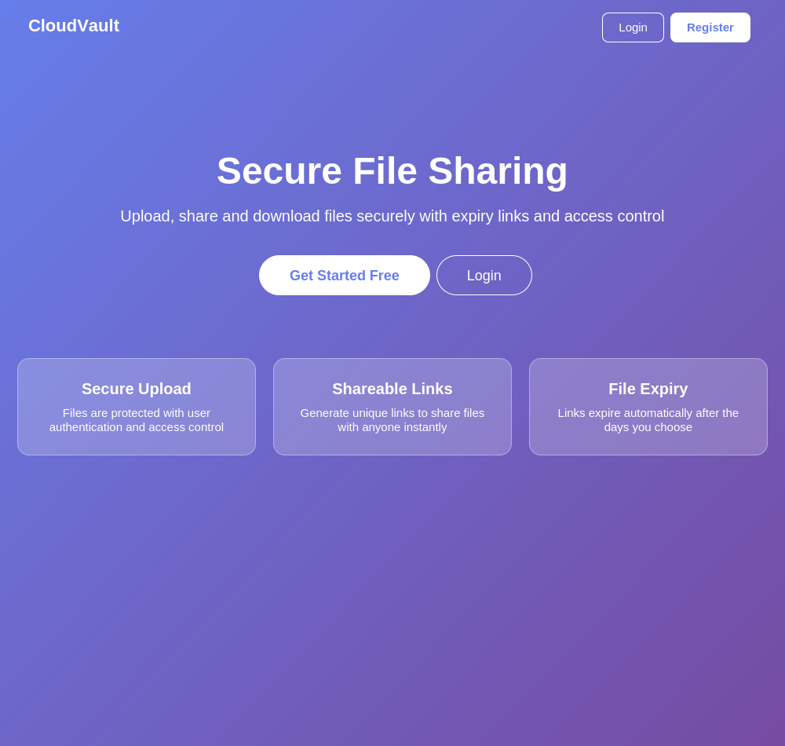
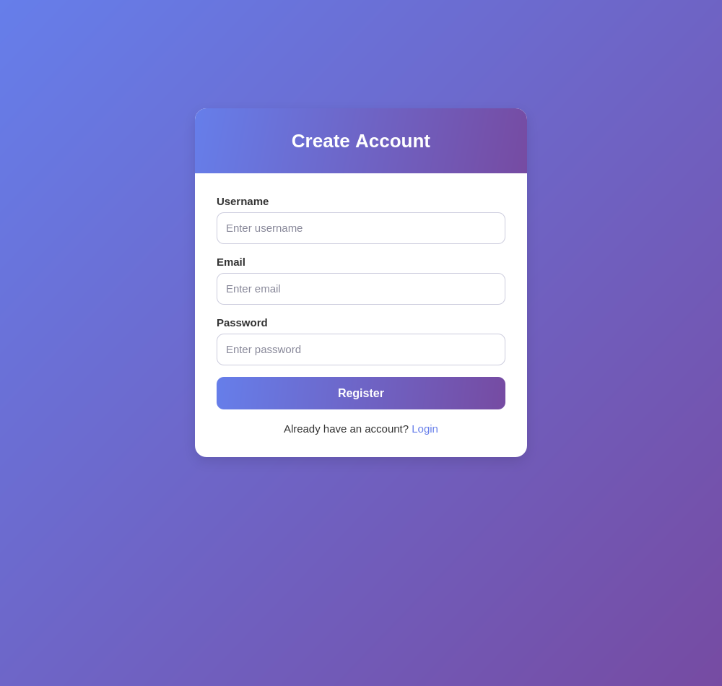
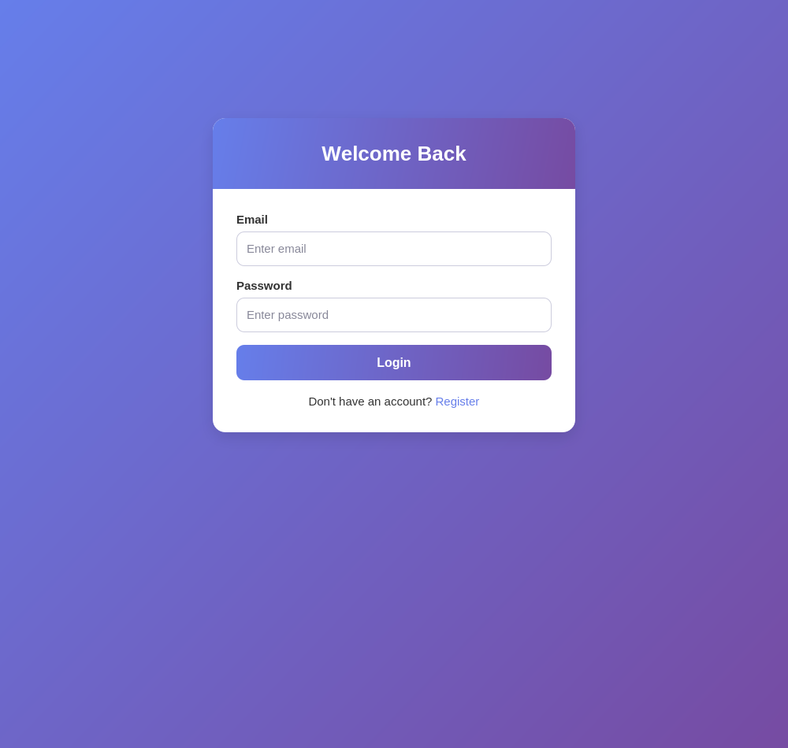
Application Screens (1)
Landing Page
Register Page
Login Page
Hero section and three feature cards
Username, email and password
Email and password login
Interface previews with sample data

Slide 16
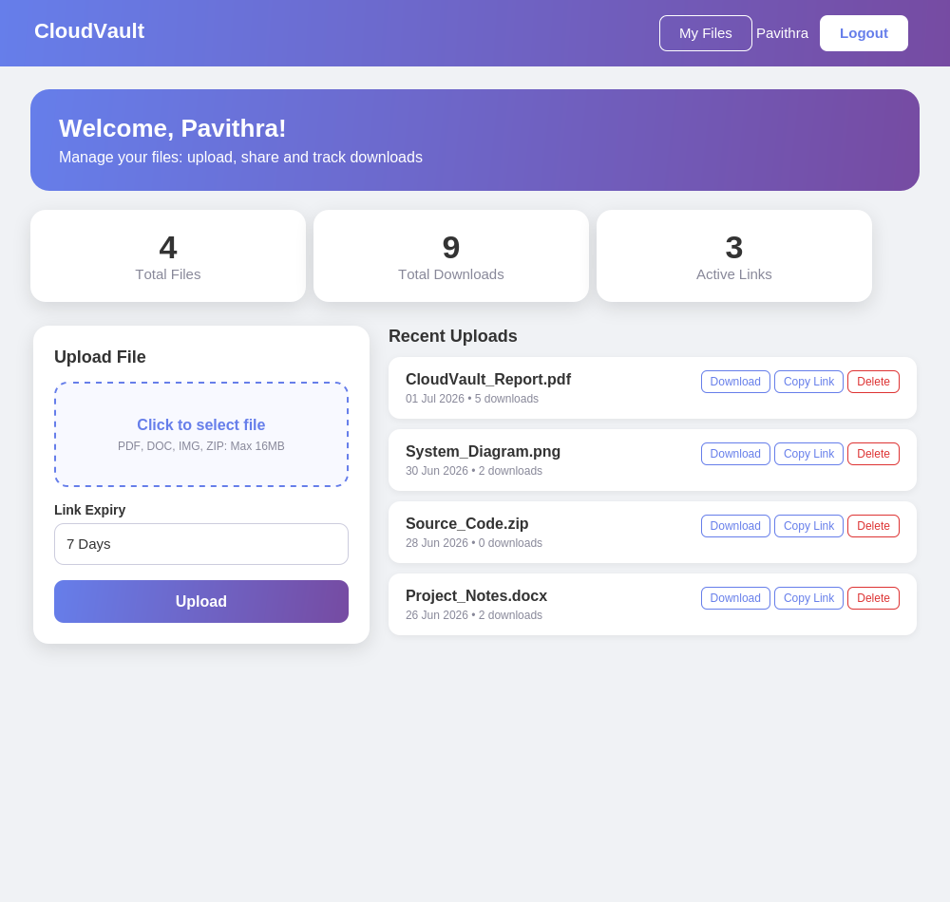
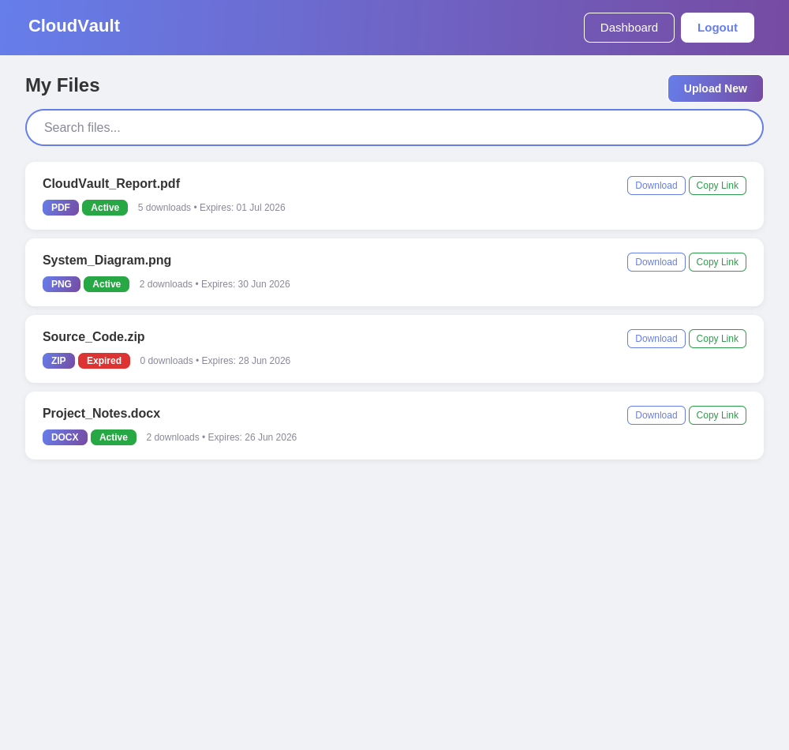
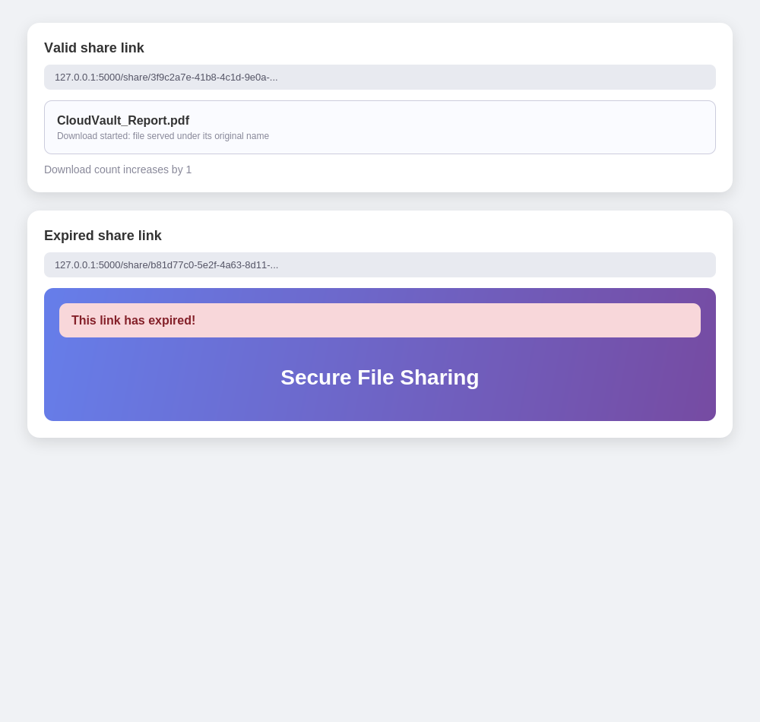
Application Screens (2)
Dashboard
My Files
Share Link Access
Statistics, upload form and recent files
Type and status badges, search, copy link
Valid link downloads, expired link shows a message
Interface previews with sample data

Slide 17
Analysis
14 / 14
test cases passed
10
application routes
4 weeks
from zero Flask knowledge
What was tested
Observations
Registration, duplicate email, login, wrong password
Allowed and blocked file types, 16 MB limit
Valid and expired share links, download count
Dashboard totals, delete, search, drag and drop, responsive layout
Fast response with Flask and SQLite at this scale
Hashed passwords, sanitized names, random tokens
To harden: ownership check, CSRF, secret key in environment variable

Slide 18
Skills Gained and Learning Outcomes
Python Flask
Database Design
Security Basics
Routing, templates, forms
MVC project structure
Built a complete web app
ORM models and relationships
SQLite queries with SQLAlchemy
Users and files tables
Password hashing, sessions
Safe file names, type checks
Unguessable share tokens
File Handling
Front-End Skills
Professional Practice
Upload, download, delete
Size limits and unique naming
Link expiry logic
Bootstrap 5 responsive layout
Drag-drop, live search
Clipboard and toast alerts
Git version control
Testing and bug fixing
Documentation and reporting

Slide 19
Conclusion and Future Work
Conclusion
Future work
Complete CloudVault built in the one-month internship
Authentication, upload, expiring links, tracking, dashboard and search implemented
Hands-on Flask, SQLAlchemy, Flask-Login, Jinja2, Bootstrap and JavaScript
A sound base for secure document sharing
Ownership checks and CSRF protection
AWS S3 and cloud deployment
Password-protected links, email alerts
In-browser preview, storage quota
Admin panel and REST API
Mobile app

Slide 20
SUMMER INTERNSHIP REVIEW | IT3711
Thank You
Questions and feedback are welcome
Project
Internship
Outcome
CloudVault: secure file storage and sharing
Flask, SQLAlchemy, SQLite, Bootstrap 5
DLK Software Solutions, Vadapalani, Chennai
06 June – 06 July 2026, Mentor: Mr. Ram
14 of 14 test cases passed
Upload, expiring links, tracking, dashboard
J. Pavithra – 810023205035 | B.Tech Information Technology, UCE (BIT Campus), Anna University
GitHub: github.com/Pavithra200620

