Slide 1
Digital Portfolio
STUDENT NAME: P.PAVITHRA
REGISTER NO :36324U18043
NMID:
DEPARTMENT: BSC(COMPUTER SCIENCE)
COLLEGE: COLLEGE/ UNIVERSITY :SREE ABIRAAMI ARTS AND SCIENCE COLLEGE FOR WOMEN THIRUVALLUVAR UNIVERSITY

Slide 2
PROJECT TITLE
WEB DEVELOPMENT

Slide 3


AGENDA
Problem Statement
Project Overview
End Users
Tools and Technologies
Portfolio design and Layout
Features and Functionality
Results and Screenshots
Conclusion
Github Link
3/21/2024 Annual Review

Slide 4

PROBLEM STATEMENT
Develop a compelling digital portfolio that showcases creative, technical, and strategic skills across diverse projects. The challenge lies in curating content that reflects personal growth, aligns with industry standards, and effectively communicates value to potential employers or collaborators.

Slide 5

PROJECT OVERVIEW
This content project showcases a curated selection of original works, blending creativity, strategy, and storytelling across digital platforms. It highlights design thinking, audience engagement, and brand alignment through visual, written, and multimedia formats. The portfolio reflects personal growth, versatility, and a commitment to impactful communication tailored for professional opportunities and creative collaborations.

Slide 6

WHO ARE THE END USERS?
End users of a portfolio are individuals or organizations who view it to assess skills, achievements, and experiences. They can include employers, recruiters, clients, investors, teachers, or peers depending on the portfolio’s purpose. Their goal is to evaluate credibility, creativity, and suitability for opportunities such as jobs, projects, or academic assessments.

Slide 7

TOOLS AND TECHNIQUES
A portfolio uses various tools and techniques to present skills and achievements effectively. Tools include software like MS Word, PowerPoint, Canva, Photoshop, or coding platforms for digital portfolios. Techniques involve clear organization, use of visuals, highlighting key projects, and providing evidence of work. Together, these help create a professional, engaging, and easy-to-navigate portfolio for end users.

Slide 8
PORTFOLIO DESIGN AND LAYOUT
Portfolio design and layout focus on creating a professional, visually appealing, and easy-to-navigate presentation of work. A good design balances text, visuals, and white space to avoid clutter. Layout techniques include clear headings, consistent fonts, and logical sequencing of sections. Effective portfolios highlight strengths, showcase creativity, and ensure readability, leaving a strong impression on potential employers, clients, or evaluators.
8

Slide 9
FEATURES AND FUNCTIONALITY
A portfolio’s features and functionality highlight its usability and effectiveness. Key features include organized sections, visuals, and detailed project descriptions. Functionality ensures easy navigation, responsiveness, and accessibility, especially in digital portfolios. Interactive elements like links, videos, or downloadable files enhance engagement. Together, they provide a smooth user experience while showcasing skills, achievements, and creativity clearly to impress potential employers or clients.

Slide 10
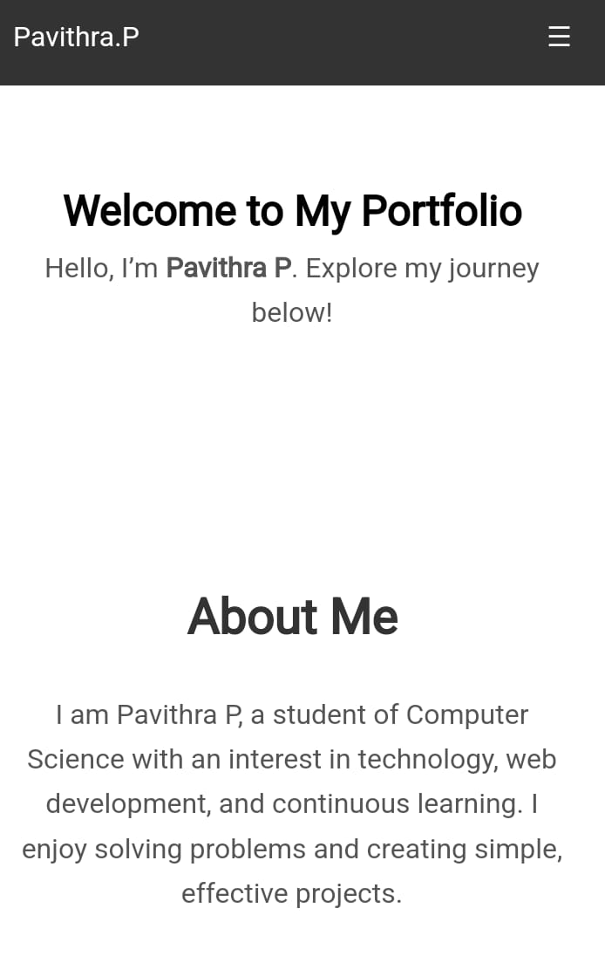
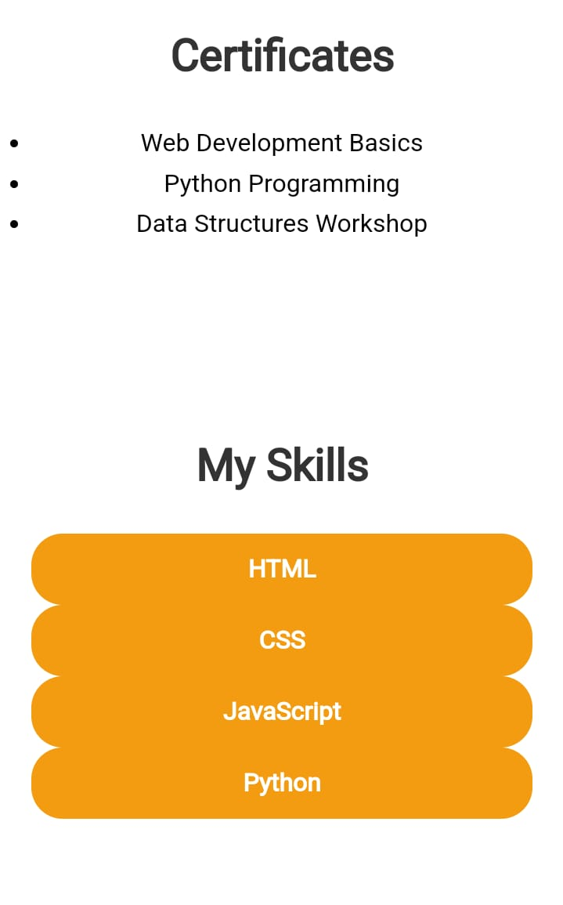
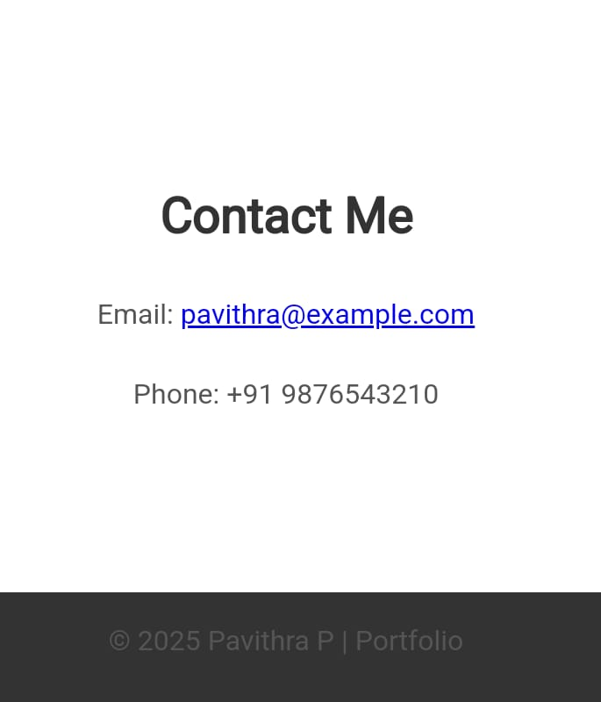

RESULTS AND SCREENSHOTS
3/21/2024 Annual Review
10

Slide 11
CONCLUSION
A portfolio serves as a powerful tool to showcase skills, achievements, and creativity in a structured way. It reflects professionalism, dedication, and personal growth while helping individuals stand out. With proper design, features, and functionality, it becomes an effective medium for communication. Ultimately, a well-prepared portfolio builds credibility and opens opportunities for career advancement, projects, or academic success.
11

Slide 12
GITHUB LINK
https://pavithra2007p.github.io/pavithra/

