Slide 1

MACHINE LEARNING REINFORCEMENT PROJECT
DONE BY
PAVITHRA MUTHUMAYAN

Slide 2
INTRODUCTION
Overview:
The Indian Premier League (IPL) is one of the most popular cricket leagues globally.
Predicting match outcomes helps teams, analysts, and fans with strategic insights.
Objective:
The aim of this project is to predict the winner of an IPL match based on various features such as the teams playing, toss winner, toss decision, and other match-related factors using different machine learning models like Logistic Regression, SVM, KNN, Decision Trees, Random Forest, and XGBoost. The best model must be selected after evaluating the performance and hyperparameters must be tuned for further improvements.
Dataset:
Real IPL match data with features such as teams, toss decisions, match city, and winning metrics.

Slide 3
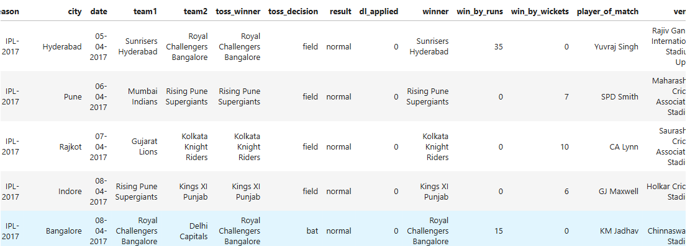
Data Understanding
Dataset Description:
Total records: ~750 matches
Columns: Season, city, team1, team2, toss_winner, toss_decision, win_by_runs, win_by_wickets, winner, etc.
Target Variable: winner
Features Used:
team1, team2, toss_winner, toss_decision, city, Season, and derived flags like team1_home.

Slide 4
Data Cleaning
Cleaning Steps:
Removed unnecessary columns (like umpire names, ids).
Dropped rows with missing winner or team names.
Categorical Encoding:
Applied pd.get_dummies() for columns like team1, team2, city, toss_winner, and toss_decision.
Target Encoding:
Used LabelEncoder to convert team names (winner column) to numerical labels.
Final Features:
About 30+ binary and numerical features after encoding.

Slide 5
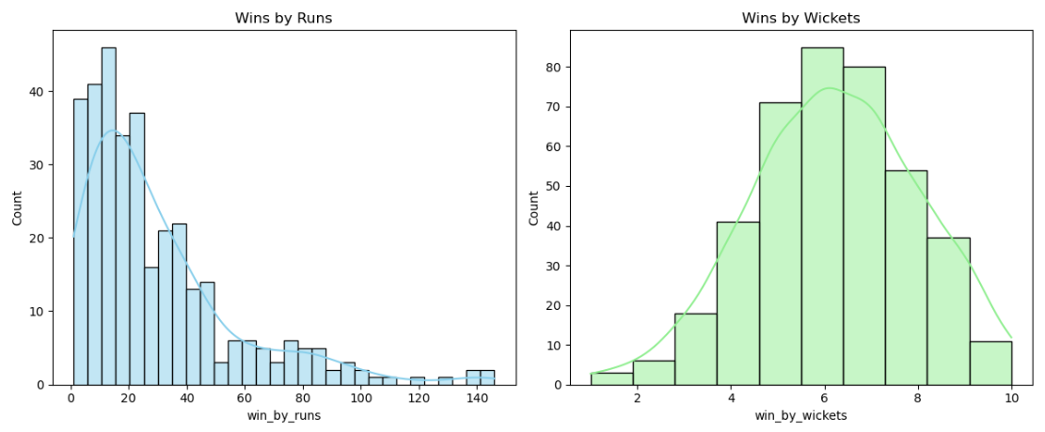
Exploratory Data Analysis (EDA)

Slide 6
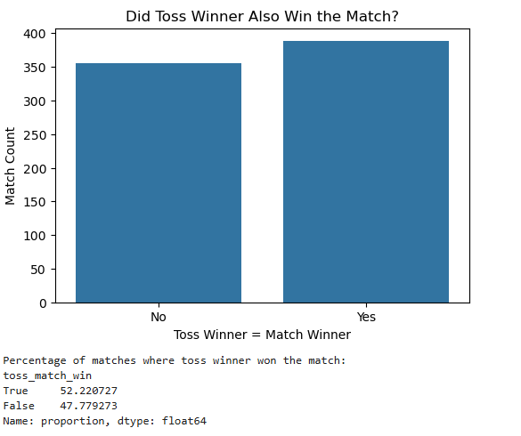
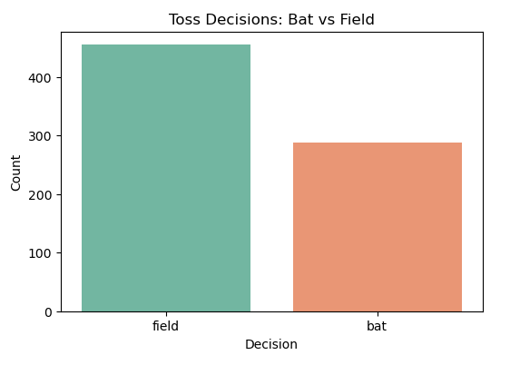
Exploratory Data Analysis (EDA)

Slide 7
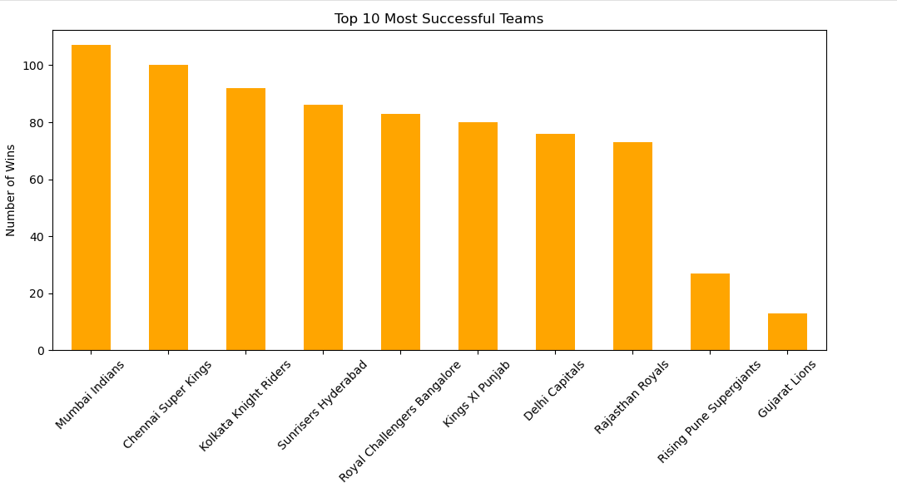
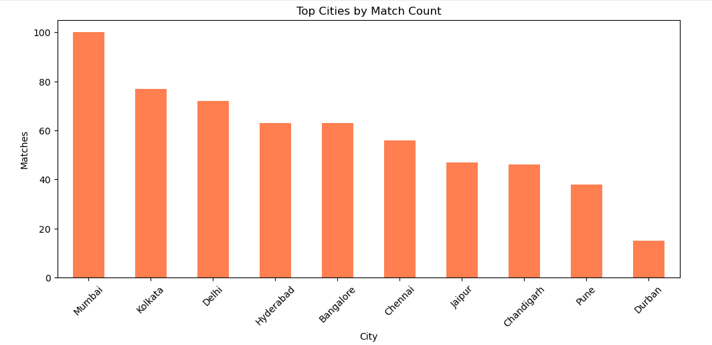

Slide 8
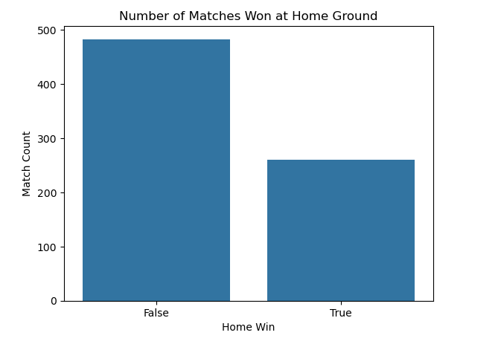
Exploratory Data Analysis (EDA)

Slide 9
Modeling Process
Models Implemented:
Logistic Regression
Support Vector Machine (SVM)
K-Nearest Neighbors (KNN)
Decision Tree
Random Forest (with OOB score)
XGBoost (with hyperparameter tuning)
Hyperparameter Tuning:
Used GridSearchCV for KNN, Decision Tree, Random Forest, and XGBoost.
Used Elbow method for KNN optimization.
Evaluation Metrics:
Accuracy
Precision, Recall, F1-score
Confusion Matrix

Slide 10
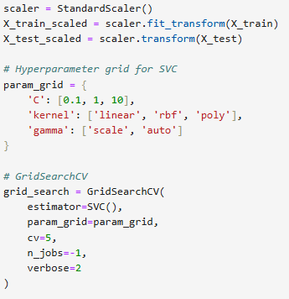
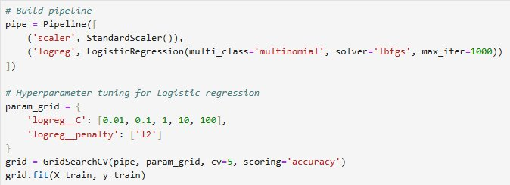
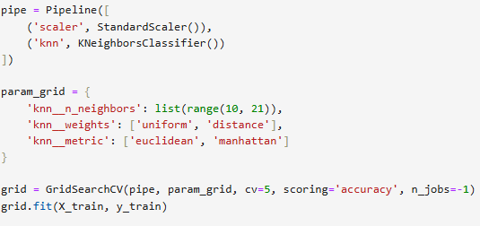
Hyperparameter Tuning

Slide 11
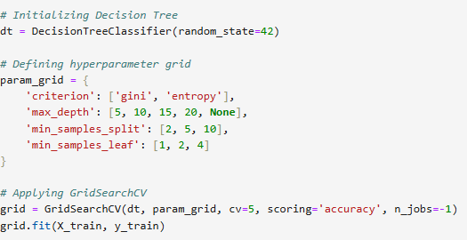
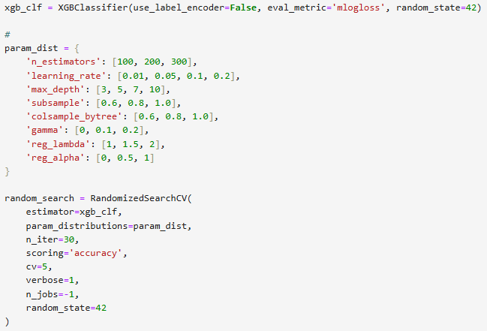
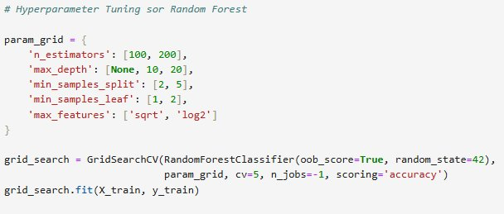

Slide 12
Model Comparison
Model | Accuracy (%)
Logistic Regression | ~61%
SVM | ~63%
KNN | ~66%
Decision Tree | ~92%
Random Forest | ~96%
XGBoost | 98%
Best Model: XGBoost
Highest accuracy and stable performance across classes.
Able to handle multicollinearity and feature interactions effectively.

Slide 13
CONCLUSION
While our current model uses several match-level features like team names, toss winner, and venue, it still lacks some of the most crucial elements that truly define a cricket match. To improve its real-world performance, we must consider adding:
Match-specific details such as current team lineups, player form, head-to-head stats, and even captaincy.
External match-day factors like pitch condition, weather, and dew—all of which significantly affect the outcome but aren’t captured in the dataset.
More importantly, cricket as a sport can never be predicted with 100% certainty. It’s not just about numbers—it’s about how players perform on that particular day, which often defies expectations and historical data.

Slide 14


