Slide 1

Project Title : Patient Management System
Name : Pavithra B
Date Submitted : 17.10.2024

Slide 2
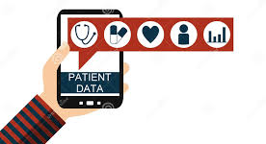
Aim of the Project
The primary objective of this project is to develop an efficient and user-friendly Patient Management System that streamlines the management of patient records and enhances communication between healthcare providers and patients.
Key Aims:
Improve Data Management: Automate patient registration and record-keeping to minimize manual errors.
Enhance Communication: Foster better interaction between healthcare professionals and patients.
Ensure Accessibility: Create a centralized platform for easy access to patient information.
Support Decision-Making: Provide healthcare professionals with accurate and up-to-date patient data to facilitate informed decisions.

Slide 3

Business Problem or Problem Statement
The healthcare sector faces significant challenges in managing patient information manually, leading to inefficiencies, errors, and communication barriers.
Problem Overview:
Inefficient Processes: Many healthcare providers still rely on paper-based methods to manage patient records, resulting in lost or misfiled information.
Communication Gaps: Lack of a centralized system hampers communication between doctors, nurses, and administrative staff, leading to potential misunderstandings and delays in patient care.
Data Integrity Issues: Manual data entry increases the risk of inaccuracies, compromising patient safety and quality of care.

Slide 4

Project Description
This project involves creating a Patient Management System using Python to address the identified issues and streamline administrative tasks in healthcare.
Scope and Objectives:
Develop a user-friendly interface for easy navigation and operation.
Implement core functionalities that allow for efficient patient data management.
Use robust file handling techniques for saving and retrieving patient information.
Technologies Used: Python programming language, file handling, and exception management.

Slide 5

Functionalities
The Patient Management System includes several key functionalities aimed at simplifying the management of patient records.
Main Functionalities:
Patient Registration: Allows healthcare providers to add new patient records efficiently.
Patient Display: Enables users to view detailed information about existing patients.
Patient Search: Provides a quick search feature to locate patients by their unique patient ID.
Patient Deletion: Facilitates the removal of patient records when necessary, ensuring data management is up to date.

Slide 6

Functionalities(continued)
Additional Functionalities: Medical History Management: Allows for the recording and updating of a patient's medical history for better treatment planning.
File I/O Operations: Utilizes file handling to store and retrieve patient data, ensuring that all information is preserved even after the program closes.

Slide 7

Input Versatility with Error Handling and Exception Handling
The system is designed to handle various input types, ensuring robustness and versatility in data entry.
Error Handling Mechanisms: Validates user inputs to prevent incorrect or incomplete data entry.
Exception handling is implemented to manage potential errors during file access, such as file not found or permission issues.
Provides user-friendly error messages to guide users in correcting input errors.

Slide 8
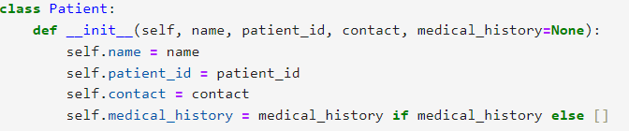
Code Implementation
The code is organized into classes to enhance readability and maintainability.
Key Components:Patient Class: Represents individual patient records with attributes such as name, ID, contact information, and medical history.
PatientManager Class: Manages a list of patients, including functions for adding, displaying, searching, and deleting patient records.
Code snippet example

Slide 9

Results and Outcomes
The implementation of the Patient Management System led to significant improvements in managing patient data and overall administrative efficiency.
Key Outcomes:Reduction in Administrative Workload: Automation of record-keeping processes minimized manual entry, saving time for healthcare staff.
Improved Data Accuracy: Centralized storage of patient information reduced errors associated with manual data handling.
Enhanced Communication: Facilitated better communication between healthcare providers and patients through organized and accessible records.

Slide 10

Conclusion
In conclusion, the Patient Management System effectively addresses the administrative challenges faced by healthcare providers, promoting efficient data management and communication.
Future Developments:
Potential enhancements could include features such as appointment scheduling, integration with electronic health records (EHR), and advanced reporting capabilities.
Thank you for your attention!

Slide 11


