Slide 1
Mentor id vadivelmurugang@sowdambikaengg.edu.inEvaluator id menakak@sodambikaengg.edu.in

Slide 2
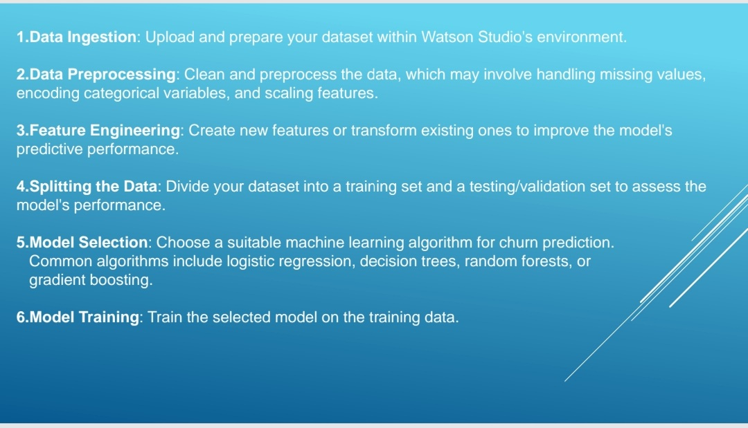

Slide 3
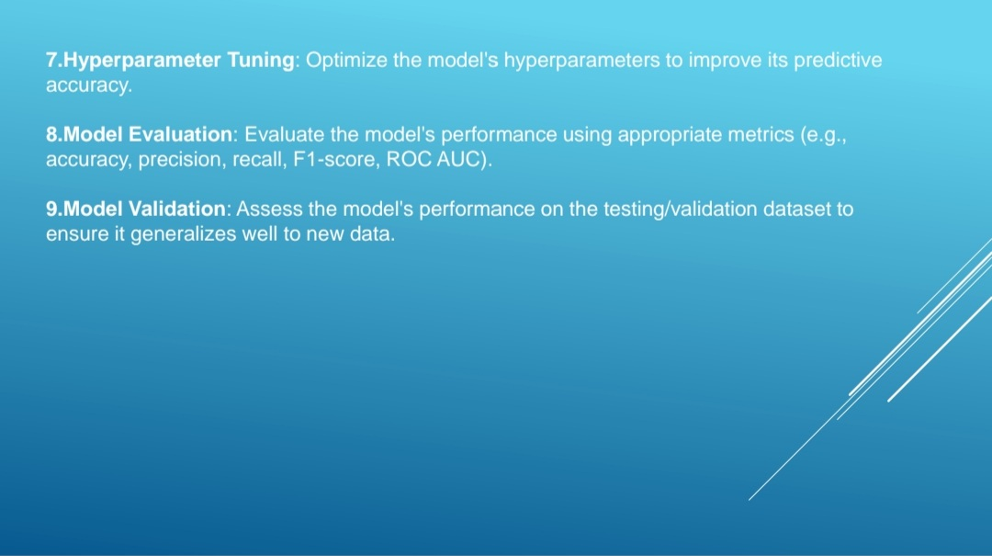

Slide 4
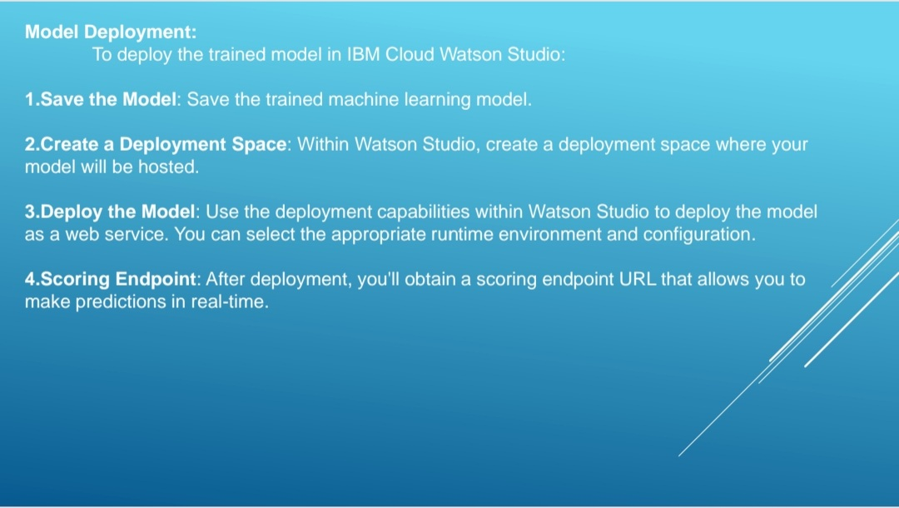

Slide 5
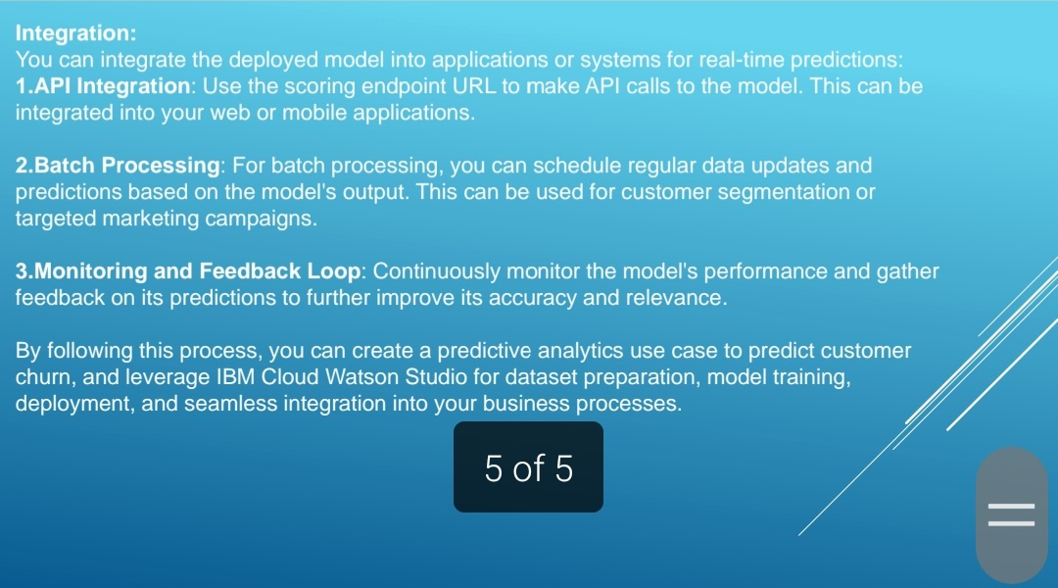

Slide 6
Thank you

