Slide 1



Hospital Management System
L
BY:
NEHA V 23CDR108
PAVITHRA DEVI M 23CDR117

Slide 2
Problem Description
Managing hospital operations manually leads to inefficiencies, errors in patient data handling, and delays in appointments and medical services. There is a need for a centralized, digital system that allows for secure, streamlined management of hospital resources including patient records, appointments, doctor profiles, and medical histories. The aim of this project is to develop a web-based Hospital Management System using Flask that automates these tasks, improves data accuracy, and enhances the overall hospital workflow.

Slide 3
Objectives
Centralize patient records, appointments, and medical data.
Provide secure user authentication and role-based access (Admin, Doctor, Staff).
Streamline appointment scheduling, medical record management, and billing.
Offer a responsive, easy-to-use web dashboard for staff and doctors.
Ensure data security, with CSRF protection, authentication, and role restrictions.
3

Slide 4
Tech Stack
Backend: Python Flask
Database: PostgreSQL with Supabase
Authentication: Supabase Auth
Frontend: HTML, CSS, Bootstrap 5, jQuery
Templating: Jinja2
Forms: Flask-WTF
Deployment-ready with HTTPS support
4

Slide 5
Advantage
Centralized digital hospital management
Real-time patient, appointment, and billing data
Secure, role-specific access control
Uses Supabase for secure cloud database and authentication
Disadvantage
Initial training required for non-technical staff
Storage and cybersecurity measures need regular audits
Advanced features like pharmacy or insurance pending future updates

Slide 6
Security Features
Password hashing via Supabase Auth
CSRF protection with Flask-WTF
Role-based access control
Secure session management
Input validation and sanitization
HTTPS protocol for deployment
Secure file upload handling and storage permissions

Slide 7
Types of Modules
User Registration & Authentication Module
Dashboard Module
Patient Management Module
Doctor Management Module
Appointment Scheduling Module
Medical Records Management Module
Billing and Invoicing Module
Notification System Module
User Profile and Settings Module
7

Slide 8
Future Enhancements
Patient self-service appointment portal
Integrated telehealth consultations
Laboratory and pharmacy management modules
Health insurance claim processing
Mobile apps for doctors and patients
Advanced reporting and analytics dashboards

Slide 9
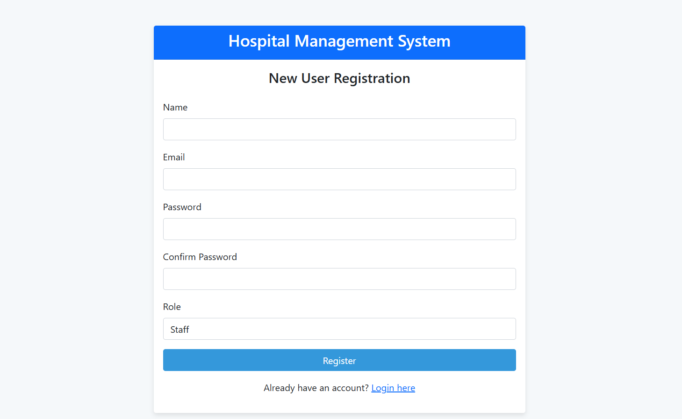
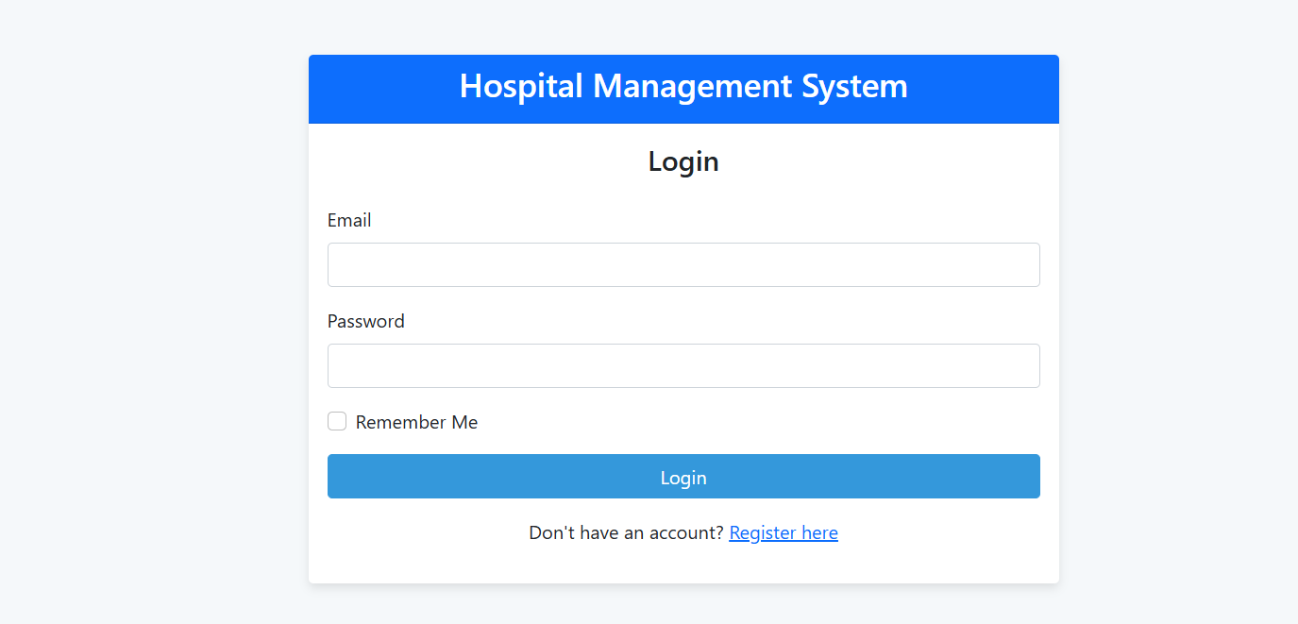
Screenshots
Registration page
Login page

Slide 10
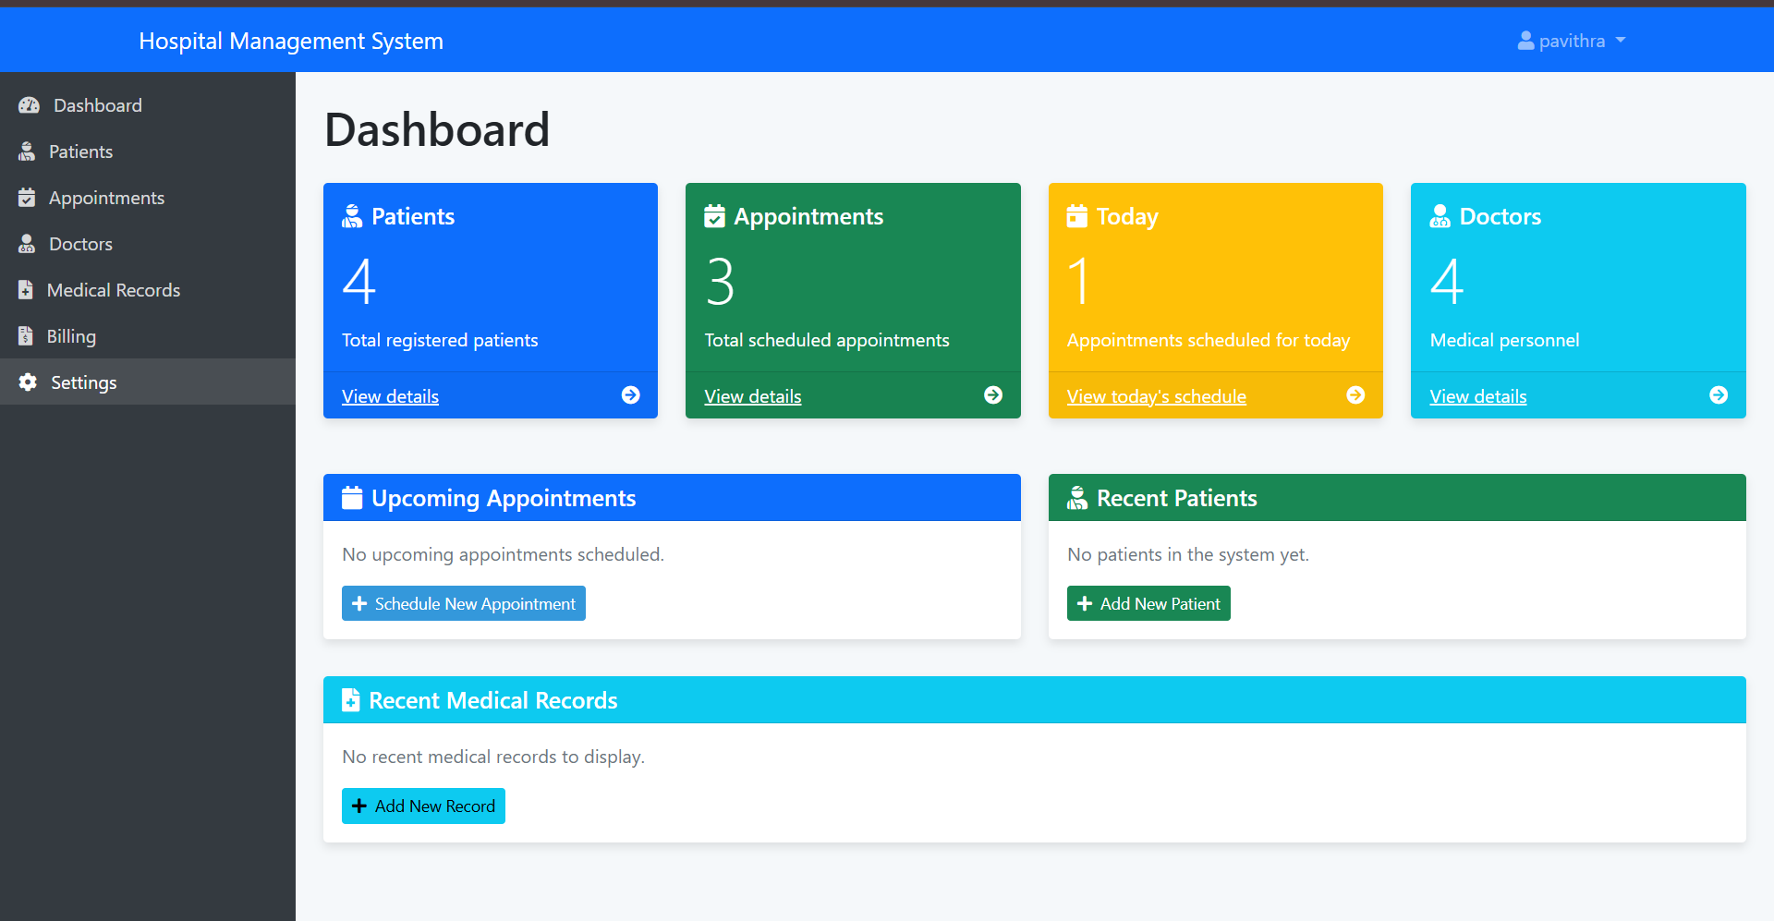
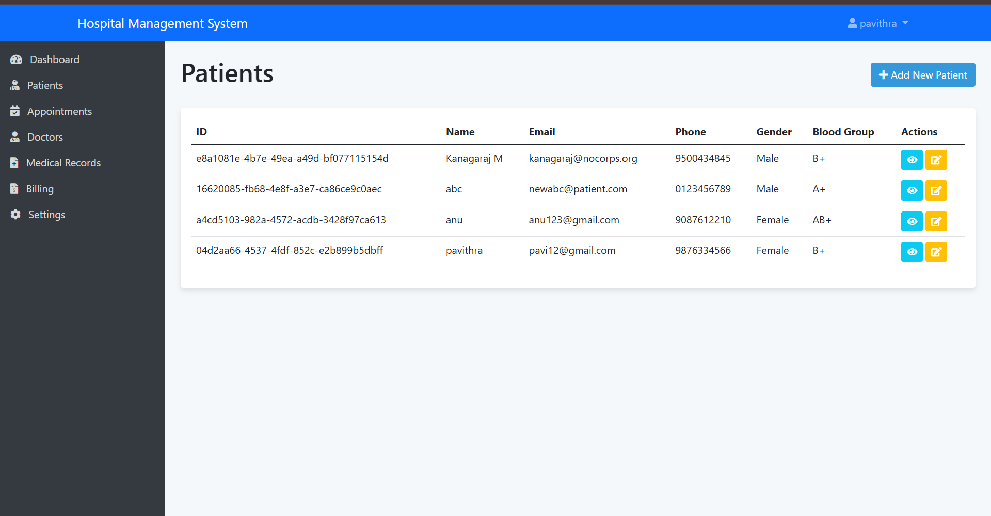
Dashboard
Patient page

Slide 11
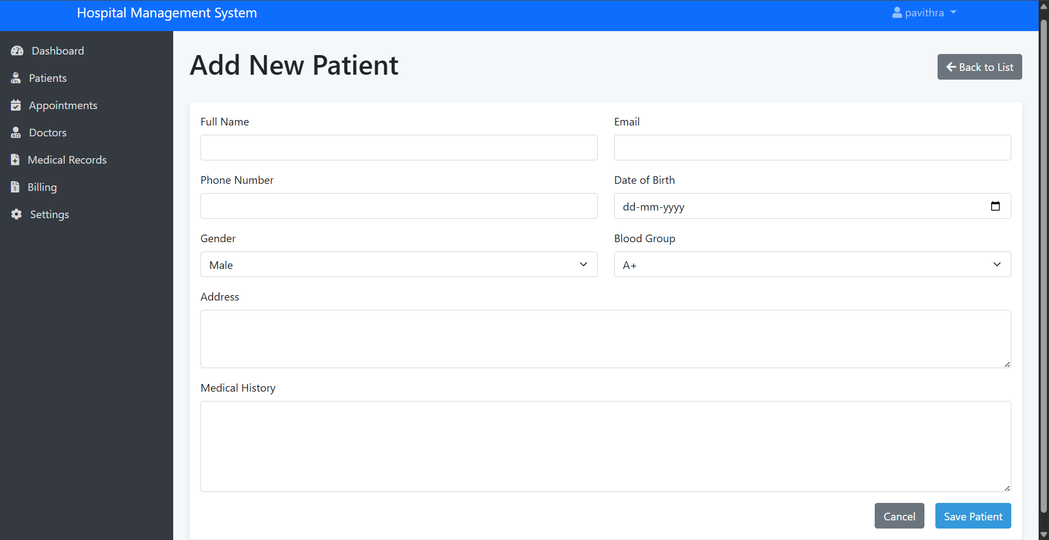
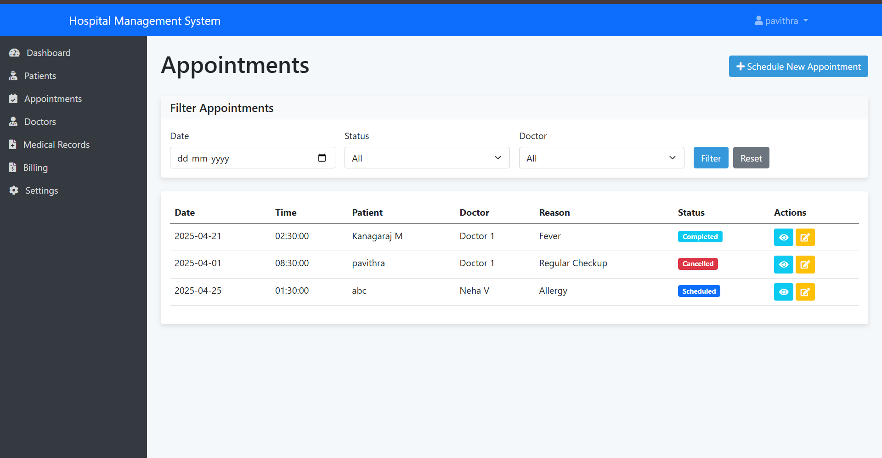
Appointment page

Slide 12
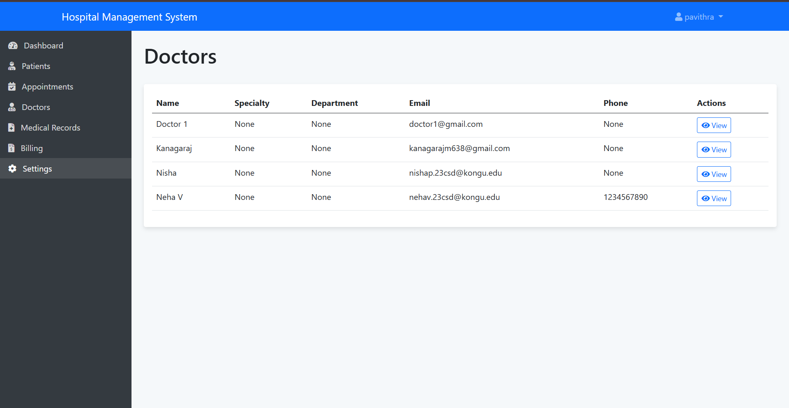
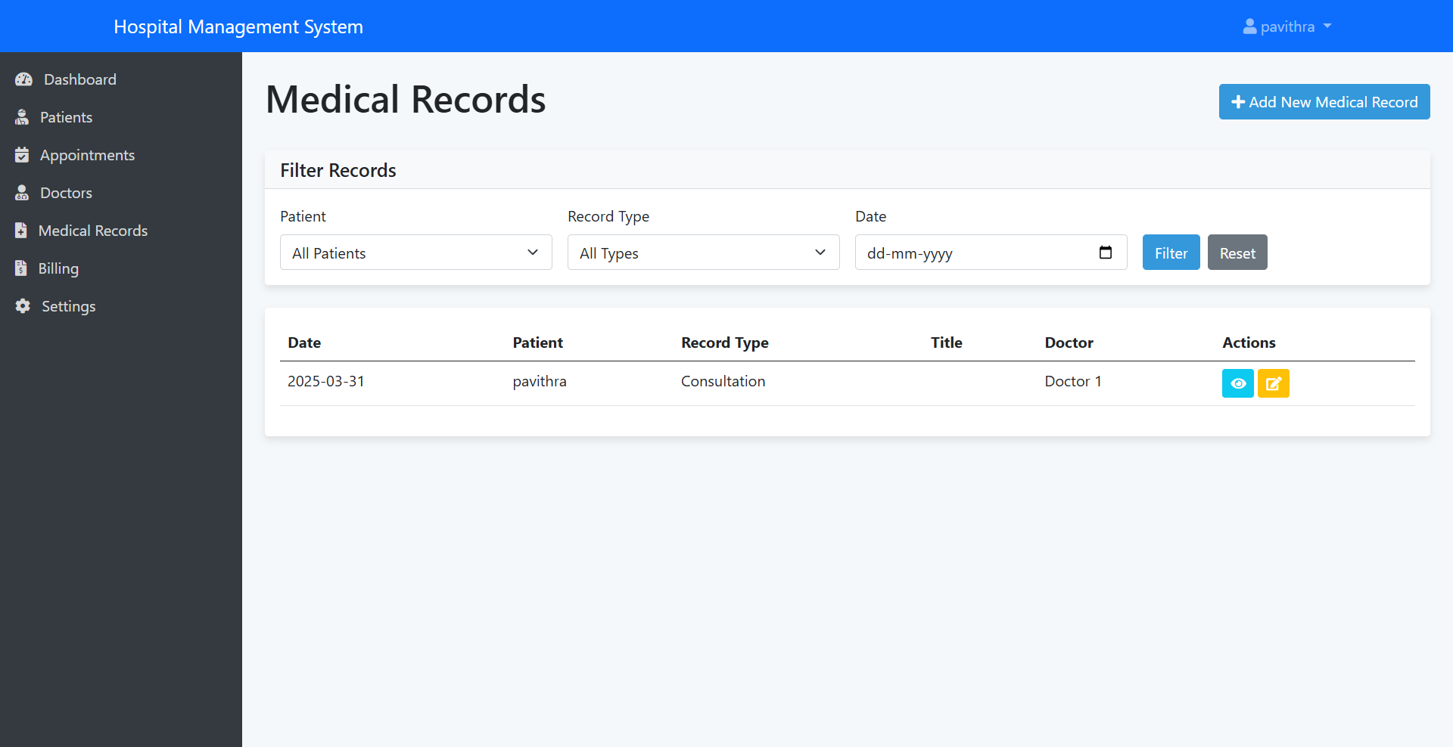
Doctors page
Medical Records Page

Slide 13
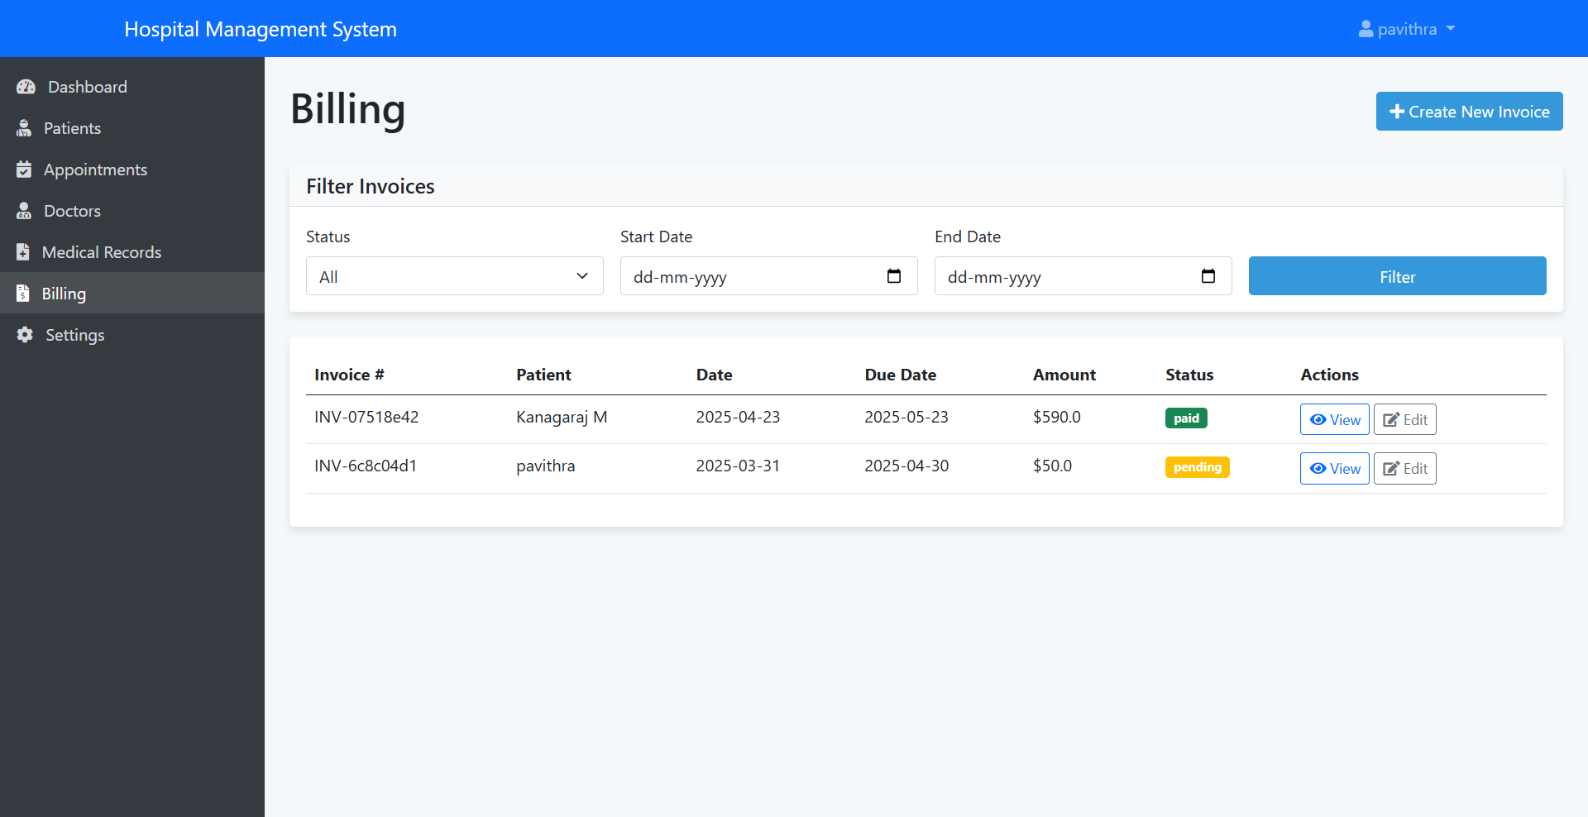
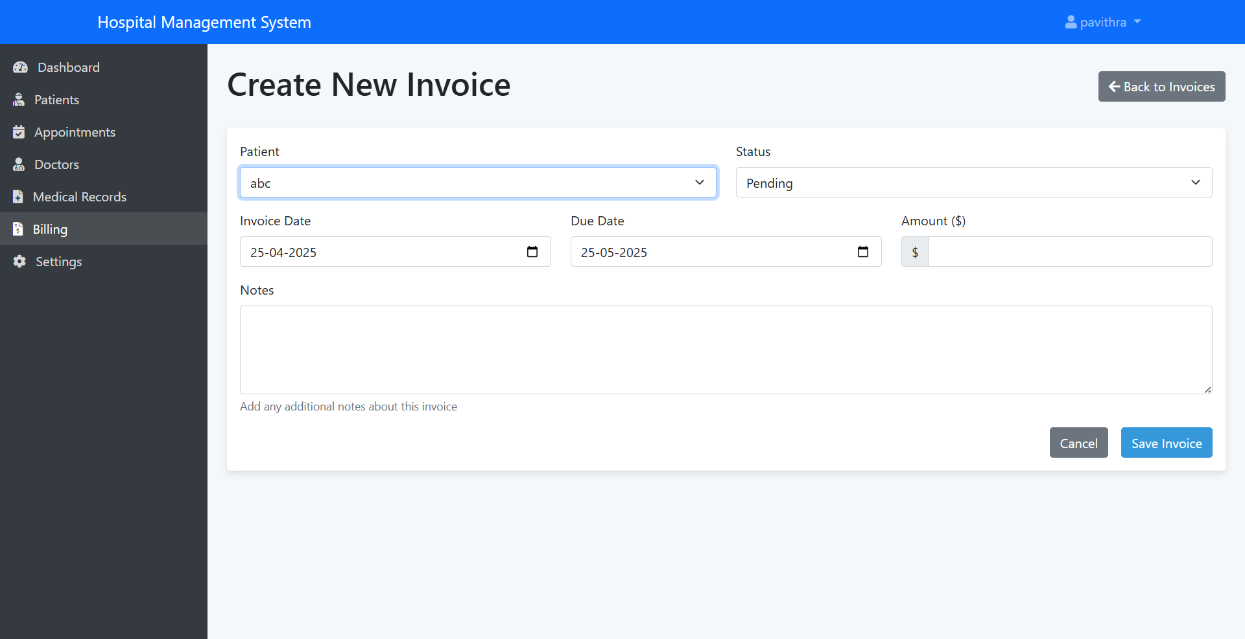
Billing page
Invoice page

Slide 14
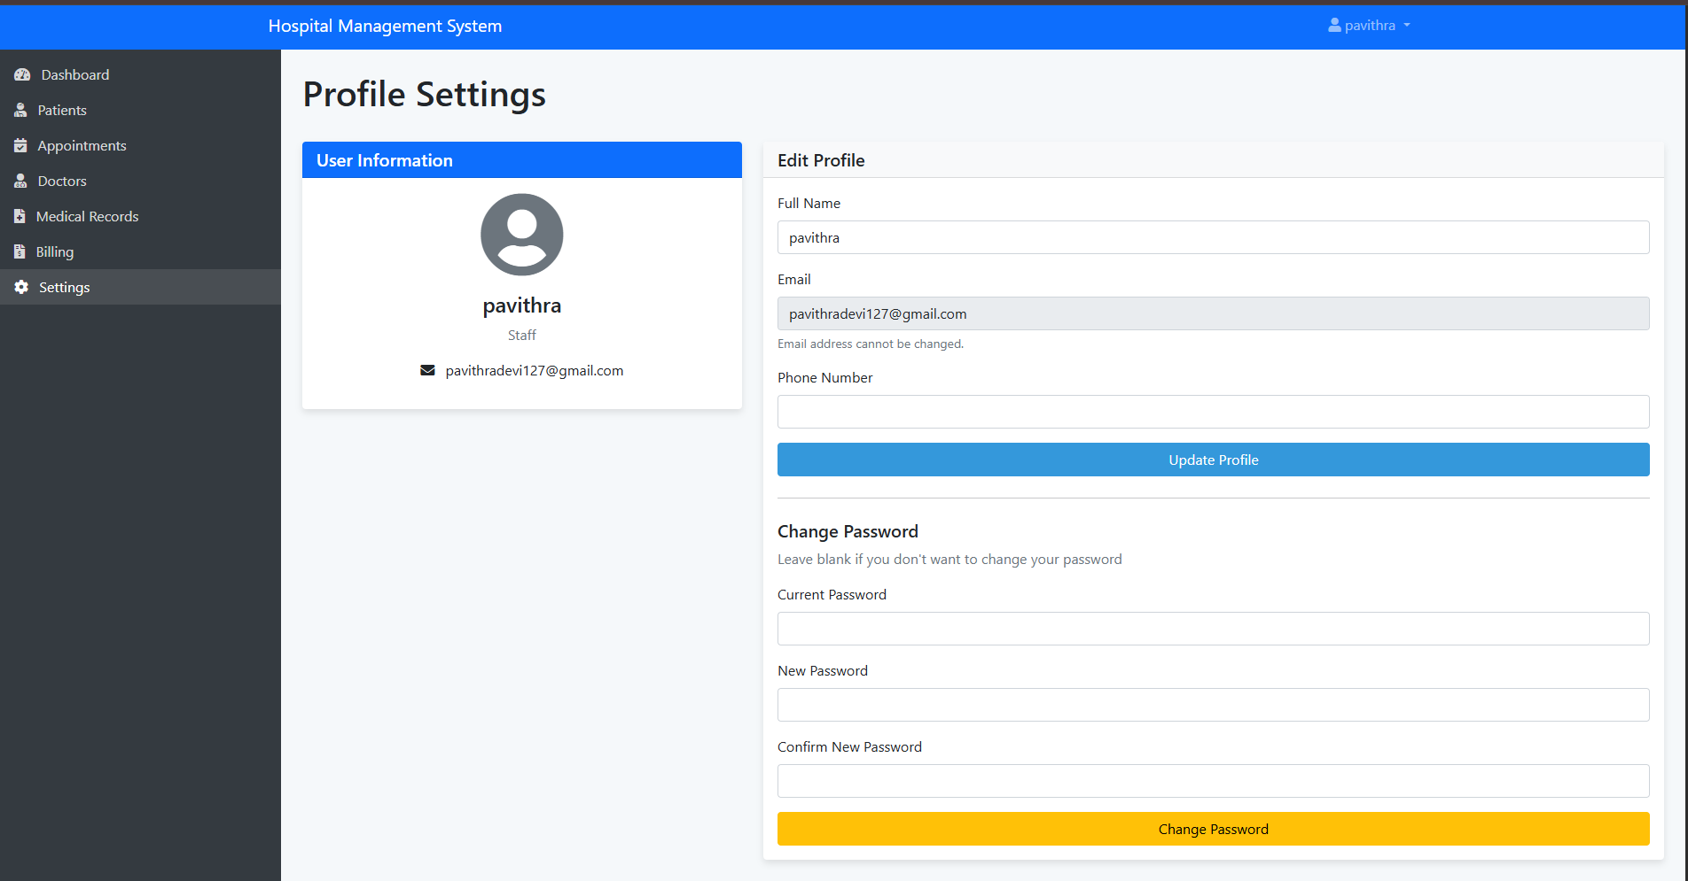
Settings Page

Slide 15
Thank you!

