Slide 1
Employee Insights Prediction Dashboard

Slide 2
Project Overview
Objective: Predict key employee insights using ML models
Modules:
- Attrition Prediction (Classification)
- Promotion Likelihood (Regression)
Tools Used: Python, Pandas, Scikit-learn, XGBoost, Streamlit,Seaborn,Matplotlib

Slide 3
Dataset Details
Records: 1470 employees
Important Features:
- Job Role, Monthly Income, Education
- Performance Rating, Job Level
- Years at Company, Years in Current Role
-Age, Marital Status, etc..,

Slide 4
Data Preprocessing
1. Handle Missing Values (Imputation)
2. Label & One-Hot Encoding
3. Outlier Handling (IQR Method)
4. SMOTE for balancing classes
5. Feature Scaling (for regression)
6. Train-test split

Slide 5
Model 1: Attrition Prediction
Model Used: XGBoost Classifier
Target: Attrition (Yes/No)
Balanced using SMOTE
Achieved Accuracy: ~86%
Key Features:
- Job Involvement, Education, Income, etc.

Slide 6
Model 2: Promotion Likelihood
Model Used: Linear Regression
Target: Years Since Last Promotion
R² Score: ~0.44
Features Used:
- Job Level, Total Working Years
- Years in Current Role, Education, Performance Rating etc..,

Slide 7
Streamlit Integration
Developed interactive UI using Streamlit
Two separate tabs for models:
- Tab 1: Predict Attrition
- Tab 2: Predict Promotion Likelihood
Real-time prediction with form inputs
User-friendly design with sidebar navigation

Slide 8
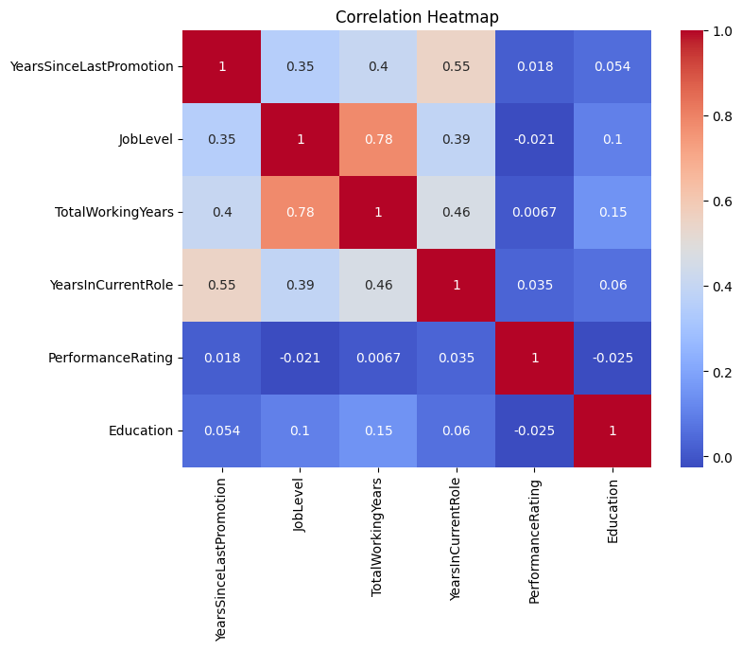
Correlation heatmap for promotion analysis

Slide 9
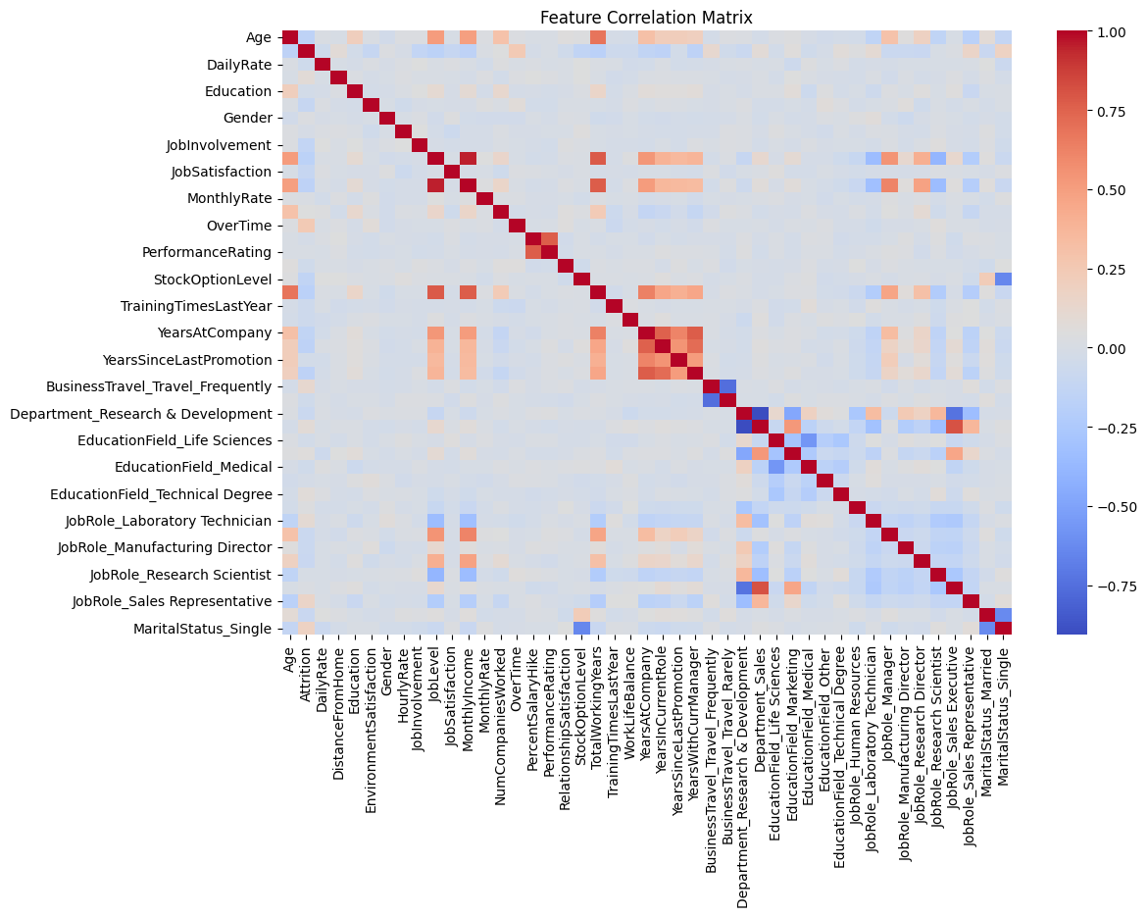
Correlation heatmap for attrition analysis

Slide 10
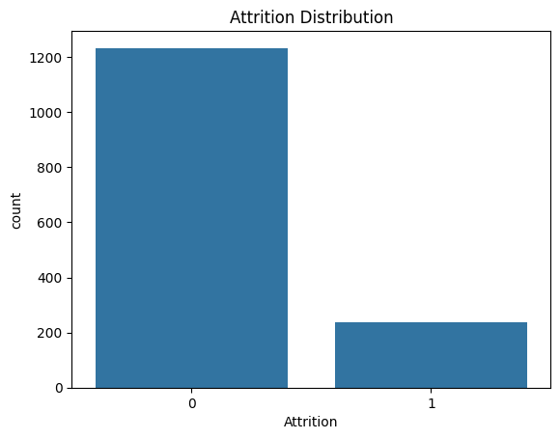
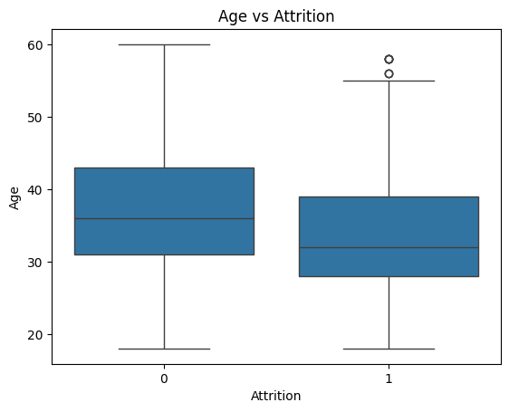
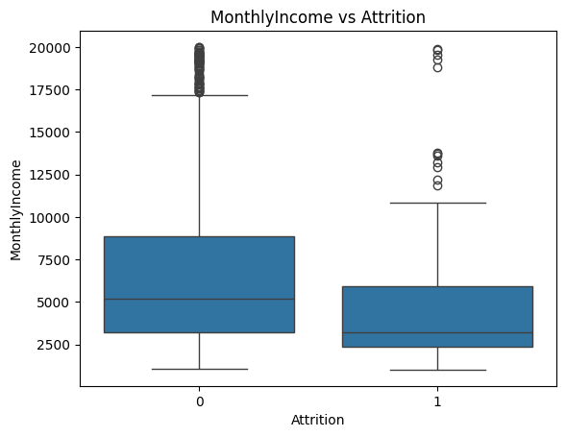
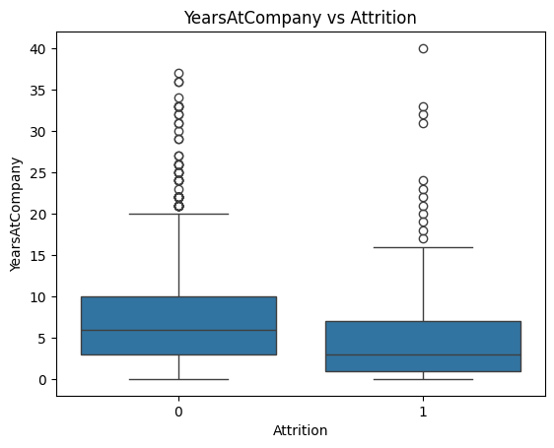
EDA for Attrition analysis

Slide 11
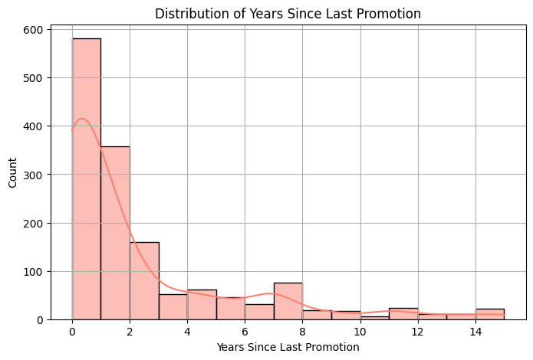
EDA for promotion analysis:

Slide 12
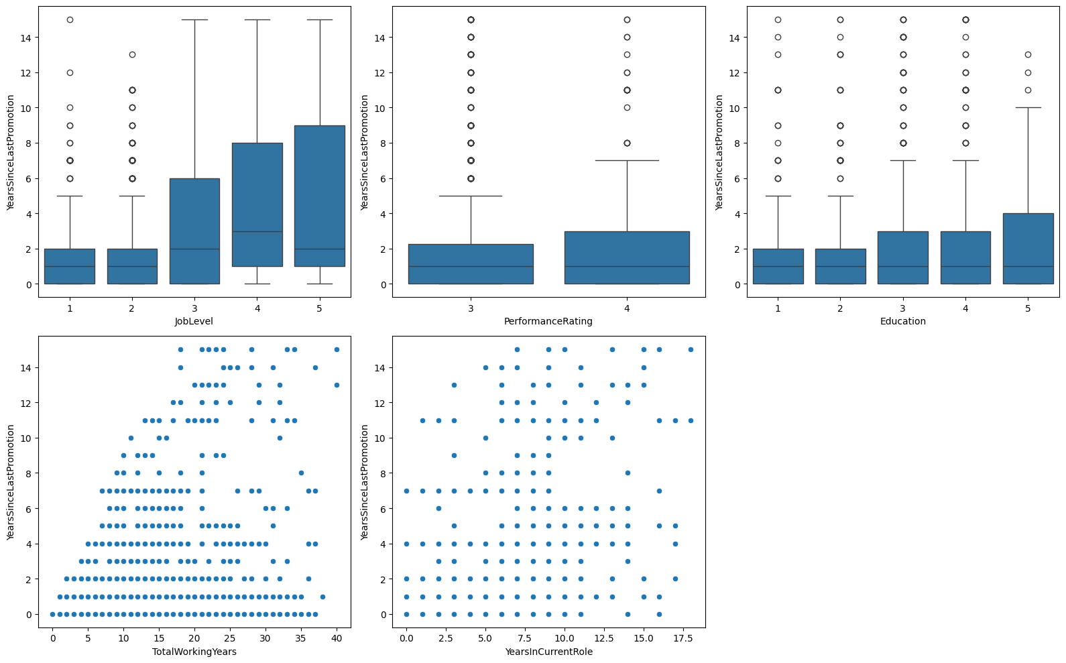
EDA for promotion analysis:

Slide 13
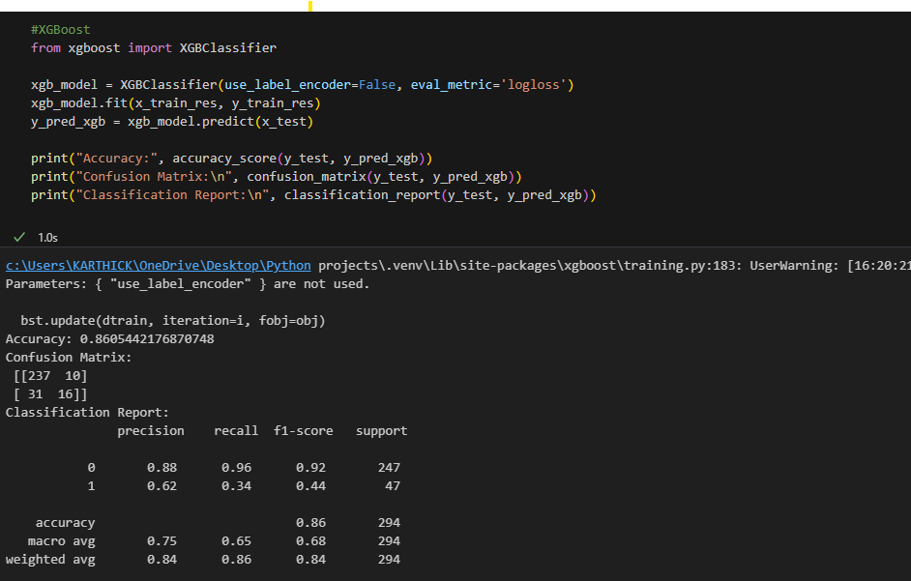
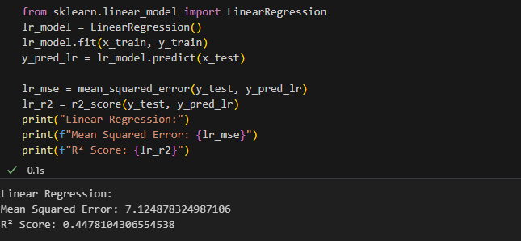

Slide 14
