Slide 1

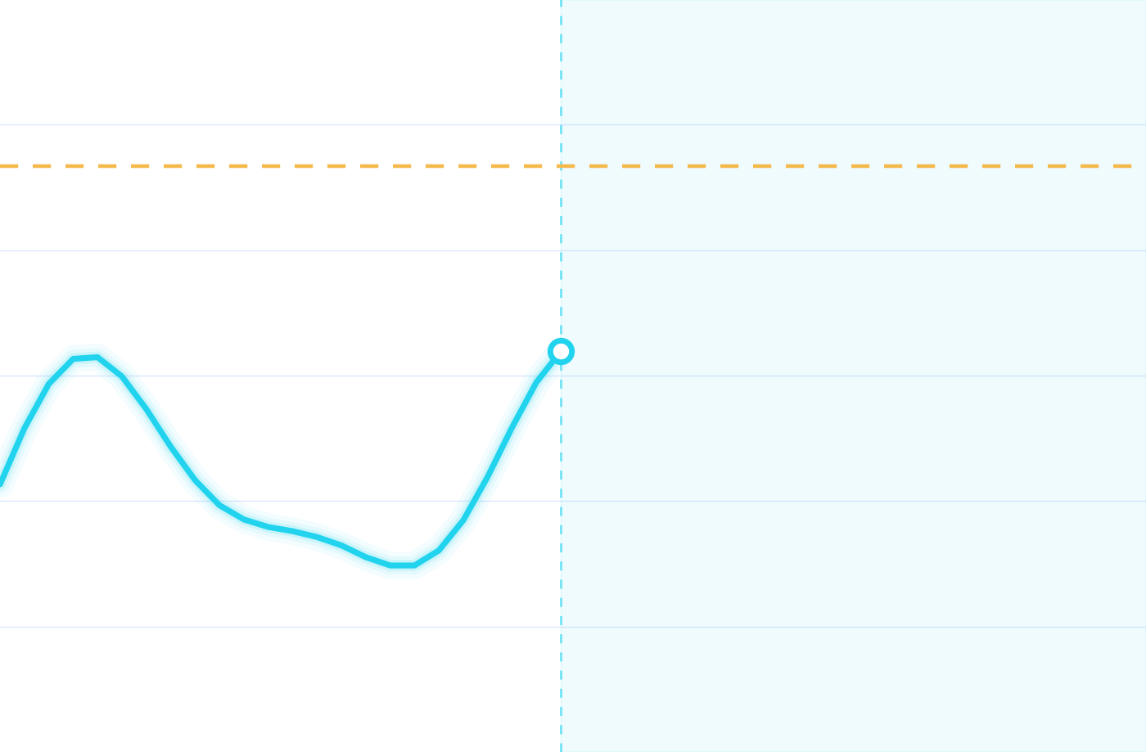
GlycoTwin AI
DIGITAL TWIN PROTOTYPE
180 mg/dL threshold
A transparent digital-twin prototype that turns glucose timelines into an inspectable two-hour excursion score.
Happiest Health Digital Twin Challenge 2026
LAST 2 HOURS · synthetic readings
NEXT 120 MIN · experimental score
[Team name] · [Institution]
Curve: GT001 synthetic readings generated by the prototype API.
SYNTHETIC DATA
EXPERIMENTAL PROTOTYPE
Notes:
Hi everyone, we're [team] from [institution], and this is GlycoTwin AI. It's a digital-twin prototype that takes a virtual patient's glucose timeline and turns it into a transparent, inspectable two-hour excursion score. One thing up front: everything you'll see uses synthetic data, and the score is an experimental heuristic, not a trained model. We'll be clear about what works today and what is still ahead.

Slide 2


A single lab value can't show how glucose moves
THE PROBLEM
A snapshot
GT-024 · synthetic CGM-like readings · prototype output
HbA1c summarises average glucose over weeks. It does not show swings hour to hour.
A timeline
384 recent readings at 15-minute intervals show direction, swings and speed of change.
Our question: can recent readings give an inspectable signal of a likely rise above 180 mg/dL within two hours?
Notes:
Glucose isn't a single number, it's a moving signal. A lab value like HbA1c summarises weeks of average glucose, but it can't show how glucose is moving right now. Sensor-style readings can. This chart is real output from our prototype's synthetic data, not a patient. Our question is whether recent readings can give a simple, inspectable signal of a possible rise above 180 mg/dL in the next two hours.

Slide 3




A digital twin built from profile and timeline
OUR APPROACH
Virtual patient profile
Experimental 2-hour score
Age, diagnosis, years since diagnosis, HbA1c, baseline glucose
Probability of crossing 180 mg/dL
Virtual patient twin
Profile and recent timeline held together as one patient state
Glucose timeline
Historical replay
Timestamped readings every 15 minutes
Step through earlier readings
Today's twin is a data model, not a physiological simulation.
Notes:
Our approach is a digital twin of a virtual patient. On the left are the two inputs: a profile and a glucose timeline. The twin holds them together as one patient state, and from it the prototype produces an experimental two-hour score and a historical replay. To be precise, today's twin is a data model. It does not simulate physiology, and we don't claim it does.

Slide 4





From virtual patient to prediction in five steps
USER JOURNEY
01
02
03
04
05
Select patient
Review profile
View history
Inspect prediction
Replay a point
Choose from 36 synthetic virtual patients
Age, diagnosis, HbA1c, baseline
Recent readings from a 15-minute sensor stream
Score and experimental risk band
Pick an earlier reading
GET /api/patients
GET /api/patients
GET …/timeline
GET …/predict
POST /api/simulate
Example outputs vary by patient and current model run. Use the live dashboard for actual displayed values; all data are synthetic.
Notes:
Here's the journey. Pick a virtual patient, review the profile, look at the last two hours of readings, then inspect the experimental score and its risk band. There's also a replay endpoint that lets you look at an earlier point in the timeline. In our example, GT001 shows 157.9 milligrams per decilitre and a 47.3 percent experimental score, in a Moderate band. It's a demonstration of the workflow, not a clinical result.

Slide 5
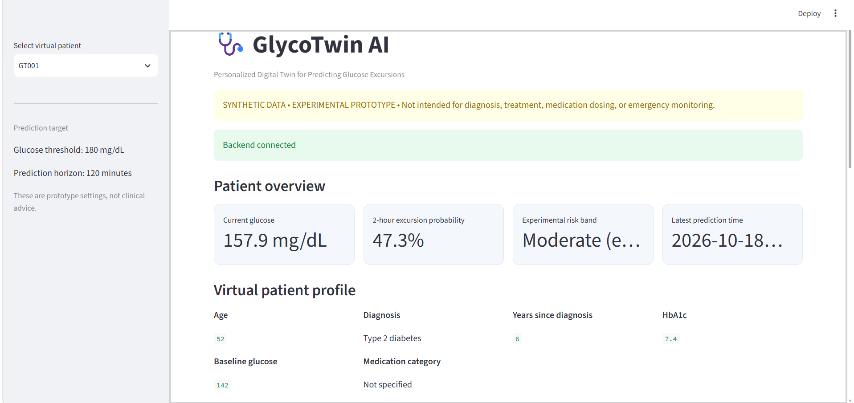
The prototype, running end to end
LIVE PROTOTYPE
1
Virtual patient selector
1
Switch between 36 synthetic patient profiles
3
Prediction target
2
2
180 mg/dL within 120 minutes
3
Safety banner
4
Synthetic, experimental, non-clinical
5
4
Overview metrics
Glucose, probability, band, time
5
Virtual patient profile
Age, diagnosis, HbA1c, baseline
Dashboard illustration · synthetic data
IMPLEMENTED NOW
Notes:
This is the actual dashboard, not a mockup. One: the virtual patient selector. Two: the prediction target in the sidebar, 180 milligrams per decilitre within 120 minutes. Three: a banner that states up front that this is synthetic and not for clinical use. Four: the overview metrics, and five: the virtual patient profile. [Switch to the live demo here and scroll to the glucose timeline.]

Slide 6
Three layers, one clear data path
SYSTEM ARCHITECTURE
PRESENTATION
SERVICE
DATA & LOGIC
Streamlit dashboard
FastAPI service
Synthetic data + trained ML
Patient selector
GET /health
36 generated virtual patients
HTTP · JSON
HTTP · JSON
Overview metrics
GET /api/patients
CGM-like stream: 15-minute readings
Virtual patient profile
GET /api/patient/{id}/timeline
Random Forest model (experimental)
Glucose timeline
GET /api/patient/{id}/predict
POST /api/simulate
Not built yet: database · authentication · external clinical validation
PLANNED
Notes:
The architecture has three layers. A Streamlit dashboard for presentation, a FastAPI service exposing five endpoints, and a data-and-logic layer holding three in-memory virtual patients, a synthetic timeline generator, and the heuristic baseline. Dashboard and API talk over plain HTTP and JSON. Be upfront about the gaps: there's no database, no authentication, and no trained model service yet. Those are in the roadmap.

Slide 7
How the model estimates future risk
SYNTHETIC-DATA MODEL
RANDOM FOREST · EXPERIMENTAL
RISK BANDS
0.9608
Random Forest classifier
Uses past-only rolling glucose features
Fuses sensor history with EHR context
Low
Moderate
High
Display bands are UI categories, not clinical classifications.
MODEL EVALUATION · HELD-OUT PATIENTS
Test set: 9 synthetic patients; 6,804 time points
What it is not
ROC-AUC 0.9608 · Average precision 0.2258
Synthetic-data metrics do not establish clinical performance. Positive events are rare, so accuracy can mislead.
Precision 47.6% · Recall 19.2% at threshold 0.5
The model is experimental; compare it with a simple baseline and validate externally before clinical claims.
Notes:
This is exactly what the prediction does today. It's a heuristic, a short formula, not a trained model. It starts at 0.15, adds weight when glucose is above 140, and adds weight when glucose has risen over the last 15 minutes. The result is clamped between 0.05 and 0.90 and mapped to three experimental bands. For GT001 that works out to 0.473. We report no accuracy because there's nothing to measure yet. Also note HbA1c is returned in the response but isn't used in the score. This formula becomes the baseline a trained model has to beat.

Slide 8

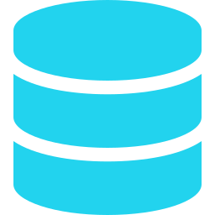


How a prediction request flows through the API
DATA AND API WORKFLOW
Dashboard
Patient lookup
Generate timeline
Extract features
Random Forest
GET …/predict
404 if unknown
384 displayed synthetic readings
Rolling glucose + EHR features
Probability + risk band
GET
/health
Service status
EXAMPLE RESPONSE · SYNTHETIC · SCHEMATIC
/api/patients
Profiles
{
"current_glucose_mg_dl": 157.9,
"predicted_probability": 0.31,
"risk_band": "LOWER",
"threshold_mg_dl": 180,
"horizon_minutes": 120,
"model": "RandomForestClassifier"
}
Example values are illustrative; use live API output.
GET
GET
/api/patient/{id}/timeline
Glucose history
GET
/api/patient/{id}/predict
Experimental probability
POST
/api/simulate
Historical replay
Notes:
When the dashboard asks for a prediction, the API looks up the patient and returns a 404 if it doesn't exist. It then generates the 24-reading synthetic timeline, extracts two features, the current glucose and the 15-minute change, applies the heuristic, and returns JSON. On the left are the five endpoints. On the right is a real response for GT001. Note that model_status says heuristic_baseline_not_trained, and feature_importance is null. The API is honest about itself.

Slide 9
What works today, and what remains
FEASIBILITY AND IMPLEMENTATION
IMPLEMENTED NOW
SYNTHETIC-DATA MODEL
PLANNED
Streamlit dashboard with 36 generated virtual patients
Random Forest 2-hour excursion estimate
Validated, permitted datasets
FastAPI service with 5 endpoints
Experimental probability bands
External validation and clinical review
Synthetic 15-minute glucose time series
Target: 180 mg/dL within 120 min
Clinician feedback
Architecture documentation
Synthetic metrics only; no clinical claim
Security and data governance
STACK
Python
FastAPI
Streamlit
Pandas
NumPy
Plotly
Scikit-learn Random Forest and Joblib power the prediction pipeline.
Notes:
Here's the honest scorecard. Implemented now: the dashboard, the five-endpoint API, synthetic timelines, and the documented architecture. Experimental: the heuristic score and its bands. Planned: real datasets, a trained and evaluated model, clinician feedback, and proper security and governance. The stack is Python, FastAPI, Streamlit, Pandas, NumPy and Plotly. scikit-learn and Joblib are installed as dependencies but not yet used for prediction.

Slide 10




Built to be honest about what it isn't
RESPONSIBLE HEALTHCARE AI
Synthetic data only
Not clinically validated
No real patient data is used. Results say nothing about real people.
The model is trained on synthetic data; results are not clinically validated.
Privacy and governance
Clinicians stay in charge
Real data would need consent, access control, security and permitted use.
It does not diagnose, replace clinicians or guide medication doses.
Not for diagnosis · treatment · medication dosing · emergency monitoring
Notes:
Responsible healthcare AI starts with saying what you're not. The data is synthetic, so nothing here says anything about real patients. The score isn't clinically validated. Using real data would need consent, security, access control and permitted use. And clinicians stay in charge: this does not diagnose, replace clinicians or recommend doses. The same warning sits at the top of our dashboard.

Slide 11
A realistic path from prototype to evidence
ROADMAP
0
1
2
3
4
TODAY
DATA
MODEL
FEEDBACK
PILOT
Synthetic prototype
Validated datasets
External validation
Clinician review
Monitored pilot
Dashboard, API, trained synthetic-data model
Permitted, de-identified data and governance
Independent permitted dataset; compare with baselines
Usability and usefulness of outputs
Only after validation and approvals
The current model remains experimental; external validation and clinical review are required before any real-world claims.
Notes:
Our roadmap has five stages. Today is the synthetic prototype. Next comes data, permitted and de-identified, with governance. Then model development with patient-level splits, compared against our heuristic baseline. Then clinician feedback, and finally a monitored pilot, only after validation and the right approvals. We're not committing to dates. The order matters more than the speed.

Slide 12
Honest about today.
Built for what comes next.
GlycoTwin AI combines synthetic EHR context and evolving CGM-like data to estimate a two-hour glucose excursion. External validation remains future work.
IMPLEMENTED
EXPERIMENTAL
PLANNED
[Team name] · [Institution] · [Contact]
Notes:
To close: GlycoTwin AI is a working, transparent foundation. A dashboard, an API and an inspectable baseline, built on synthetic data and honest about its limits. We know what's real, what's experimental and what's still ahead, and we've laid out how to get from here to evidence. Thank you, and we'd love your questions.

