Slide 1
DevOps Automation
Name: Pavithra R
Project: DevOps Automation Overview

Slide 2
What is DevOps?
DevOps is a software development approach that combines development (Dev) and operations (Ops) to improve collaboration and deliver software faster.
It focuses on:
continuous integration
continuous delivery
faster deployment
better system reliability

Slide 3
What is DevOps Automation?
DevOps Automation means automating repetitive tasks in the software development lifecycle.
Examples:
automated testing
automated deployment
automated builds
automated monitoring
Automation reduces human errors and improves efficiency.

Slide 4
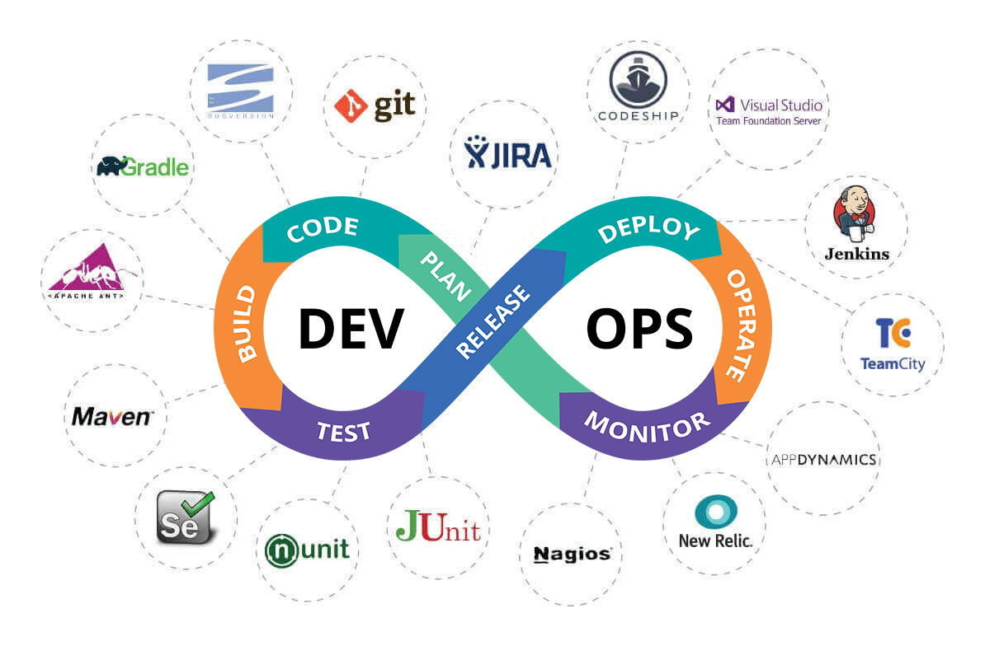
DevOps Lifecycle

Slide 5
DevOps Tools Benefits of DevOps
Automation
Popular DevOps tools include:
Git – version control
Jenkins – CI/CD automation
Docker – containerization
Kubernetes – container orchestration
GitHub Actions – workflow automation
Benefits include:
faster software delivery
improved collaboration
reduced deployment errors
continuous improvement
better scalability

Slide 6
Mind Map
DevOps Automation
Tools
Lifecycle
Benefits
CI/CD
Git
Build
Faster Delivery
Docker
Test
Reliability
Jenkins
Deploy
Automation

Slide 7
THANK YOU

