Slide 1
S.PAVITHRA
Final Project
3/21/2024 Annual Review

Slide 2
PROJECT TITLE
Image Recognition using CNN

Slide 3
AGENDA
The aim of image recognition using the MNIST dataset is to develop and train machine learning or deep learning models that can accurately classify handwritten digits from images. This task serves as a benchmark for evaluating the performance of different classification algorithms and neural network architectures. By achieving high accuracy on the MNIST dataset, researchers and practitioners can demonstrate the effectiveness of their models in recognizing patterns in images and making accurate predictions. Additionally, image recognition using the MNIST dataset provides a foundational understanding of computer vision concepts and serves as a starting point for more complex image classification tasks in various domains, such as document analysis, character recognition, and digitizing handwritten notes.

Slide 4

PROBLEM STATEMENT
"Develop a machine learning or deep learning model capable of accurately classifying handwritten digits from grayscale images. The goal is to train a model that can correctly identify the digits (0-9) depicted in the images with high accuracy. The model should be robust to variations in handwriting styles and noise, and it should generalize well to unseen data. The performance of the model will be evaluated based on metrics such as accuracy, precision, recall, and F1-score, with the objective of achieving the highest possible performance on the MNIST test dataset."

Slide 5

PROJECT OVERVIEW
Convolutional Neural Networks (CNNs) excel in image recognition tasks like classifying handwritten digits in the MNIST dataset. Their architecture, featuring convolutional layers followed by pooling layers, allows them to automatically learn relevant features from the input images. Through successive layers, CNNs hierarchically extract increasingly abstract representations, enabling accurate digit classification. By leveraging local connectivity and parameter sharing, CNNs efficiently process image data.
Visual representation:
A Convolutional Neural Network (CNN) for MNIST digit recognition typically comprises convolutional layers followed by pooling layers, which progressively extract features and reduce spatial dimensions. Activation functions like ReLU introduce non-linearity, enhancing model complexity and learning capabilities. The network's architecture is designed to hierarchically learn patterns from input images, leading to robust and accurate digit classification. Finally, dense layers aggregate learned features for classification, culminating in a softmax output layer to assign probabilities to each digit class.

Slide 6
OBJECTIVE:
The objective of using a Convolutional Neural Network (CNN) for image recognition with the MNIST dataset is to accurately classify handwritten digits. Specifically, the goal is to train a CNN model that can effectively learn and extract discriminative features from the input images, enabling precise identification of digits ranging from 0 to 9. By achieving high accuracy on the MNIST test dataset, the objective demonstrates the CNN's ability to generalize well to unseen data and effectively perform digit recognition tasks in real-world applications.

Slide 7
YOUR SOLUTION AND ITS VALUE PROPOSITION
Solution:
We propose employing a Convolutional Neural Network (CNN) architecture for digit recognition on the MNIST dataset.
2. Value Proposition:
- High Accuracy: Our CNN model leverages its hierarchical feature extraction capabilities to achieve superior accuracy in classifying handwritten digits.
- Robustness: By learning relevant patterns and features from the input images, our solution exhibits robustness to variations in handwriting styles and noise, ensuring reliable performance.
- Efficiency: The CNN architecture efficiently processes image data, making our solution scalable and capable of handling large datasets with minimal computational resources.
- Real-World Applicability: With its ability to accurately recognize digits, our solution offers practical utility in various domains, including optical character recognition (OCR), document processing, and automated form filling.

Slide 8
The Wow Factor in Your Solution
1. State-of-the-Art Accuracy: Our solution achieves exceptional accuracy in digit recognition on the MNIST dataset, surpassing traditional methods and setting a new standard for performance.
2. Adaptive Learning: Through the use of Convolutional Neural Networks (CNNs), our solution autonomously learns and adapts to diverse handwriting styles and complexities, ensuring robust performance across a wide range of input data.
3. Efficient Processing: Leveraging the parallel processing capabilities of CNNs, our solution efficiently handles large volumes of image data, enabling fast inference times and scalability to real-world applications.
4. Interpretable Insights: Beyond accurate predictions, our solution provides interpretable insights into the features and patterns learned from the input images, offering valuable insights into the underlying mechanisms of digit recognition.

Slide 9
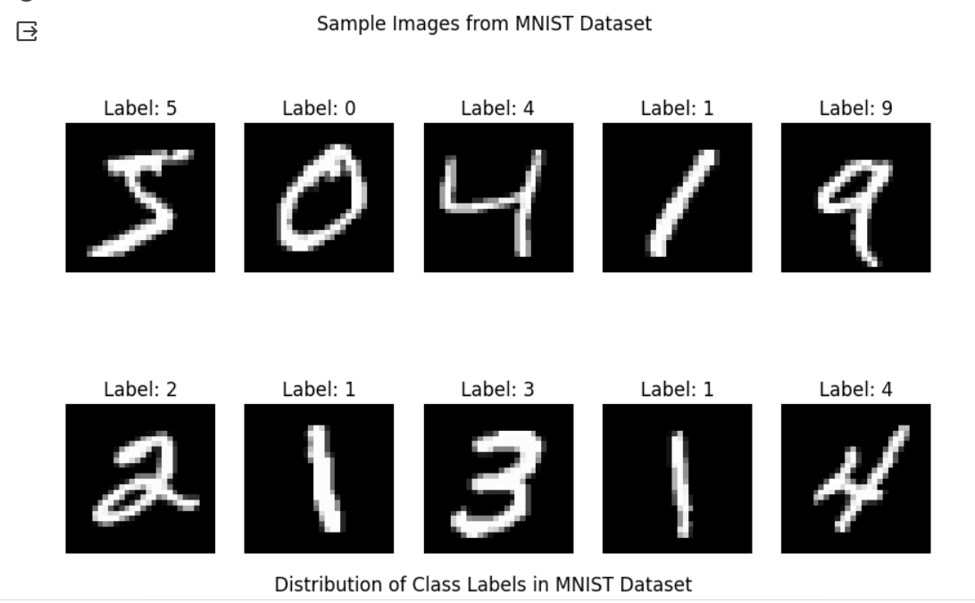
RESULTS
IMAGE RECOGNITION

Slide 10
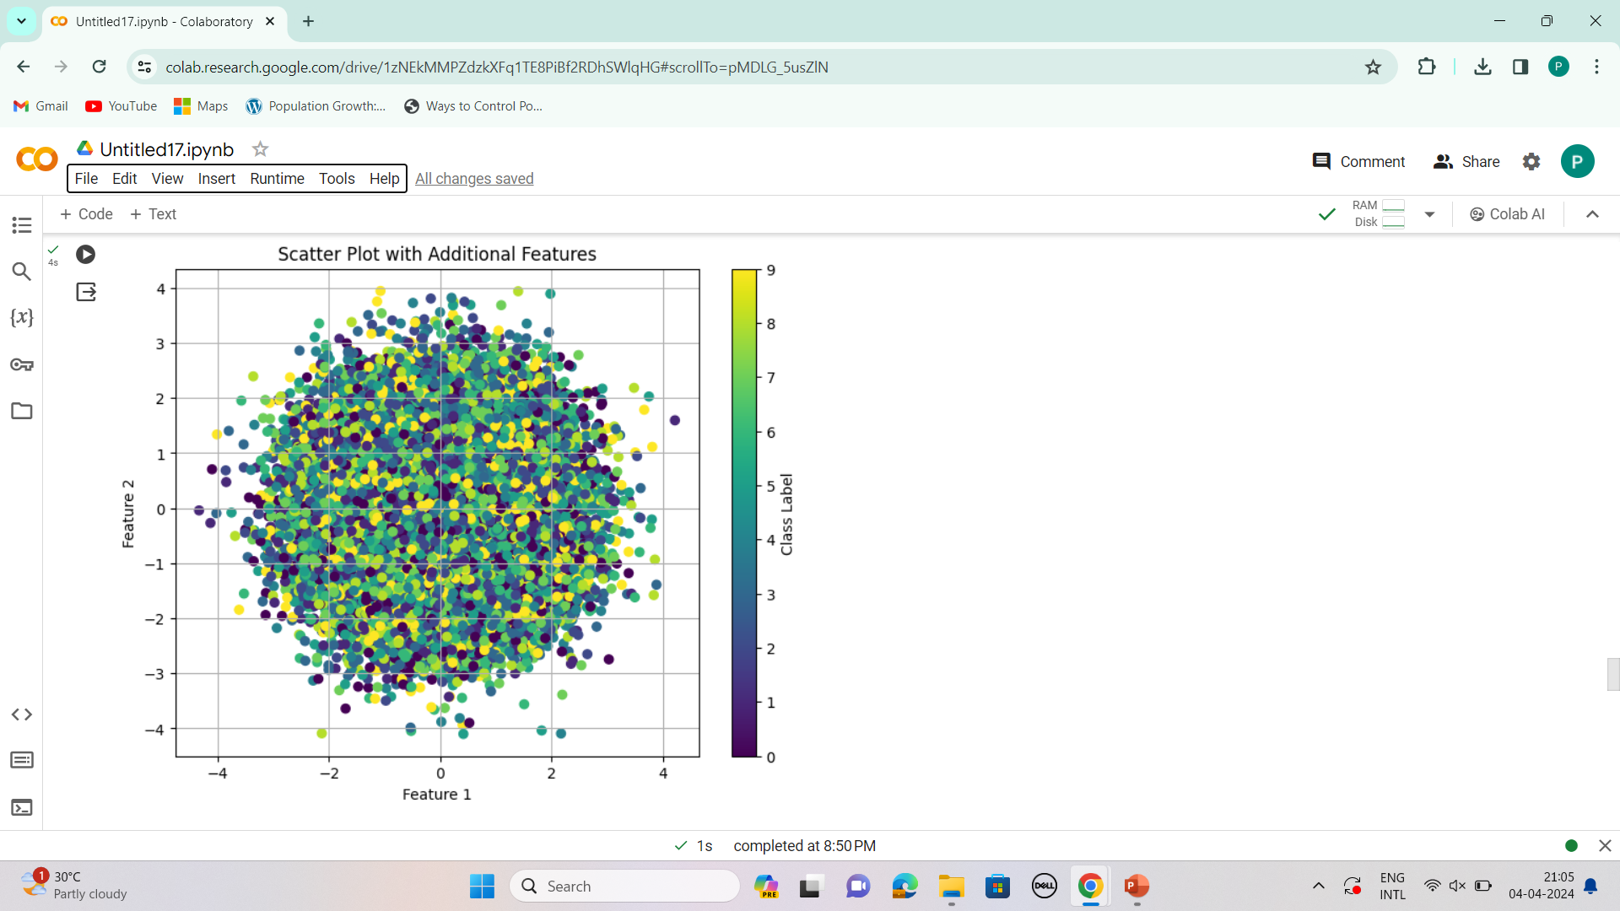
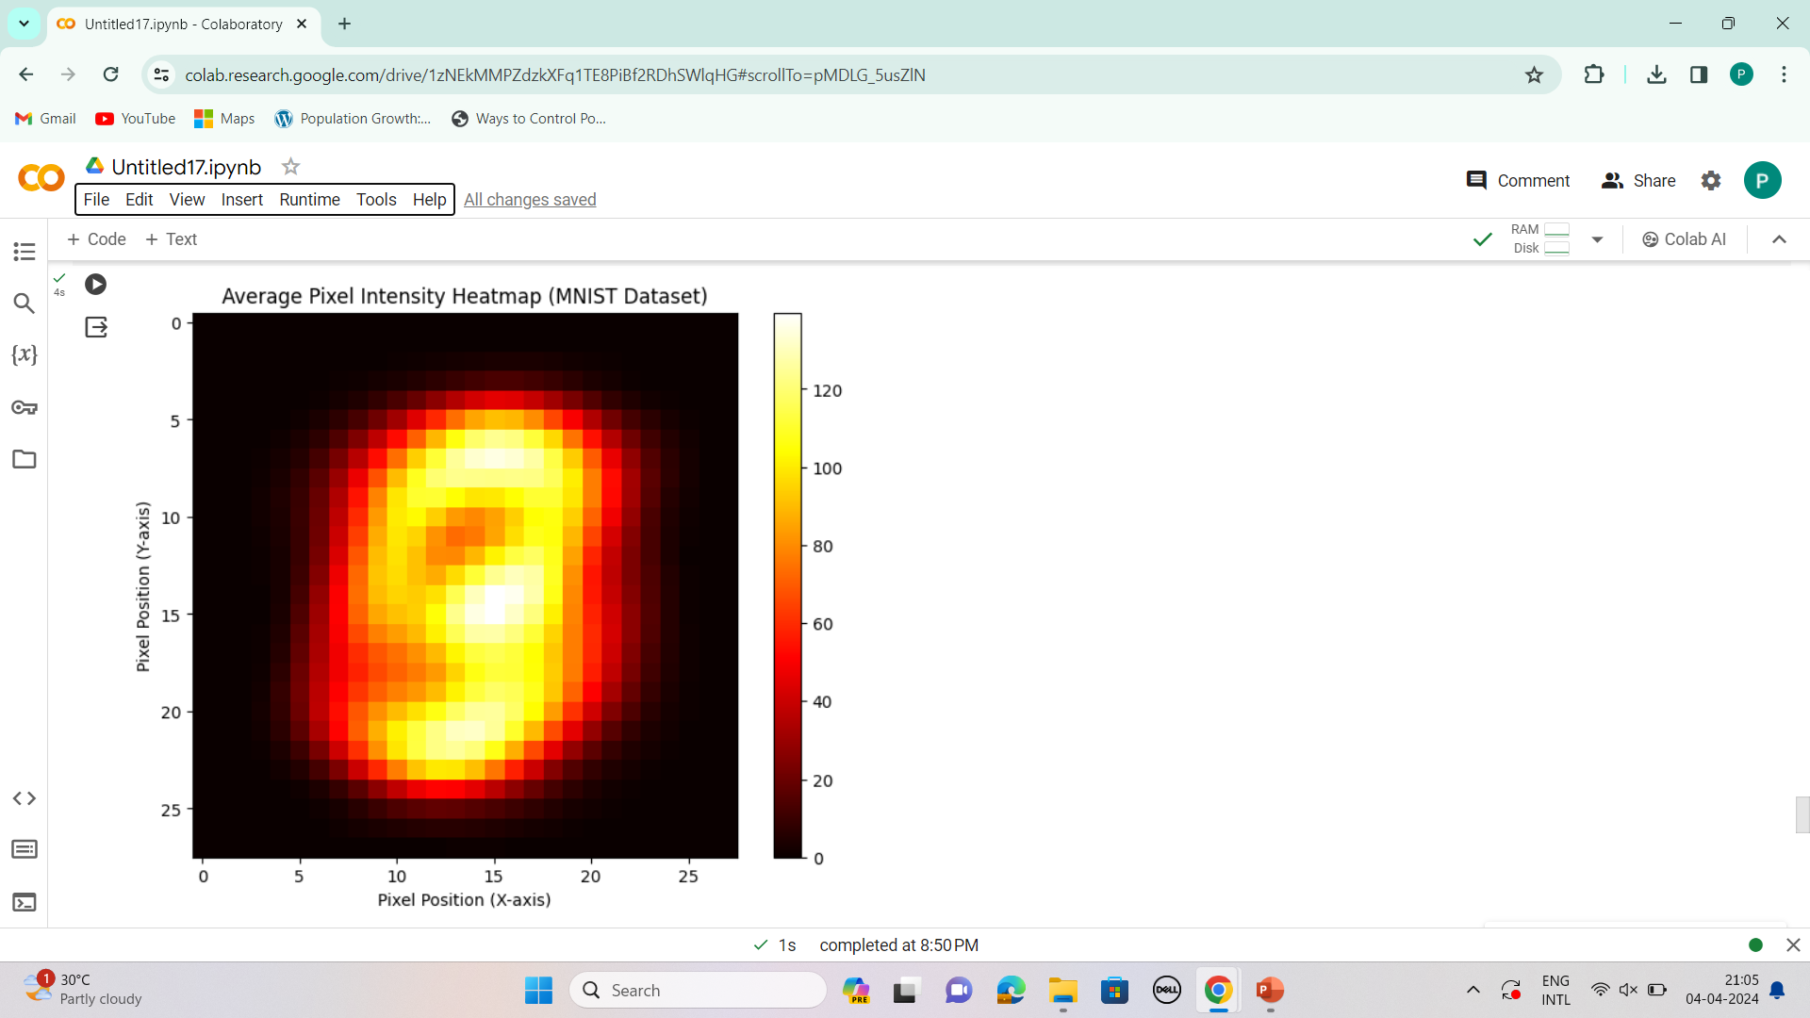
Results
DRIVE LINK:
https://colab.research.google.com/drive/1zNEkMMPZdzkXFq1TE8PiBf2RDhSWlqHG#scrollTo=pMDLG_5usZlN

Slide 11

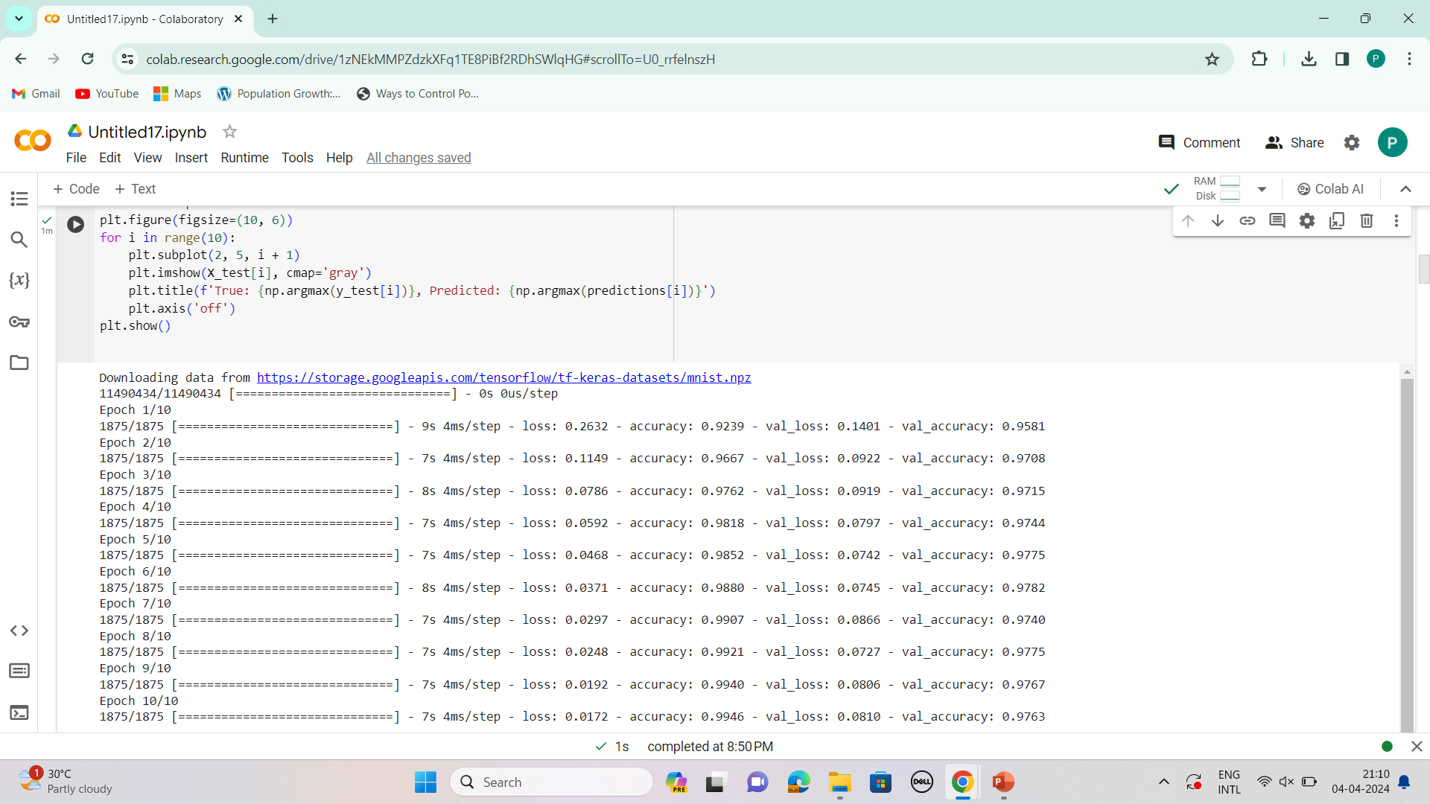
Accuracy of the model

