Slide 1



Forecasting CO₂ Emissions per Capita Using Machine Learning
Name : Pavithra Balusu
AICTE ID:STU679a4648466501738163784

Slide 2

Learning Objectives
Clean and prepare complex indicator datasets for analysis.
Understand global carbon emission trends using multi-country indicators.
Apply regression models to predict CO₂ emissions per capita.
Forecast future emissions and identify key influencing factors.
Visualize results using meaningful charts for insights
GOAL
Source :
www.freepik.com/

Slide 3
Tools and Technology used
Python: A versatile language used for end-to-end data processing and model building.
Pandas, NumPy: Libraries for efficient data handling, transformation, and numerical operations.
Matplotlib, Seaborn: Tools for creating clear and insightful data visualizations.
Jupyter Notebook: An interactive coding platform for analysis, visualization, and documentation.
Scikit-learn: A powerful library for building and evaluating machine learning models.
Linear Regression, Random Forest: Algorithms used for predicting and forecasting CO₂ emissions.

Slide 4
Methodology
Data Collection Collected country-wise environmental and economic indicator data spanning multiple years. The dataset included features such as energy use, population statistics, GDP, urbanization rates, and land use. CO₂ emissions per capita served as the target variable for modeling and forecasting.
Data Cleaning and Transformation Reshaped the wide-format multi-year dataset into a long time-series structure suitable for machine learning. Missing or invalid values (e.g., "..") were handled using appropriate imputation techniques or removed. Numeric features were normalized and standardized for better model performance.
Exploratory Data Analysis (EDA) Explored CO₂ emission trends over time and across countries. Used correlation heatmaps and distribution plots to identify patterns. Key indicators influencing emissions were identified, such as energy consumption, GDP, and urban population growth.
Model Development Implemented supervised machine learning models to predict CO₂ emissions per capita. Linear Regression was used for forecasting trends, and Random Forest Regression was applied to capture complex relationships between features. The dataset was split into training and testing sets for validation.

Slide 5
Methodology
Model Evaluation Evaluated model performance using Mean Absolute Error (MAE) and R² Score. MAE helped understand average prediction error, while R² indicated the percentage of variance explained by the model. The Random Forest model showed good accuracy with low error and high R².
Forecasting Future Emissions Linear regression was used to forecast CO₂ emissions per capita for the next 20 years (2024–2043). Predictions were based on historical trends of average yearly emissions.
Visualization and Interpretation Created several visualizations including:
Line graph of average CO₂ emissions over time
Future forecast plot
Feature importance chart from Random Forest
Actual vs Predicted CO₂ emissions plot These insights highlighted key contributing factors and enabled interpretation of both historical and future emission patterns.

Slide 6
Problem Statement:
Global CO₂ emissions have been steadily increasing due to industrialization, urbanization, and growing energy demands. However, the rate and contributing factors of these emissions vary significantly across countries and regions, influenced by economic status, energy policies, population trends, and land usage patterns.
Understanding and predicting these emissions is critical for developing effective climate action strategies and meeting international sustainability goals.
The key problem addressed in this project is:
"How can we build a robust and data-driven model that accurately predicts and forecasts CO₂ emissions per capita by analyzing historical multi-country data on economic, demographic, and environmental indicators?“
This prediction will help policymakers and researchers understand trends, identify key emission drivers, and plan mitigation strategies more effectively.

Slide 7
Solution:
To address the problem, we developed a complete end-to-end machine learning pipeline focused on predicting and forecasting CO₂ emissions per capita using multi-dimensional historical data.
The key steps in the solution include:
Data Integration: Combined economic, demographic, environmental, and energy-related indicators from multiple countries and years into a structured dataset suitable for modeling.
Prediction Modeling: Used supervised regression techniques including Random Forest and Linear Regression to predict CO₂ emissions based on factors like GDP, energy use, population growth, and urbanization.
Forecasting Future Emissions: Applied trend-based forecasting using linear regression to estimate emissions for the next 20 years, enabling long-term climate planning.
Feature Impact Analysis: Used feature importance metrics from Random Forest to identify the most influential factors contributing to emissions, such as energy use per capita and GDP.

Slide 8
Solution:
Visualization and Insights: Generated clear visual reports including trend lines, forecast charts, feature importance plots, and actual vs. predicted comparisons to support data-driven conclusions.
Model Evaluation: Validated the model using Mean Absolute Error (MAE) and R² Score to ensure prediction reliability and interpretability.
This solution provides actionable insights for understanding CO₂ emissions and supports better policy-making and environmental strategies.

Slide 9
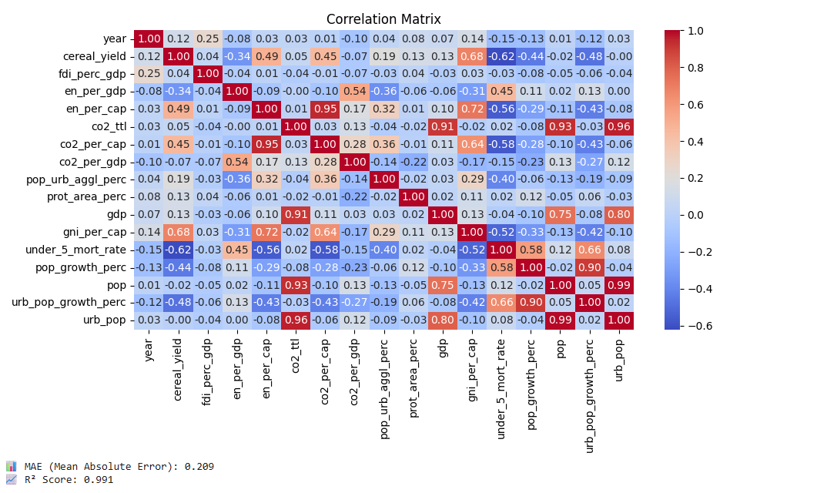
Screenshot of Output:

Slide 10
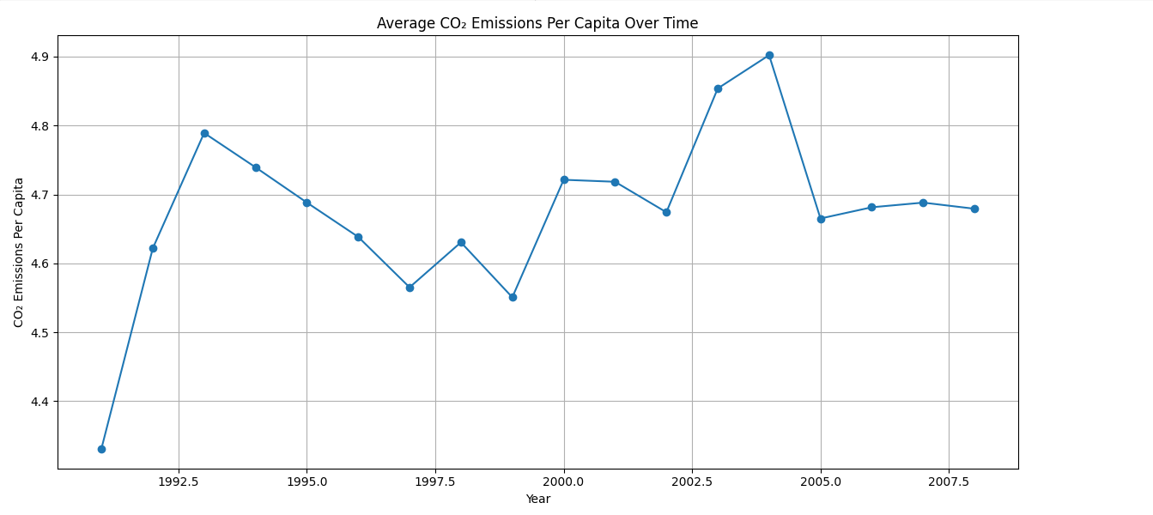
Screenshot of Output:

Slide 11
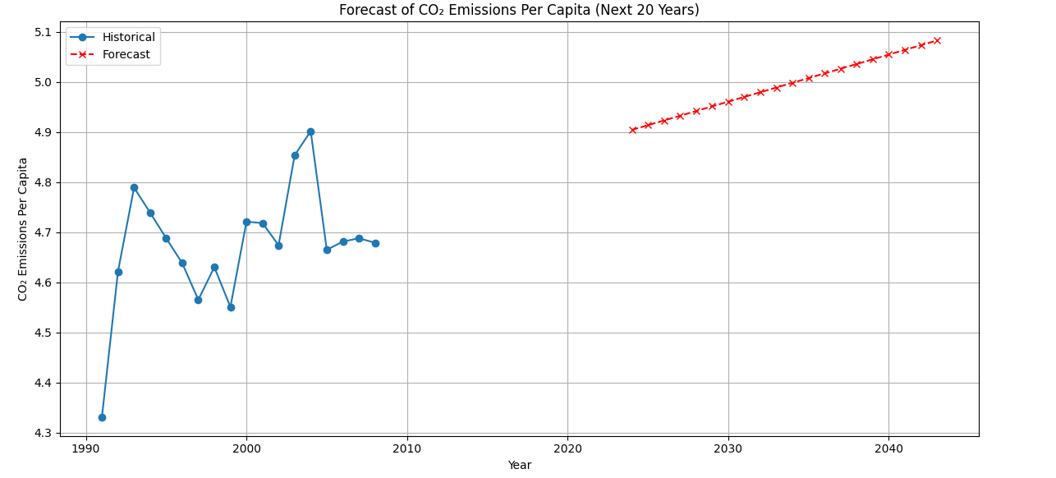
Screenshot of Output:

Slide 12
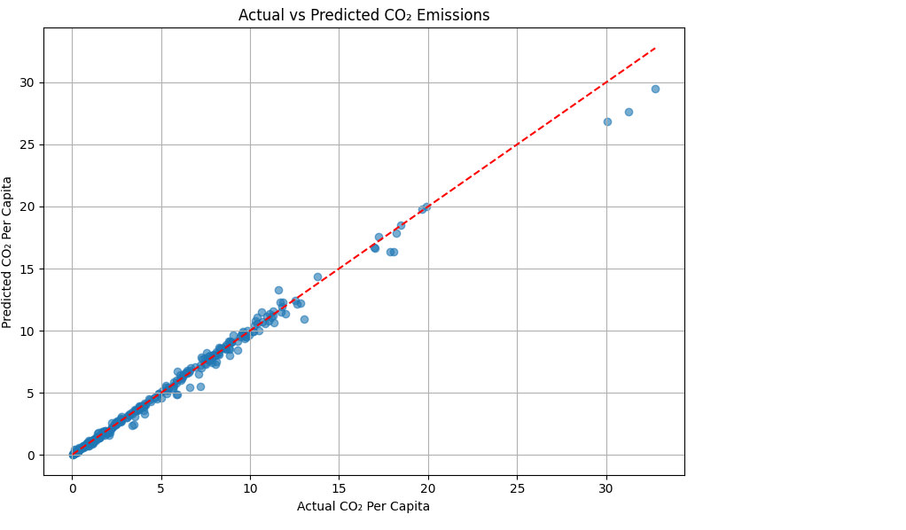
Screenshot of Output:

Slide 13
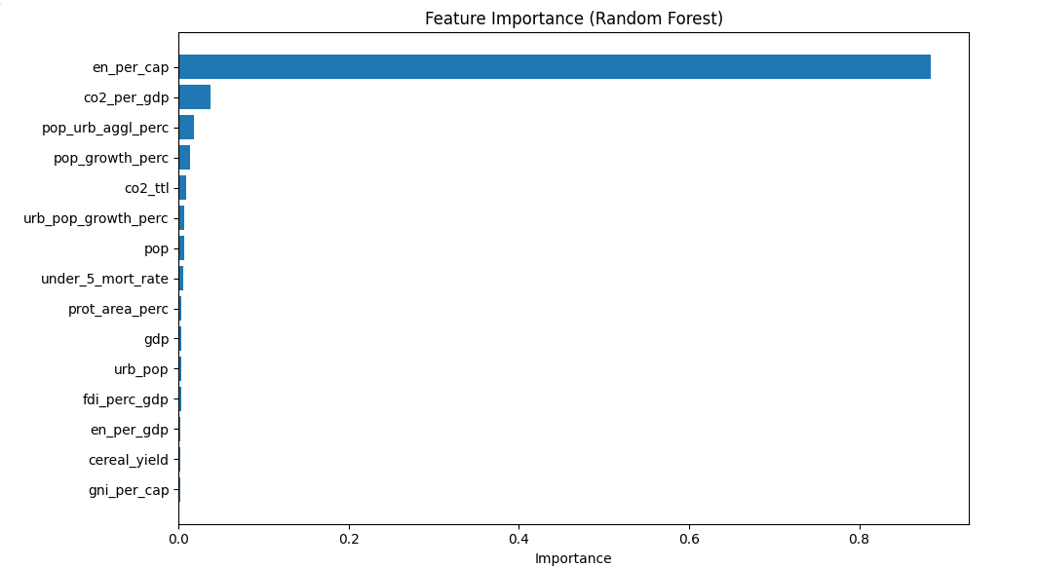
Screenshot of Output:

Slide 14
Conclusion:
This project effectively demonstrated that CO₂ emissions per capita are strongly influenced by factors like energy use and urbanization. Using machine learning models, especially Random Forest, we achieved accurate predictions with high R² and low MAE. Linear regression allowed us to forecast future emissions over the next 20 years. Visualizations helped convey key insights clearly, supporting strategic decision-making. The approach is scalable and can be applied to different countries and timeframes for broader environmental analysis.
Github link: https://github.com/Pavithrabalusu/CarbonEmission_Project

