Slide 1
Understanding
Market suitation
of Petcares
Presented by Pavithra

Slide 2


PROCESS
1
Data Understanding
Data Collection
2
Data Cleaning
3
Data analysis
4
5
Conclusion

Slide 3
AMAZON
Amazon is an e-commerce platform that sells many product lines, baby products, consumer electronics, beauty products, Pet products, etc.,
Amazon is selling the pet products categories like Dog, cat, fishes, birds.
The customer shown more interest in purchasing the pet products for Cat, Dog and Fishes.
The stocks of pet products are getting demanded.

Slide 4
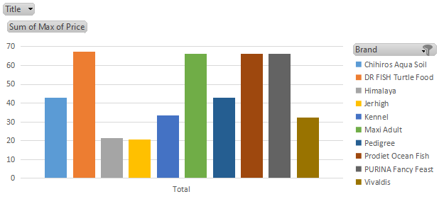
PRICE OF BRANDS
The brands such as DR Fish, Purina, Maxi, and Prodiet are high branded manufacturers.
The Price of products is maximum when compare to others

Slide 5
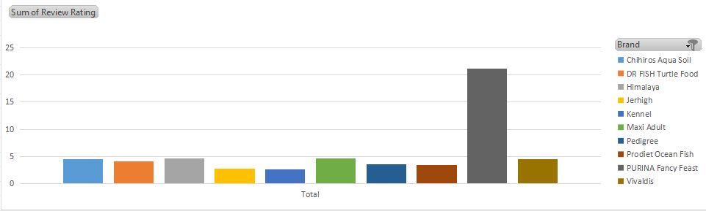
REVIEWS
The customer shown more interest on Purina products. The review by customers is high which shows that customer likely to purchase Purina brand products

Slide 6
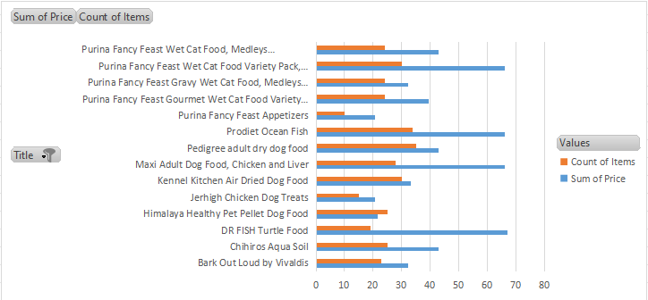
Negative product review
Product and quantity reviews
The high brands manufactures such as DR Fish, Purina, Maxi, and Prodiet.
The customer notice that the quantity of products is low when the price is maximum

Slide 7
Conclusion
The customers shown more interest in purchasing the dog catergory under purina brand manufactures.
There are posititve review and interest of the customers in Purina brand products which show the trust towards the company.
Negative feedback - The customer was dissatified with the high price of products and low quantity of product.

Slide 8
Thank you

