Slide 1
Machine Failure Prediction using Random Forest
A Predictive Maintenance Approach

Slide 2
Introduction:
Machine failures can lead to significant downtime and financial losses.
This project aims to develop a machine learning model that predicts failures, enabling proactive maintenance and minimizing disruptions.

Slide 3
Dataset Description:
Dataset Source: Machine sensor data
Number of Observations: 944
Number of Features: 10 (All numerical)
Target Variable: 'fail' (0 - No failure, 1 - Failure)

Slide 4
Data Preprocessing:
Steps taken:
Removed missing values
Standardized numerical features using StandardScaler
Selected relevant features based on correlation analysis

Slide 5
Exploratory Data Analysis (EDA):
Key insights:
Histogram & Boxplots to visualize data distributions
Correlation Heatmap to identify relationships between features
Feature distribution analysis for selecting influential predictors

Slide 6
Feature Engineering:
Selected important features based on correlation analysis
Standardized the dataset to improve model efficiency

Slide 7
Model Selection:
Chosen Model: Random Forest Classifier
Robust ensemble model
Handles complex data distributions effectively

Slide 8
Model Training & Evaluation:
Training Details:
Train-Test Split: 80% Training, 20% Test Data
Performance Metrics:
Accuracy Score: High
Precision & Recall: Good balance
F1 Score & ROC-AUC Score: Strong performance

Slide 9
Feature Importance Analysis:
Identified key features influencing predictions
Plotted feature importance scores for model interpretation

Slide 10
Conclusion & Future Work:
Findings:
Random Forest Classifier achieved strong predictive performance.
The model can assist in predictive maintenance strategies.
Future Enhancements:
Hyperparameter tuning for optimization.
Testing advanced models like Gradient Boosting.

Slide 11
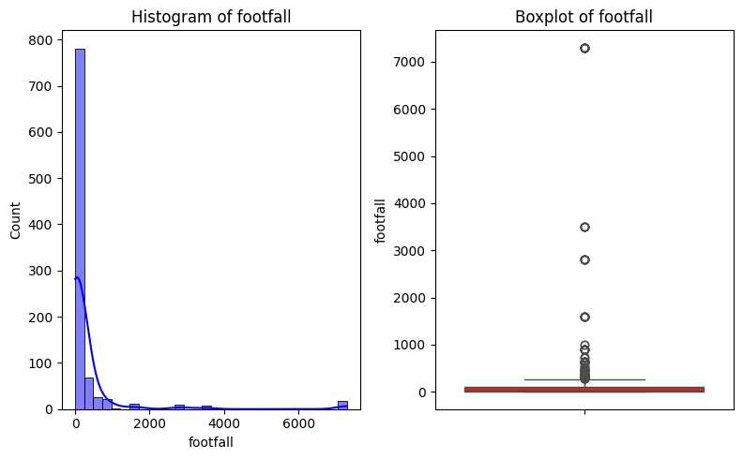
Visualization

Slide 12
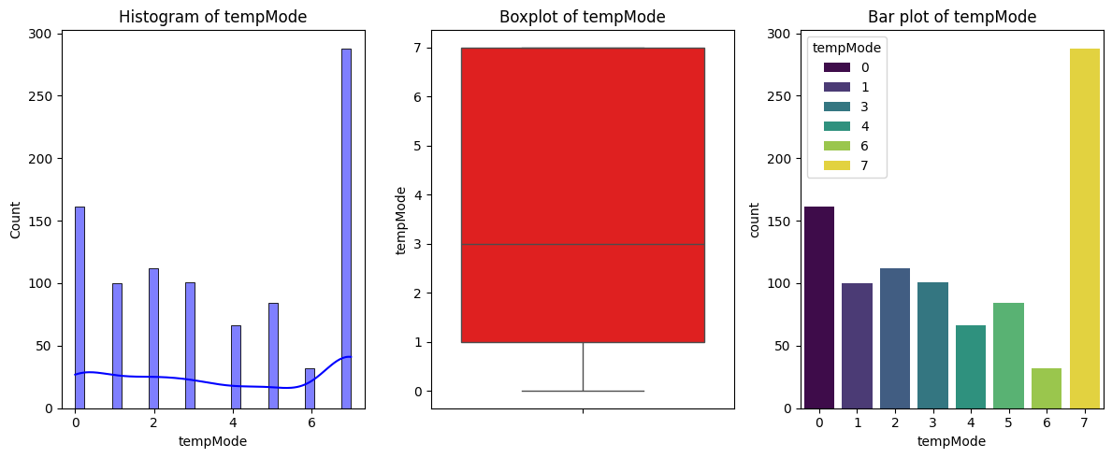
Visualization

Slide 13
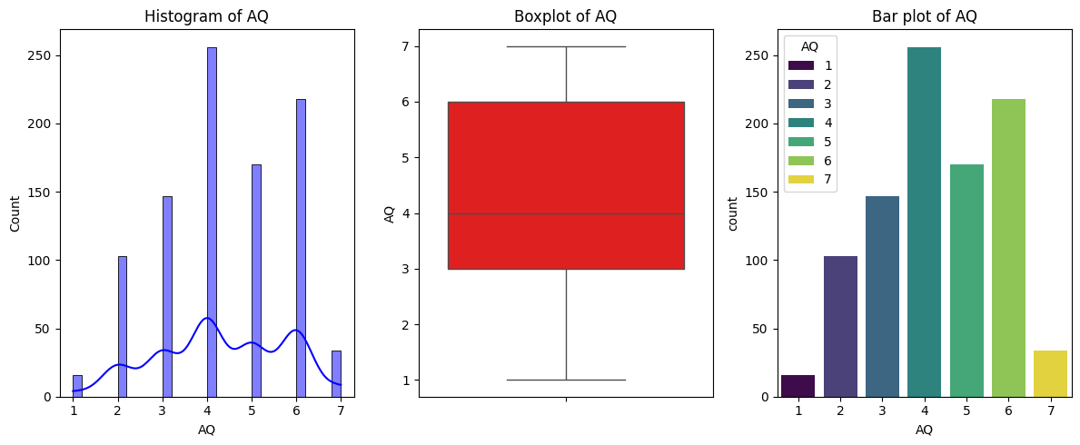
Visualization

Slide 14
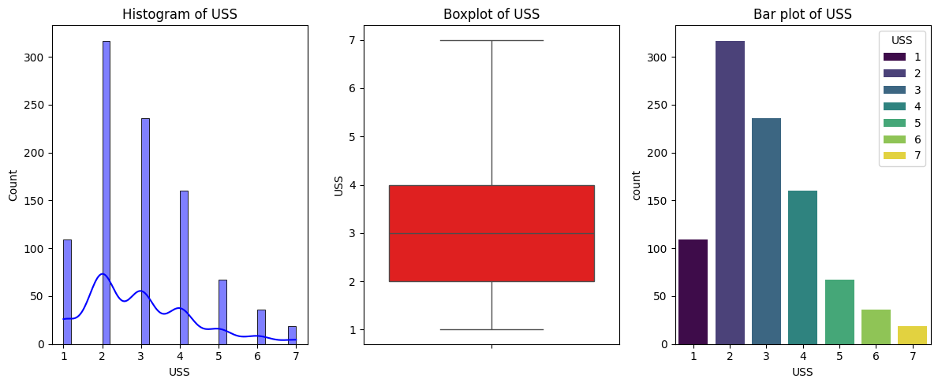
Visualization

Slide 15
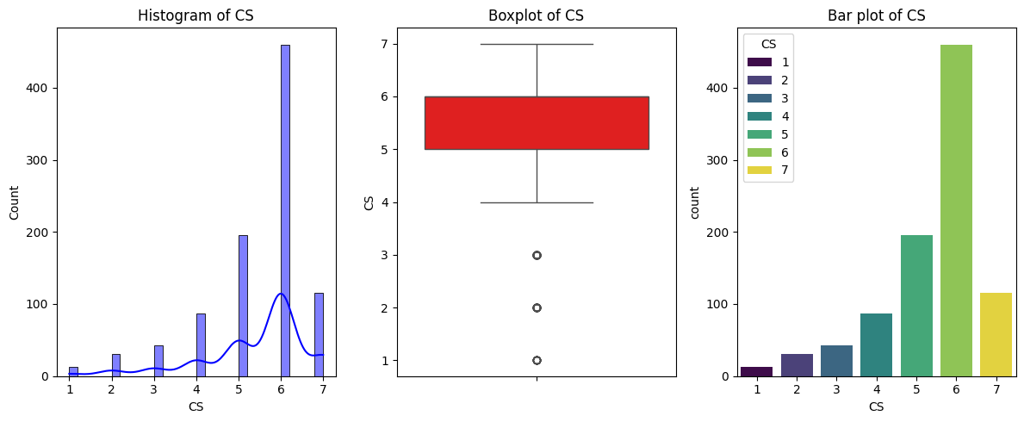
Visualization

Slide 16
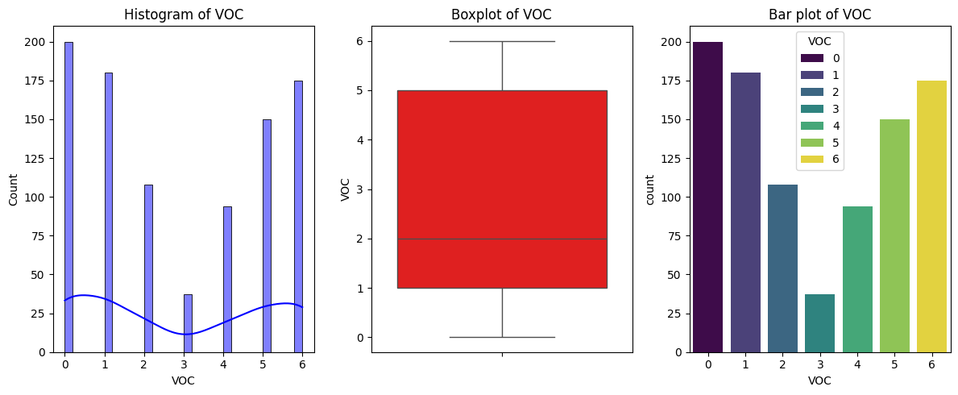
Visualization

Slide 17
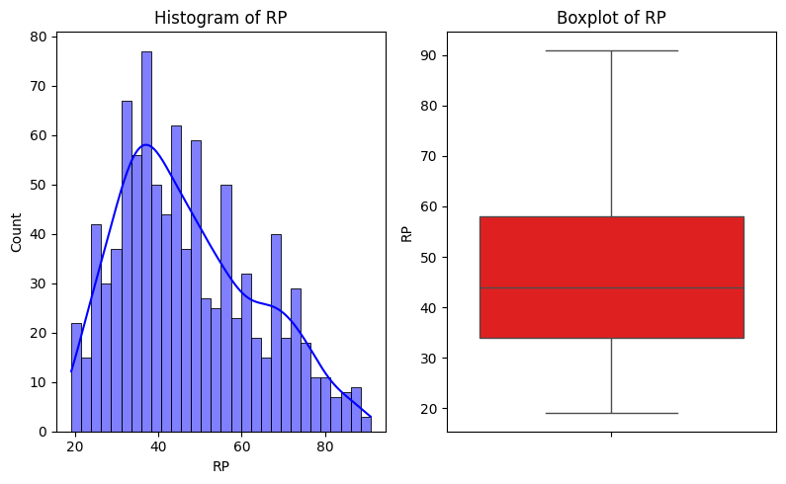
Visualization

Slide 18
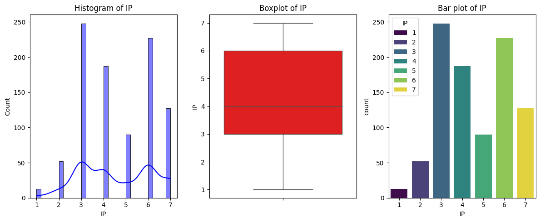
Visualization

Slide 19
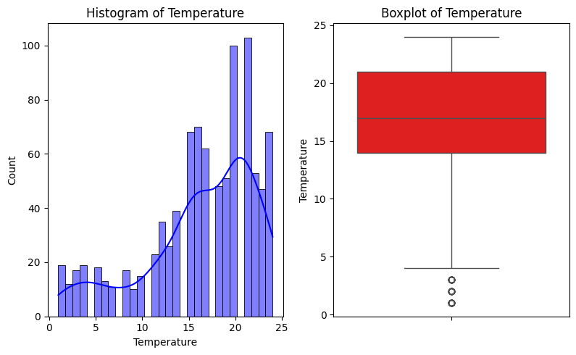
Visualization

Slide 20
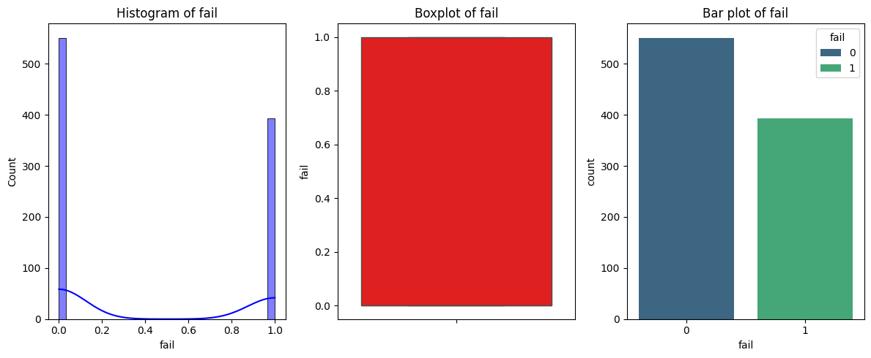
Visualization

Slide 21
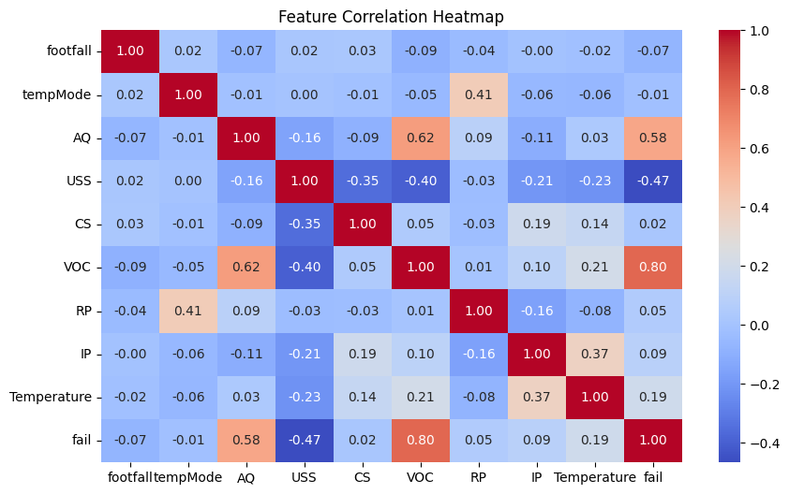
Correlation Heat map:

Slide 22
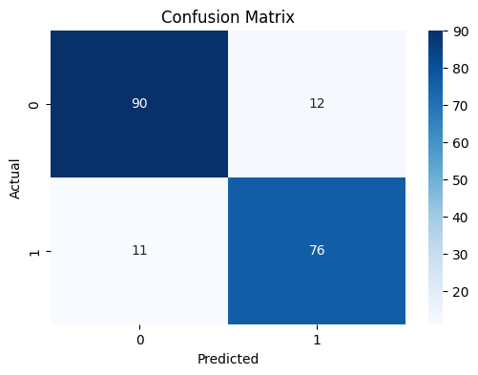
Confusion Matrix:

Slide 23
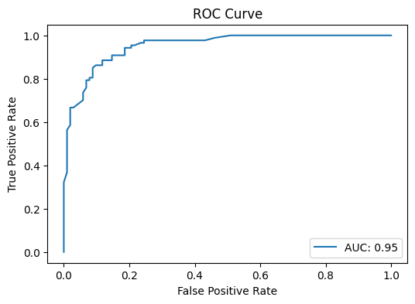
ROC Curve:

Slide 24
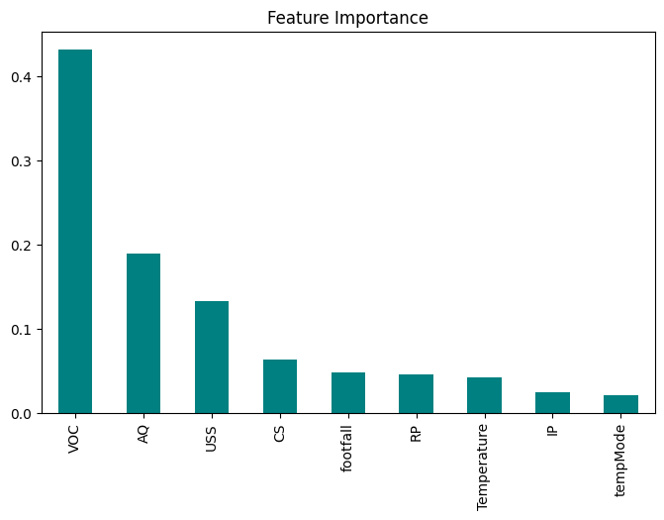
Feature Importance:

