Slide 1

SMART TICKETING SYSTEM IN METRO RAIL

Slide 2
Mentor :Mr.Arun Francis
(Assistant Professor)
Presented By -
Gowtham.D
15L315
Pavithran.K.S
15L332
Sridhar.A
15L344
Veerapandian.C
15L350

Slide 3
Contents
◆ Introduction to the topic
◆ What is RFID
◆ Components of basic RFID System
◆ RFID Tags
◆ Structure
◆ Working
◆ RFID Reader
◆ Structure
◆ Working
◆ Types of RFID System
◆ Uses of RFID System
◆ RFID System vs Barcodes
◆ Introduction to Project
◆ Hardware Description
◆ Software Description
◆ Circuit Diagram
◆ Conclusion

Slide 4
What is RFID
◆ Radio Frequency Identification (RFID) is the wireless use of electromagnetic fields to transfer data, for the purposes of automatically identifying and tracking tags attached to objects.
◆ It is an automatic identification method, relying on storing and remotely retrieving data using devices called RFID tags.

Slide 5
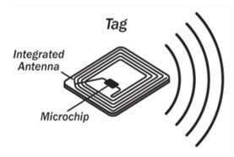
RFID Tags

Slide 6
What are RFID Tags
◆ RFID tags contain electronically stored information.
◆ Tags are powered by electromagnetic induction from magnetic fields produced
near the reader.
◆ An RFID tag is an object that can be applied to or incorporated into a product, animal, or person for the purpose of identification and tracking using radio waves.

Slide 7
Types of RFID Tags
◆ Active - An active tag has an on-board battery and periodically transmits its ID signal.
◆ Battery Assisted Passive - A battery-assisted passive (BAP) has a small battery on board and is activated when in the presence of an RFID reader.
◆ Passive - A passive tag is cheaper and smaller because it has no battery; instead, the tag uses the radio energy transmitted by the reader.

Slide 8
Types of RFID Tags
◆ Tags may either be read-only, having a factory-assigned serial number that is used as a key into a database.
◆ Tags can be read/write, where object-specific data can be written into the tag
by the system user.
◆ Field programmable tags may be write-once, read-multiple; "blank" tags may be written with an electronic product code by the user.

Slide 9
Working of RFID Tags
◆ An RFID reader transmits an encoded radio signal to interrogate the tag.
◆ The RFID tag receives the message and then responds with its identification and other information.
◆ Since tags have individual serial numbers, the RFID system design can discriminate among several tags that might be within the range of the RFID reader and read them simultaneously.

Slide 10
Working of RFID Tags
◆ The antenna emits radio signals to activate the tag and read and write data to it.
◆ Antennas are the conduits between the tag and the transceiver, which controls the system's data acquisition and communication.
◆ The electromagnetic field produced by an antenna can be constantly present when multiple tags are expected continually. If constant interrogation is not required, a sensor device can activate the field.

Slide 11
What is RFID Reader
◆ An RFID reader is a network connected device (fixed or mobile) with an antenna that sends power as well as data and commands to the tags.
◆ The RFID reader acts like an access point for RFID tagged items so that the tags' data can be made available to business applications.

Slide 12
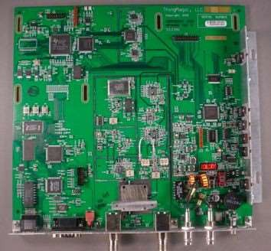
Structure of RFID Reader
◆ Individual Components are –
Digital Signal Processor
Network Processor
Power Supply
Radio Frequency Emitter

Slide 13
Working of RFID Reader
◆ The reader emits radio waves in ranges of anywhere from one inch to 100 feet or
more, depending upon its power output and the radio frequency used.
◆ When an RFID tag passes through the electromagnetic zone, it detects the reader's activation signal.
◆ The reader decodes the data encoded in the tag's integrated circuit (silicon chip) and the data is passed to the host computer for processing.

Slide 14
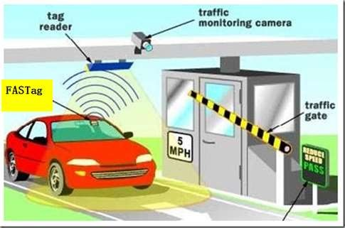
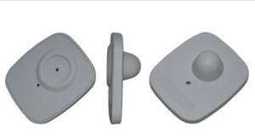
Present Uses
Tracking consumer products, luggage, and logistics
Toll collection contactless
payment

Slide 15
Future Uses
◆ Imagine going to the grocery store, filling up your cart and walking right out the door. No longer will you have to wait as someone rings up each item in your cart one at a time. Instead, these RFID tags will communicate with an electronic reader that will detect every item in the cart and ring each up almost instantly.
◆ Railway Reservation System

Slide 16
Future of RFID
◆ In 2014, the world RFID market is worth US$8.89 billion, up from US$7.77 billion in 2013 and US$6.96 billion in 2012. This includes tags, readers, and software/services for RFID cards, labels, fobs, and all other form factors.
◆ The market value is expected to rise to US$27.31 billion by 2024.
◆ Report by IDTechEx.

Slide 17
RFID System vs Barcodes
◆ No line of sight communication required
◆ Longer read range
◆ Portable Database
◆ Multiple tag read/write at once
◆ Tracking in real time
◆ Information can be updated in the process
◆ Less expensive in the long run
◆ Higher data capacity

Slide 18


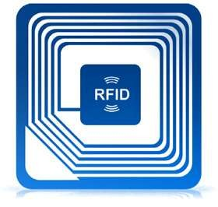


Introduction to
Project

Slide 19
Introduction to Project
◆ The project demonstrates the use of RFID in reservation of railways.
◆ With the employment of RFID, it can hope to get rid of its many problems like increasing capital expenditure and debt management.
◆ This technology can help such organizations like railways in consolidating their revenues while cutting costs through better operations and asset operation.

Slide 20
Hardware Description
Name
Specification
Quantity
RFID Reader
1
RFID Tags
2
Arduino
1
LCD
16*2
1
Capacitor
10µF, 1000µF
1 each
Diode
4
Push Button
1
Regulator
7805
1
Potentiometer
1
Oscillator
11.0592 MHz
1

Slide 21
Power Supply
◆ Here in our application we need a 5V DC power supply for all electronics involved
in the project.
◆ Transformer is connected to mains power supply (240V). It is used to step-down voltage to 9V.
◆ The power is converted from 5V AC to 5V DC with the help of bridge rectifier.
◆ The output voltage is smoothened using voltage regulator.

Slide 22
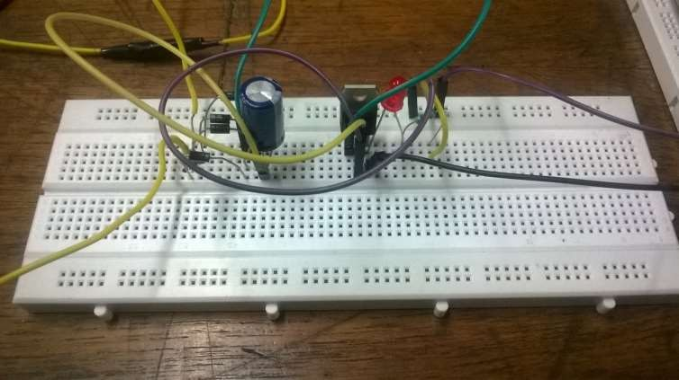
Bridge Rectifier and Voltage Regulator

Slide 23
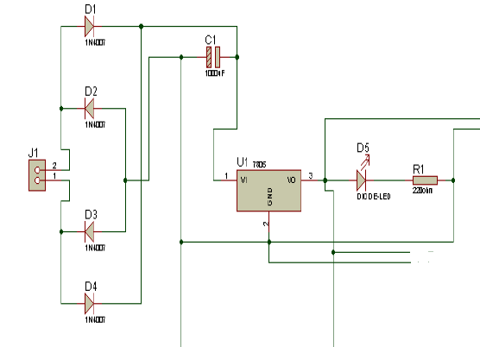
Bridge Rectifier and Voltage Regulator

Slide 24
16x2 Character LED
◆ 5 x 8 dots with cursor
◆ Built-in controller (KS 0066 or Equivalent)
◆ +5V power supply (Also available for + 3V)
◆ 1/16 duty cycle
◆ B/L to be driven by pin 1, pin 2 or pin 15, pin 16 or A.K (LED)
◆ N.V. optional for + 3V power supply

Slide 25
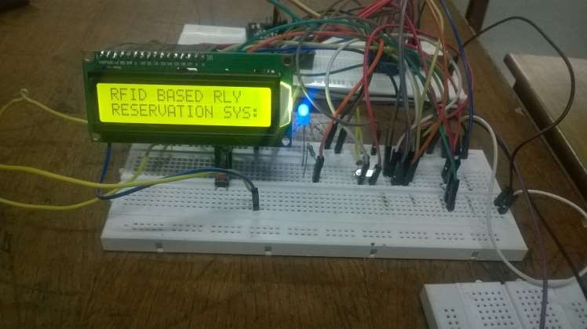
16x2 Character LED

Slide 26
Arduino UNO
◆ Arduino is an open source electronics prototyping platform based on flexible, easy-to-use hardware and software (called sketch). It is intended for artists, designers, hobbyists and anyone interested in creating interactive objects or environments.
◆ Arduino UNO is a board based on ATmega328 microcontroller. It consists of 14 digital input/output pins, six analogue inputs, a USB connection for programming the on-board microcontroller, power jack, an ICSP header and a reset button. It is operated with a 16MHz crystal oscillator and contains everything needed to support the microcontroller. It is very easy to use as the user simply needs to connect it to a computer with a USB cable or power it with an AC-to-DC adaptor or battery to get started. The microcontroller on the board is programmed using Arduino programming language and Arduino development environment.
◆ Pin 0 (RX) of Board1 is connected to pin 7 (TX) of RFID1. Pin 10 of the board is connected to solenoid driver transistor T1 through base resistor R1. When pin 10 goes high, T1 conducts and solenoid is activated, which means lock is opened.

Slide 27
Software
Description

Slide 28
Arduino IDE Software
◆ The software for this project is written in Arduino programming language. The Arduino UNO is programmed using Arduino IDE software. Atmega328 on Arduino UNO comes with a boot loader that allows you to upload new code to it without the use of external hardware programmer. It communicates using STK500 protocol. You can also bypass the boot loader and program the microcontroller through in-circuit serial programming (ICSP) header, but with boot loader the programming is quick and easy.

Slide 29
Complete Circuit
Diagram

Slide 30
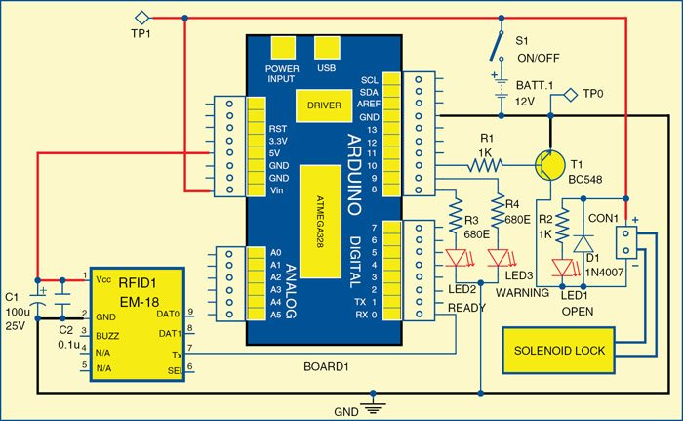

Slide 31
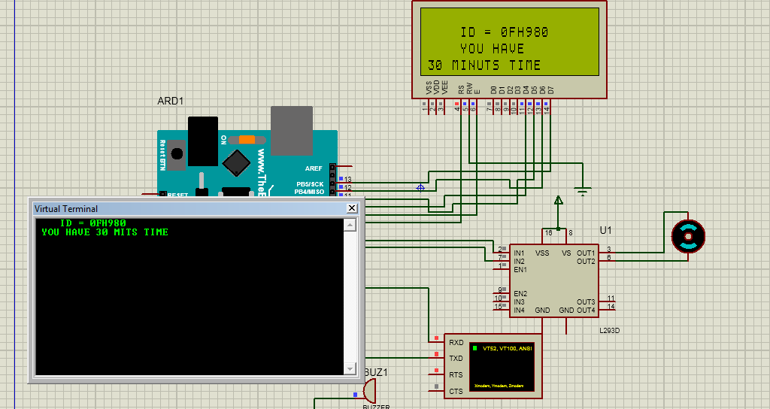
Output

Slide 32
Conclusion
◆ Even though numerous limitations and unresolved issues still hinder the widespread application of RFID. Despite these challenges, RFID continues to make inroads into inventory control systems, and it’s only a matter of time before the component costs fall low enough to make RFID an attractive economic proposition. Furthermore, extensive engineering efforts are under way to overcome current technical limitations and to build accurate and reliable tag reading systems.
In order to implement contemporary system of “RFID based swipe card draw power in Indian Railways” the embedded systems plat- form has utilized. And hence this proposed project seems to brought about equality among masses and also conserve the power.

Slide 33
THANK YOU

