Slide 1
GJK ALGORITHM

Slide 2
Introduction
The Gilbert–Johnson–Keerthi algorithm is an efficient method used for detection of collision of two convex polyhedra. First published by Elmer G. Gilbert, Daniel W. Johnson, and S. Sathiya Keerthi in 1988.
Collision detection is the geometric process of determining whether two objects intersect. The GJK algorithm is a popular algorithm used in several fields such as computer graphics and robotics.

Slide 3
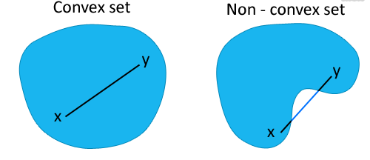
Definition 1:
Convex Set:
Let S be a vector space. A subset C of S is convex if, for all x and y in C, the line segment connecting x and y is included in C.

Slide 4
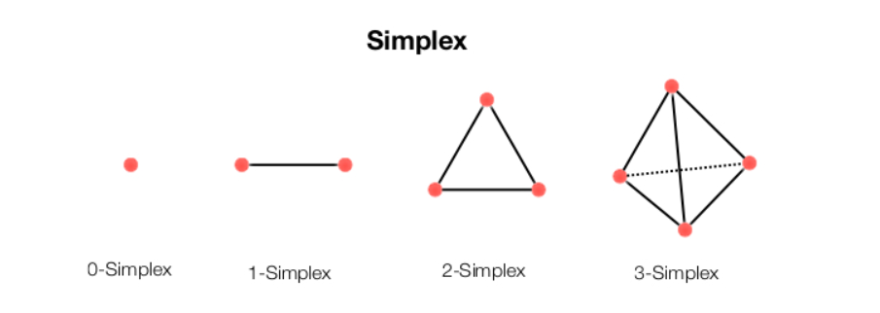
Definition 2:
Simplex:
In geometry, a simplex is a generalization of the notion of a triangle or tetrahedron to arbitrary dimensions.
A k-simplex is a k-dimensional polytope which is the convex hull of its k + 1 vertices. It is guaranteed to enclose a point in k- dimensional space.

Slide 5
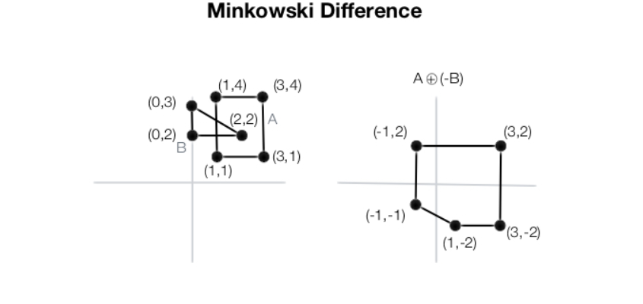
Definition 3:
Minkowski Difference:
In geometry, the Minkowski difference of two sets A and B in Euclidean space is formed by subtracting each coordinate in B from each coordinate in A,
A - B = { a - b | a ∈ A, b ∈ B }

Slide 6
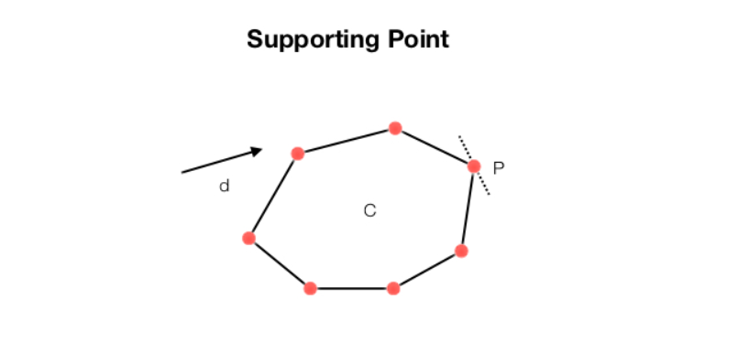
.
Definition 4:
Supporting Point:
In a convex object, the supporting point is the most distant point in a given direction.
In the example below, the supporting point in direction d is P.

Slide 7
Lemmas Used:
Lemma 1:
Let A, B be two convex polyhedra. Define M(A,B) as the Minkowski Difference.
If the Minkowski set contains the origin ⇔ A, B Collide

Slide 8
Lemma 2:
Let A, B be two convex polyhedra. Define M(A,B) as the Minkowski Difference.
Then M(A,B) is also a convex polyhedra.

Slide 9
Lemma 3
Let S(A, d) be the support point of the convex polyhedra A in direction d.
S(M(A,B), d) = S(A,d) - S(B, -d)

Slide 10
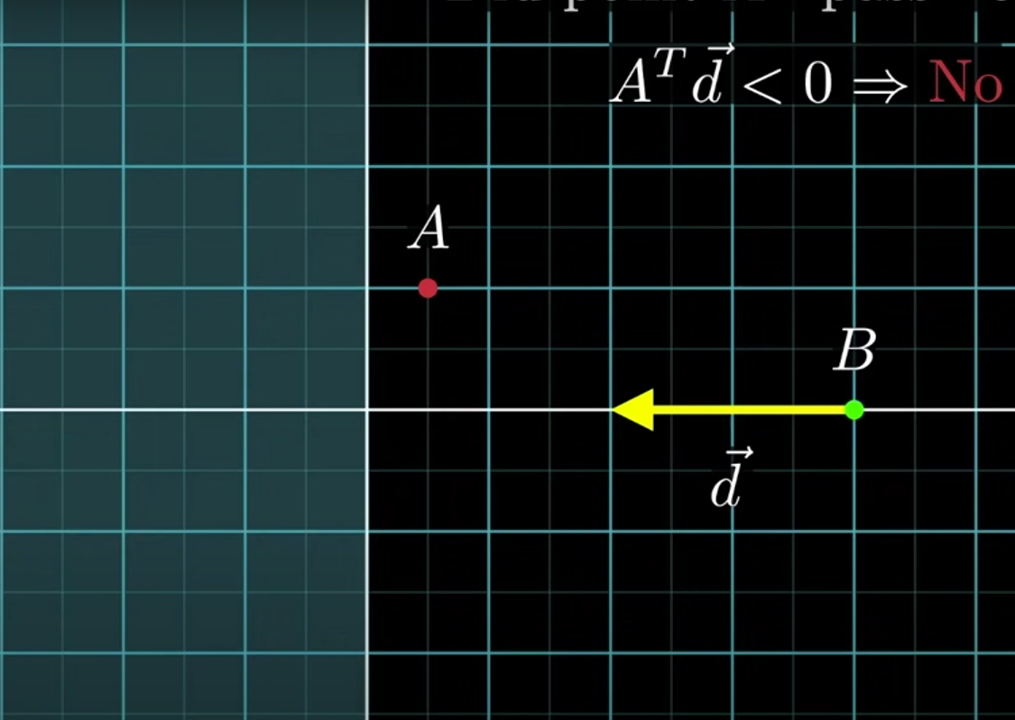
Lemma 4
If a new support point is not beyond the origin in the computed direction then the support point is invalid .So there is NO collision.
O

Slide 11
Step 1
Maintain a direction vector initialized randomly.
Find the support point in Minkowski set along that direction. (Lemma 3)
After finding the first support point, update the direction from this point to origin to find the new support point. If the new point is not beyond the origin, terminate the algo with No Collision possible. (Lemma 4)

Slide 12
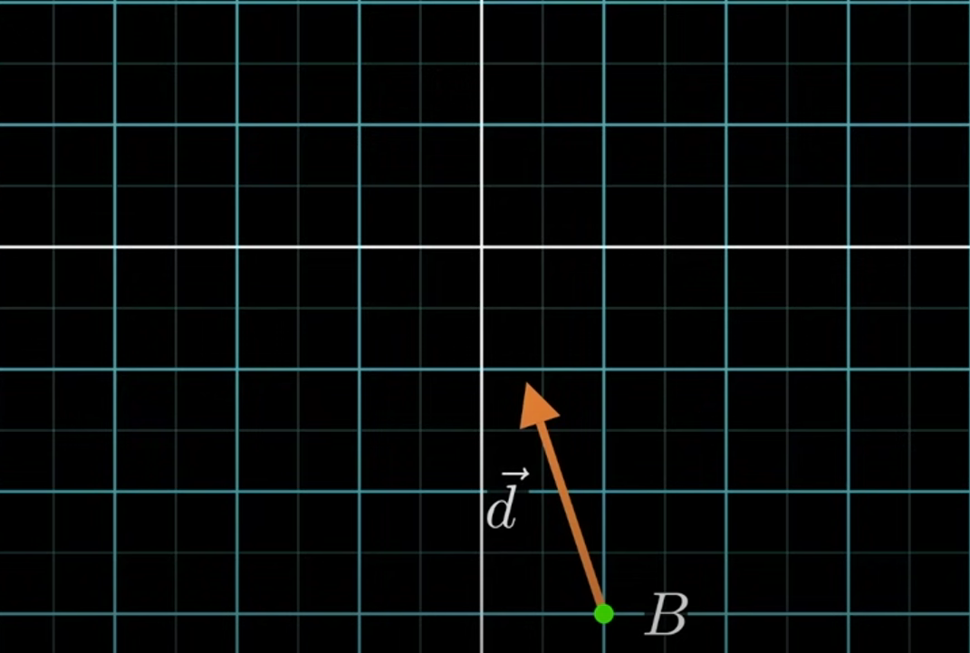
0-simplex
O

Slide 13
Step 2:
After getting two support points, take the direction normal to line joining those two points and towards the origin to find the new support point.
If the new point is in front of origin then terminate.(Lemma 4)

Slide 14
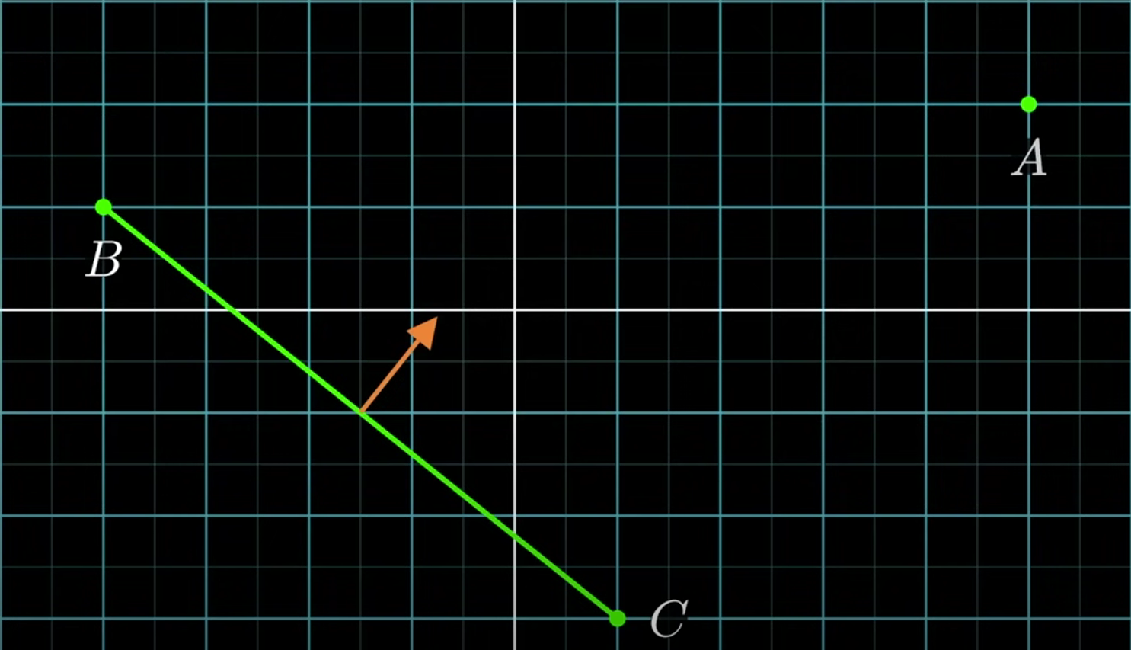
1 simplex
O

Slide 15
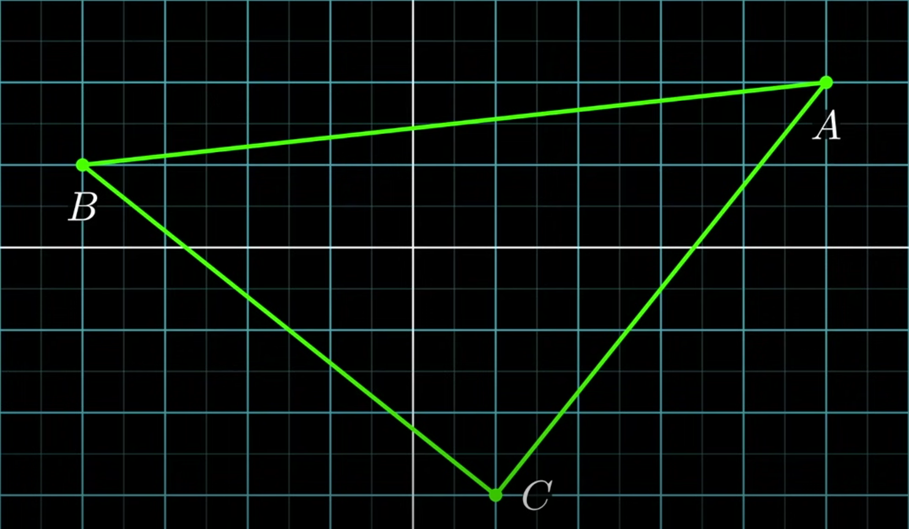
2-simplex
O

Slide 16
Step 3
After obtaining 3-simplex, we can now narrow our search of origin to a few regions.

Slide 17
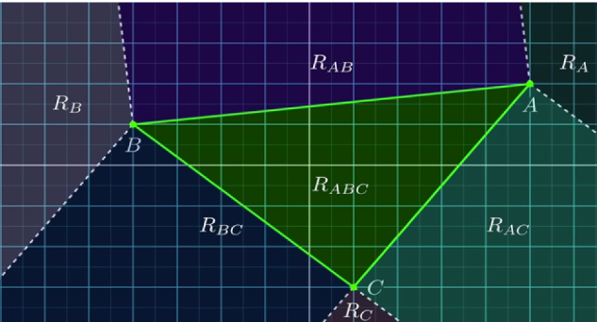
Voronoi Regions
O

Slide 18
Step 4:
After eliminating some regions we only need to check 2 regions.
If the origin is not contained in either of these two, then we can conclude that the origin is inside 3-simplex i.e collision. (lemma 2)
Else, if we find origin in one of these regions, choose the side closest to origin and update the direction to normal towards the origin.
Remove the point farthest to this direction and the new support point computed. Goto step 2
If the new support is the same as earlier point then the origin is not contained and the shapes don’t intersect. Otherwise, if the new point is in front of origin then stop and the shapes are not intersecting, else continue.

Slide 19
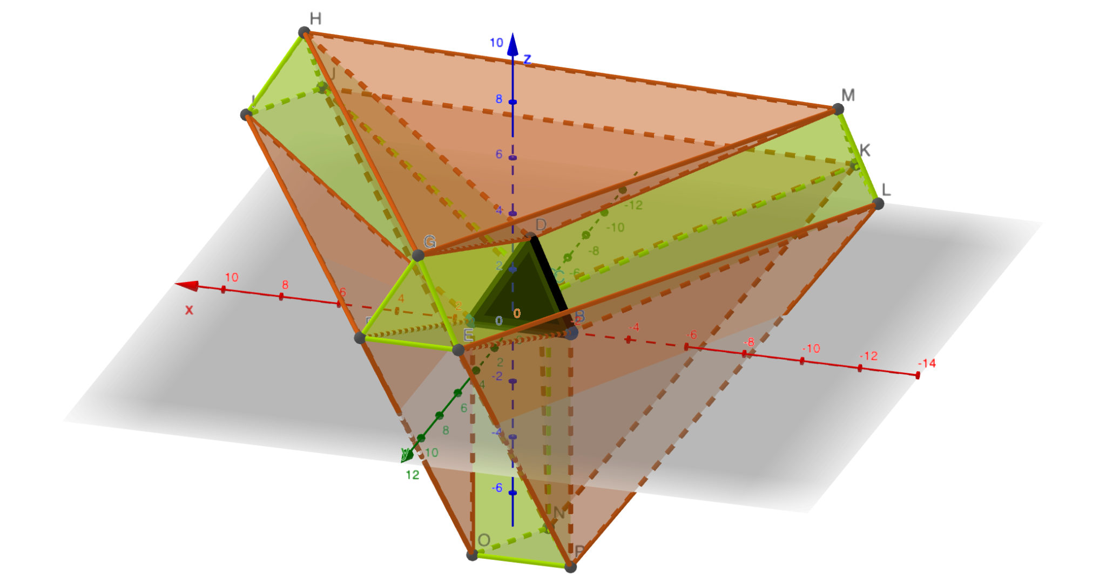
Voronoi regions for a 3-simplex
Made with geogebra, file attached.

Slide 20
Time complexity:
It detects the collision in O(N).

Slide 21
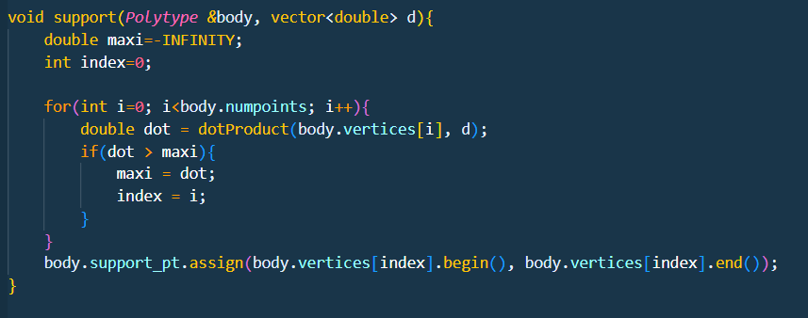
Support function:

Slide 22
Step wise analysis
Step 1 : Calculating support points using support function. O(d*N)
D is the dimension
N is the number of vertices in the polyhedra.
Each call to support function computes dot product N times. For a dimension d, dot Product calculation takes O(d).

Slide 23
Step 2
To compute the normal for the line, two cross products are required.
For a dimension d, cross product takes O(d²). We also compute a new support point which takes order of O(d*N).
The order for step 2 is O(2.d²) + O(d * N).

Slide 24
Step 3+4
We search in at most d regions which comprises of :
2 cross products → O(d²)
1 dot product → O(d).
Step3+4 time complexity is O(d²) + O(d)
Step 2,3,4 will be computed finite number of times until origin is detected. In each iteration, simplex gets closer to the origin so, if the origin is inside we will terminate when the simplex contains it.
If the origin is not contained, we will terminate upon generating same support point as discussed at end of step 4

Slide 25
Final complexity
O(d*N) + k(O(2.d²) + O(d * N) + O(d²) + O(d)) where k is finite, independent of N.
For constant d,
O(d*N) ~ O(N)
O(d²), O(d) ~ O(1)
Overall complexity is O(N).

Slide 26
References
https://ieeexplore.ieee.org/document/2083 - Original paper
Geometrical pictures from - @Reducible, Youtube
3D build of 3-simplex at geogebra - https://www.geogebra.org/3d (open source)
Input testing done with help of - Blender (open source), a 3D rendering and modelling engine.

