Slide 1

Peer Project Team Formation & Skill-Gap Matcher
M.TECH DATA MODELLING PROJECT
Sevakula Pavithra (26MAI0049)
Duggu Sujana (26MAI0056)
Firebase + React implementation
Notes:
Introduce yourself and the project. One sentence: this system forms project teams automatically by matching people on complementary skills, using a NoSQL data model on Firebase.

Slide 2




The Challenge
Slow, manual team formation
Students and coordinators spend days sorting profiles by hand.
Skill mismatches
Teams overlap on some skills and leave critical gaps uncovered.
No compatibility insight
There is no way to judge how well a team fits before it starts.
Notes:
About 1 minute for slides 2 and 3 together. Establish the pain: forming teams by hand is slow, ignores skill balance, and gives no way to measure compatibility.

Slide 3




What Existing Solutions Miss
Static matching
No skill analytics
Manual processes
Weak team-fit metrics
Fixed keyword filters that ignore what a team is actually missing.
Skill gaps are never measured or visualised.
Teams are assigned through spreadsheets and chat threads.
Roles, experience and availability are not considered.
Traditional systems lack intelligent, data-driven team recommendations
Notes:
Four gaps in current approaches: static matching, no skill analytics, manual processes, and poor compatibility metrics. Lead into the solution: our system is data-driven.

Slide 4


A Smart Team Matching Engine
1
2
3
4
User profile
Skill analysis
Match score calculation
Team recommendations
Firebase Firestore
Cloud Functions
Scoring algorithm
Real-time updates
Complementarity scoring
Real-time updates
Skill-gap analytics
Recommends people who fill the skills a team is missing, not ones who duplicate them.
The team compatibility index refreshes automatically as the team changes.
Radar charts compare team skill coverage against project requirements.
Notes:
About 2 minutes for slides 4 and 5. Walk the pipeline left to right: a profile is stored in Firestore, Cloud Functions analyse skills, the scoring algorithm calculates a match score, and recommendations update in real time. Then highlight the three key features.

Slide 5


Architecture & Technologies
Frontend layer
Technologies
React + Vite + Material-UI
Dashboard, skill radar and recommendations
Firebase
REST API
Auth, Firestore, Cloud Functions
Backend layer
React.js
Node.js + Express + Cloud Functions
UI framework, built with Vite
Match scoring, TBI calculation and triggers
Node.js
Queries
Backend runtime with Express
Database layer
Material-UI
Firebase Firestore (NoSQL)
Design system and components
Collections: users, projects | Subcollection: applications
Notes:
Three layers: React frontend, Node/Express plus Cloud Functions backend, Firestore as the NoSQL database. The frontend talks to the backend over REST; the backend queries Firestore. Cloud Functions also handle triggers for real-time updates.

Slide 6
Intelligent Scoring Model
Match Score
Team Building Index (TBI)
Ranks a candidate for a team
Rates the whole team
Match
Score
55%
Marginal skill gain
TBI
40%
Skill coverage
20%
Role compatibility
25%
Role diversity
15%
Availability overlap
15%
Experience mix
10%
Experience diversity
20%
Availability fit
Marginal skill gain measures how many of the team’s missing skills a candidate would add. The TBI then rates the assembled team on four team-level factors.
Notes:
About 1.5 minutes. This is the most technical slide. Match Score ranks one candidate against a team: 55% marginal skill gain (how many missing skills they add), 20% role compatibility, 15% availability overlap, 10% experience diversity. The Team Building Index rates the whole team: 40% skill coverage, 25% role diversity, 15% experience mix, 20% availability fit.

Slide 7
NoSQL Schema Design
USERS
PROJECTS
APPLICATIONS
Collection
Collection
Subcollection of projects
uid
primary key
1:N
projectId
primary key
1:N
userUID
reference
name
title
status
owns
contains
skills[]
domain
matchScore
roles[]
status
ownerUID
reference
500+
Users
100+
Projects
20+
Active teams
Notes:
About 1 minute. Three structures: users and projects are top-level collections; applications are a subcollection under each project, which keeps all applicants for a project together and makes a single project query cheap. ownerUID links a project to its owner; userUID links an application to the applicant. The stats at the bottom describe the generated test dataset.

Slide 8
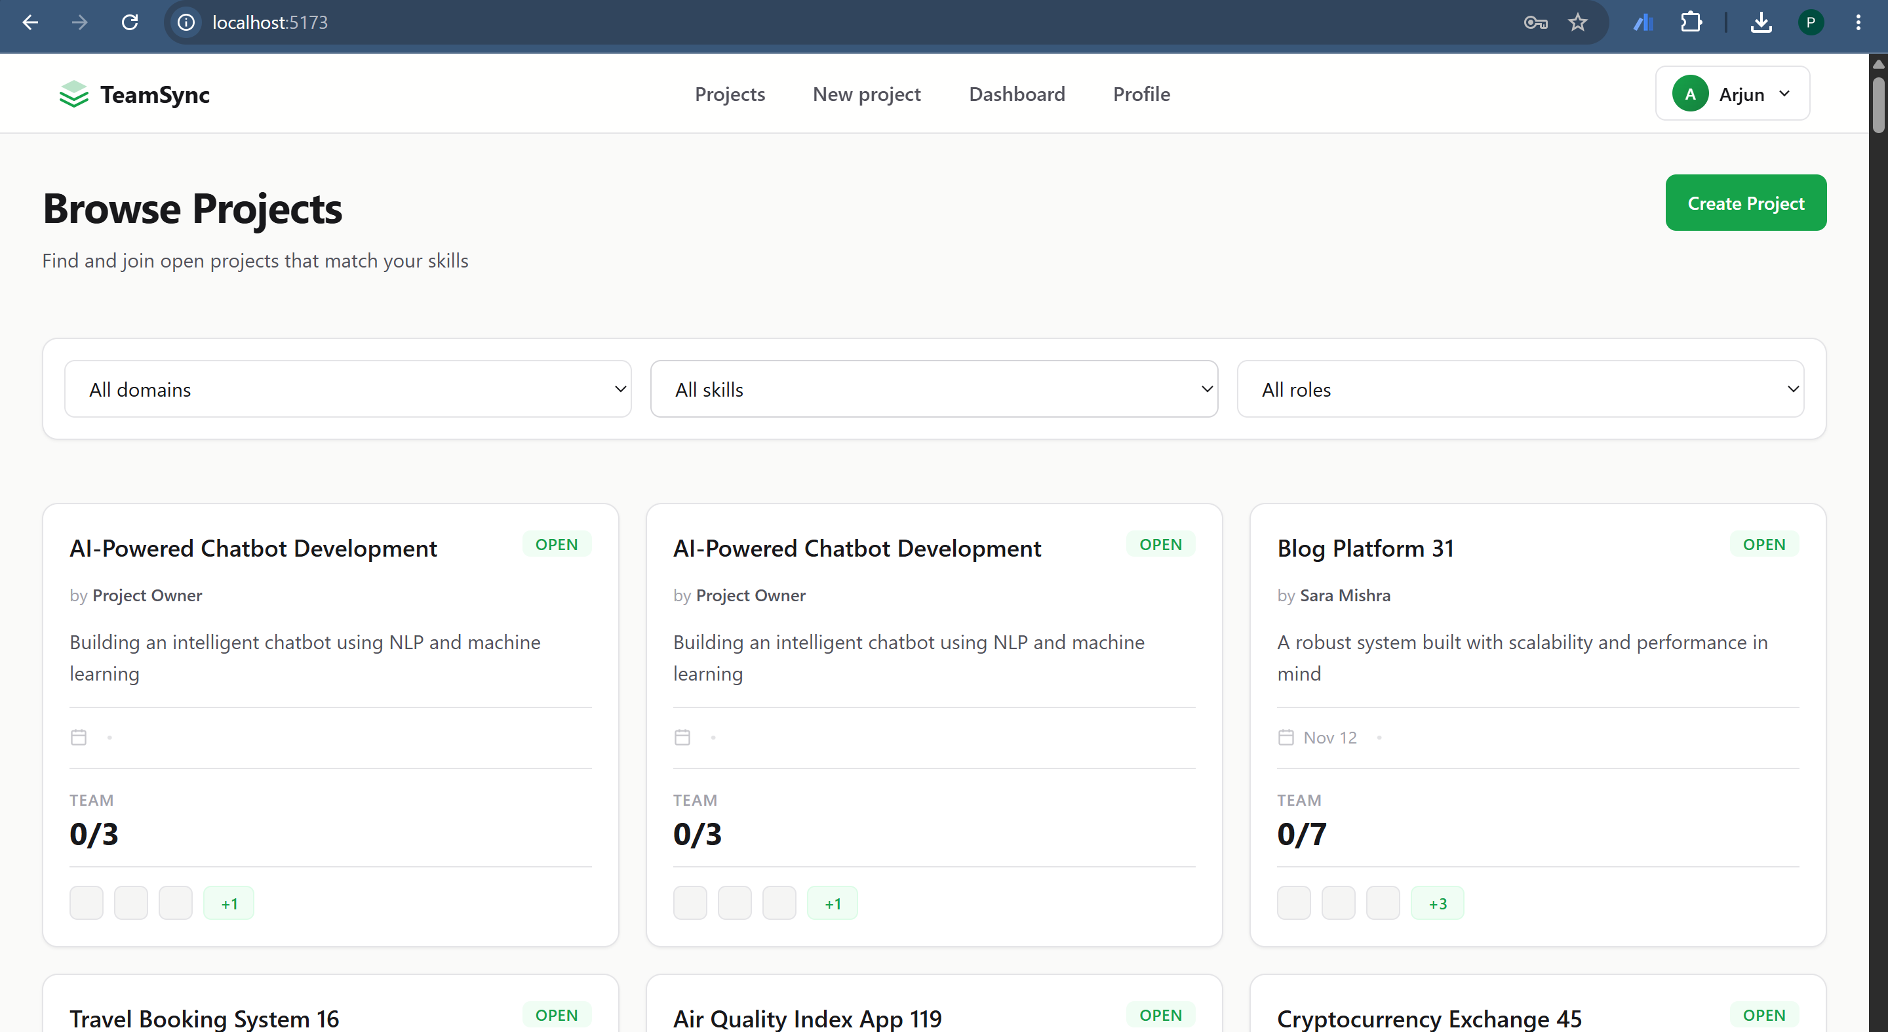

Live Application Features
User authentication and profiles
Skill radar visualisation
Smart project recommendations
Real-time match scoring
Team Compatibility Index (TBI)
Application management dashboard
Notes:
About 2 minutes. Switch to the live app if possible: sign in, show a profile and skill radar, open a project and show recommendations with match scores, then open the application dashboard. Replace the demo URL on this slide with your real Firebase link.

Slide 9


Project Outcomes
500+
57
Real-time
Serverless
Records
Queries implemented
Firestore triggers
Cloud Functions logic
“Transforming team formation from guesswork to data science”
Notes:
Close with the outcomes: a populated dataset, 57 implemented queries, real-time triggers and Cloud Functions. End on the quote and invite questions.

