Slide 1

HeartHealth
Name : USDADIYA Pavitraben Prafulbhai Roll no.: 11 Enrollment no.: 21002170210094

Slide 2
Dataset :
1. Age: The person's age in years 2. Gender: The person’s gender (1 = male, 0 = female) 3. ChestPainType: The chest pain experienced (Value 1: typical angina, Value 2: atypical angina, Value 3: non-anginal pain, Value 4: asymptomatic) 4. Resting_BP: The person's resting blood pressure (mm Hg on admission to the hospital) 5. Cholesterol: The person's cholesterol measurement in mg/dl 6. FastingBS: The person's fasting blood sugar (> 120 mg/dl, 1 = true; 0 = false) 7. RestingECG: Resting electrocardiographic measurement (0 = normal, 1 = having ST-T wave abnormality, 2 = showing probable or definite left ventricular hypertrophy by Estes' criteria) 8. MaxHR: The person's maximum heart rate achieved 9. ExerciseAngina: Exercise induced angina (1 = yes; 0 = no) 10. oldpeak: ST depression induced by exercise relative to rest ('ST' relates to positions on the ECG plot.) 11. ST_Slope: the slope of the peak exercise ST segment (Value 1: upsloping, Value 2: flat, Value 3: downsloping) 12. HeartDisease: Heart disease (0 = no, 1 = yes)

Slide 3
Three step Process :
Split the dataset
Train the dataset
Compare the Algorithm

Slide 4
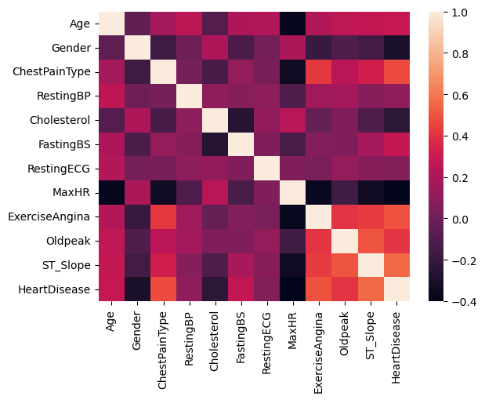
CORRELATION :

Slide 5
Django Framework

Slide 6
UserProfileInfo Model :
class UserProfileInfo(models.Model): This line defines a new model named UserProfileInfo that inherits from models.Model. This model will have fields and methods specific to user profiles.
user = models.OneToOneField(User, on_delete=models.CASCADE, related_name='profile'): This line defines a one-to-one relationship between UserProfileInfo and the built-in User model. It creates a foreign key field named user, which links each UserProfileInfo instance to a user. The on_delete=models.CASCADE argument specifies that when a user is deleted, their associated profile should be deleted as well. The related_name attribute allows you to access the profile from a user instance using the name 'profile'.
profile_pic = models.ImageField(upload_to='profile_pics', default="1.jpg"): This line defines an ImageField named profile_pic. This field is used to store user profile pictures. The upload_to argument specifies the directory where uploaded images will be stored within the MEDIA_ROOT. The default argument provides a default image (in this case, "1.jpg") if a user doesn't upload a profile picture.
def __str__(self): This method defines the string representation of a UserProfileInfo instance. By returning self.user.username, it will display the username of the associated user when you query the model.

Slide 7
Predictions Model:
class Predictions(models.Model): This line defines the Predictions model, which inherits from models.Model. This model is used to store prediction data related to a user's medical condition.
profile = models.ForeignKey(UserProfileInfo, on_delete=models.CASCADE, related_name='predict'): This field represents a foreign key relationship with the UserProfileInfo model, suggesting that each prediction is associated with a user profile. The on_delete=models.CASCADE argument specifies that if a user profile is deleted, all related predictions should be deleted as well. The related_name attribute allows you to access predictions related to a user profile.
The model includes various fields such as age, gender, cp, resting_bp, serum_cholesterol, fasting_blood_sugar, resting_ecg, max_heart_rate, exercise_induced_angina, st_depression, st_slope, predicted_on, and result. These fields capture data related to the user's medical condition or the prediction itself.
get_absolute_url(self): This method defines how to get the absolute URL of a Predictions instance. It uses the reverse function to generate the URL for a specific prediction based on its primary key (pk) and the app name (predict).

Slide 8
DataPredict :
age = int(form['age'].value()) gender = int(form['gender'].value()) cp = int(form['cp'].value()) resting_bp = int(form['resting_bp'].value()) serum_cholesterol = int(form['serum_cholesterol'].value()) fasting_blood_sugar = int(form['fasting_blood_sugar'].value()) resting_ecg = int(form['resting_ecg'].value()) max_heart_rate = int(form['max_heart_rate'].value()) exercise_induced_angina = int(form['exercise_induced_angina'].value()) st_depression = int(form['st_depression'].value()) st_slope = int(form['st_slope'].value())
features = [[age, gender, cp, resting_bp, serum_cholesterol, fasting_blood_sugar, resting_ecg, max_heart_rate, exercise_induced_angina, st_depression, st_slope]]
lr = linearregression() lr.intercept_ = [0.04036609] lr.coef_ = np.array([[ 0.00265557, -0.16398325, 0.1116549 , 0.00084365, -0.0004857 , 0.1416075, -0.0008661, -0.00122041, 0.17004547, 0.05761804 , 0.22223918]])
predictions = lr.predict(features)

Slide 9
Thank You

