Slide 1

Song Popularity Predictor
1

Slide 2


Dataset
We use Kaggle website to fetch the original data of Spotify.
In dataset there are many columns like title , artist , top genre, year, bpm, ngry , dnce , dB , live , val , dur , acous , spch , pop ,.. Etc
In dataset bpm stands for beats per minutes , dB related to loudness , ngry means energy of the sound , acousticness is an estimate of how acoustic a particular song is , pop is for popularity of the song , spch column for the more spoken word the song contains.

Slide 3
DJango
Django is free, open source and written in Python.
we use django as gui because django makes easier to create web sites using Python.
Django follows the MVT design pattern (Model View Template).
Model - The data you want to present, usually data from a database.
View - A request handler that returns the relevant template and content based on the request from the user.
Template - A text file (like an HTML file) containing the layout of the web page, with logic on how to display the data.
Django comes with ready-to-use features like login system , database connection and CRUD operations (Create Read Update Delete).

Slide 4
Models
Popularity Predictions Model : This model is used for prediction the popularity of songs and includes the following fields.
Title : A character field for the song’s title.
Artist : A character field for the song’s artist.
Year : An integer field for the year the song released.
bpm : An integer field for the bpm.
Energy : An integer field representing the energy level of the song.
Loudness : An integer field for the loudness of the song.
Duration : An integer field for the duration of the song.
Acousticness : it representing the acousticness of the song.

Slide 5
Forms
Predict_Popularity_Form :
This form inherits from forms.ModelForm , which is a base class for creating forms based on Django models.
In this form field like Title , Artist , Year , bpm , Energy , Loudness and Acousticness.
UserForm :
This form includes several fields like Username , Email , Password , Confirm Password.
form can be used in Django views to handle user registration.

Slide 6

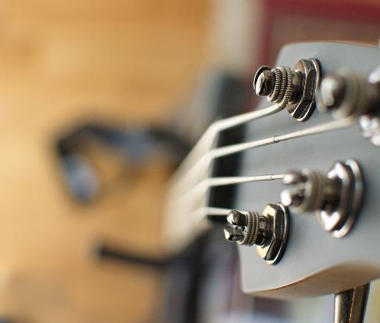
Summary
The Song Prediction Project demonstrates the power of data analysis and machine learning in the field of music. It offers a valuable tool for predicting song popularity and enhancing the music listening experience for users and artists alike.

Slide 7

Thankyou

