Slide 1
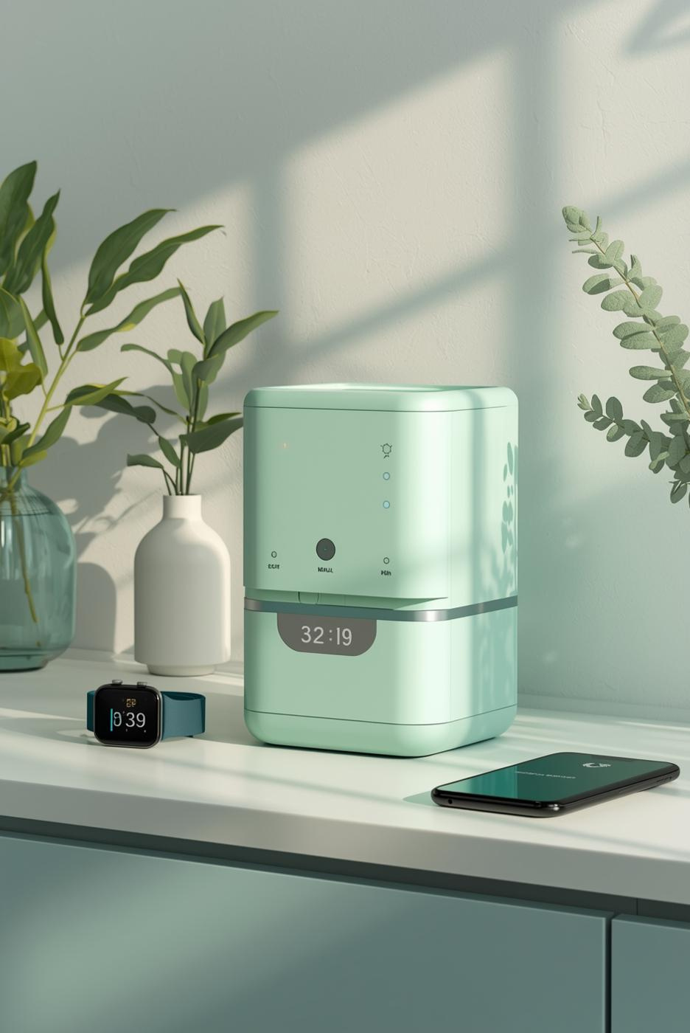
MediAlert: Smart Medicine Reminder
Presented by [Logic Legends]

Slide 2



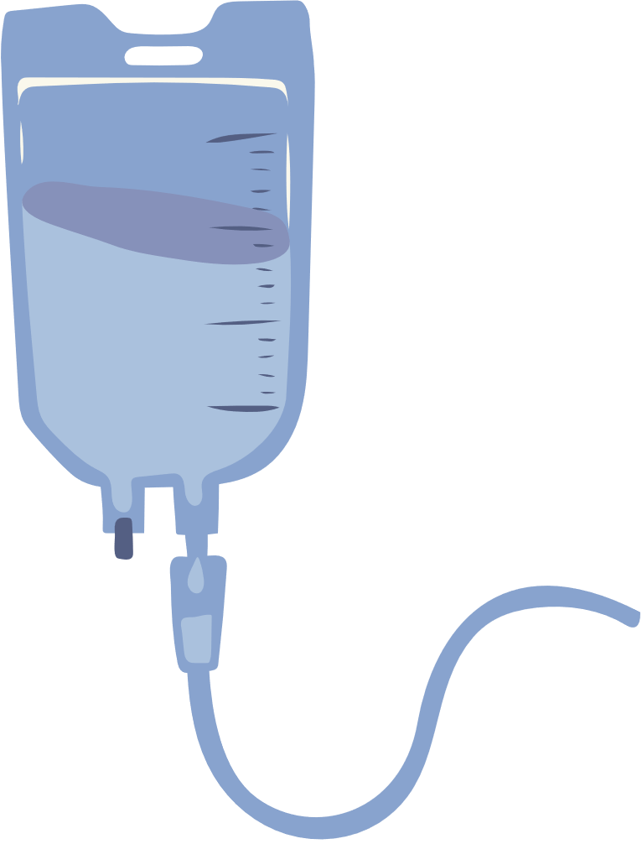





Problem Statement
Smart Medicine Remainder Using AI Voice Alerts

Slide 3



OBJECTIVES
1. To ensure timely medicine intake through smart alerts.
2. To support multi-day reminder scheduling effortlessly.
3. To simplify medicine tracking with an easy interface.
4. To maintain reminder data securely using local storage.
5. To deliver a clean, full-screen, user-friendly experience.

Slide 4

The future of Medical Science
1. Smart dose-time detection.
2. Auto-repeat daily alerts.
3. Voice-guided reminders.
4.Self-saving reminder memory.
5.Touch-friendly_full-screen layout.
An exploration of innovations in medicine

Slide 5
TECHNOLOGY
STACK
1. HTML5 – Builds the structure of the reminder interface.
2. CSS3 – Designs a clean, full-screen responsive layout.
3. JavaScript – Powers alert logic, voice, and time checking.
4. SpeechSynthesis API – Generates real-time voice reminders.
5. LocalStorage – Saves reminders permanently in the browser.

Slide 6

ADVANTAGES
1. Reduces chances of missing medicines.
2. Voice alerts improve attention and clarity.
3. No app needed—runs directly in browser.
4. Reminders stay saved even after closing.
5. Simple, fast, and user-friendly interface.

Slide 7
FUTURE ENHANCEMENT
1. Push notifications support.
2. Multiple reminders per day.
3. Medicine history tracking.
4. Cloud backup and sync.
5. User login and personalization.

Slide 8
Conclusion
This project provides a simple yet powerful medicine reminder system that ensures timely alerts, improves medication habits, and offers a user-friendly experience with voice notifications and multi-day scheduling. It demonstrates how a lightweight web-based tool can meaningfully support health management and daily routines.

Slide 9
Thank you for your attention

