Slide 1
Adaptive Multi-Error FEC Link Layer for High-Interference Environments
Extension of "Fast-Lane FEC for Automated Toll Booths" - Computer Networks Project
Team: [Your Name] [Reg. No.] | [Teammate Name] [Reg. No.]
Guide: [Guide Name, Designation] | Review 3 - Final Project, 26-30 Oct 2026
Notes:
Fill in team names, registration numbers and guide before presenting.

Slide 2
Problem & Objectives
The problem
Objectives
• A toll unit must read a vehicle's 96-bit RFID tag ID in passing.
• The wireless channel is noisy: random flips plus bursts (trucks, other readers, MRI/CT equipment).
• Retransmission costs a round trip the vehicle may not have; a wrong ID means a wrong charge.
• Implement Hamming, SECDED, BCH, Reed-Solomon, LDPC and CRC-32 from scratch (C11).
• Model BSC, Gilbert-Elliott and burst noise in two profiles: toll plaza, hospital imaging.
• Build a real 3-process UDP link with feedback.
• Compare FEC, ARQ, HARQ and an adaptive controller with 20-seed statistics.
• Never accept a wrong ID silently.
Adaptive Multi-Error FEC Link Layer | Review 3
2 / 12
Notes:
A moving vehicle cannot wait for a retransmission round trip.

Slide 3
Proposed Solution
• Correct in place: FEC on ID96 + CRC-32 - no round trip needed for most frames.
• End-to-end safety: CRC-32 turns miscorrections into DETECTED_FAIL, never a wrong bill.
• Right code for the noise: BCH for random errors, Reed-Solomon for bursts.
• Hybrid ARQ: retransmit only when the CRC fails.
• Adaptive ladder: receiver feedback changes code strength as the channel changes.
3
8
UDP processes: vehicle, channel, tollgate
codes incl. RS & LDPC
4
0
link strategies: FEC, ARQ, HARQ, adaptive
SILENT_WRONG in 1.4M frames
Adaptive Multi-Error FEC Link Layer | Review 3
3 / 12

Slide 4
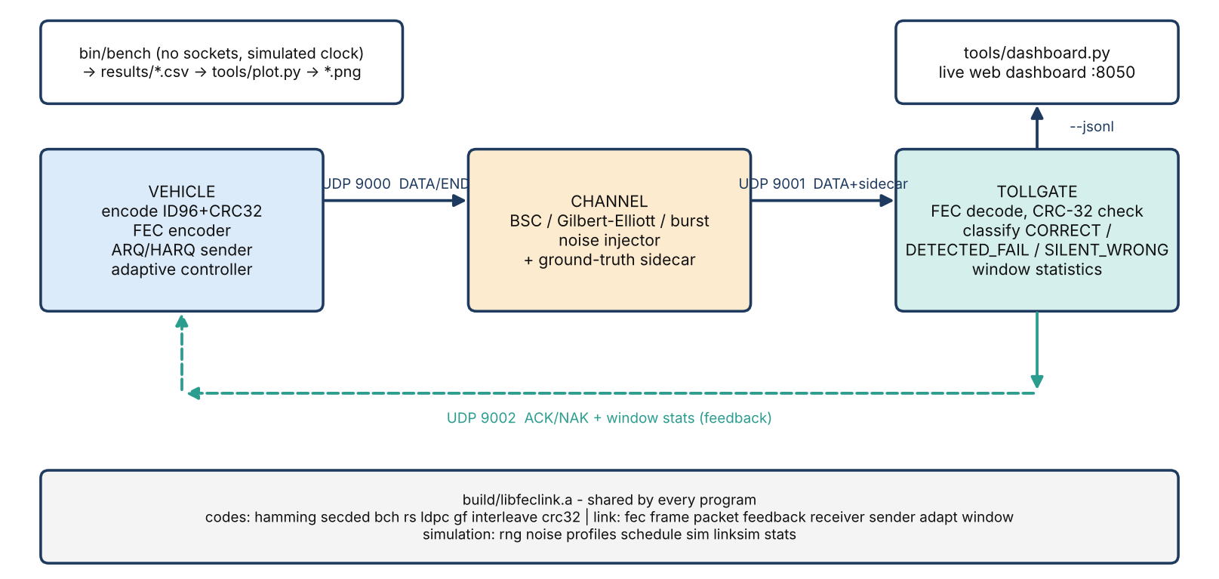
Final Architecture
Evaluation-only ground-truth sidecar lets us count SILENT_WRONG without the decoder ever seeing the truth. Same library powers the UDP programs and the in-process benchmark.
Adaptive Multi-Error FEC Link Layer | Review 3
4 / 12

Slide 5
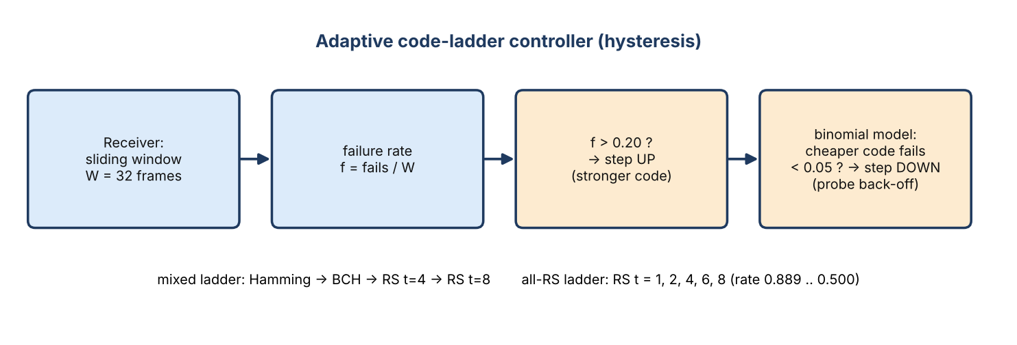
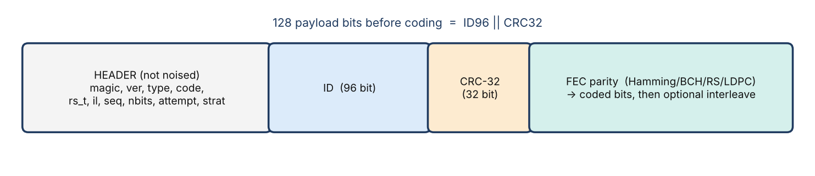
Methodology
• Codes: syndromes + Berlekamp-Massey + Chien (BCH); + Forney (RS); bit flipping (LDPC).
• Noise: seeded BSC / Gilbert-Elliott / burst.
• Metrics: success, goodput, retx/frame, p99 latency.
• Statistics: 20 seeds, Student-t 95% CI, paired differences.
• Pre-registered all-RS ladder experiment.
Adaptive Multi-Error FEC Link Layer | Review 3
5 / 12

Slide 6
Implementation
Area | Delivered
Codes | Hamming, SECDED, BCH, RS, LDPC
Detection | CRC-32 (IEEE 802.3)
Noise | BSC, Gilbert-Elliott, burst
Strategies | FEC, ARQ, HARQ, adaptive
Tools | bench, plots, live dashboard
Quality | ASan/UBSan, fuzz, CI (Ubuntu+macOS)
28
158
library modules
unit test cases
~4.5k
0
lines C11 (+3.1k tests)
external libraries
C11 + POSIX only. Built and tested on Ubuntu (gcc, clang) and macOS CI; every test run under ASan + UBSan finds no issues.
Adaptive Multi-Error FEC Link Layer | Review 3
6 / 12

Slide 7
Live Demonstration
Step | Command | What you will see
1 | make && make test | build + all unit, integration and failure-injection tests green
2 | make demo | 3 processes; coloured bit map; all frames CORRECT (toll)
3 | make demo-hospital | bursty errors; weak codes fail, strong codes survive
4 | make demo-adaptive | controller steps up in hospital segment, down in toll
5 | make dashboard | live web dashboard at 127.0.0.1:8050
6 | Wireshark | real UDP on ports 9000 / 9001 / 9002
Measured demo run: 20/20 CORRECT, channel flipped 48 of 4,480 bits (BER 0.0107), decoder corrected all 48.
Adaptive Multi-Error FEC Link Layer | Review 3
7 / 12
Notes:
Run these in order; docs/DEMO.md has a 2-minute script.

Slide 8
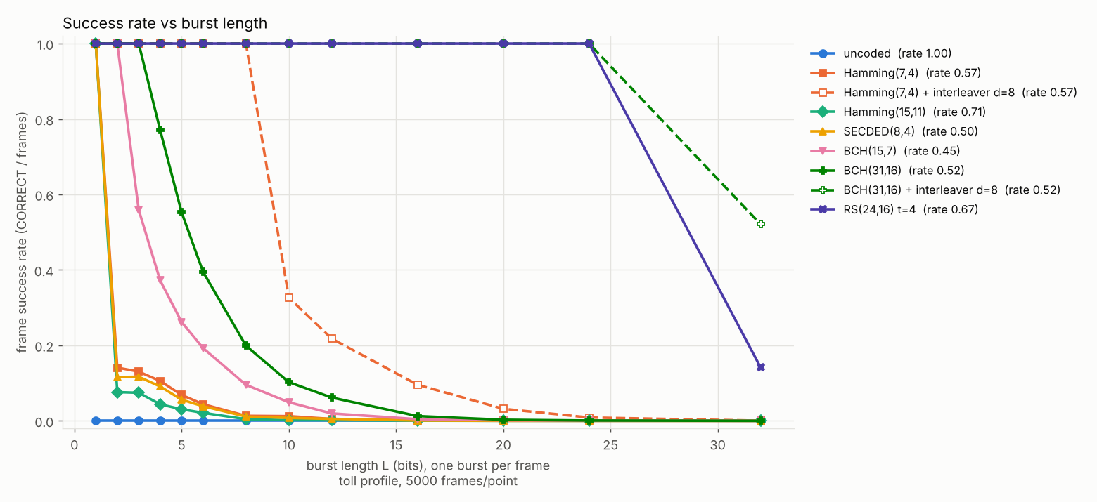
Testing & Results
Layer | Result
24 unit binaries / 158 cases | pass
Fuzz: 450,000 inputs | pass
3-process UDP integration | pass
Failure injection | pass; 4 bugs found & fixed
ASan + UBSan | no findings
CI Ubuntu + macOS | green
Bursts (L=16): bit codes collapse (BCH 0.013); RS and interleaved BCH reach 1.000. SILENT_WRONG = 0 of 1,395,000 frames per profile.
Adaptive Multi-Error FEC Link Layer | Review 3
8 / 12

Slide 9
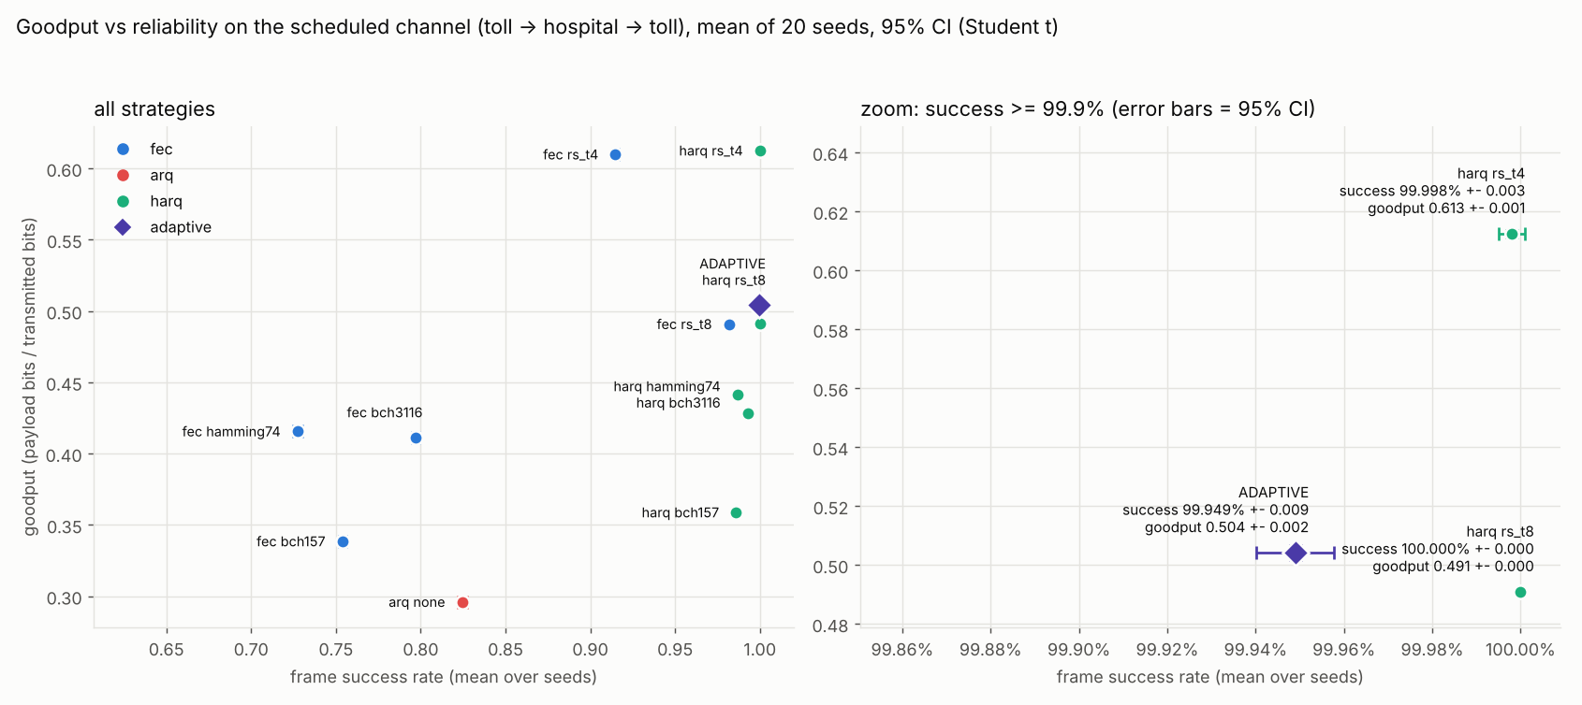
Performance / Comparison
Strategy (20 seeds) | Success | Goodput | p99 ms
Stop-and-Wait ARQ (existing) | 0.8244 | 0.296 | 94.0
FEC RS t=8 (fixed) | 0.9817 | 0.491 | 11.6
HARQ BCH(31,16) | 0.9932 | 0.429 | 76.2
HARQ RS t=8 | 1.0000 | 0.491 | 33.2
HARQ RS t=4 | 0.99998 | 0.613 | 42.0
Adaptive (mixed) | 0.9995 | 0.504 | 33.2
Adaptive (all-RS) | 0.99999 | 0.584 | 33.0
Honest finding: always-on HARQ + RS t=4 beats the adaptive controller on goodput (paired -0.108 +- 0.003); adaptive wins on retransmissions/frame and p99.
Versus Stop-and-Wait ARQ: success 0.82 -> ~1.00, p99 94 ms -> 33 ms.
Adaptive Multi-Error FEC Link Layer | Review 3
9 / 12

Slide 10
Innovation & Application
• Ground-truth sidecar: makes the dangerous SILENT_WRONG case measurable without leaking truth to the decoder.
• Adaptive ladder with window evidence, binomial step-down model, probe back-off.
• Rigour: pre-registered experiments, 20-seed CIs, paired differences, failure injection.
• One library, five code families directly comparable.
Real-world application
• Electronic toll collection at speed
• Hospital / MRI and industrial impulsive-noise links
• Vehicle-to-infrastructure and RFID readers
• Teaching reference for FEC vs ARQ vs HARQ trade-offs
Adaptive Multi-Error FEC Link Layer | Review 3
10 / 12

Slide 11
Conclusion
• CRC-protected FEC is safe: no wrong ID in 1,395,000 frames per profile.
• Best code depends on the noise: BCH for random errors, Reed-Solomon or interleaving for bursts.
• FEC + feedback clearly beats pure retransmission: success 0.82 -> ~1.00, p99 94 -> 33 ms.
• Adaptive FEC tracks the channel but a strong fixed HARQ + RS t=4 wins on goodput - ladder design matters more than control logic.
All objectives achieved except 'adaptive beats every fixed strategy' - reported honestly. Limitations: simulation only, assumed noise parameters, unprotected header (known open problem).
Adaptive Multi-Error FEC Link Layer | Review 3
11 / 12

Slide 12
Future Enhancement
• Header CRC-16 to stop misrouting under header corruption.
• Type II HARQ with soft combining; soft-decision (sum-product) LDPC.
• Smarter controller: bandit over fixed codes; ladder tuned on a held-out channel.
• Real-world validation: measured channel traces, real RTT, hardware-in-the-loop on an RFID / SDR link.
• Outcome: conference paper on adaptive FEC ladders for bursty channels [venue to be filled].
Adaptive Multi-Error FEC Link Layer | Review 3
12 / 12

