Slide 1
Distributed calculations using MapReduce on a mobile platform
TI-71mp: Pavlenko V.М. diploma advisor: Alekseev M.O.

Slide 2
Goal: Suggest a model of a heterogeneous distributed calculating system for use on mobile platforms
Subject: the structure of a heterogeneous system, the construction of a distributed calculation system
Object: mobile platform, task balancing server

Slide 3
Introduction
The use of distributed systems for performing calculations is becoming widespread, but all existing implementations are created for PCs (personal computers) and supercomputers.
Modern mobile phones, called smartphones, have a relatively large supply of work resources that are not used to the fullest.
This work is aimed at creating an analogue of a distributed system for mobile platforms.

Slide 4
Areas of use
Medicine
Decoding of complex signals
Commercial projects
Research projects
Cryptographic tasks

Slide 5
System requirements
Work with any platform
A universal approach to problem solving
Keep intermediate results
Monitor the status of mobile devices
Use the universal MapReduce methods
Determine the state of readiness of the result according to the performed work
Reassign tasks to other devices
Provide comprehensive information on the task through a user-friendly interface

Slide 6
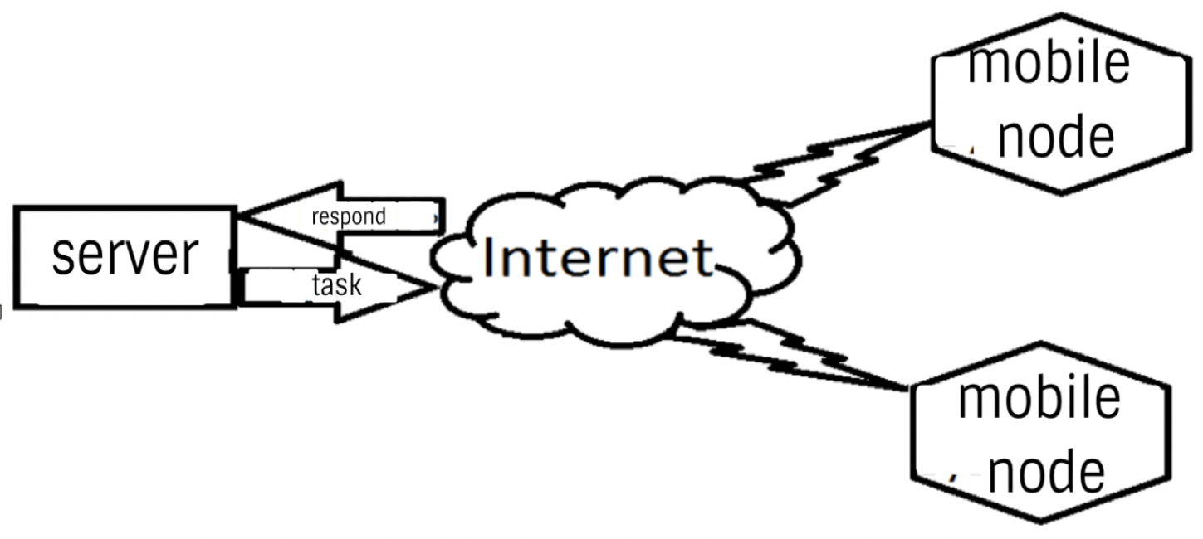
Architecture

Slide 7
Algorithm (On an example of large letters search)
Incoming data:
Example of MapReduce
Example
work
MapReduce
Mobile node:
Result:
E , M, R

Slide 8
Conclusions
A heterogeneous system has been constructed that allows the use of a mobile device as a node for the calculation of various types of tasks using MapReduce technology.
The basic requirements for such a system were fulfilled and all the peculiarities of work with mobile devices via the Internet were taken into account with the help of web-level Http / Https;

