Slide 1
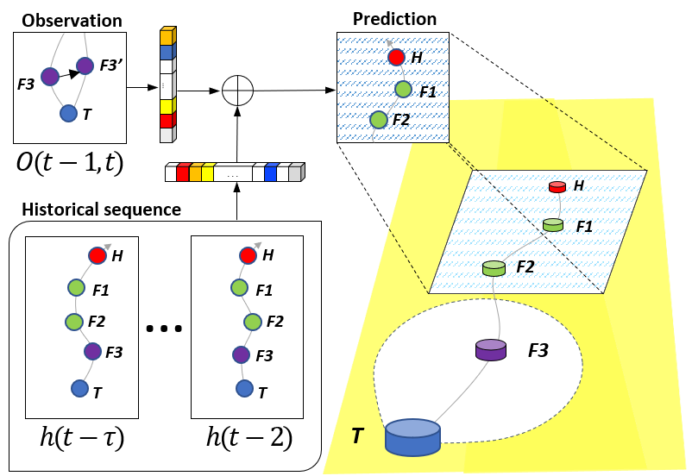
Learning local behavioral sequences to better infer non-local properties in real multi-robot systems
Taeyeong Choi, Sehyeok Kang, and Theodore P. Pavlic
School of Computing, Informatics, and Decision Systems Engineering,
Arizona State University, USA
Solved Remote Teammate Localization (ReTLo) problem, where a robot is to localize its teammates only using local information of its neighbor.
Implemented on Thymio II, a physical robotic platform, to demonstrate feasibility in realistic environments.
Proposed learning of historical poses and recent observations led >40% error reduction compared to observation-only models.
5-robot system with Tail performing predictions for Follower 1 & 2 and Head from observations of Follower 3.

