Slide 1
“Virtual Node 2”
e.g. Group-2
“Virtual Node 2”
e.g. Group-2
“Virtual Node 1”
e.g. Group-1
“Virtual Node 1”
e.g. Group-1
A
B
C
“Virtual Node 2”
e.g. Group-2
“Virtual Node 2”
e.g. Group-2
“Virtual Node 1”
e.g. Group-1
Group-1
Group-2
D
E
F

Slide 2
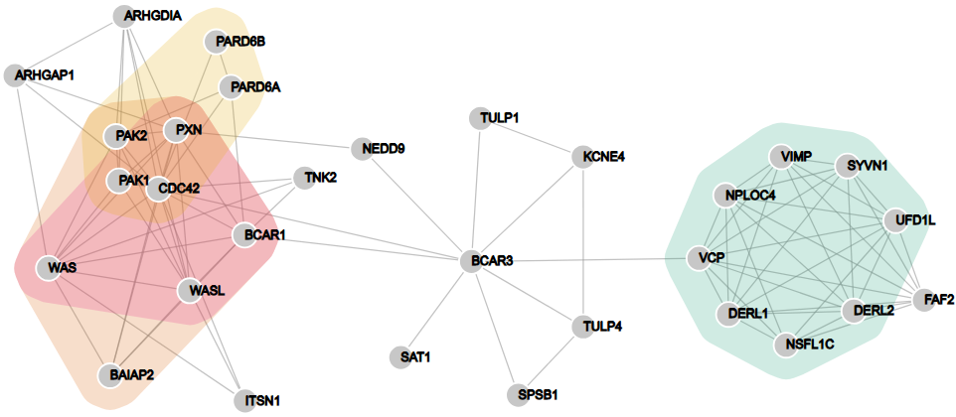
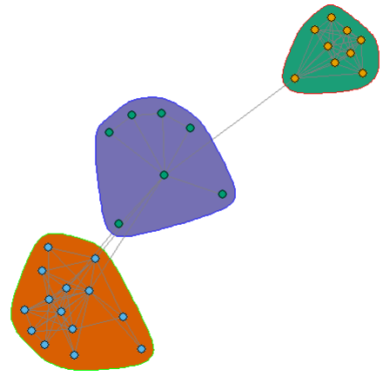
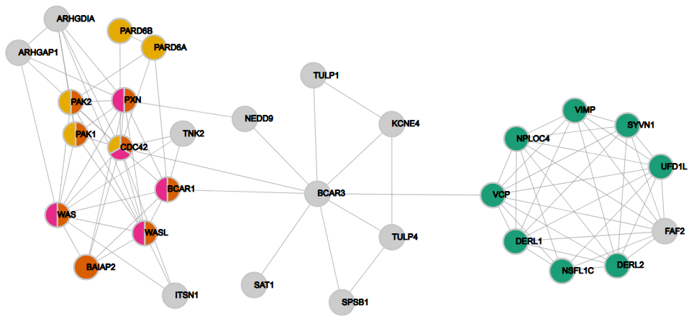
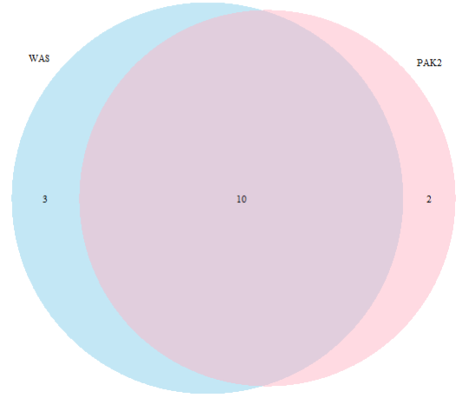
A
B
C
D

Slide 3
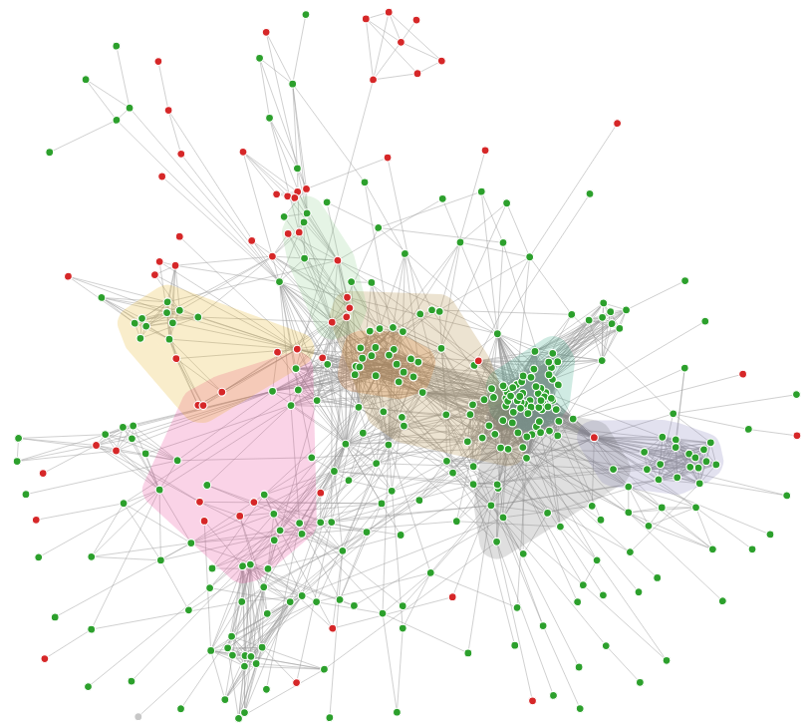
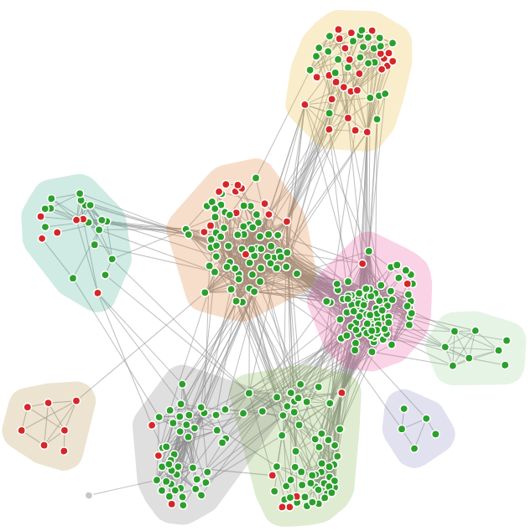
Oxidative phosphorylation
Glycolysis
Proteasome
Endocytosis
Oxidative phosphorylation
RNA degradation
Proteasome
Ribosome
Ribosome
Aminoacyl- tRNA biosynthesis
Phagosome
Spliceosome
RNA transport
ECM-receptor interaction
Peroxisome
Phagosome
Spliceosome -
RNA transport
A
B

