Slide 1
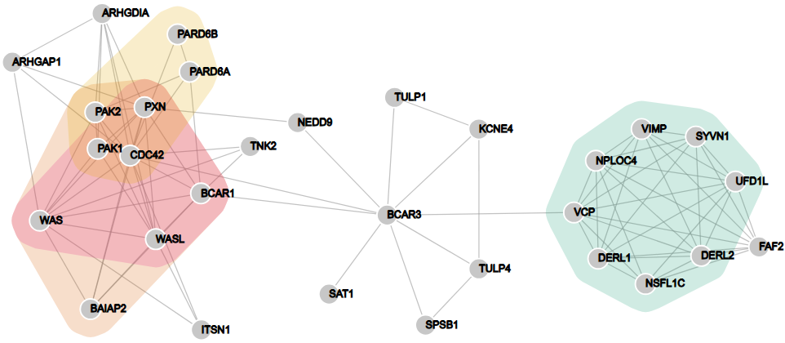


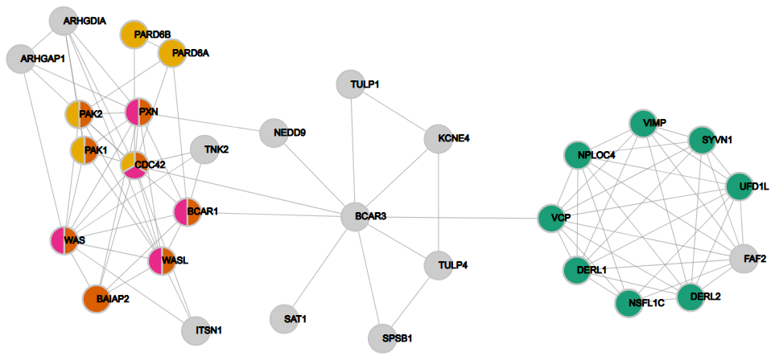


Protein processing in endoplasmic reticulum
Regulation of actin cytoskeleton
A
Axon guidance
Bacterial invasion of epithelial cells
B

Slide 2
“Virtual Node 2”
e.g. Group-2
“Virtual Node 2”
e.g. Group-2
“Virtual Node 1”
e.g. Group-1
“Virtual Node 1”
e.g. Group-1
A
B
C
“Virtual Node 2”
e.g. Group-2
“Virtual Node 2”
e.g. Group-2
“Virtual Node 1”
e.g. Group-1
Group-1
Group-2
D
E
F

Slide 3
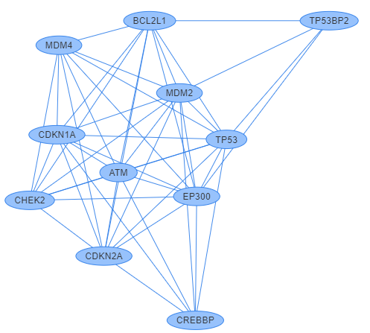
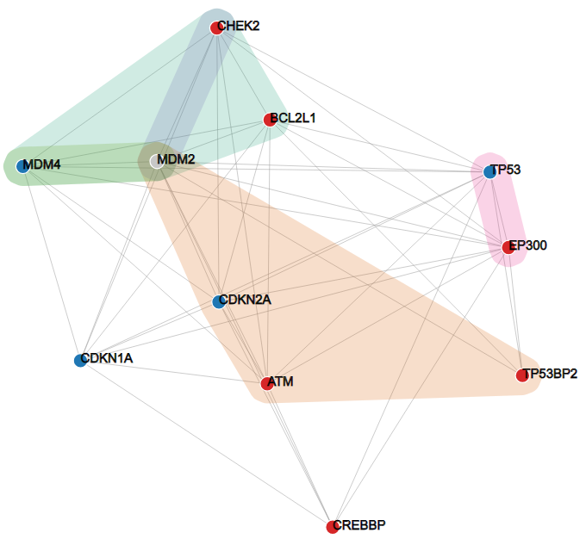
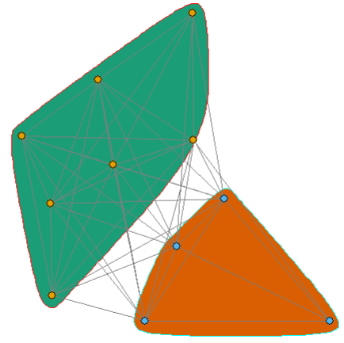
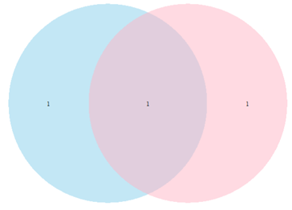
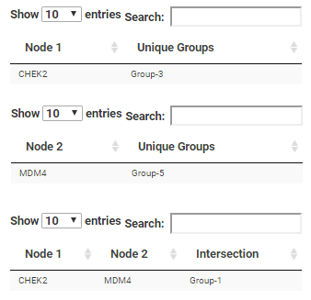
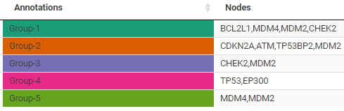
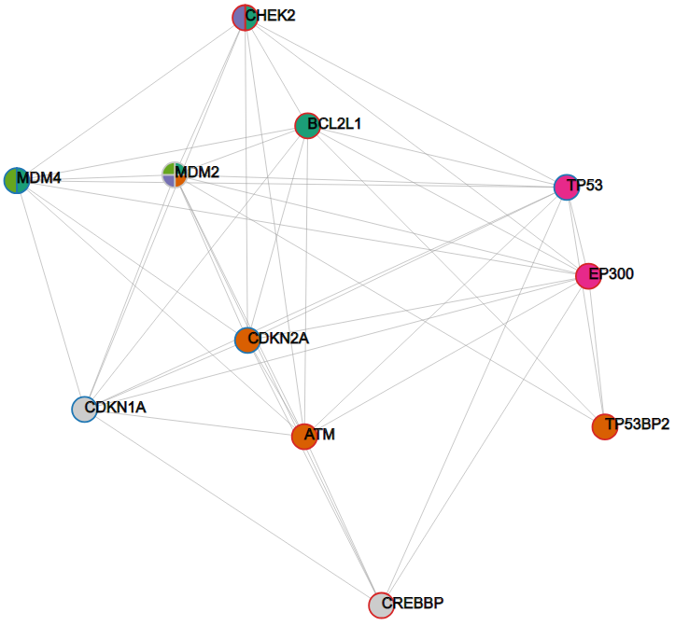
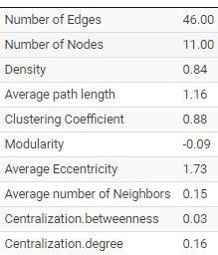
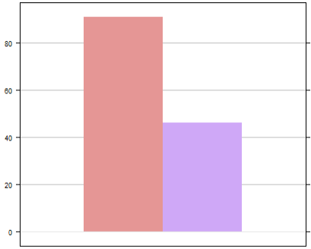

A
B
CHEK2
MDM4
D
BCAR3
TP53
Number of edges
E
C

Slide 4
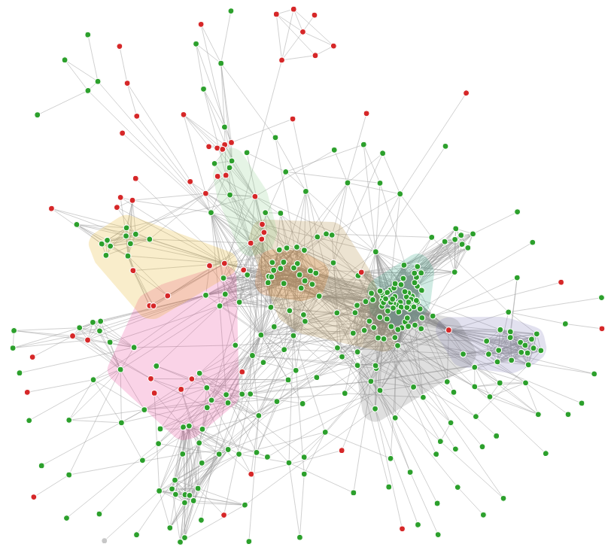
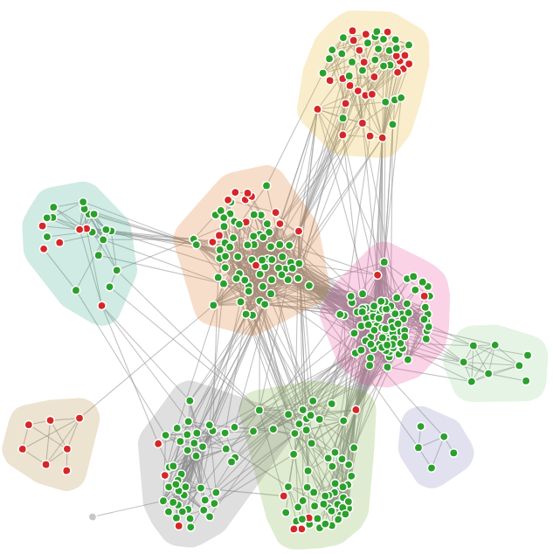
Oxidative phosphorylation
Glycolysis
Proteasome
Endocytosis
Oxidative phosphorylation
RNA degradation
Proteasome
Ribosome
Ribosome
Aminoacyl- tRNA biosynthesis
Phagosome
Spliceosome
RNA transport
ECM-receptor interaction
Peroxisome
Phagosome
Spliceosome -
RNA transport
A
B

