Slide 1
CSCI561 Fall 2017 Week 11 Discussion
Prof Sheila Tejada stejada@usc.edu
Prof Wei-min Shen shen@isi.edu
Prof Ning Wang nwang@ict.usc.edu

Slide 2
What is Learning?
No hard and fast definition
Prototype (or fuzzy) definition
Modification of a system
by itself
Not simply programming/surgery by others
Although others (teachers?) may be involved
that improves its performance
Not random or detrimental changes (forgetting, etc.)
Although some learning may, at least temporarily, cause a performance decrement
Or the impact on performance may become apparent only later, or not at all if the right situation does not arise
for the long term
Not simply a transient change

Slide 3
Why Learning?
Critical for autonomy
i.e., for systems operating without human intervention
Essential for unknown environments
i.e., when designer lacks omniscience
Useful for system construction
i.e., expose agent to reality rather than writing it down
Central piece of human cognition
Understanding learning is key in cognitive modeling
But considered undesirable in some applications
Unpredictable outcomes, unverifiable (if learning is online) and untrustable

Slide 4
Rote Learning (Memorization)
Duck
Goose
Pig
Elephant
Horse
Azalea
Computer
Perhaps the simplest form of learning conceptually
Given a list of items to remember,
Learn the list so that can respond to queries about it
Recognition: Was Horse in list? Rhino? Goose? Azalea? Camellia?
Recall: What items did you see?
Cued Recall: What animals did you see?
Relatively simple to implement in computers (except cued)
Can improve accuracy by remembering what is perceived
Can improve efficiency by caching computations
Core research topic in human learning (semantic memory)
Memorization is a relatively difficult skill for people
Notes:
Recall: Who thinks can say the whole list
Cued Recall: Duck, goose, pig, elephant, horse
Cued might require an ontology or other background knowledge

Slide 5
Generalization
A major step beyond rote learning is to create generalizations across items seen
Adds some understanding to memorization
One aspect of larger assimilation process, of relating new knowledge/items/experiences to what is already known
Notes:
Cluster chairs and table
Classify lights (but could be lights in classroom, or lights in LA, or …)

Slide 6
Typical generalization/learning problems
Clustering (unsupervised learning)
uses commonalities and differences among items to group them in some useful way
Concept formation (supervised or inductive learning)
uses commonalities among items assigned to a class, and differences with items assigned to other classes, to develop general definitions for class membership
Semi-supervised learning
uses a small number of classifed examples with a larger number of unclassified ones
Reinforcement learning
acquires general policies for controlling behavior from external reinforcement signals concerning the utility of states reached in environment
Approaches tend to be knowledge lean in general
Notes:
Cluster chairs and table
Classify lights (but could be lights in classroom, or lights in LA, or …)

Slide 7
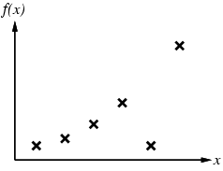
Inductive Learning
Learn a target function f from classified examples
Each example is a pair (x, f(x))
If both x and f are numeric, this is traditional function fitting
AI traditionally focused on cases where x is described discretely/symbolically and f is either Boolean or discrete
Modern methods may do both
f(Robin: WarmB & LayE & Fly)=Bird
f(Bat: WarmB & ¬LayE & Fly)=Mammal
f(Pteranodon: ColdB & LayE & Fly)=Reptile
f(Ostrich: WarmB & LayE & ¬Fly)=Bird

Slide 8
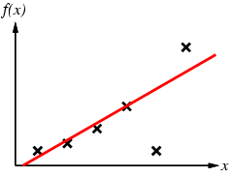
Inductive Learning
Problem:
Find a hypothesis h in Hypothesis Space (H), e.g.
Univariate polynomial functions
Boolean feature vectors
Such that h ≈ f
Given training set of examples
WarmB & LayE ⇒ Bird

Slide 9
Inductive Learning Method
Construct or adjust h to agree with f on training set
h is consistent if it agrees with f on all examples
f is realizable in H if there is some h∈H that exactly represents f
Although, often must be satisfied with best approximation
Generally search through H until find a “good” h
If H is defined via a concept description language there is usually an implicit generalization hierarchy
Can search this hierarchy from specific to general, or vice versa
Or there may be a measure of simplicity on H so that can search from simple to complex
Using Ockham’s razor to choose simplest consistent, or good, h
…
¬Fly
Fly
WarmB
LayE
…
¬Fly & WarmB
Fly & WarmB
WarmB & LayE
…
¬Fly & WarmB & LayE
Fly & WarmB & LayE

Slide 10
Curve Fitting From Simple to Complex

Slide 11
Curve Fitting From Simple to Complex
Linear

Slide 12
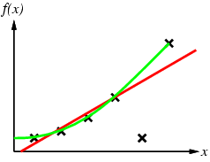
Curve Fitting From Simple to Complex
Quadratic
If willing to treat remaining point as noise, could stop here

Slide 13
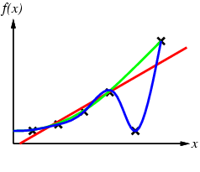
Curve Fitting From Simple to Complex

Slide 14
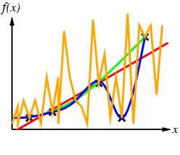
Curve Fitting From Simple to Complex
By Ockham’s razor, should prefer blue to orange

Slide 15
What makes for a good ML problem?
Labeled examples
Customer churn: records of current customers (loyal) + former customers who left (churn)
Fraud detection: examples of fraud and not fraud
Relevant features
Customer information: age, sex, zip code, historic spending patterns, etc.
Transaction information: amount, previous transactions, customer information, etc.
Uncertainty/error tolerance
Identifying some customers who are leaving is better than current system
Automated fraud identification still verified by human user

Slide 16
Example: predicting housing prices
Square Footage | ZipCode | Price
2000 | 48075 | 200,000
3000 | 48075 | 300,000
4000 | 48075 | 400,000
5000 | 48075 | 500,000
2000 | 98052 | 400,000
3000 | 98052 | 800,000
4000 | 98052 | 1,500,000
5000 | 98052 | 3,000,000

Slide 17
Example Induction Problem
Problem: decide whether to wait for a table at a restaurant, based on the following attributes:
Alternate: is there an alternative restaurant nearby?
Bar: is there a comfortable bar area in which we can wait?
Fri/Sat: is today Friday or Saturday?
Hungry: are we hungry?
Patrons: number of people in the restaurant (None, Some, Full)
Price: price range ($, $$, $$$)
Raining: is it raining outside?
Reservation: have we made a reservation?
Type: kind of restaurant (French, Italian, Thai, Burger)
WaitEstimate: estimated waiting time (0-10, 10-30, 30-60, >60)

Slide 18
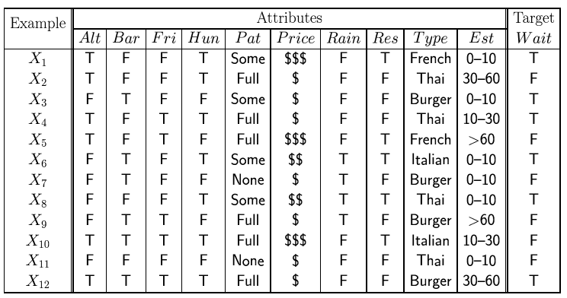
Attribute-Based Representations
Examples described by attributes and values
Values may be Boolean, discrete, or continuous
Example situations where will/won't wait for a table:
Classification of examples as positive (T) or negative (F)
Want a general way of deciding when to wait or not
E.g., generalize from specific examples to a general rule (or tree)

Slide 19
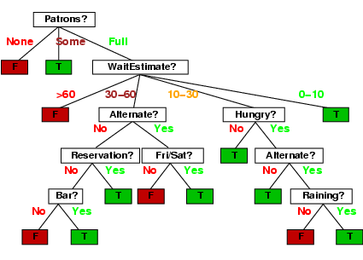
Decision Trees
One possible representation for hypotheses
Each non-leaf node splits on an attribute, w/ a branch per value
Leaf nodes specify the class for any instance reaching them
Can view each path from root to terminal as a rule
Here is a hand-engineered tree for deciding on waiting:
Note: This is a performance model rather than a learning model, but it can make a good target for inductive learning

Slide 20
Hypothesis Spaces
How many distinct decision trees with n Boolean attributes?
= number of Boolean functions over n symbols
= number of distinct truth tables with 2^{n} rows = 2^{2n}
E.g., 6 Boolean attributes implies 18,446,744,073,709,551,616 trees
How many purely conjunctive hypotheses?
E.g., Hungry ∧ ¬Rain?
Each attribute can be positive, negative, or omitted
⇒ 3^{n} distinct conjunctive hypotheses
A more expressive hypothesis space implies
Increased chance that target function can be expressed
Increased number of hypotheses consistent with training set
⇒ May make learning slower and yield worse predictions
Notes:
Answer column in truth table has 2^{n} positions, each of which can take on 2 possible values

Slide 21
Sample Trace
0/2
4/0
2/4
0/2
1/1
1/1
0/0

Slide 22
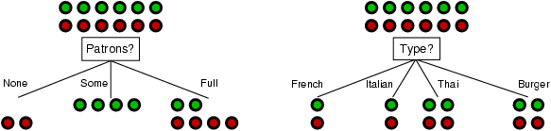
Choosing an Attribute
Idea: An ideal attribute splits the examples into subsets that are "all positive" or "all negative"
If can’t get perfect split, the closer you are to a perfect split the closer you are to a consistent hypothesis
Greedy strategy: as pure a split as possible at each point
Patrons is a better choice

Slide 23
Using Information Theory for Choose-Attribute
Consider information required for a decision
One bit is enough to answer a yes/no question if there is no other information about it available
E.g., determining heads vs. tails for a fair coin
Approach: Choose attribute so as to minimize the remaining information that will be required to answer the question once have split on attribute
Result is Information Gain for splitting on that attribute

Slide 24
Information in an Answer
The amount of information contained in an answer given prior probabilities of the possible values is:
I(P(v₁), … , P(v_{n})) = Σ_{i=1} -P(v_{i}) log₂ P(v_{i})
For a training set with p positive and n negative examples:
For a fair coin: (-1/2log₂1/2 - 1/2log₂1/2) = 1 bit
n
Notes:
Say yes versus no

Slide 25
Information Gain
A chosen attribute A divides the training set E into subsets E₁, … , E_{v} according to the values of these examples for A (where A has v distinct values) On average, the amount of remaining information to answer after splitting on A is:
So, the Information Gain (IG) from testing attribute A is the total information required before split on A, minus the information required after split on A:
Choose the attribute with the largest IG
Minimizes total expected information required for answer
Notes:
p_{i}+n_{i} is the number of examples that hit value i, while p+n is the total number of examples, so we have expected information needed after choice

Slide 26
Information Gain Example
For Restaurant training set, p =n = 6
So, I(6/12, 6/12) = 1 bit
Consider attributes Patrons and Type (and others too):
Patrons has the highest IG of all attributes and so is chosen by the DTL algorithm as the root of the tree
Notes:
Patron value ordering is none, some, full
Type value ordering is french, italian, thai, burger

Slide 27
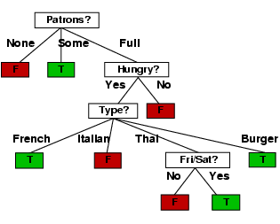
Example (Cont.)
Decision tree learned from the 12 examples:
Substantially simpler than tree created by hand
More complex hypothesis isn’t justified by small amount of data available

Slide 28
Decision Trees
1
0
Notes:
Patrons

Slide 29
Decision Trees
2. Calculate the information gain (or change in entropy), in bits, for each attribute.
IG(A) = .94 – (7/14 I(3/7,4/7) + 7/14 I(6/7,1/7)) = .94 -.5(.98+.59)
IG(B) = .94 – (8/14 I(8/8,0/8) + 6/14 I(3/6,3/6)) = .94 – 3/7
3. Which one of the two attributes A and B is a better classifier according to the decision tree learning (DTL) algorithm?
B
Notes:
Patrons

Slide 30
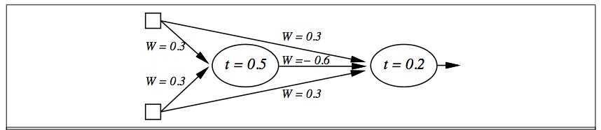
Neural Nets
Draw the neural network to solve the XOR function for two inputs. Specify what type of unit you are using.

Slide 31
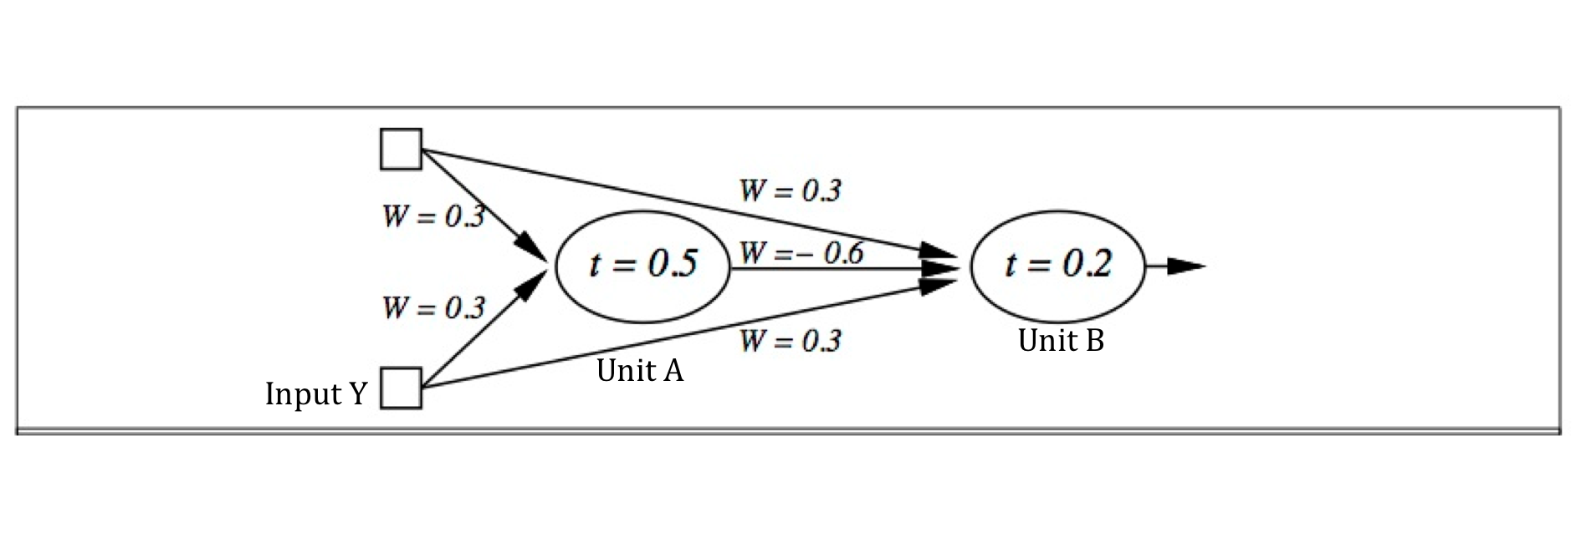
>0
When input X = 0 and input Y = 0, what does the Unit A output? What does the Unit B output?
When input X = 0 and input Y = 1, what does the Unit A output? What does the Unit B output?
When input X = 1 and input Y = 0, what does the Unit A output? What does the Unit B output?
When input X = 1 and input Y = 1, what does the Unit A output? What does the Unit B output?
What Boolean function does this Neural Network compute?

Slide 32
What you should know?
What is learning? Why is learning important? What are some of the performance measures for learning?
What is generalization? What is bias? What is Occam’s Razor? Why is they important for learning?
What is the difference between supervised, semi-supervised, and unsupervised learning?
What is overfitting? When does this happen? Why do we want to avoid this?
Cross-validation? How is this addressing over overfitting?
What are Neural Networks? What are the advantages
and disadvantages?

Slide 33
Want more?
Try exercise 18.5-7 in AIMA

Slide 34
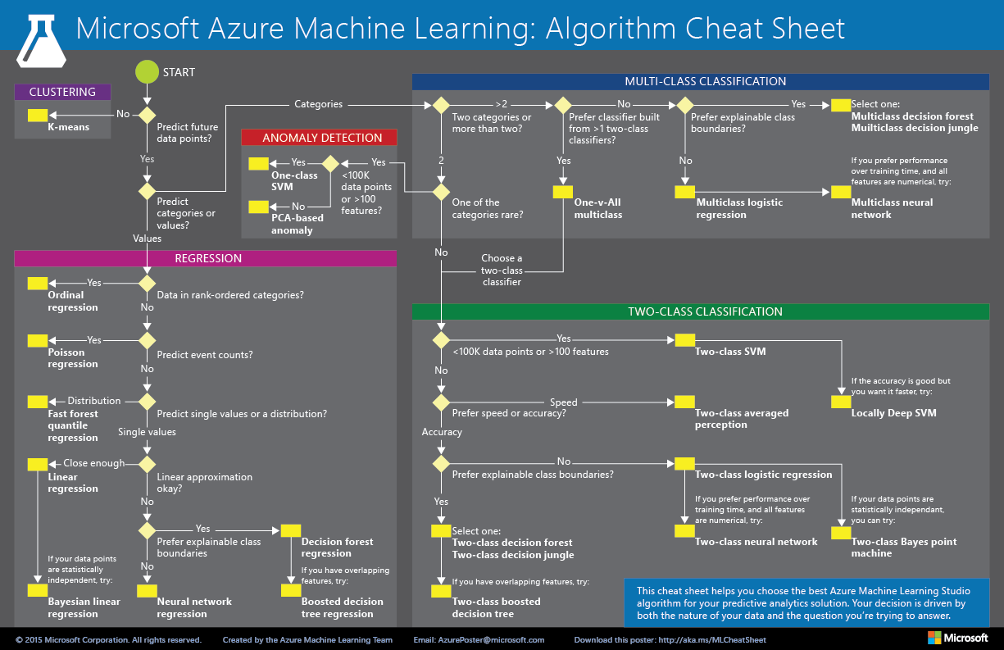
Machine Learning Cheat Sheet

Slide 35
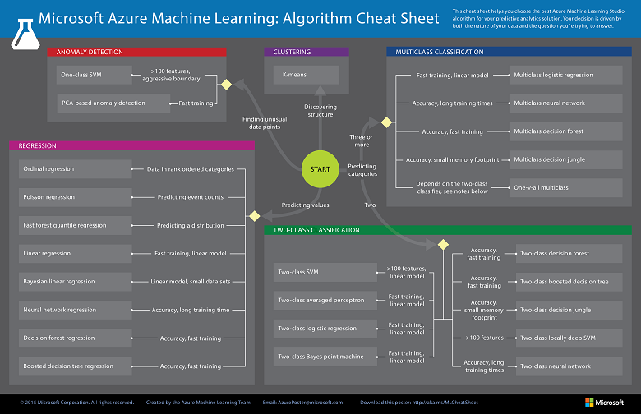
Machine Learning Cheat Sheet

