Slide 1
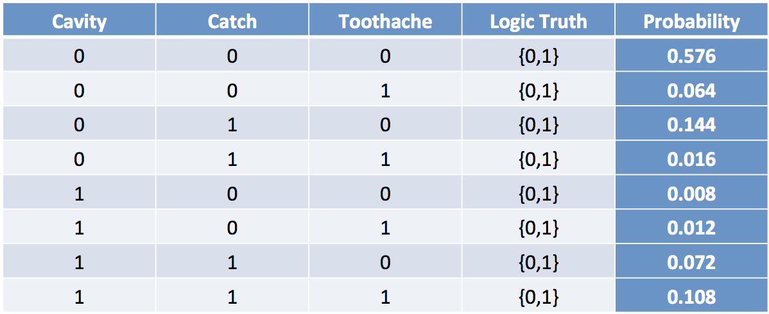
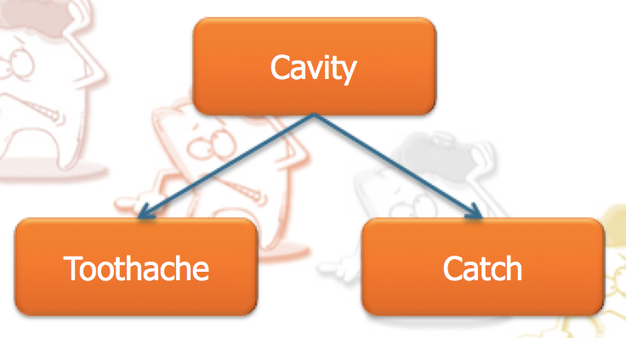

Why Bayesian Networks?
A better representation for the Probability Distribution Model
(take advantage of “variable independence”)
Fully Joint Distribution Table
Bayesian Network
⬅➔
P(X₁, X₂, …, X_{n})
Size = O(d^{n})
d: variable domain
⬅➔
Size = O(nd^{k})
k: # of parents

